Slide 1
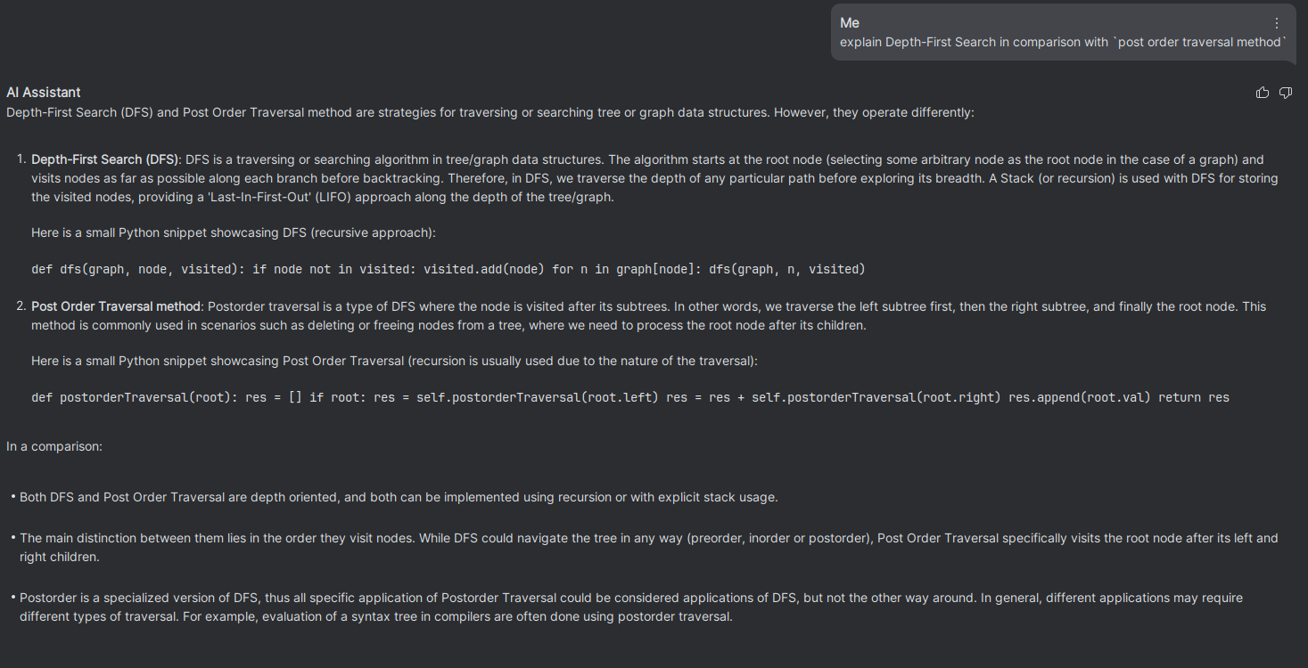
explain Depth-First Search in comparison with `post order traversal method`

Slide 2
https://www.cs.usfca.edu/~galles/visualization/ConnectedComponent.html
https://algorithm-visualizer.org/brute-force/depth-first-search
https://github.com/trekhleb/javascript-algorithms/tree/master/src/algorithms/tree/depth-first-search
https://en.wikipedia.org/wiki/Depth-first_search
https://opendatastructures.org/versions/edition-0.1e/ods-java/12_3_Graph_Traversal.html#SECTION001532000000000000000
https://www.geeksforgeeks.org/tree-traversals-inorder-preorder-and-postorder/
https://www.geeksforgeeks.org/write-a-c-program-to-delete-a-tree/

Slide 3
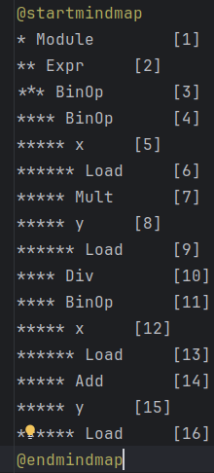
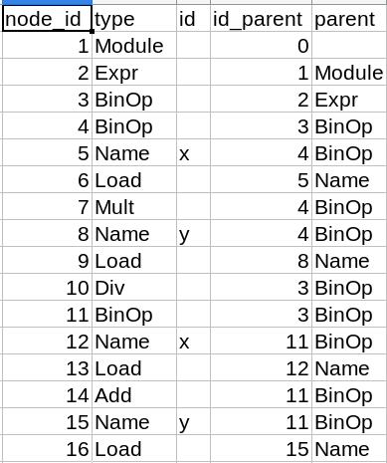
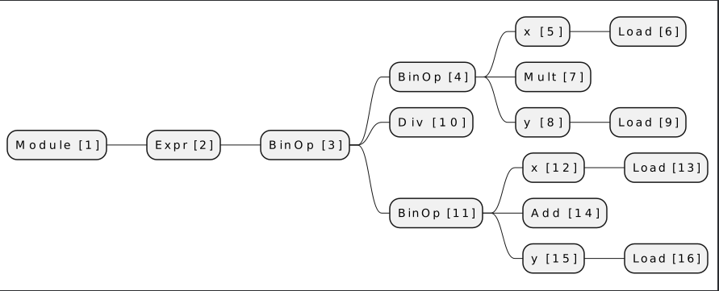
Beginne mit der höchsten node_id
Wenn type = load lade dim von parent

Slide 4
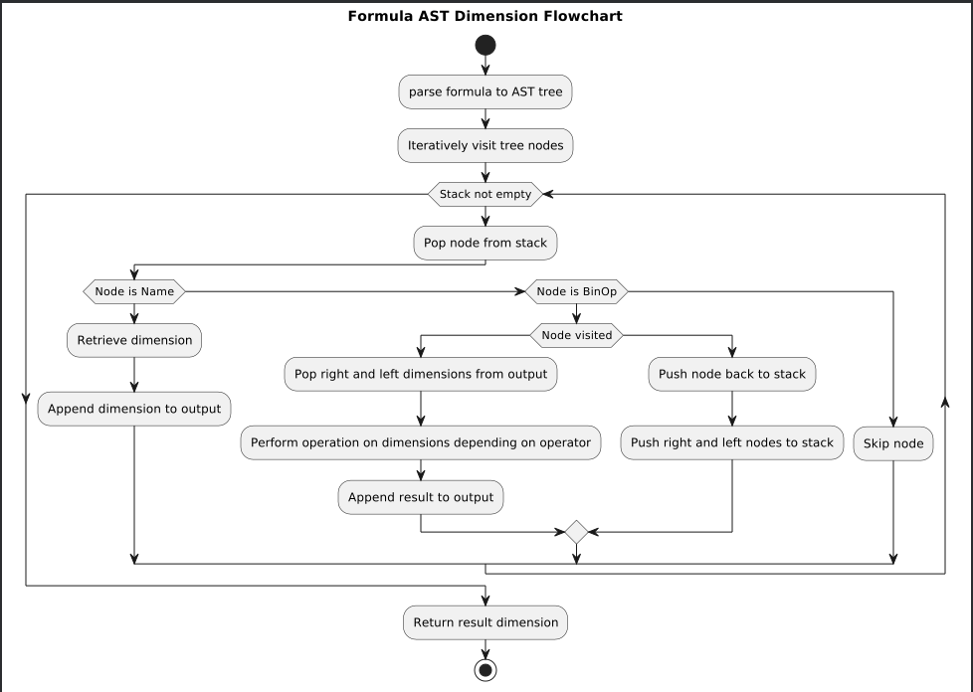

Slide 5
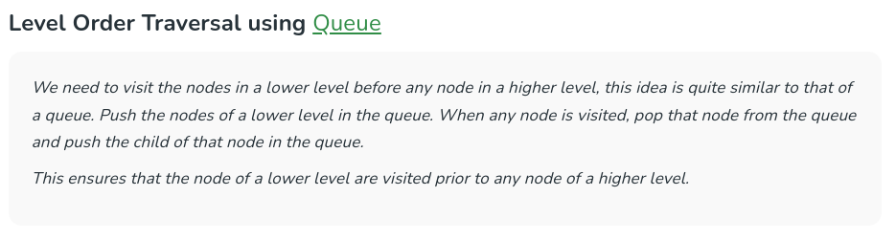
https://www.geeksforgeeks.org/level-order-tree-traversal/

