Slide 1

ORD Corporate Backbrief
Jeffery Boczkaja

Slide 2
Overview
We have spent the last eight weeks analyzing data to determine whether it would be in our company’s interest to add ORD cycles by adding it to our portforlio. We analyzed this data utilizing PostgreSQL and also examined whether this relational database management system would be beneficial for us in the future.

Slide 3
What is a Relational Database?
A relational database is a type of database management system (DBMS) that organizes and stores data in a structured manner, using a collection of tables with defined relationships between them.

Slide 4
The key characteristics of a relational database include:
Structure: Data is organized into tables with rows and columns, allowing for a structured representation.
Relationships: Tables can be related to each other through common fields, enabling the establishment of connections and associations between entities.
Integrity: Relational databases enforce data integrity through constraints and rules, ensuring that data remains accurate, consistent, and valid.
Querying: Relational databases support the Structured Query Language (SQL), a standardized language used for querying and manipulating data.
ACID properties: Relational databases adhere to ACID (Atomicity, Consistency, Isolation, Durability) properties to ensure transactions are reliable, consistent, and durable.

Slide 5
PostgreSQL
PostgreSQL is an open-source, object-relational database management system (DBMS) that is highly extensible and widely used for handling structured data. It was initially developed at the University of California, Berkeley in the 1980s and has since become one of the most popular and powerful relational database systems available.

Slide 6
OPC Data Overview
We analyzed data from 14 CSV files to come to our conclusions. They covered things from customer info, supplier info, order info, and more.
The data required some modification and cleaning but all in all was reliable for our purposes

Slide 7
Basic SQL Coding Principles
Use Meaningful and Consistent Naming Conventions: Choose clear and descriptive names for tables, columns, and other database objects. Use consistent naming conventions to improve code readability and maintainability.
Be Mindful of Data Types: Use appropriate data types for columns based on the nature of the data. This helps optimize storage and ensures data integrity.
Use WHERE Clause to Filter Data: Utilize the WHERE clause to filter data based on specific conditions. This helps narrow down the result set and improves query performance.
Use Indexes for Performance: Identify and create appropriate indexes on columns that are frequently used in WHERE clauses or join conditions. Indexes can significantly improve query performance by facilitating faster data retrieval.
There are additional principles but these are some of the more important ones.

Slide 8
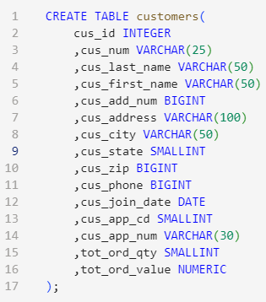
Building the database
We began by putting all the tables from our csv files into PostgreSQL for our analysis.
We transferred the information into our new created tables.
The queries looked like this:

Slide 9

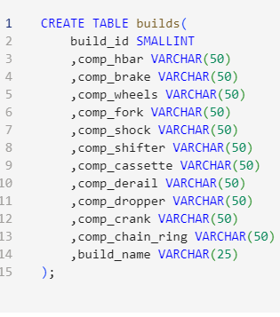
Be Warned!
When building a database and using outside table information you need to make sure all the columns match up exactly. Otherwise the information will not transfer perfectly.
You can check your tables after the fact with a SELECT * query and even alter tables but doing so would take additional time.
Double check so you don’t have to go back! Who would want to type this up again??

Slide 10
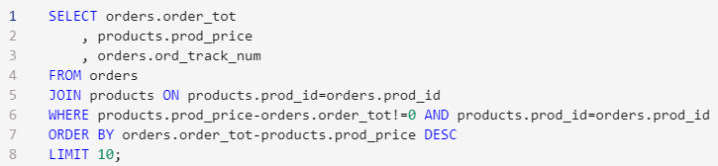
Working with Data in PostgreSQL
Once the data was in the tables it was not too difficult to learn how to use the database to find information we needed to help us in our decision process.
Even with our data we were able to either add dupilicate columns to certain tables or use joins to help analyze information from multiple tables.
Here is an example:

Slide 11
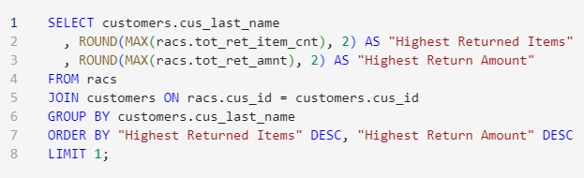

Intermediate SQL Functions
We began to get into aggregate functions to dive deeper into the data. Examples would be finding sums or counts which are necessary when trying to find information useful to us like sales and bikes sold.
They varied in complexity, here are examples of how they can vary.

Slide 12
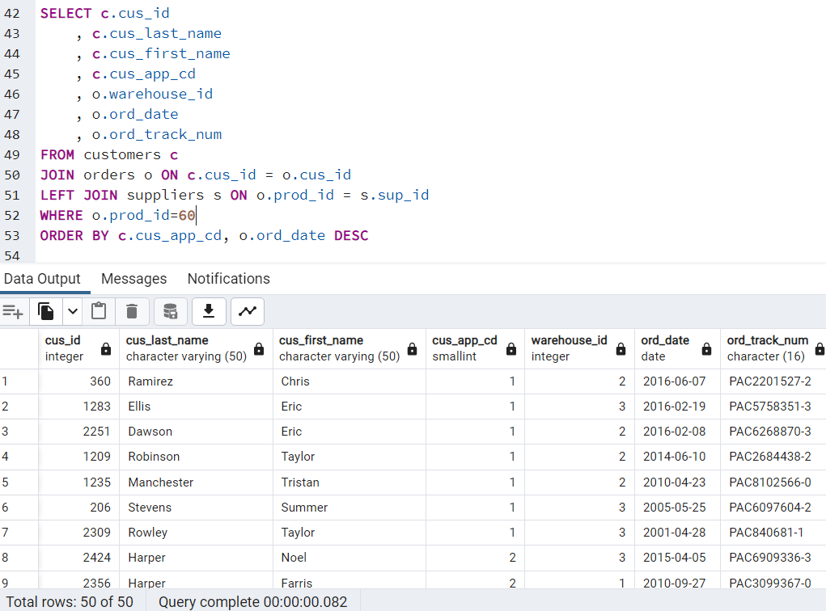
Intermediate SQL Functions cont.
Some situations involved combining multiple table which required more thought that putting together two. Here is an example:
We combined three tables. Customers, Orders, and Products were added together in this query.

Slide 13
Advanced SQL Functions
It became necessary to evolve our use of SQL and we began utilizing more complex tools to parse the data. We used things like window functions which allow you to perform calculations and analysis over a set of rows without modifying the overall query. You can spot a window function whenever there is an OVER clause.
Also sorting data by dates takes more thought to it then you would think. Dates can be saved in many different ways and can be hard to compute if you’re not sure what to do.

Slide 14
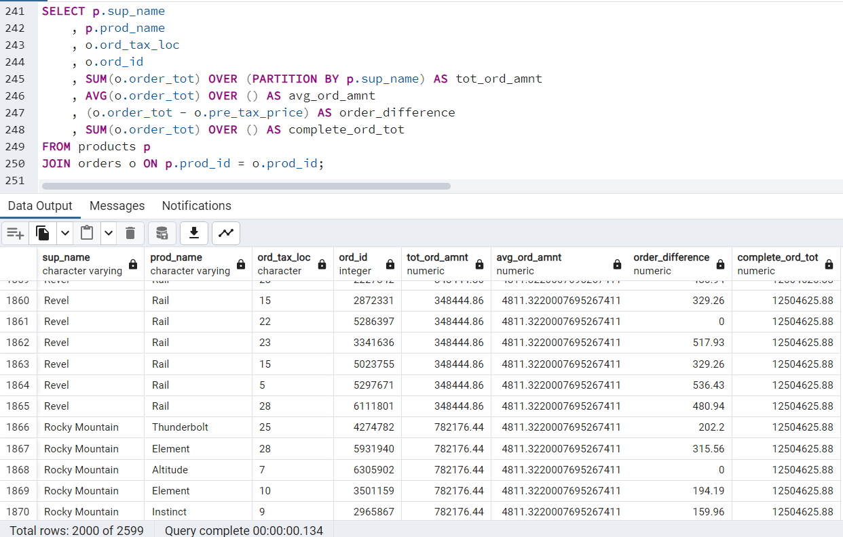
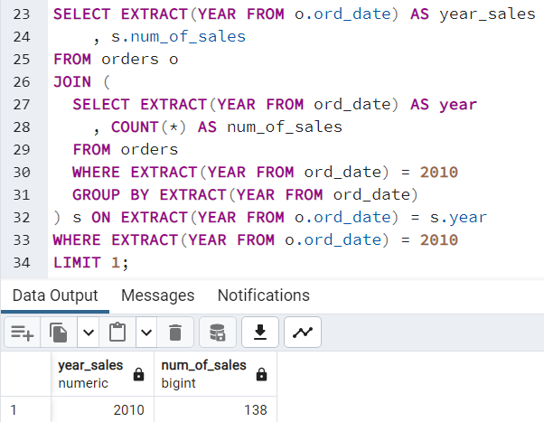
Advanced SQL Functions cont.
Here are examples of a window function and another using date to sort information.

Slide 15
Query Optimization
Depending on how you construct your query you can use differing amounts of computing power and time. We want to ideally optimize our queries to run in the most efficient manner.
PostgreSQL uses a five stage query processing engine. The five engines involved in query processing are:
The Parser – The parser generates a parse tree from a SQL statement in plain text
The Analyzer- The analyzer analyses the parse tree to develop a query tree
The Rewriter- The rewriter transcribes the query tree based on rules in the rules engine
The Planner- The planner generates a query plan to most effectively execute the query tree.
The Executor- The executor executes the query by accessing the tables and indexes based on the query plan the planner develops from the query tree.

Slide 16
Key Findings
We found that even with some hiccups along the way it is possible to train your staff in a reasonable amount of time to utilize PostgreSQL.
There are a few things that an employee would need to practice but with proper guidance it can be learned within 8 weeks for purposes of analyzing data and storing it inside a database.
By using this tool, we were able to reach our conlcuison in regards of acquiring Ord Cycles.

Slide 17
Lessons Learned
One of the best pieces of advice I’ve received when it come to coding is to keep trying and the stuff that seems hard will become easy.
If someone started trying to do week 8 content week 1 they would have probably given up.
We have learned how to create databases, store data in databases, how to modify and clean the data, and how to run analysis within PostgreSQL.

Slide 18
Recommendations
Not to get away from the main point, we would not recommend acquiring Ord cycles. The past twenty years have seen steady sales but there has been no increase. The peak year of sales was before the 2008 recession hit.
We could calculate revenue and the number of sales. No additional warehouses would be needed at the current sales rate but the most important number for a decision was not available. We could not calculate yearly profit!!!
We would recommend teaching and utilizing PostgreSQL for database management and analysis.

Slide 19
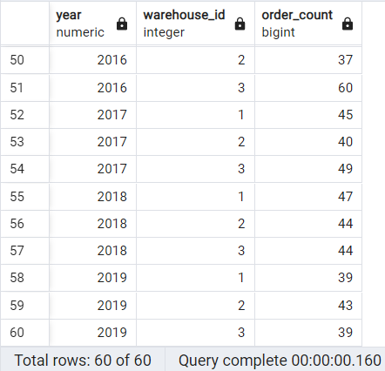
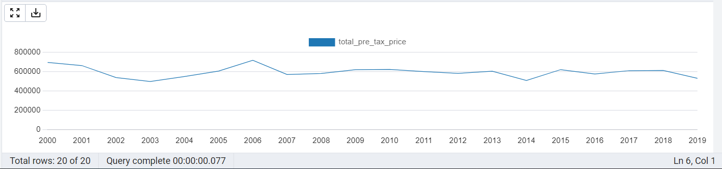
Bikes sold by warehouse and total revenue over time.

Slide 20
Sources
We learned what we needed from two main sources.
1. Maryville University DSCI 504 featuring 14 Modules
2. DATACAMP online learning also helped sure up our skills
We would recommend utilizing a structured course buffed up with additional practice on DATACAMP
For our decision on acquiring Ord Cycles see our backbrief.ipynb to see how the information was calculated that led to our choice.

