Slide 1

COLLEGE OF COMPUTER SCIENCE AND INFORMATION TECHNOLOGY JAZAN UNIVERSITY
MINI PROJECT
Souq.com
COURSE – INTERNET TECHNOLOGY
Student Name | Student ID
Huda khubrany | 201801510
Amani oraibi | 201806766
Noura alharbi | 201701379
Amal shapi | 201806741

Slide 2
Introduction
We connect people and products – opening up a world of possibility. From bracelets and backpacks to tablets and toy cars – we give you access to everything you need and want. Our range is unparalleled, and our prices unbeatable. Driven by smart technology, everything we do is designed to put the power directly in your hands – giving you the freedom to shop however, whenever and wherever you like. We’re trusted by millions, because we don’t just deliver to your doorstep, we were born here. With Souq.com you’ll always be getting a good deal – with exceptional service that makes your shopping experience as easy and seamless as possible. This is Souq.com – the power is in your hands.

Slide 3
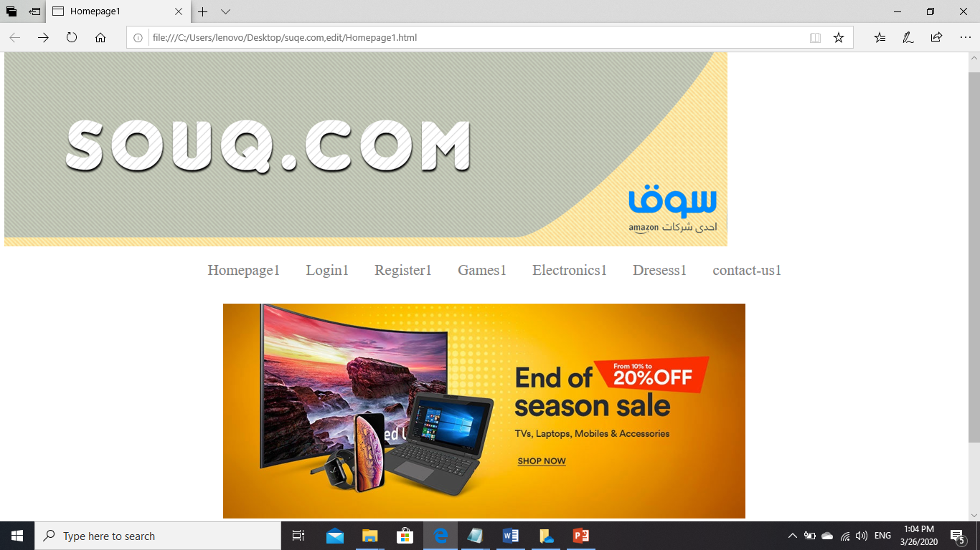
Home page

Slide 4
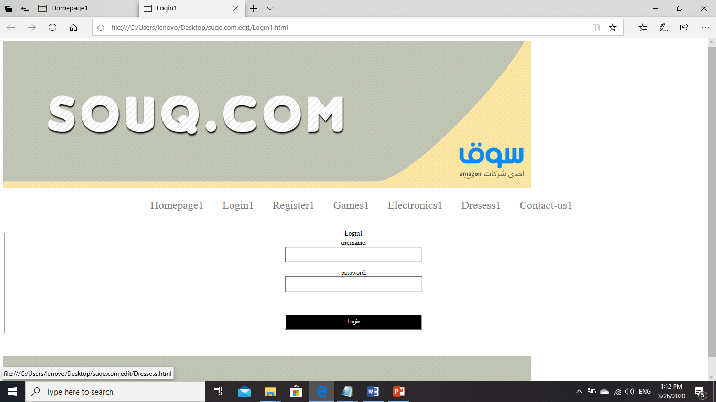
Login

Slide 5
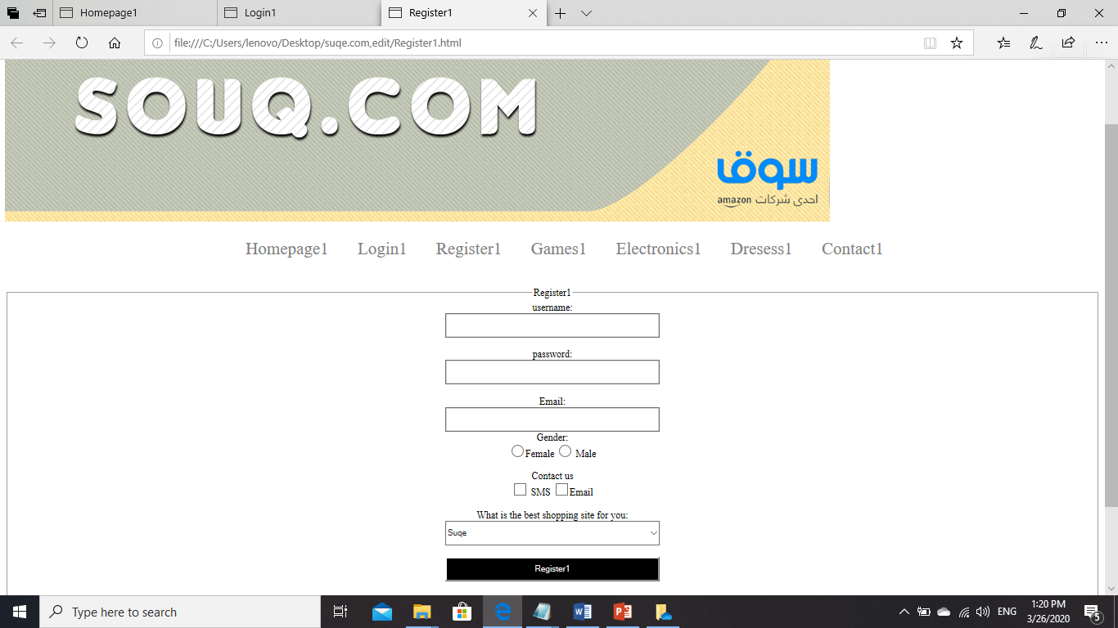
Register

Slide 6
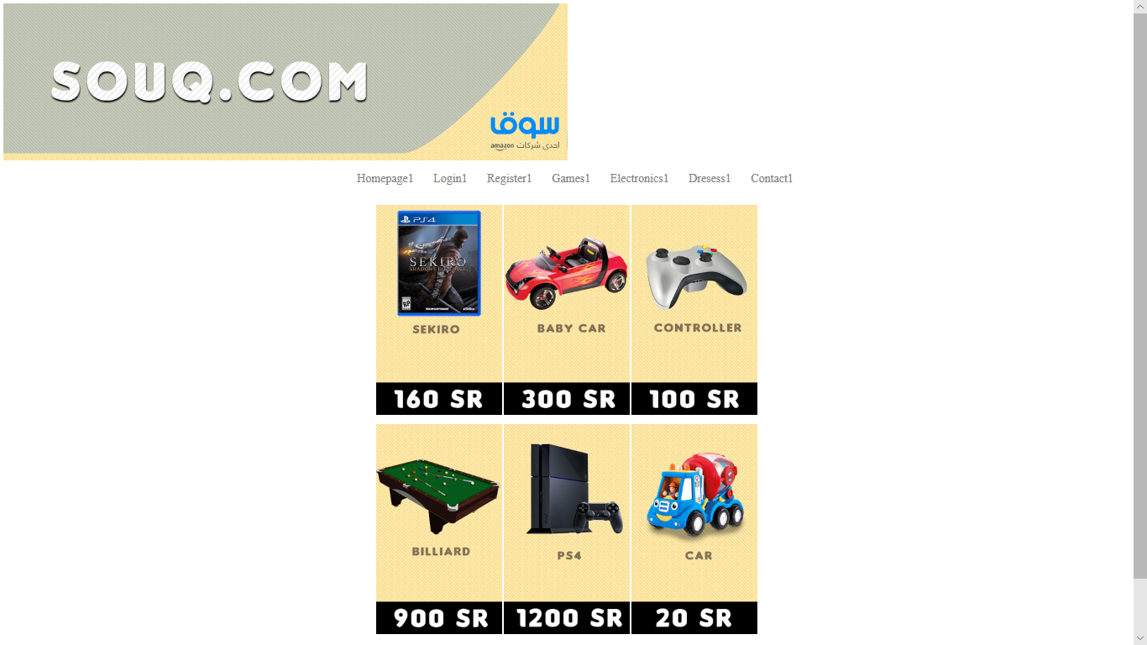
Games

Slide 7
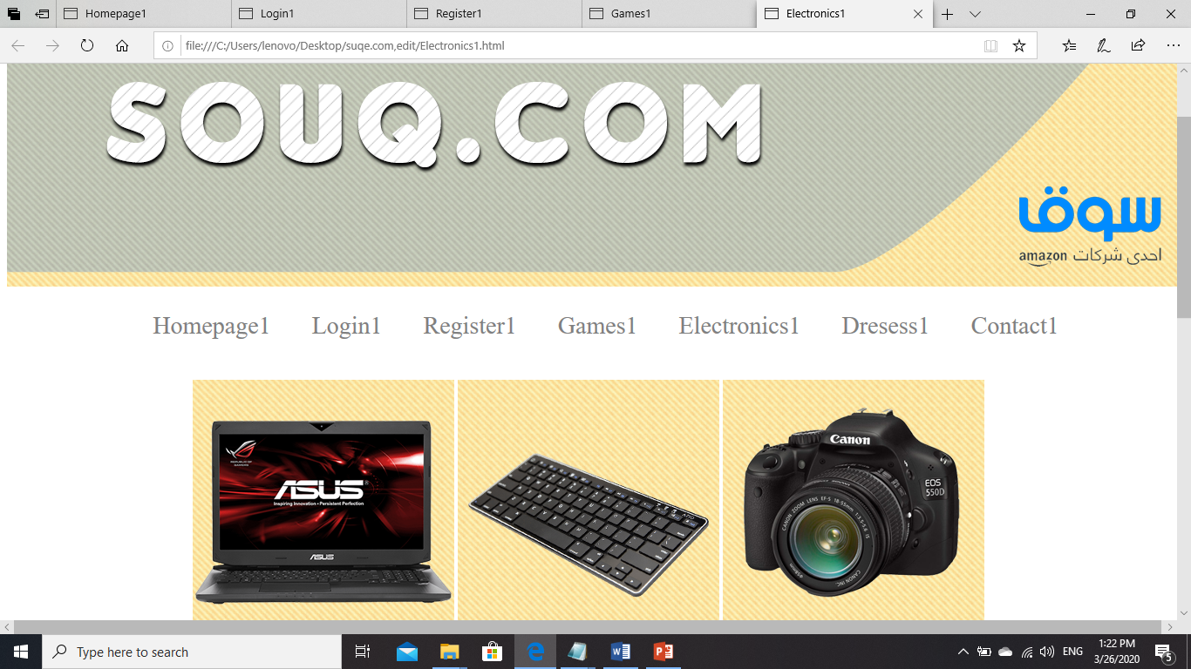
Electronics

Slide 8
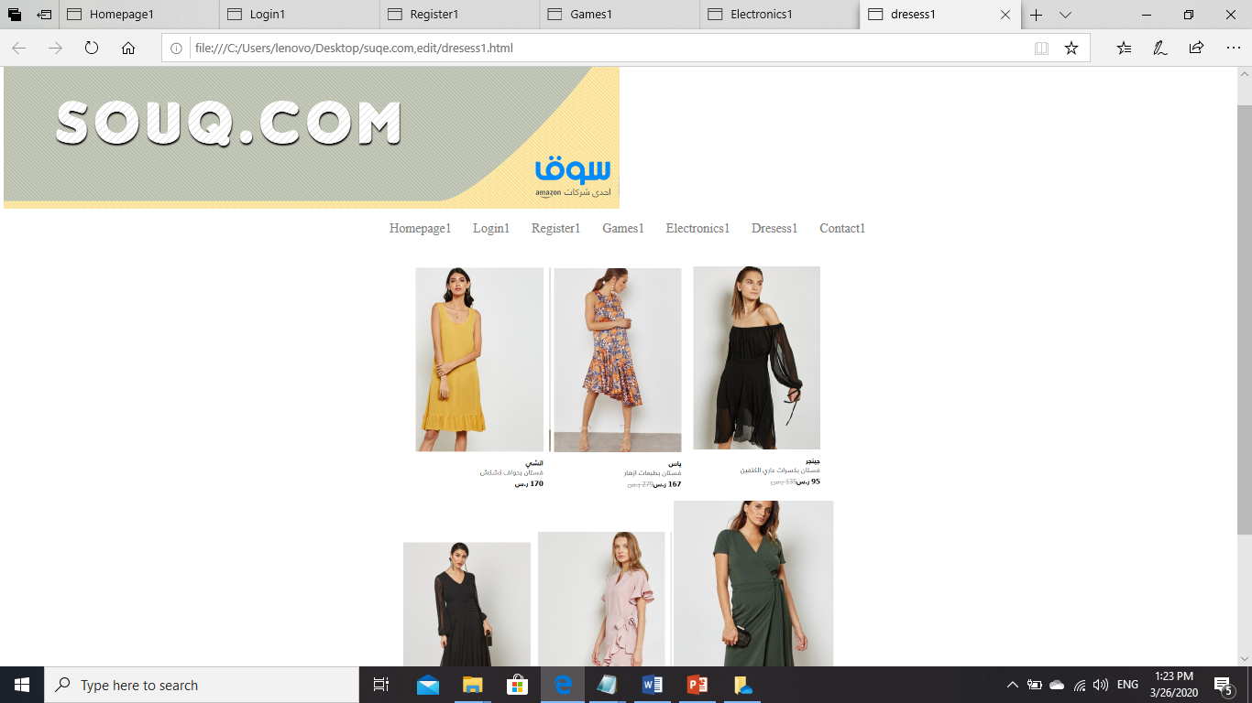
Dresses

Slide 9
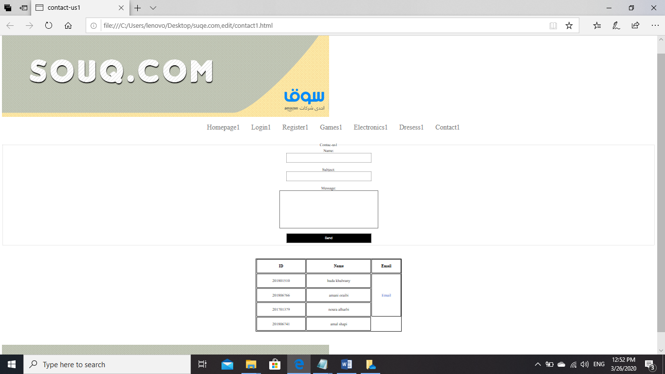
Contact us

Slide 10
Thank you

