Slide 1
Welcome!
Data Science for Physicists
APS Global Physics Summit 2025

Slide 2

Wifi Name and Password
APS GPS 2025-ACC
Password: 100yearsquantum!

Slide 3
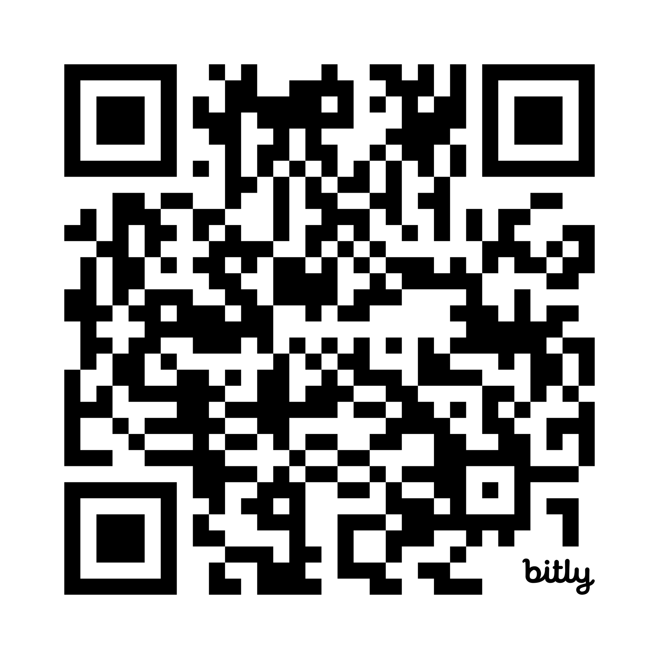
Anonymous Feedback Form
https://bit.ly/3FKf2aw

Slide 4
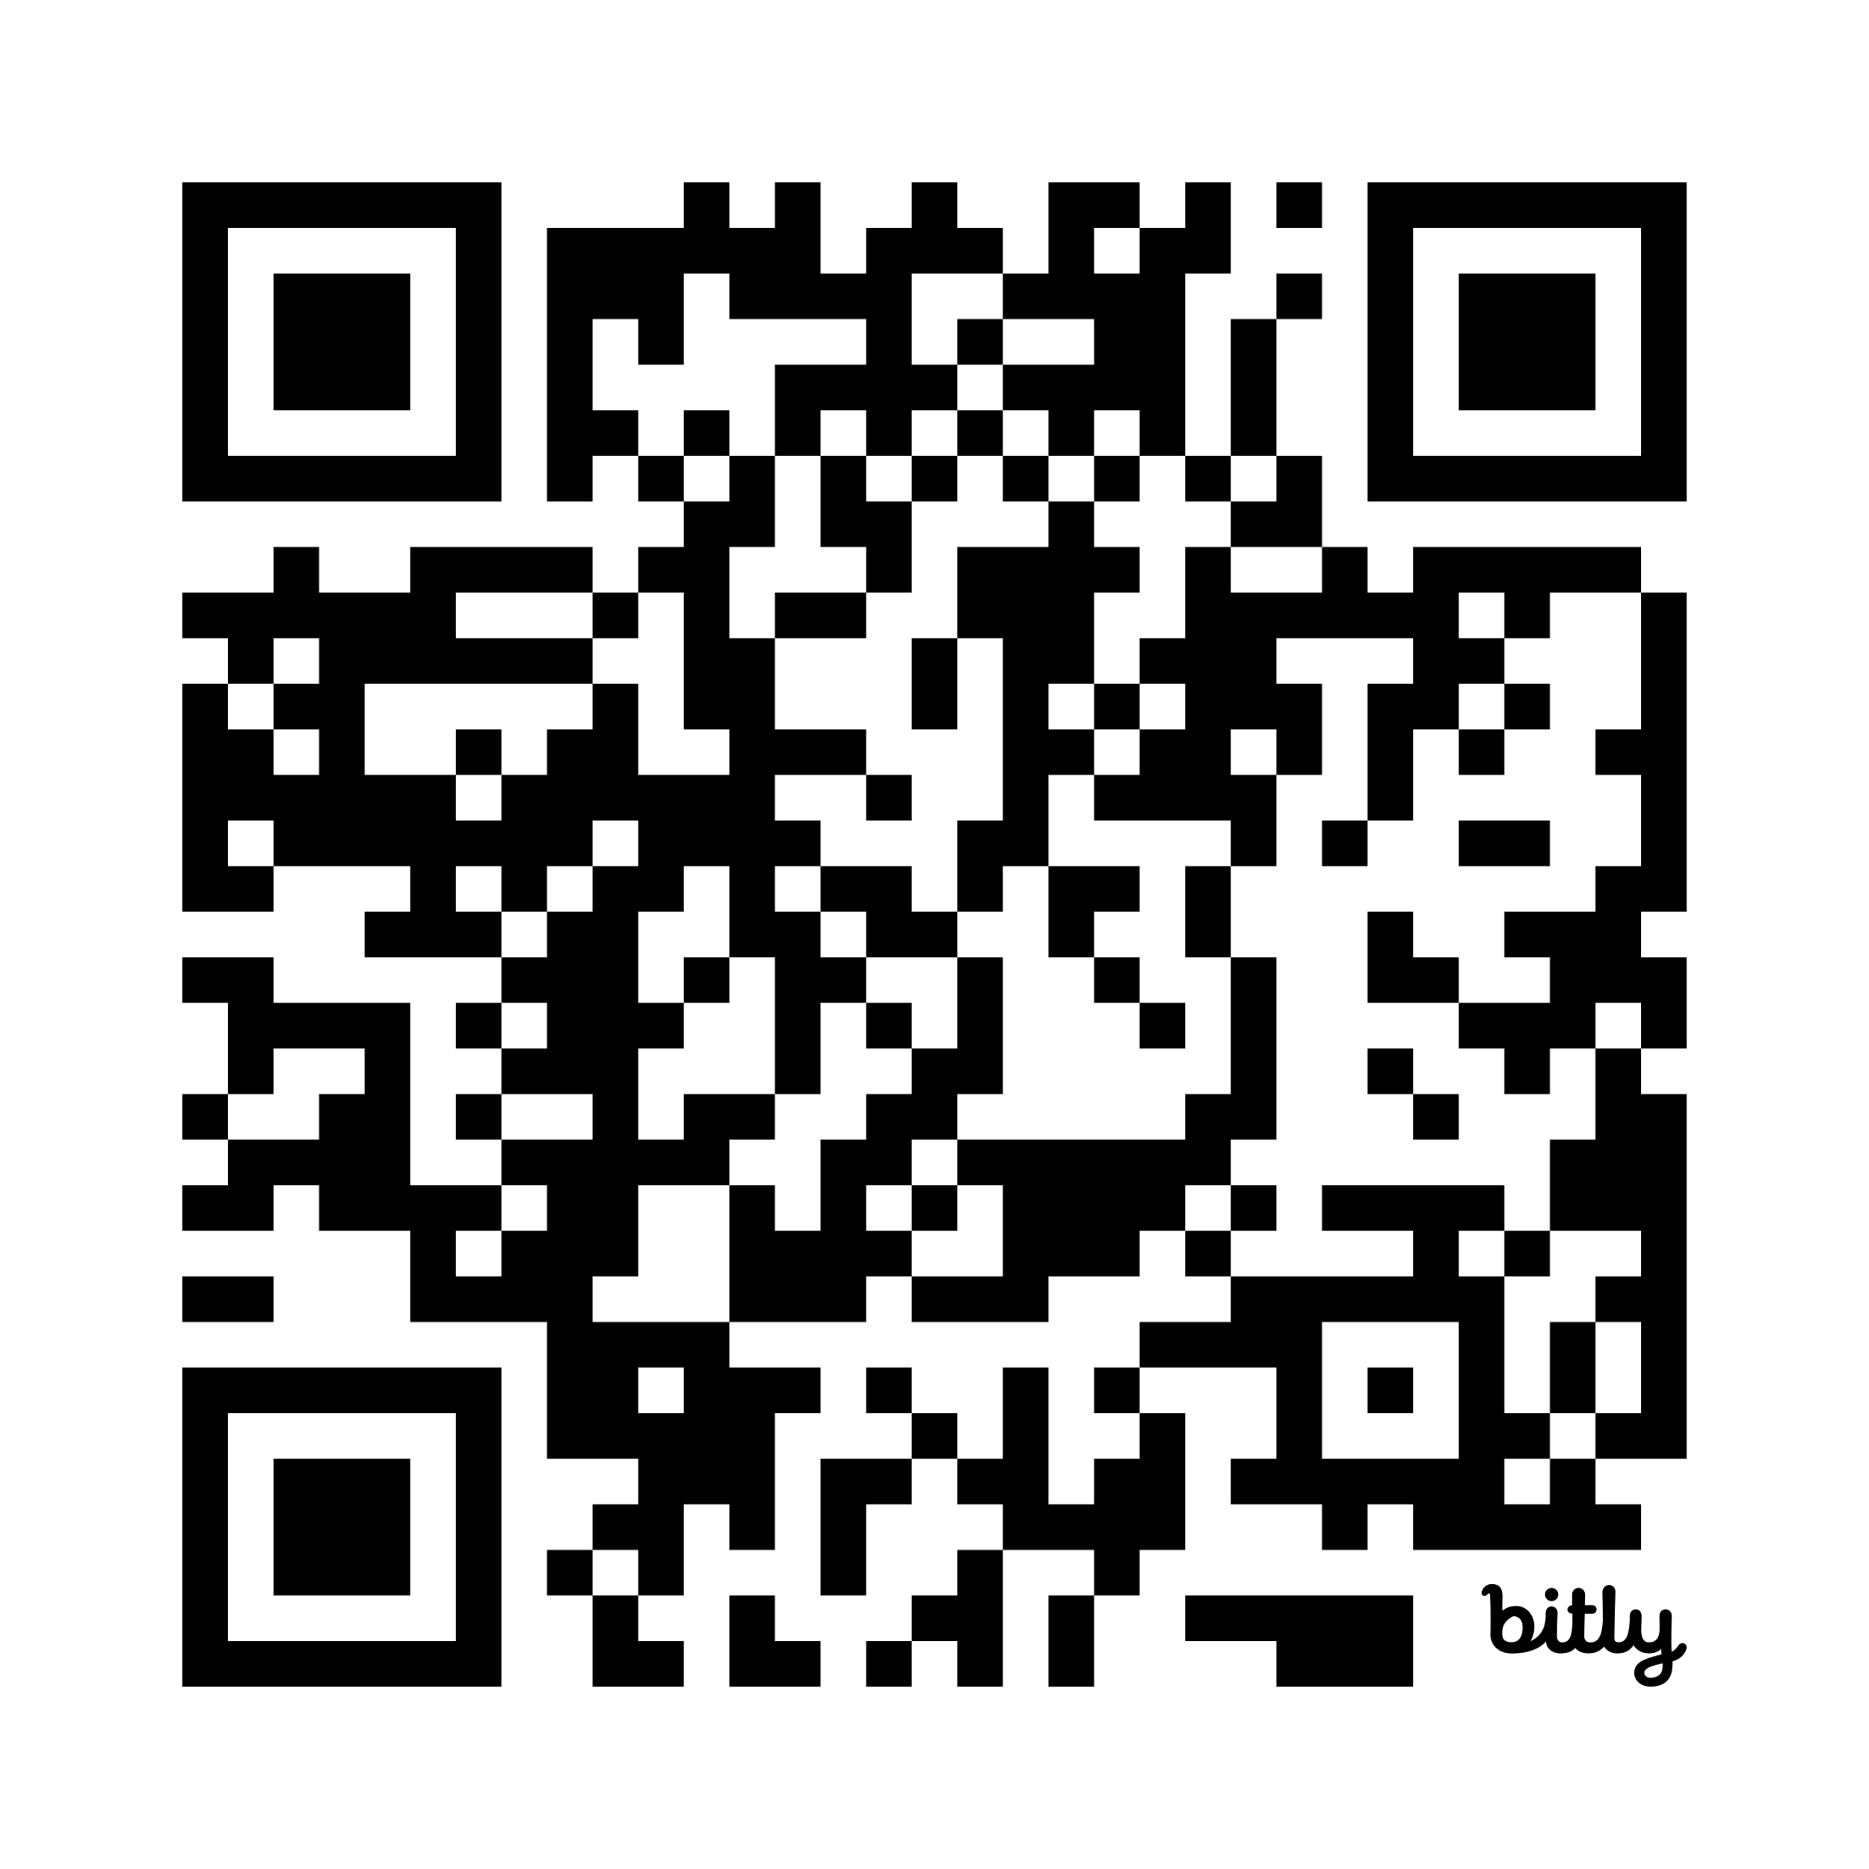
Introductory Survey
https://bit.ly/427yQxl

Slide 5
Schedule Day 1
8:00 AM – 8:15 AM
Introduction to the Course
8:15 AM – 9:45 AM
Data Exploration and Visualization
9:45 AM – 10:15 AM
Coffee Break
10:15 AM – 11:45 AM
Introduction to Machine Learning
11:45 AM – 1:15 PM
Lunch Break
1:15 PM – 2:45 PM
Introduction to Unsupervised Learning
2:45 PM – 3:15 PM
Coffee Break
3:15 PM – 5:15 PM
Introduction to Neural Networks and Convolutional Neural Networks

Slide 6
Schedule Day 2
8:00am - 8:15am: Introduction to Day Two
8:15am - 9:15am: Introduction to Graph Neural Networks
9:15am - 10:15am: Introduction to Large-Language Models and Retrieval Augmented Generation
10:15am - 10:30am: Coffee
10:30am - 11:30am: Physics Applications of Large Language Models
1:00pm - 1:50pm: Accessing Training Data: Material Data APIs
1:50pm - 2:40pm: Introduction to neural-network quantum states
2:40pm - 3:00pm: Coffee Break
3:00pm - 3:50pm: Using Data Science to Understand Complexity in Soft Matter Systems
3:50pm - 4:40pm: Applications of Machine Learning to Biology
4:40pm - 5:00pm: Conclusion and Final Announcements
11:30am - 1:00pm: Lunch Break

Slide 7
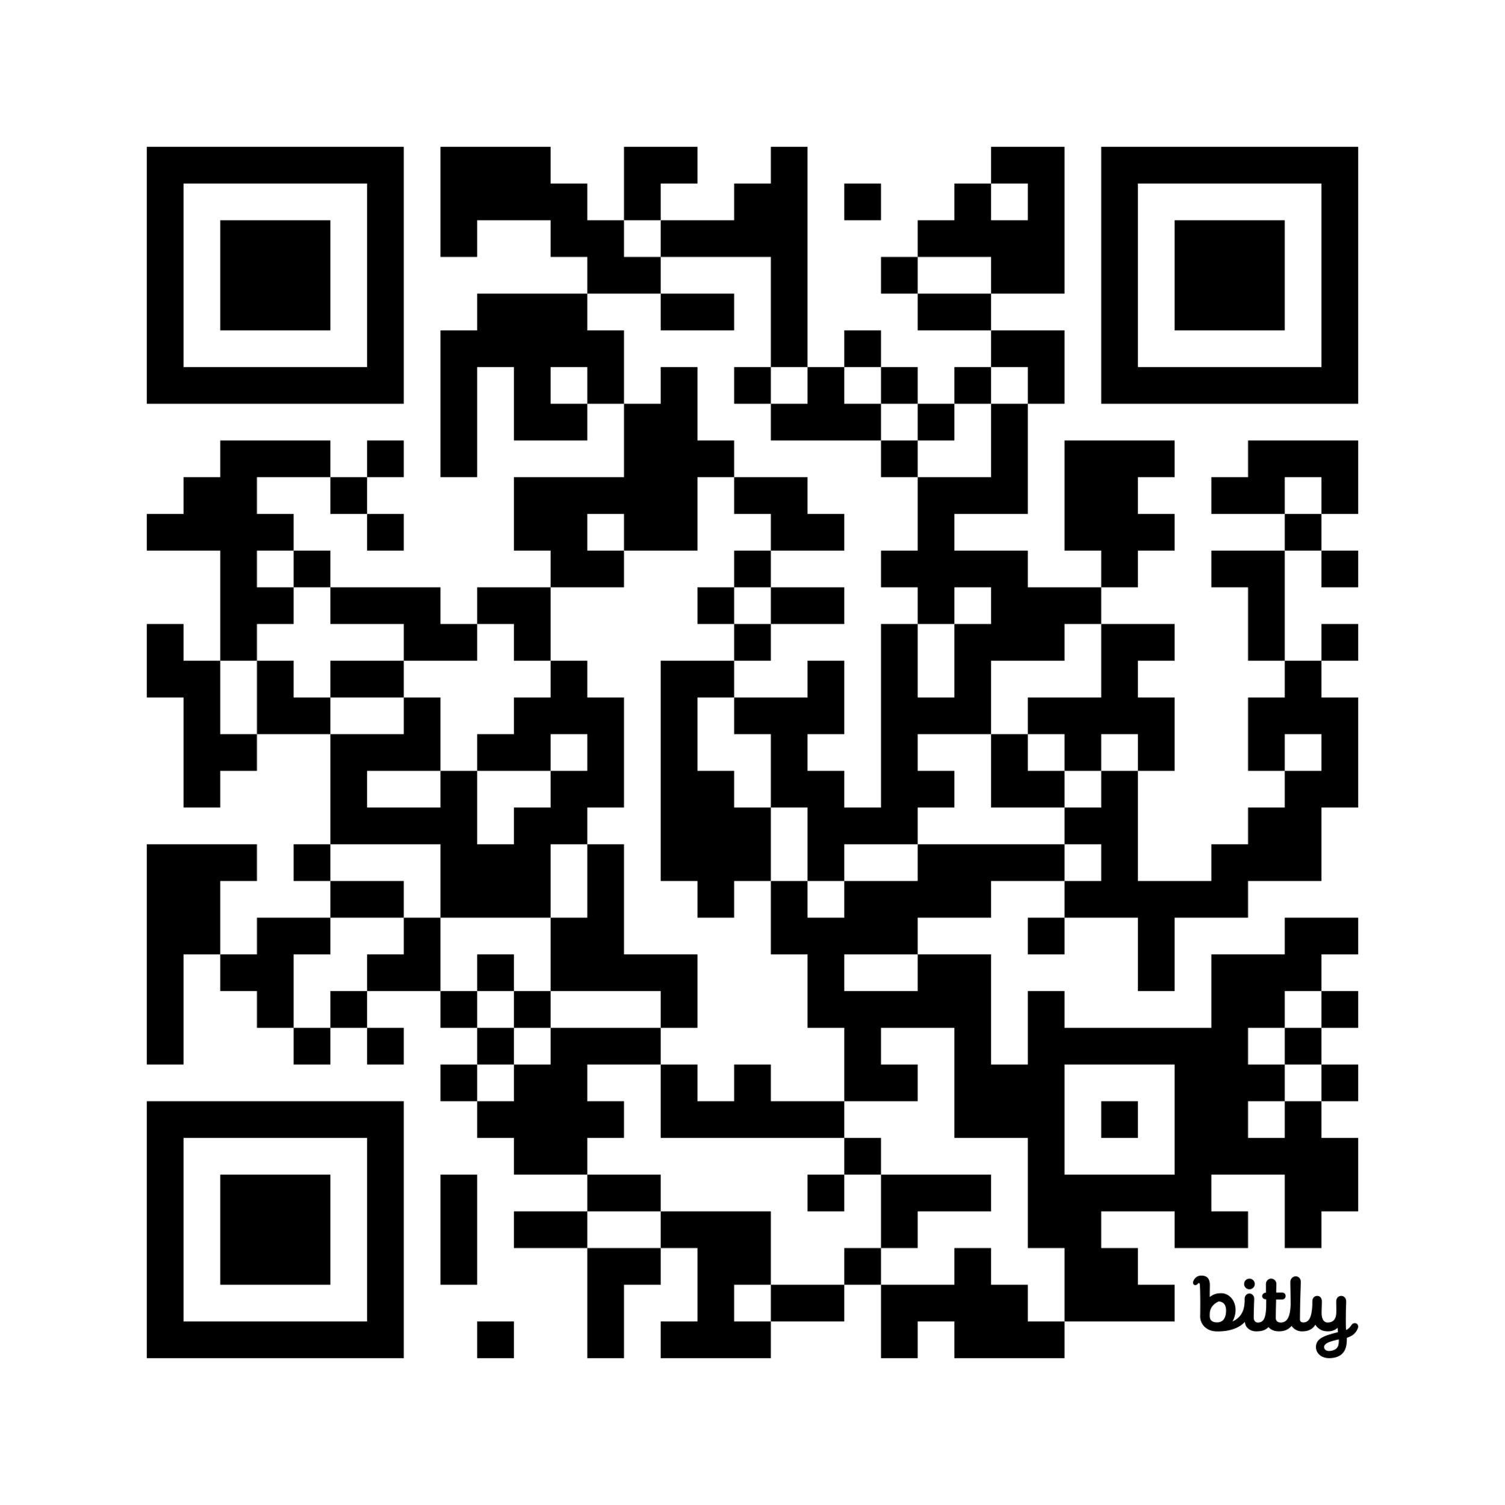
Link to Materials
https://bit.ly/3FvGeKh

Slide 8
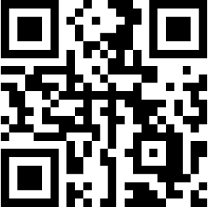


Join us on Slack and Social Media!

Slide 9
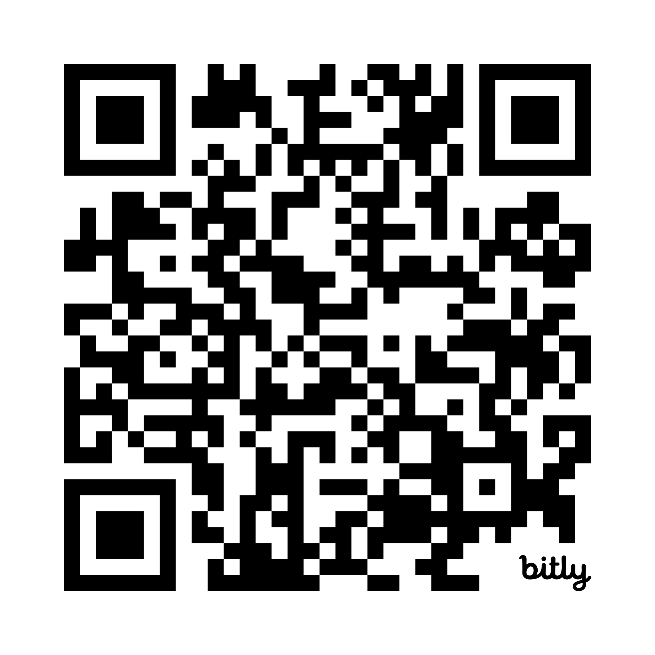
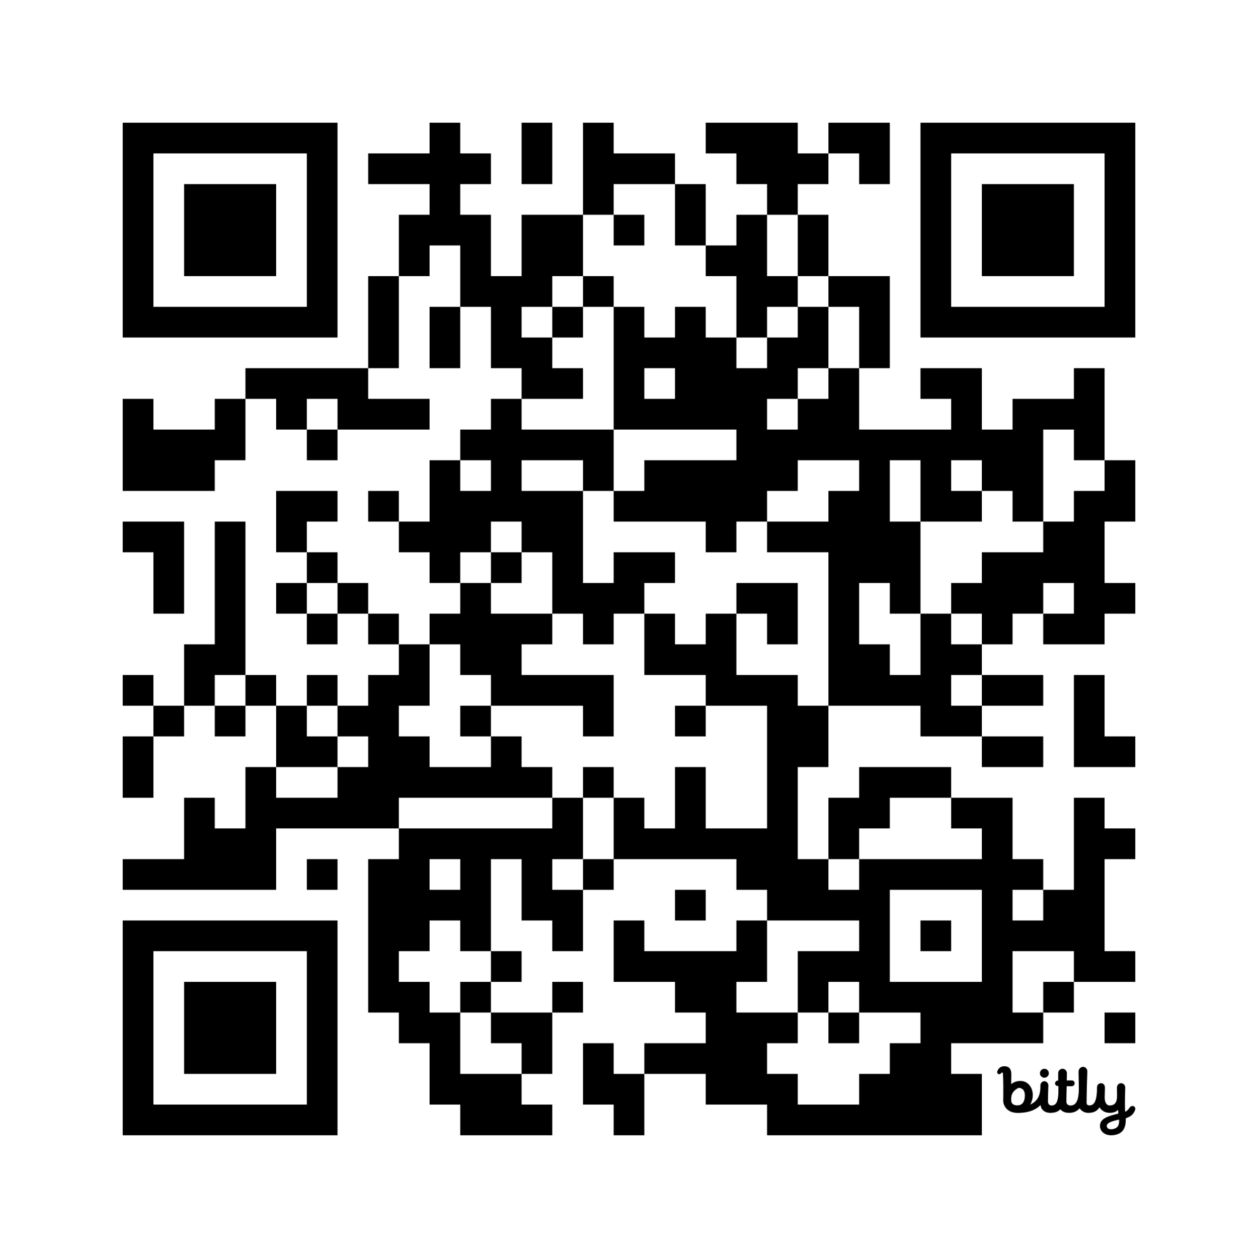
Virtual GDS Tutorial Series Starts March 28th!
Bi-weekly virtual seminar series covering topics related to data science, machine learning, and artificial intelligence. Geared towards physicists and shown with applications to physical systems.
GDS YouTube Channel
https://bit.ly/3RfATJq
Sign-up to receive updates about the seminars!
https://bit.ly/4kt2IeW

Slide 10
Contact the Organizers!
Julie Butler (University of Mount Union)
butlerju@mountunion.edu
William Ratcliff (National Institute for Safety and Standards)
william.ratcliff@nist.gov

