Slide 1
Lucky Unicorn Documentation
Robson Butler

Slide 2
Lucky Unicorn
Link to GitHub Repository: https://github.com/butlerdtc/LuckyUnicorn
Links to Trello board / project management tools: [here]
Link to final version of your program: [here]
Ensure you have made these links ‘public’ so that they are open to anyone, including the marker. The link to your program is the final outcome of this whole project – your finished program.

Slide 3
Describe relevant Implications 1:
Relevant implication | Describe the implication and give an example
Functionality | Functionality is to make sure that the program performs as intended. It must work for expected, boundary, and unexpected scenarios. For instance, if my software asks the user how many rounds they want, it should function for expected input, such as "2," or boundary input, such as "1," but it shouldn't crash if the user enters an incorrect value, such as "0," "0.5," or "one."
Usability | Usability refers to how simple it is for the user to use the program for its intended purpose. It addresses concerns like making instructions and error messages understandable to users. It's essential to reduce or get rid of any frustration.
Aesthetics | Aesthetics is how the program’s overall appearance looks. A program which looks good because it includes well-spaced instructions, prompts and ‘decoration’ around key messages is going to be more aesthetically pleasing than one which is composed of unspaced plain text.
Notes:
Additional rows can be added by clicking in the last cell and then using the Tab key

Slide 4
Describe relevant Implications 2:
Relevant implication | Describe the implication and give an example
Social | The social implications of a computer program are about the affect it might have on users, the wider community, and society. For example, computer programs which are based around a gambling game can have a negative impact on society if there are no safeguards in place to limit users from excessive losses. It's also important to use clear instructions and feedback which is culturally neutral and inoffensive.
Future Proofing | Future proofing is the process of making a program which is adaptable and easy to modify later if necessary. The code needs to be organized and commented so that another programmer in the future can make changes easily. Anyone who wants to modify my code in the future needs to understand the purpose and reasoning behind different parts of the code. It's important to use constants rather than literals to minimize the number of places where changes must be made.
Notes:
Additional rows can be added by clicking in the last cell and then using the Tab key

Slide 5
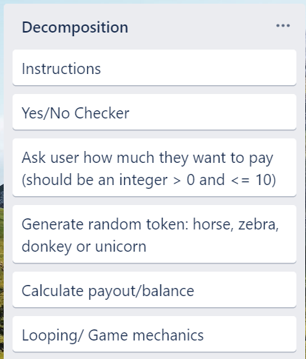
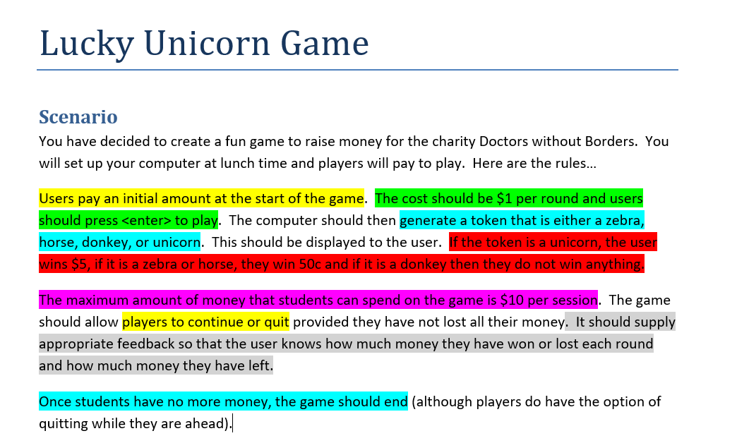
Decomposition:
Notes:
Paste screenshots of your initial Trello board / task decomposition on this slide. If you have a long list, you might need to break it up into several slides.

Slide 6
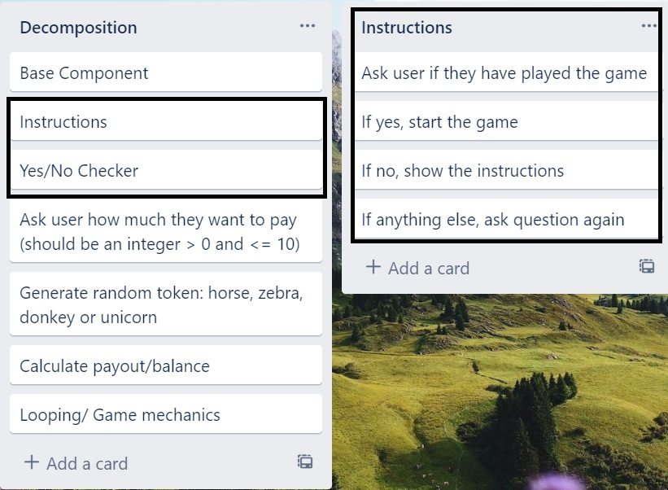
Component 1: Instructions and Yes/No checker

Slide 7
Component 1 (Yes/No Checker) - Test Plan
Test Cases - input | Expected output
Yes | Program continues
yes | Program continues
Y | Program continues
No | Program continues
no | Program continues
N | Program continues
Maybe | Please enter either “Yes” or “No”
Notes:
Additional rows can be added by clicking in the last cell and then using the Tab key

Slide 8
[Component name]: Trialling
NOTE: Trialling needs to happen for at least 2 of your components but is not necessary for ALL components.
Trialling is not the same as testing. Trialling is about finding different ways of building the same component. Show evidence of your trialling here. Select one of your trials for further development and give reasons for your choice.
Notes:
NOTE: Trialling needs to happen for at least 2 of your components but is not necessary for ALL components.
Trialling is not the same as testing. Trialling is about finding different ways of building the same component. Show evidence of your trialling here. Select one of your trials for further development and give reasons for your choice.

Slide 9
[Component name]: Testing
You must show the results of testing. For each component, include a screenshot proving it works. You can also include notes about each test.
Notes:
You must show the results of testing. For each component, include a screenshot proving it works. You can also include notes about each test.

Slide 10
Assembled Outcome Testing:
Show testing for your assembled outcome below. This should include a test plan followed by screenshot proof.
Notes:
Show testing for your assembled outcome below. This should include a test plan followed by screenshot proof.

Slide 11
Address relevant Implications:
Relevant implication | Explain how your final outcome addresses each implication

Slide 12
Version Control Evidence:
Your version control evidence should go here. This could be in the form of screenshots (both of your GitHub repository as well as your local project folder) as evidence of your incremental development.
Notes:
Your version control evidence should go here. This could be in the form of screenshots (both of your GitHub repository as well as your local project folder) as evidence of your incremental development.

Slide 13
Final Discussion:
Discuss how the information from planning, testing and trialling of components assisted in the development of a high-quality outcome.
Notes:
Discuss how the information from planning, testing and trialling of components assisted in the development of a high-quality outcome.

