Slide 1
Adaptive CGF Trainer
HACKATHON PROTOTYPE · SYNTHETIC DATA
Computer-generated forces that find each trainee’s focus area, work inside limits the instructor sets, and explain every move.
Air, sea and land platforms. Runs offline from a file.
Notes:
Open by naming the gap: one instructor, many trainees, one scripted enemy. We built a trainer where the enemy adapts to each trainee and the instructor stays in command. Everything shown uses synthetic data.

Slide 2
One instructor, many trainees, one scripted enemy
THE PROBLEM
01
02
03
Same scenario for all
Weak spots by chance
No time to retune
Fixed scenarios train the average trainee.
Each person’s focus area is practised only if the script happens to reach it.
The instructor cannot adjust the enemy for every seat while running the exercise.
ADAPTIVE CGF TRAINER
02
Notes:
One instructor runs many trainees. A fixed scenario trains the average, so a trainee’s weak spot is practised by chance. The instructor has no spare hands to retune the enemy per seat. Do not quote figures here; we have none.

Slide 3
The key challenge: train each person’s weak spot, without losing control
THE KEY CHALLENGE
THE CHALLENGE
THE APPROACH
WHAT THE PROTOTYPE SHOWS
A scripted enemy cannot target one trainee’s weak spot, ease off when they struggle or push when they excel. An instructor cannot retune it by hand for every seat.
History picks the competency to exercise. The last 10 events set how hard to push. Every change stays inside the instructor’s limits and is explained.
Pressure lands on the weak competency first.
It eases when the trainee struggles and rises when they do well.
No setting leaves the limits.
The report updates the profile.
THE PROTOTYPE SHOWS THE MECHANISM · TRAINING TRANSFER NEEDS A TRIAL
03
Notes:
Name the key design challenge in one breath: make the enemy train each person's weak spot and adapt to how they perform, while the instructor stays in command and can see why. Then say what the demo proves. Be honest about the limit: it shows the mechanism works end to end. Proving training transfer needs a trial with real cohorts.

Slide 4
History picks what to exercise. Live behaviour sets how hard.
THE IDEA
EXPERIENCE · WHAT
CURRENT BEHAVIOUR · HOW HARD
The trainee profile
The last 10 events
Kept across sessions. The weakest competency with enough evidence becomes the target.
Doing well on the target: raise the pressure. Struggling: ease off.
Adjustments change CGF settings only. They never change the trainee’s score or the outcome.
ADAPTIVE CGF TRAINER
04
Notes:
The core idea in one sentence. The profile decides which competency to exercise. This run’s behaviour decides how hard to push it. Today’s evidence also updates the profile, so a trainee who improves stops being the target.

Slide 5
Allocate, run, report, update
THE LOOP
allocate.html
runtime.html
report.html
profile + history
Allocate
Run
Report
Update
Platform, crew, limits.
The CGFs adapt and say why.
A debrief for each trainee.
The next session starts from it.
Every page opens from a file. No server, no install.
ADAPTIVE CGF TRAINER
05
Notes:
Four steps, each a page that opens from a file. The report feeds the competency update, which writes the trainee’s history, so the loop closes. Next slides walk through the steps.

Slide 6
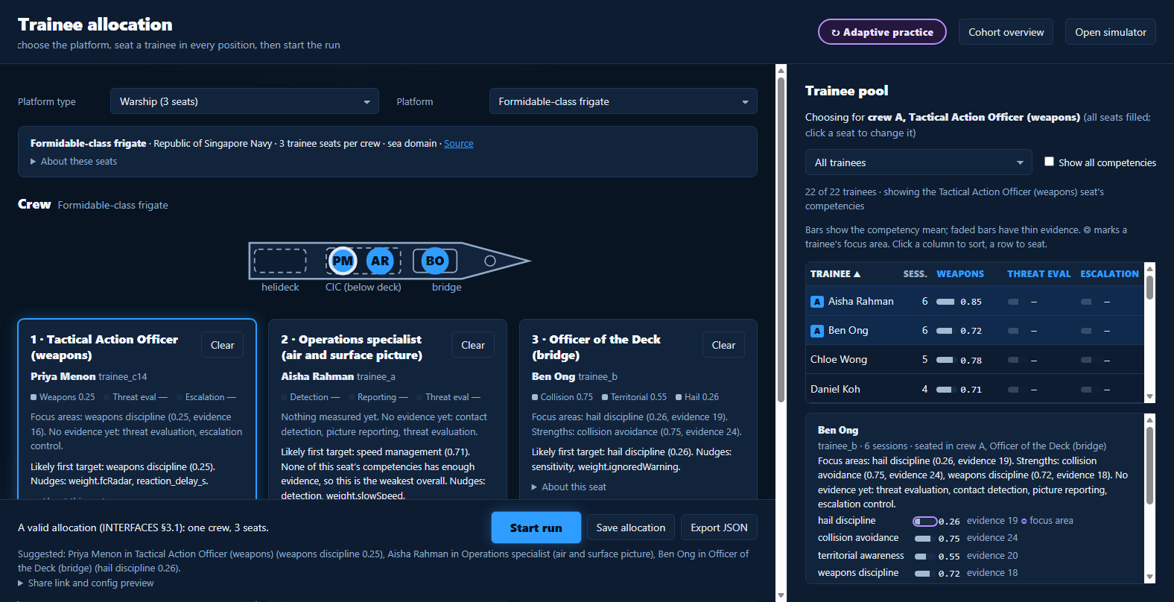
Choose the platform, seat the crew, set the limits
ALLOCATE
Six platforms
Fighter, warship and tank, two models each, with their own seats.
Know the trainee
Competency bars and focus areas per seat, plus a private note.
Practice or assess
The mode badge, run length and the envelope are set before start.
ADAPTIVE CGF TRAINER · SYNTHETIC TRAINEES
06
Notes:
Live beat if the demo runs: pick the warship, press Suggest demo crew, point at the competency bars and the likely first target, then the Adaptive practice badge. Fallback: this screenshot. All names are synthetic.

Slide 7
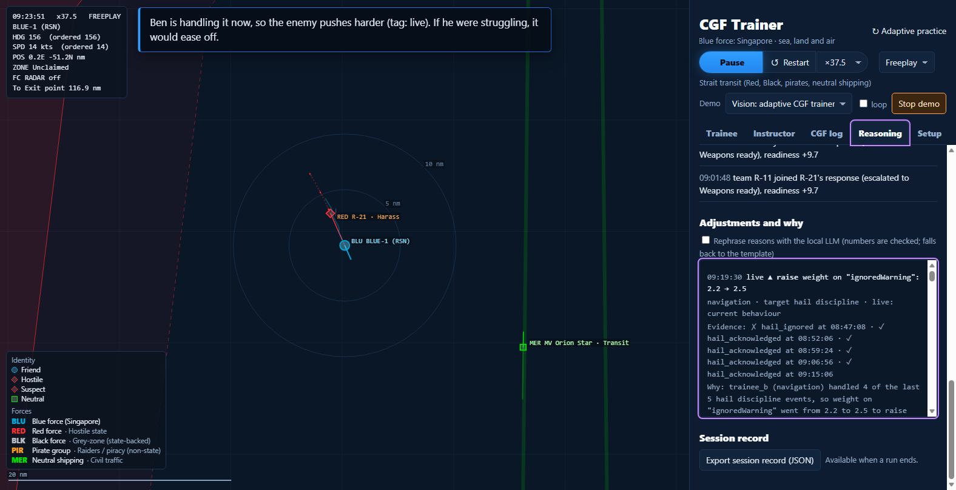
The enemy reacts to this crew, not a script
RUN
Targets the focus area
The first pressure lands on the competency the profile says needs it.
Forces cooperate
A unit that meets a response shares it, and nearby units join in.
Invisible to the trainee
The trainee sees an exercise. The reasoning shows to the instructor.
ADAPTIVE CGF TRAINER · STRAIT TRANSIT SCENARIO
07
Notes:
Warship crew on the strait transit scenario, the one scenario with a competency signal today. Start the run. The CGFs press hails at the navigation seat because that is the history-based target. Fallback: the recorded clip.

Slide 8
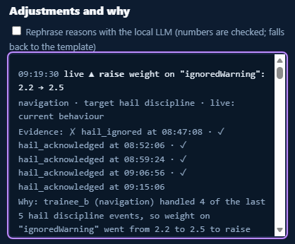
Every adjustment shows what, why and on what evidence
EXPLAINED
Success rate over the last 10 events on the target
below 40%
40–70%
above 70%
▼ Ease off
Hold
▲ Raise
Each entry names its cause: history, live, team or the instructor.
Fewer than 3 events: no rate yet, so exposure stays up.
Easing stops at the instructor’s base setting.
Every step stays inside the envelope.
REAL ENTRY FROM THE DEMO RUN · REASONING TAB
08
Notes:
The screenshot is a real entry from the demo run: trainee_b handled 4 of the last 5 hail discipline events, so the weight on ignored warnings went from 2.2 to 2.5 to raise the pressure. Each entry shows direction, setting change, the evidence events and a one-line reason, tagged history, live, team or instructor. The rule on the right: above 70 percent the CGFs get harder, below 40 percent they ease off, never below the instructor's base.

Slide 9
The instructor stays in command
CONTROL
1
Limits the AI cannot leave
2
Fixed mode for assessment
Min, base and max for each setting. A clamped value is marked.
Zero adjustments, a different badge. Practice and assessment stay apart.
3
Steer in plain language
4
Figures come from code
The typed request becomes a directive, shown before it applies.
The optional local LLM only rephrases. It never adds a number.
ADAPTIVE CGF TRAINER
09
Notes:
Answer the standing worry: does adaptation break standardised assessment? Practice runs adapt, fixed mode is for qualification, and the badge differs. The demo runs with the local LLM off; every LLM feature has a template fallback. Steering: type a request, show the parsed directive, then apply.

Slide 10
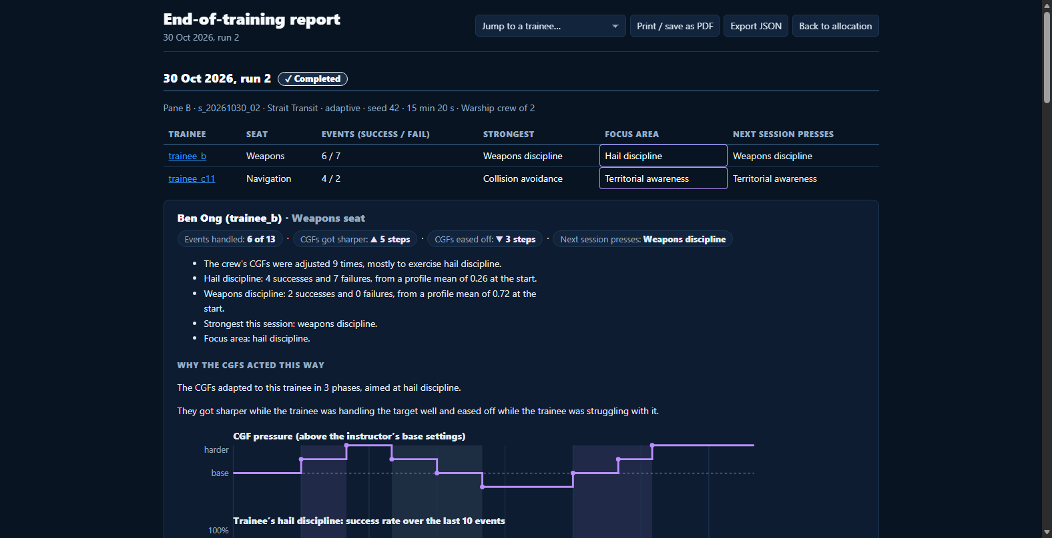
The report feeds the profile for next time
DEBRIEF
One debrief per trainee
Events handled, focus area, and why the CGFs acted.
Pressure over time
A chart of CGF pressure against the trainee’s success rate.
Then the update
The profile and history change, and the next target is predicted.
ADAPTIVE CGF TRAINER · SEEDED SESSION
10
Notes:
Code computes every figure in the report; the narrative is a template. The order is fixed: report, then competency update, then the history entry. The screenshot is a seeded session, not a live run.

Slide 11
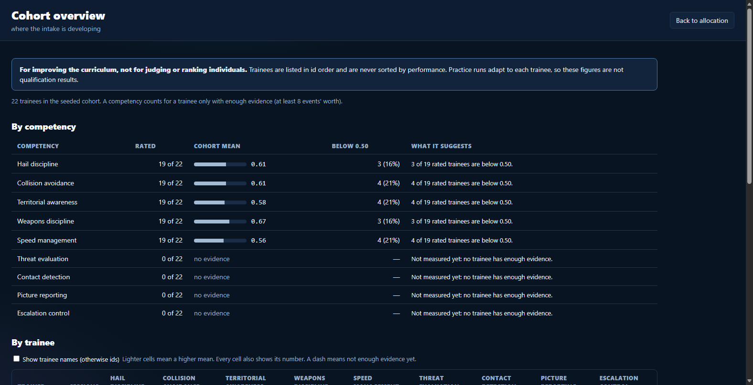
Where the whole intake is developing
COHORT
22 synthetic trainees
A heatmap of competencies, with the evidence behind each cell.
5 of 9 measured
The other four read “no evidence” until the simulator emits events for them.
For the curriculum
Not for ranking people.
ADAPTIVE CGF TRAINER · SYNTHETIC COHORT
11
Notes:
The cohort view is for improving the curriculum, never for judging individuals, and its own banner says so. Adaptive runs give different exercises, so these figures are not qualification results.

Slide 12
Where AI is used, and where it is not
AI IN THE SOLUTION
1
Learns who the trainee is
2
Decides how to push
A Beta estimate for each competency, updated from every session’s events. It is the trainee model, and it persists.
A rule-based policy picks the target and the step size every 30 s. A bandit policy is planned, not built.
3
Understands plain language
4
Plays AI partners
An optional local model turns a typed request into a validated directive and rephrases explanations. Both fall back to templates.
Empty seats can be played from parameters derived from past runs, so a crew can train with a realistic teammate.
Human in command: every AI action is bounded, explained and reversible. The model never produces a figure; code does.
ADAPTIVE CGF TRAINER
12
Notes:
Be precise about which parts are AI. The trainee model is statistical and learned from events. The policy that adjusts the enemy is rule-based today; a bandit version is planned. The language model is optional and local, used for steering and for rephrasing reasons, and every feature has a template fallback so the demo runs with it off. AI partners are played from parameters derived from earlier runs. The model never invents a number.

Slide 13
Why this is different
NOVELTY
 | Typical training simulator | This trainer
What adapts | A fixed script, or overall difficulty | The specific weak competency of each trainee
What it reads | The score of this run | History across sessions plus the last 10 events
The instructor | Sets a scenario in advance | Sets limits, steers in plain language, sees every reason
The enemy | Independent units | Units share what they know and respond together
OUR READING OF COMMON PRACTICE · NOT A SURVEY OF PRODUCTS
13
Notes:
The novelty is what the enemy adapts to. Most adaptive training raises or lowers overall difficulty from this run's score. Here the target is a specific competency chosen from the trainee's history, and the pressure is set by what they are doing now. The instructor stays in command and can see every reason. Do not claim that nobody else has done this; this is our reading of common practice, not a product survey.

Slide 14
What works today, and what is left
WHAT IS LEFT
✓ WORKING TODAY
STILL TO DO · NOT BUILT
The loop runs end to end: allocate, run, report, update
Offline from a file: no server, no install
Six platforms (air, sea, land) in allocation
Adaptation on the sea scenario, five competencies
Fixed assessment mode and instructor limits
Report, cohort view and baseline comparison pages
Competency events for air and land scenarios
Crew and team competencies, crew report
Adapter to a real simulator over HLA or DIS
Trial with real cohorts
Local model approved on the event laptops
Division figures for the business case
NO COMPATIBILITY CLAIMED WITH ANY NAMED SIMULATOR OR STANDARD
14
Notes:
Beyond the core loop, what else needs to be done? Left column is what runs today and was tested. Right column is the honest list of what is not built: competency signals for air and land, crew-level adaptation, an adapter to a real simulator over HLA or DIS, a trial with real cohorts, approval for a local model on the event laptops, and the division's figures. The engine changes a small explicit set of CGF settings, which is what makes the adapter feasible.

Slide 15
What fewer sessions to proficiency are worth in S$
BUSINESS CASE
Avoided sessions | S$1,000 each | S$2,000 each | S$3,000 each
r = 5% (300) | S$0.3M | S$0.6M | S$0.9M
r = 10% (600) | S$0.6M | S$1.2M | S$1.8M
r = 15% (900) | S$0.9M | S$1.8M | S$2.7M
ASSUMED · REPLACE WITH DIVISION FIGURES
200 trainees a year
30 sessions to proficiency
= 6,000 sessions a year
Value of an avoided session = simulator running cost + instructor time
r = share of sessions avoided by targeted practice, never yet measured
Read as: if targeted practice avoids 10% of sessions and each avoided session is worth S$2,000, the saving is S$1.2M a year. Saving = sessions a year × r × value per session.
ILLUSTRATIVE ESTIMATE · r IS A HYPOTHESIS, NOT A RESULT
15
Notes:
The audience will want the value in Singapore dollars. This is a sensitivity grid built on stated assumptions, not a claim. The pool of 6,000 sessions a year (200 trainees times 30 sessions) and the value of S1,000 to S3,000 per avoided session are placeholders until the division supplies its own numbers; replace them and the grid follows from saving equals sessions times r times value. r, the share of sessions avoided, has never been measured: it is the hypothesis a trial would test. Say that out loud.

Slide 16
Exercises each trainee’s weak spot, inside limits the instructor sets, and explains every step.
ADAPTIVE CGF TRAINER
github.com/buttception/T-S_Hackathon26
Notes:
One sentence to close. Then questions: practice runs adapt and fixed mode assesses; the AI acts only inside the instructor’s limits; the demo shows the mechanism, and proving training transfer needs a trial with real cohorts.

