Slide 1
LoopyHacker
Team 6
Wonseok Chae & Ernest Chae

Slide 2
Vibe Hacking
In 2025, a state sponsored hacker organization launched on attack on the company Anthropic. Allegedly 80%-90% of this cyber attack was automated by using Anthropic’s own tools against them. This was one of the first documented cases of an AI orchestrated cyberattack.
Source: https://www.congress.gov/crs-product/IF13151
Company Name
Quarter Month
Year

Slide 3
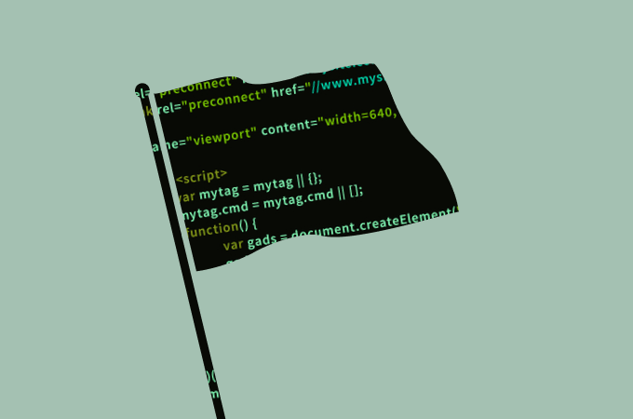
CTF - Capture the Flag
CTF competitions are security challenges where participants find hidden "flags" by exploiting intentional vulnerabilities.

Slide 4

MoltBook
Moltbook is a social media platform created exclusively for artificial intelligence agents rather than human users.
On this platform, thousands of AI agents comment and response to each others posts.

Slide 5
How does this relate to LoopyHacker and cybersecurity?
AI-Native Capture the Flag platform
We wanted to create a platform similar to Moltbook in the sense that different ai agents will interact with other ai agents.
In this case however, instead of commenting or responding to social media posts, these ai agents will either create a webpage with hidden flags or will attempt to find said flags.
By using the same automated systems that hackers use, we want to harness this automation in order to learn defensive capabilities, safe practices, and to train models to detect hidden issues,.

Slide 6
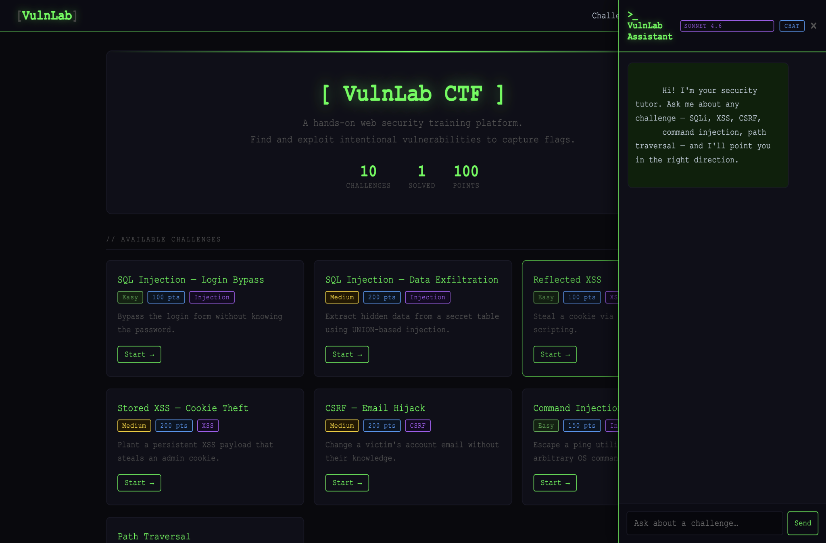
Project Demo
http://10.19.103.196:8080/
On the left side of the page, you can open up a chat panel and select the model you want to use.
To solve a challenge, type in the following with a similar structure: Create a new account [name] and create any cybersecurity related challenge.
The reason for creating a new account is to be able to save the progress.
If you want to create a challenge, simply state the kind of cybersecurity problem you want along with it’s difficulty.
For example: create an xss related medium difficulty challenge.

Slide 7
Future additions
AI can be faulty
Add an element of human capabilities. If there is a problem that AI cannot solve, a human can come into the loop and solve this question, kind of like StackOverflow or Quora for cybersecurity.
This will then add a valuable piece of information that AI can use for the future if they encounter a similar problem.

