Slide 1

Team Quantux –
Tuomas
PC
…
…
…
…
…
…
Jesmer Wong (HKG)
Group Presentation
Mar, 2023

Slide 2
Agenda
Background Review
Approach and Objective
Tasks 1A, 1B
Task 2
Task 3
Epilogue
Credits and appreciations
References

Slide 3
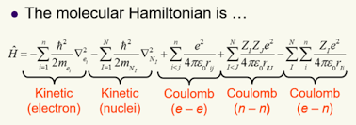
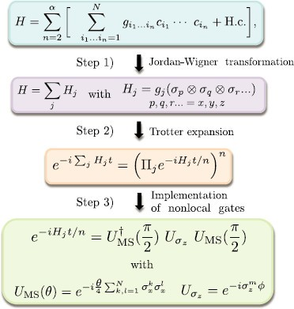
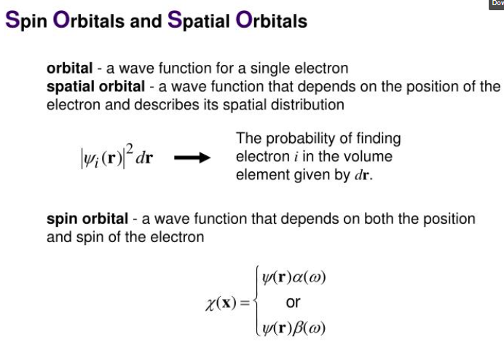
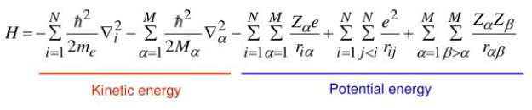
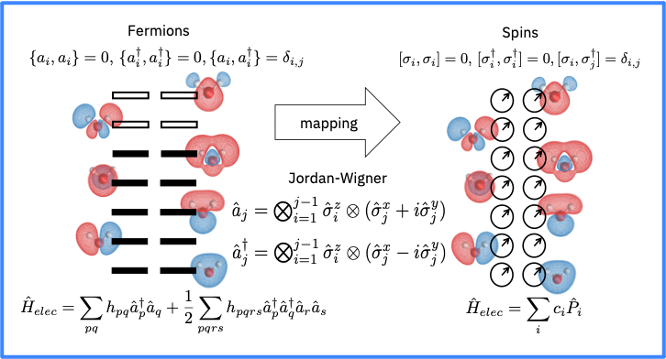
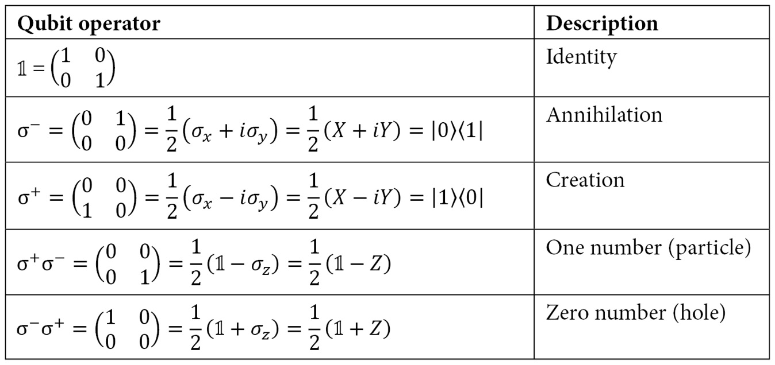
https://www.slideserve.com/heinz/hartree-fock-theory

Slide 4
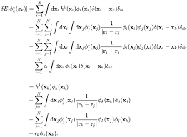
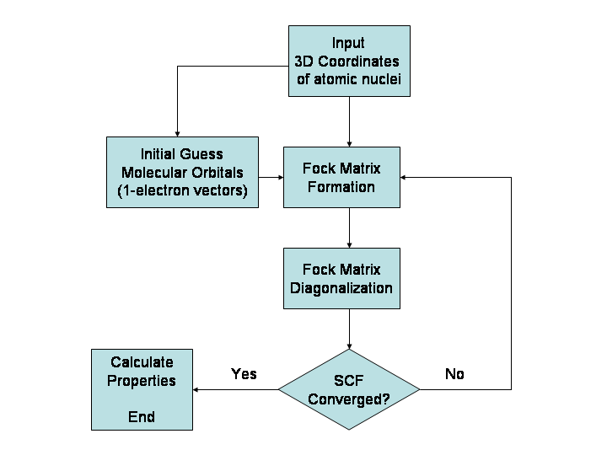
Hartree-Fock Molecular Orbital Approximation

Slide 5
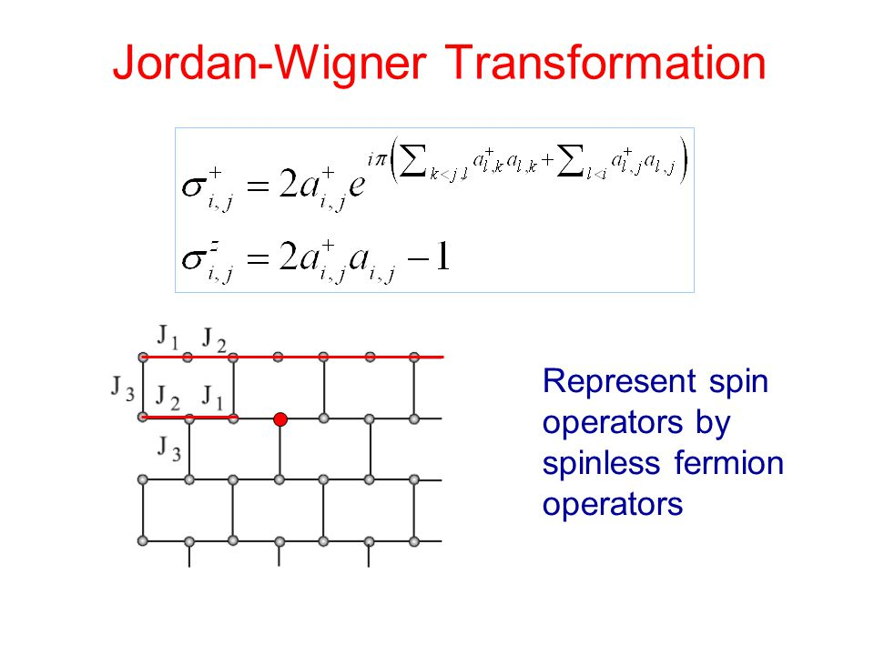
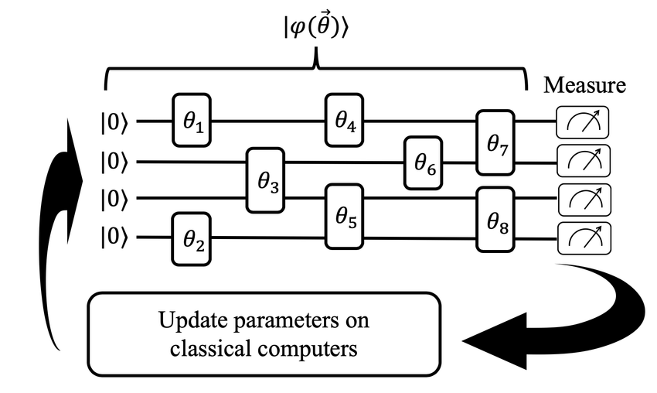
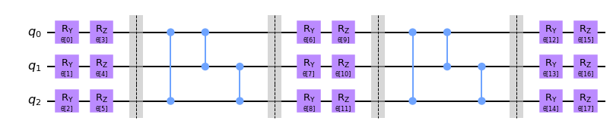
TwoLocal ansatz w/ full parameter entanglement

Slide 6
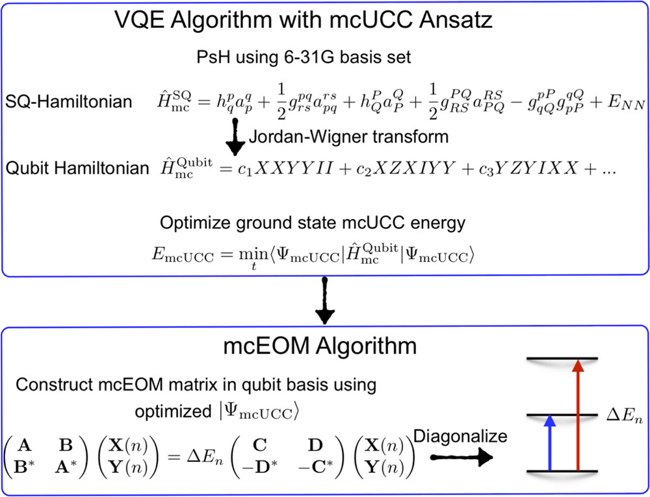
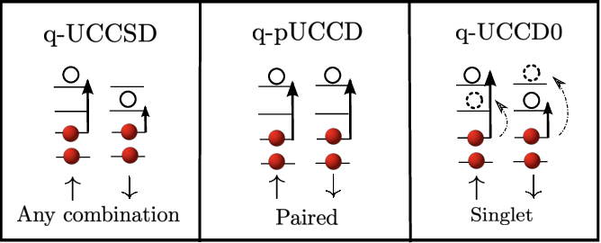

Slide 7
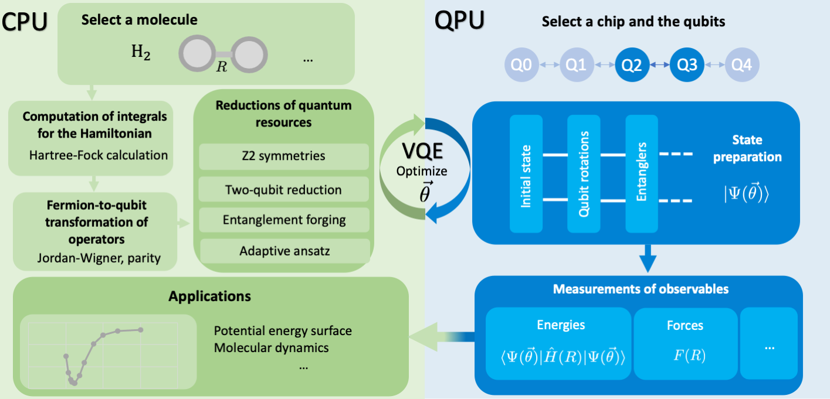

Slide 8
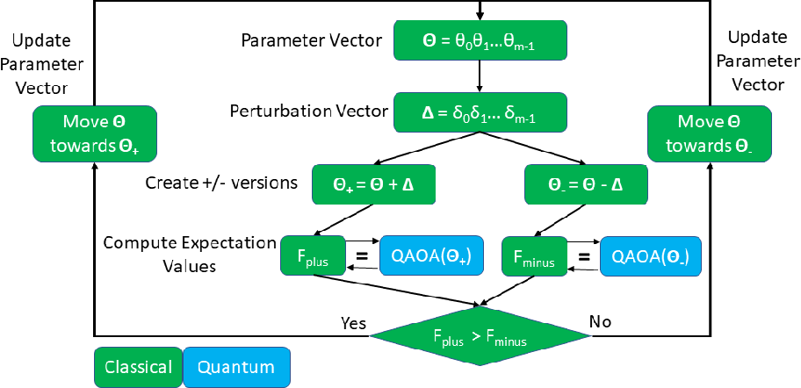
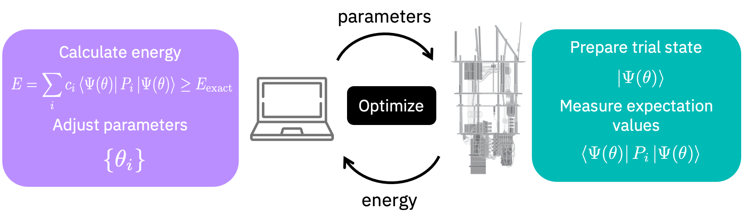
SPSA
GroundStateEigneSolver

Slide 9
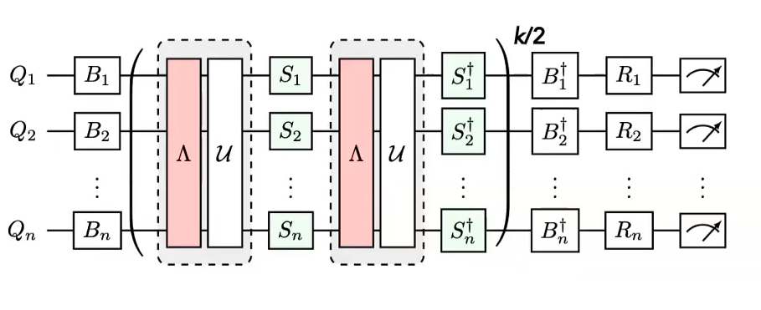
Quantum noise mitigation

Slide 10
Gas molecule physical properties
3D structure
xyz-coordinates
Spin multiplicity
Charge
Low energy potentials
Hydrogen
Oxygen
Nitrogen
Carbon dioxide
Water
Methane
Nitrous oxide
Nitrogen dioxide
https://cccbdb.nist.gov/expgeom2x.asp

Slide 11
Metal atom physical properties inside MOFs
3D structure
xyz-coordinates
Spin multiplicity
Charge
Low energy potentials
Hydrogen
Oxygen
Nitrogen
Carbon dioxide
Water
Methane
Nitrous oxide
Nitrogen dioxide
https://cccbdb.nist.gov/expgeom2x.asp

Slide 12
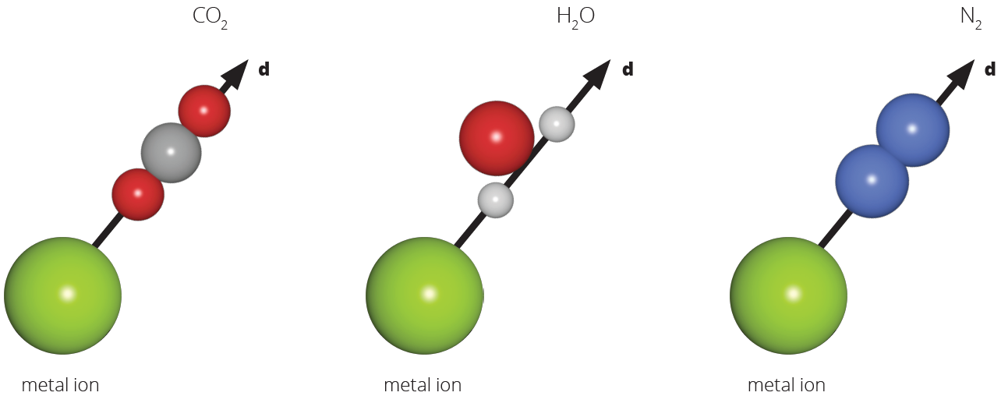
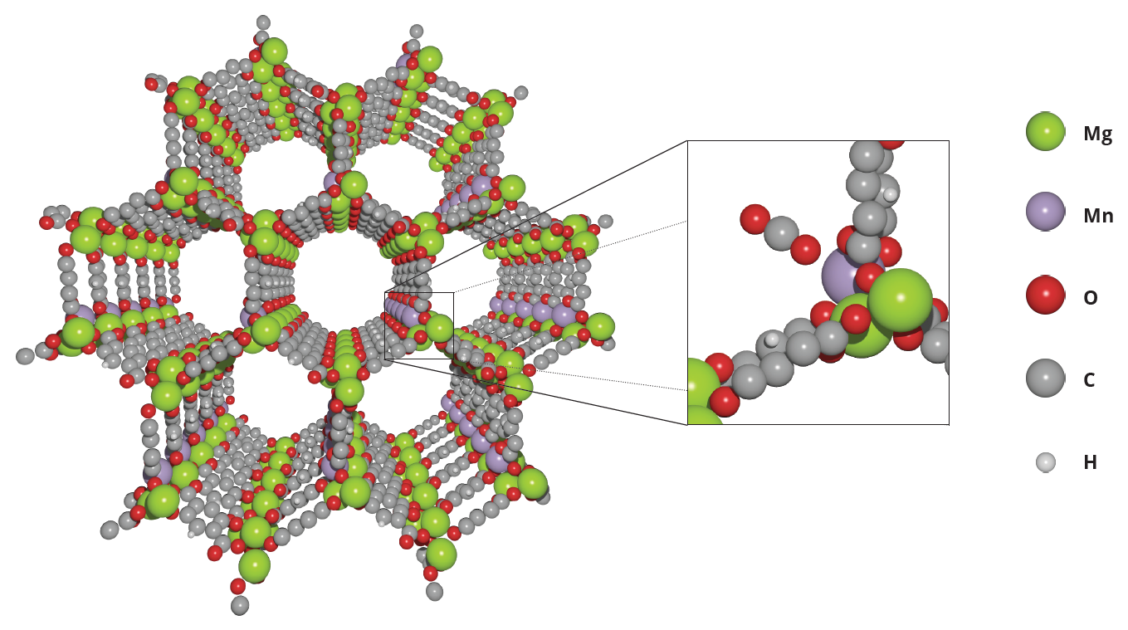

Slide 13
xyz coordinates
V
Molecule Info
V
Run PySCFDriver
V
FreezeCore/ActiveSpace Transformer w/ JW Mapper
V
Qubit Converter w/ 2bit & z2 reduction
V
Solvers/Optimizer selection:
NumPyEigenSolver
VQE w/ TwoLocal
QNSPSA
V
Solving method:
GroundStateEigenSolver
QuantumPhaseEstimation
Fermionic Hamiltonian
Qubit_operator
Qubit_converter
Ground_State Object
Num_particles
Num_spin_orbitals
min
BOPES
Pertubation Steps
Step no. ⬄
Energy level (PES)
Min energy:
Molecular energy
Phase 1: Binding energy pipeline
Phase 2: Optuna for multiple criteria optimisations
Phase 3: Add Quantum Noise
2 molecular energy of
Gas molecule & MOF
Calculate Binding Energy

