Slide 1

Mindreading & Joint Action
Mindreading & Joint Action
1. Introduction
butterfillS@ceu.hu
butterfillS@ceu.hu
Notes:
Mindreading is ...
A joint action is an event with two or more agents. Paradigm examples include painting a house together, pushing levers in sequence together to make a dog puppet sing, and tapping our fingers together.
In this course I want us to attempt three tasks ... The first task is DECOMPOSITION

Slide 2
first challenge
Notes:
we need ways of decomposing mindreading in something like the way that actual reading can be decomposed into orthographic, lexical, syntactic, semantic and pragmatic components.

Slide 3
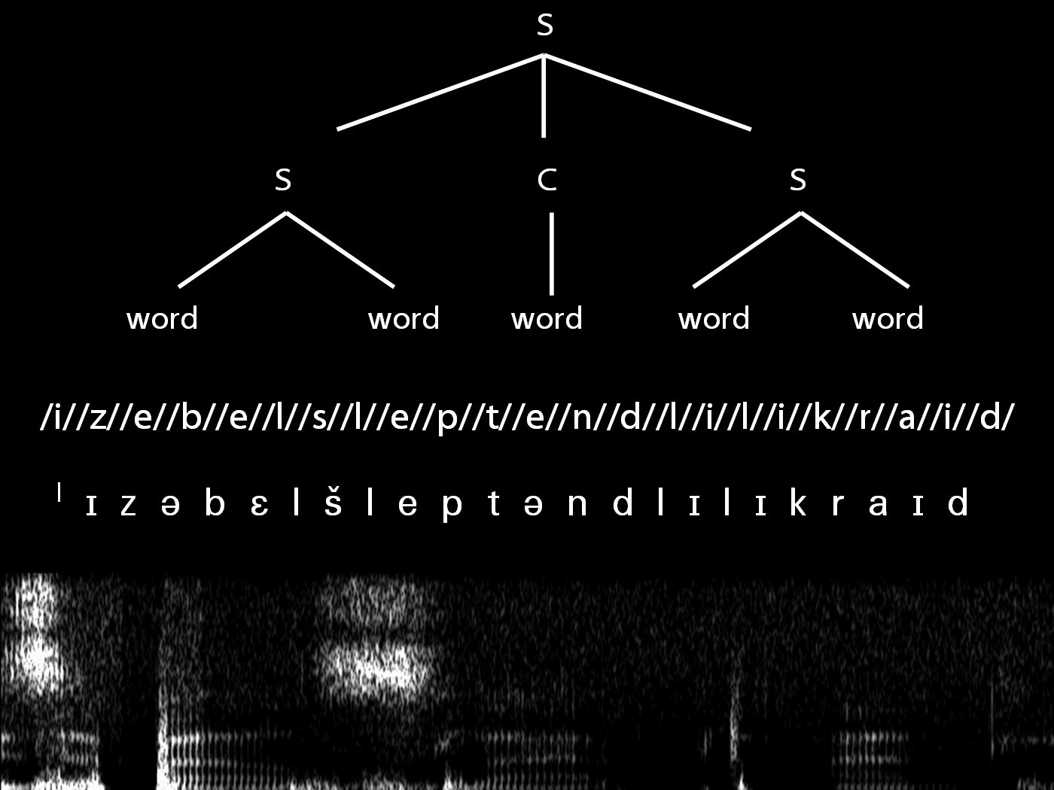
Notes:
First Task: we need ways of decomposing mindreading in something like the way that actual reading can be decomposed into orthographic, lexical, syntactic, semantic and pragmatic components.

Slide 4
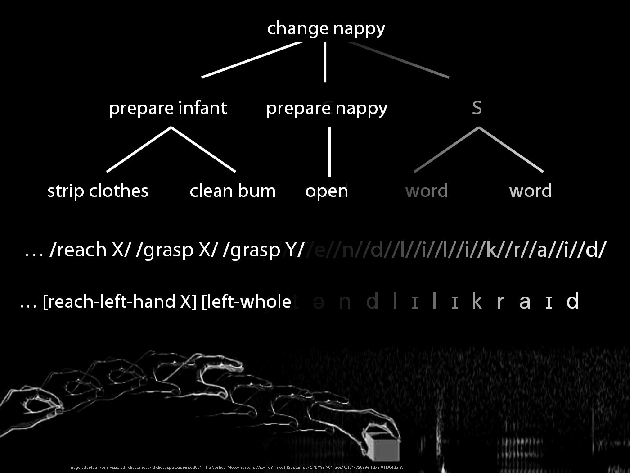

Slide 5
second challenge
Notes:
Second Task: we need theoretically coherent and empirically motivated ways of distinguishing kinds of mindreading

Slide 6
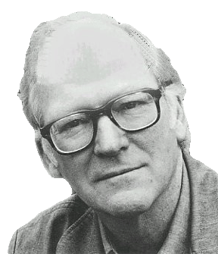
“We are stuck with our two main ways of describing and explaining things, one which treats objects and events as mindless, and the other which treats objects and events as having propositional attitudes. I see no way of bridging the gap”
(Davidson 2003: 697)

Slide 7
“We are stuck with our two main ways of describing and explaining things, one which treats objects and events as mindless, and the other which treats objects and events as having propositional attitudes. I see no way of bridging the gap”
(Davidson 2003: 697)

Slide 8

third challenge
third challenge
Notes:
Third Task: We need ways of understanding how joint action might involve more than the coordinated and cooperative behaviours exhibited by some insects, while also not requiring sophisticated forms of mindreading at close to the limits of what human adults are capable of ....

Slide 9


“perception, action, and cognition are grounded in social interaction”
(Sebanz & Knoblich 2008)
Notes:
I don’t fully understand this, but if this is right, .... [*as before but ground instead of drive]

Slide 10


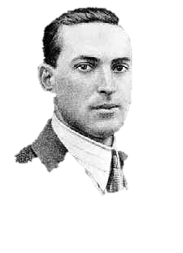
“the unique aspects of human cognition ... were driven by, or even constituted by, social co-operation”
(Moll & Tomasello 2007)
“perception, action, and cognition are grounded in social interaction”
(Sebanz & Knoblich 2008)
Notes:
I don’t fully understand this, but if this is right, .... [*as before but ground instead of drive]

Slide 11
fourth challenge
Notes:
integrating joint action

Slide 12
philosophical tools
Notes:
We want some philosophical tools to help us with these tasks.
Where to look?
A variety of new and established philosophical ideas that might usefully inform experimental research on mindreading or on joint action (or both) but have so far been neglected or misunderstood by cognitive scientists.
I want to start on our three tasks by going right back and asking what actions are and what mental states are ...

Slide 13
What Are Mental States?
Tracking, Measuring and Representing Beliefs
What is Core Knowledge (or Modularity)?
Radical Interpretation
Actions, Intentions and Goals
Goal Ascription: the Teleological Stance and Motor Awareness
What Is Joint Action?
Shared Intention and Motor Representation in Joint Action
Notes:
... which I’ll do in the first lecture next week.

Slide 14
What Are Mental States?
Tracking, Measuring and Representing Beliefs
What is Core Knowledge (or Modularity)?
Radical Interpretation
Actions, Intentions and Goals
Goal Ascription: the Teleological Stance and Motor Awareness
What Is Joint Action?
Shared Intention and Motor Representation in Joint Action
Notes:
... which I’ll do in the first lecture next week.

Slide 15
What Are Mental States?
Tracking, Measuring and Representing Beliefs
What is Core Knowledge (or Modularity)?
Radical Interpretation
Actions, Intentions and Goals
Goal Ascription: the Teleological Stance and Motor Awareness
What Is Joint Action?
Shared Intention and Motor Representation in Joint Action
Notes:
The idea that mindreading might be a modular process needs more careful examination than it has been given

Slide 16
What Are Mental States?
Tracking, Measuring and Representing Beliefs
What is Core Knowledge (or Modularity)?
Radical Interpretation
Actions, Intentions and Goals
Goal Ascription: the Teleological Stance and Motor Awareness
What Is Joint Action?
Shared Intention and Motor Representation in Joint Action
Notes:
There’s some high-quality philosophical literature on action and intention that is worth exploring. Not all actions involve intentions.

Slide 17
What Are Mental States?
Tracking, Measuring and Representing Beliefs
What is Core Knowledge (or Modularity)?
Radical Interpretation
Actions, Intentions and Goals
Goal Ascription: the Teleological Stance and Motor Awareness
What Is Joint Action?
Shared Intention and Motor Representation in Joint Action
Notes:
Finally time to turn our attention properly onto joint action ...

Slide 18
October 10:
Sugden, R. (2000). Team preferences.
October 24:
Matthews, R. J. (1994). The measure of mind
October 31:
Davidson, D. ([1984] 1973). Radical interpretation.
November 14:
Bratman, M. (1984). Two faces of intention.
Notes:
Finally time to turn our attention properly onto joint action ...

Slide 19
not adequately understanding
Notes:
I don’t intend to paint a big picture ... the idea is rather to provide some philosophical tools that might useful across a range of scientific research ... You don’t have to by a story to follow these lectures ... but I do start from the premise that we do not adequately understand what mindreading and joint action are.

Slide 20
not adequately understanding
Notes:
let me explain adequately ...

Slide 21
Objectivity
Could there be mindreaders who are able to identify differences in belief despite not understanding what it is for a belief to be true or false?
Self-awareness
Does being a mindreader entail being able, sometimes, to identify one's own mental states and actions?
Evidential basis
What evidence could in principle support the ascription of a particular belief to a given subject, and how does the evidence support the ascription?
Holism
Could there be mindreaders who can identify intentions and knowledge states but not beliefs?
Notes:
let me explain adequately ...

Slide 22
a puzzle
Notes:
This is harder ... we can define it so ... but if we go one step deeper and ask what mental states are, or what actions are, we quickly find ourselves in trouble ... Let’s look at what mental states are ... content / attitude (see lecture notes)

Slide 23
Infants’ false-belief tracking abilities
(Southgate et al 2007)
Notes:
this was last week (we considered these experiments in detail)

Slide 24
Infants’ false-belief tracking abilities
Violation of expectations - with change of location - with deceptive contents
- observing verbal comm^{n}
Anticipating action - looking
- pointing
(Onishi & Baillargeon 2005) (He et al 2011) (Song et al 2008; Scott et al 2012)
(Southgate et al 2007)
(Clements et al 1994) (Knudsen & Liszkowski 2011)
Notes:
this was last week (we considered these experiments in detail)

Slide 25
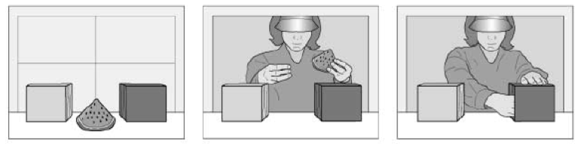
Onishi & Baillargeon (2005)
Notes:
Onishi and Baillargeon control condition

Slide 26
Yellow
Green
Onishi & Baillargeon (2005)
Notes:
Onishi and Baillargeon training sequence (simplified)

Slide 27
Yellow
Green
Onishi & Baillargeon (2005)
Notes:
Onishi and Baillargeon training sequence (simplified)

Slide 28
Yellow
Green
Onishi & Baillargeon (2005)
Notes:
Onishi and Baillargeon training sequence (simplified)

Slide 29
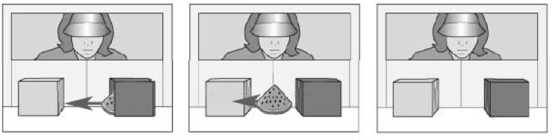
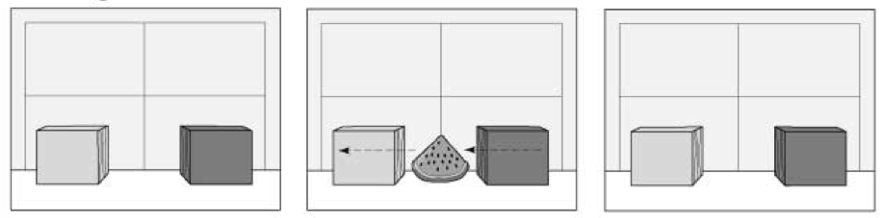
Onishi & Baillargeon (2005)
Notes:
Onishi and Baillargeon control condition (TB-yellow)

Slide 30
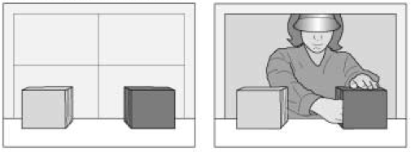
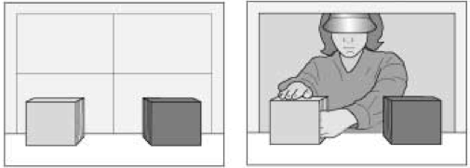
Onishi & Baillargeon (2005)
Notes:
Onishi and Baillargeon test phase

Slide 31
Onishi & Baillargeon (2005)
Notes:
Onishi and Baillargeon test phase (other reach)

Slide 32
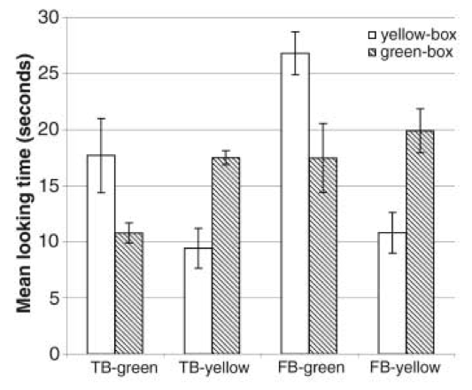
Onishi & Baillargeon (2005)
Notes:
findings: just what you’d expect if infants are following along.

Slide 33
Onishi & Baillargeon (2005)

Slide 34
Onishi & Baillargeon (2005)
Notes:
put the hand back

Slide 35
Onishi & Baillargeon (2005)
Notes:
now the FB-green condition

Slide 36
Onishi & Baillargeon (2005)
Notes:
emphasise that the expected correct box has swapped

Slide 37
Onishi & Baillargeon (2005)
Notes:
findings --- looking longer if reach in yellow than green

Slide 38
Onishi & Baillargeon (2005)
Notes:
and you can see it’s crossed compared to tb-yellow

Slide 39
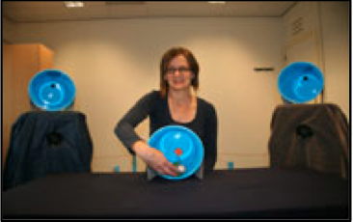
Yuck
Knudsen & Liszkowski (2011)
Notes:
Knudsen & Liszkowski (2011) --- experimenter discovers aversive object

Slide 40
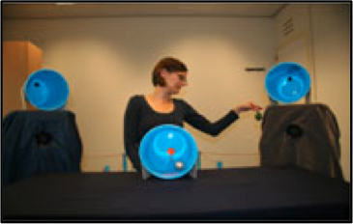
I have to clean this up
Yuck
Knudsen & Liszkowski (2011)
Notes:
Onishi and Baillargeon control condition

Slide 41
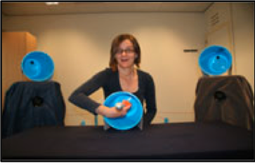
I have to clean this up
Yuck
Knudsen & Liszkowski (2011)
Notes:
plays with toy

Slide 42
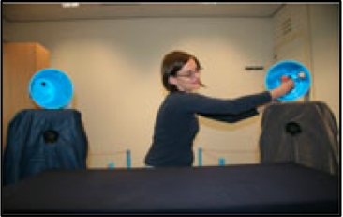
I’ll leave my toy here [target container]
I have to clean this up
Yuck
Knudsen & Liszkowski (2011)
Notes:
puts toy in container (simplified --- extra steps ensure equal attention given to both containers)

Slide 43
I’ll leave my toy here [target container]
I have to clean this up
Yuck
E1 left toy here
Knudsen & Liszkowski (2011)
Notes:
puts toy in container (simplified --- extra steps ensure equal attention given to both containers)

Slide 44
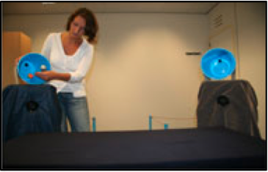
I have to clean this up
Yuck
This is E2. She is cleaning up
E1 left toy here
Knudsen & Liszkowski (2011)
Notes:
NEW EXPERIMENTER (e2) removes toy (pretext is that she’s cleaning up)

Slide 45
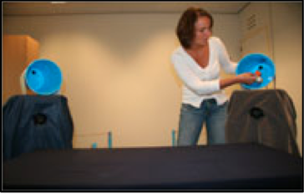
I have to clean this up
Yuck
E1 left toy here
Knudsen & Liszkowski (2011)
Notes:
puts toy in other container

Slide 46
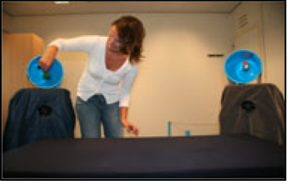
I have to clean this up
Yuck
E1 left toy here
Knudsen & Liszkowski (2011)
Notes:
puts yucky thing in distractor

Slide 47
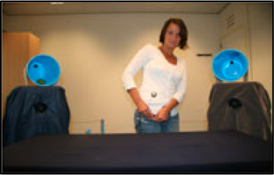
I’ll put it [the toy] in my pocket
I have to clean this up
Yuck
E1 left toy here
Knudsen & Liszkowski (2011)
Notes:
puts toy in pocket

Slide 48
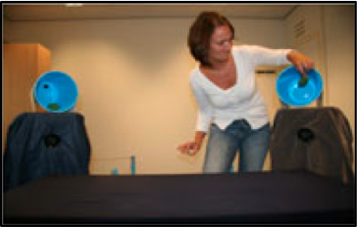
I have to clean this up
Yuck
E1 left toy here
Knudsen & Liszkowski (2011)
Notes:
puts yucky thing in other container (both contain something yucky)

Slide 49
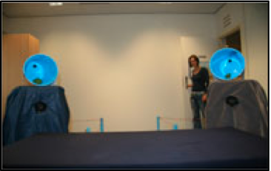
I have to clean this up
Yuck
E1 is coming back
E1 left toy here
Knudsen & Liszkowski (2011)
Notes:
test --- E1 comes back

Slide 50
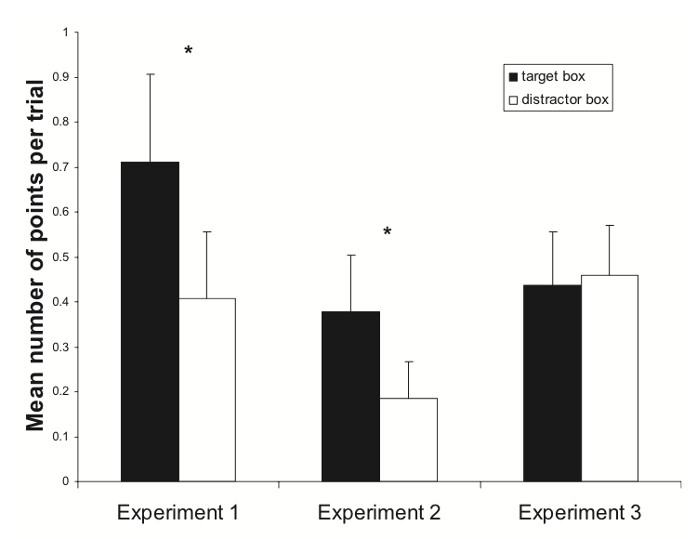
I have to clean this up
Yuck
E1 left toy here
Knudsen & Liszkowski (2011)
Notes:
results (Exp.2 is tightened version of Exp,1; Exp.3 is where e1 gives the toy to e2 (instead of leaving it in the target container) so e1 has no expectation about where her toy will be).

Slide 51
Infants’ false-belief tracking abilities
Violation of expectations - with change of location - with deceptive contents
- observing verbal comm^{n}
Anticipating action - looking
- pointing
(Onishi & Baillargeon 2005) (He et al 2011) (Song et al 2008; Scott et al 2012)
(Southgate et al 2007)
(Clements et al 1994) (Knudsen & Liszkowski 2011)
Notes:
this was last week (we considered these experiments in detail)

Slide 52
Infants’ false-belief tracking abilities
Violation of expectations - with change of location - with deceptive contents
- observing verbal comm^{n}
Anticipating action - looking
- pointing
Helping
Communicating
Altercentric interference
(Onishi & Baillargeon 2005) (He et al 2011) (Song et al 2008; Scott et al 2012)
(Southgate et al 2007)
(Clements et al 1994) (Knudsen & Liszkowski 2011)
(Buttlemann et al 2009)
(Southgate et al 2010)
(Kovacs et al 2010)
Notes:
... but there are a lot more experiments we might consider

Slide 53
Infants’ false-belief tracking abilities
Violation of expectations - with change of location - with deceptive contents
- observing verbal comm^{n}
Anticipating action - looking
- pointing
Helping
Communicating
Altercentric interference
(Onishi & Baillargeon 2005) (He et al 2011) (Song et al 2008; Scott et al 2012)
(Southgate et al 2007)
(Clements et al 1994) (Knudsen & Liszkowski 2011)
A-tasks
(Buttlemann et al 2009)
(Southgate et al 2010)
(Kovacs et al 2010)
Notes:
Call these A-tasks. Two conjectures. First, there is a single competence which these tasks measure. Second, this competence is an ability to represent belief.

Slide 54
1. There are subjects who can pass A-tasks
2. These subjects’ success on A-tasks is explained by the fact that they can represent (false) beliefs

Slide 55
3-year-olds fail false belief tasks
prediction
- action
- desire
retrodiction or explanation
select a suitable argument
own beliefs (first person)
involvement (deception)
nonverbal response
test questions word-for-word identical to desire and pretence tasks
(Wimmer & Perner 1983) (Astington & Gopnik 1991) (Wimmer & Mayringer 1998) (Bartsch & London 2000)
(Gopnik & Slaughter 1991)
(Chandler et al 1989)
(Call et al 1999; Low 2010 exp.2)
(Gopnik et al 1994; Cluster 1996)
Notes:
3-year-olds fail a wide variety of tasks where they are asked about a false belief, or asked to predict how someone with a false belief will act, or asked to predict what someone with a false belief will desire, or to retrodict a false belief after being shown how someone acts. Further, lots of factors make no difference to 3-year-olds’ performance: they fail tasks about other’s beliefs and they fail tasks about their own beliefs; they fail when they are merely observers as well as when they are actively involved; they fail when a verbal response is required and also when an nonverbal communicative response or even a noncommunicative response (such as hiding an object) is required.

Slide 56
3-year-olds fail false belief tasks
prediction
- action
- desire
retrodiction or explanation
select a suitable argument
own beliefs (first person)
involvement (deception)
nonverbal response
test questions word-for-word identical to desire and pretence tasks
(Wimmer & Perner 1983) (Astington & Gopnik 1991) (Wimmer & Mayringer 1998) (Bartsch & London 2000)
(Gopnik & Slaughter 1991)
(Chandler et al 1989)
(Call et al 1999; Low 2010 exp.2)
(Gopnik et al 1994; Cluster 1996)
Notes:
3-year-olds fail a wide variety of tasks where they are asked about a false belief, or asked to predict how someone with a false belief will act, or asked to predict what someone with a false belief will desire, or to retrodict a false belief after being shown how someone acts. Further, lots of factors make no difference to 3-year-olds’ performance: they fail tasks about other’s beliefs and they fail tasks about their own beliefs; they fail when they are merely observers as well as when they are actively involved; they fail when a verbal response is required and also when an nonverbal communicative response or even a noncommunicative response (such as hiding an object) is required.

Slide 57
3-year-olds fail false belief tasks
prediction
- action
- desire
retrodiction or explanation
select a suitable argument
own beliefs (first person)
involvement (deception)
nonverbal response
test questions word-for-word identical to desire and pretence tasks
(Wimmer & Perner 1983) (Astington & Gopnik 1991) (Wimmer & Mayringer 1998) (Bartsch & London 2000)
(Gopnik & Slaughter 1991)
(Chandler et al 1989)
(Call et al 1999; Low 2010 exp.2)
(Gopnik et al 1994; Cluster 1996)
Notes:
3-year-olds fail a wide variety of tasks where they are asked about a false belief, or asked to predict how someone with a false belief will act, or asked to predict what someone with a false belief will desire, or to retrodict a false belief after being shown how someone acts. Further, lots of factors make no difference to 3-year-olds’ performance: they fail tasks about other’s beliefs and they fail tasks about their own beliefs; they fail when they are merely observers as well as when they are actively involved; they fail when a verbal response is required and also when an nonverbal communicative response or even a noncommunicative response (such as hiding an object) is required.

Slide 58
3-year-olds fail false belief tasks
prediction
- action
- desire
retrodiction or explanation
select a suitable argument
own beliefs (first person)
involvement (deception)
nonverbal response
test questions word-for-word identical to desire and pretence tasks
(Wimmer & Perner 1983) (Astington & Gopnik 1991) (Wimmer & Mayringer 1998) (Bartsch & London 2000)
(Gopnik & Slaughter 1991)
(Chandler et al 1989)
(Call et al 1999; Low 2010 exp.2)
(Gopnik et al 1994; Cluster 1996)
Notes:
3-year-olds fail a wide variety of tasks where they are asked about a false belief, or asked to predict how someone with a false belief will act, or asked to predict what someone with a false belief will desire, or to retrodict a false belief after being shown how someone acts. Further, lots of factors make no difference to 3-year-olds’ performance: they fail tasks about other’s beliefs and they fail tasks about their own beliefs; they fail when they are merely observers as well as when they are actively involved; they fail when a verbal response is required and also when an nonverbal communicative response or even a noncommunicative response (such as hiding an object) is required.

Slide 59
3-year-olds fail false belief tasks
prediction
- action
- desire
retrodiction or explanation
select a suitable argument
own beliefs (first person)
involvement (deception)
nonverbal response
test questions word-for-word identical to desire and pretence tasks
(Wimmer & Perner 1983) (Astington & Gopnik 1991) (Wimmer & Mayringer 1998) (Bartsch & London 2000)
B-tasks
(Gopnik & Slaughter 1991)
(Chandler et al 1989)
(Call et al 1999; Low 2010 exp.2)
(Gopnik et al 1994; Cluster 1996)
Notes:
Despite all this variation and more, the B-tasks all appear to measure a single developmental transition for success on them is highly correlated (Wellman et al. 2001).
The natural explanation for subjects’ failure is that they cannot represent beliefs.

Slide 60
Children tend to pass them some time after their third birthday.
Abilities to pass these tasks has a protracted developmental course stretching over months if not years.
Success on these tasks is correlated with developments in executive function and language
Success on these tasks is facilitated by explicit training and environmental factors such as siblings
Abilities to succeed on these tasks typically emerge from extensive participation in social interactions
B-tasks
Notes:
I’m going to start from a premise which is rightly controversial: reciprocal agent-neutral motor representation enables joint action

Slide 61
1. There are subjects who can pass A-tasks but cannot pass B-tasks.
2. These subjects’ success on A-tasks is explained by the fact that they can represent (false) beliefs
3. These subjects’ failure on B-tasks is explained by the fact that they cannot represent (false) beliefs

Slide 62
1. There are subjects who can pass A-tasks but cannot pass B-tasks.
2. These subjects’ success on A-tasks is explained by the fact that they can represent (false) beliefs
3. These subjects’ failure on B-tasks is explained by the fact that they cannot represent (false) beliefs
Notes:
Putting the two claims together gives us a contradiction. which claim should we reject?

Slide 63
1. There are subjects who can pass A-tasks but cannot pass B-tasks.
2. These subjects’ success on A-tasks is explained by the fact that they can represent (false) beliefs
3. These subjects’ failure on B-tasks is explained by the fact that they cannot represent (false) beliefs
Notes:
It’s a conspiracy by scientists to confuse philosophers.

Slide 64
1. There are subjects who can pass A-tasks but cannot pass B-tasks.
2. These subjects’ success on A-tasks is explained by the fact that they can represent (false) beliefs
3. These subjects’ failure on B-tasks is explained by the fact that they cannot represent (false) beliefs
Notes:
Maybe we should reject this premise?

Slide 65
Infants’ false-belief tracking abilities
Violation of expectations - with change of location - with deceptive contents
- observing verbal comm^{n}
Anticipating action - looking
- pointing
Helping
Communicating
Altercentric interference
(Onishi & Baillargeon 2005) (He et al 2011) (Song et al 2008; Scott et al 2012)
(Southgate et al 2007)
(Clements et al 1994) (Knudsen & Liszkowski 2011)
A-tasks
(Buttlemann et al 2009)
(Southgate et al 2010)
(Kovacs et al 2010)
Notes:
variety in both measures and types of task makes hard to question on methodological grounds.
People did initially try to suggest that infants were merely representing patterns of behaviour. Given that we don’t know much about infants’ actual behaviour reading capacities, it is hard to evaluate this hypothesis. Certainly no one has shown that infants’ are able to track the sorts of patterns of behaviour they would need to track in order to solve false belief tasks.
[while some have proposed that infants might be tracking behaviour only Perner & Ruffman (2005); Ruffman & Perner (2005), this proposal faces several objections (e.g. Song et al. 2008).]

Slide 66
1. There are subjects who can pass A-tasks but cannot pass B-tasks.
2. These subjects’ success on A-tasks is explained by the fact that they can represent (false) beliefs
3. These subjects’ failure on B-tasks is explained by the fact that they cannot represent (false) beliefs
Notes:
so we’re stuck with the second premise.

Slide 67
1. There are subjects who can pass A-tasks but cannot pass B-tasks.
2. These subjects’ success on A-tasks is explained by the fact that they can represent (false) beliefs
3. These subjects’ failure on B-tasks is explained by the fact that they cannot represent (false) beliefs
Notes:
One might attempt to reject this claim on the grounds that the B-tasks impose demands which are extraneous in the sense that they are not a consequence merely of being required to represent false beliefs
(proponents of this view include
\citealp[p.\ 417]{Carpenter:2002gc},
\citealp{Bloom:2000bt}, and
\citealp{Leslie:1998nq}).

Slide 68
1. There are subjects who can pass A-tasks but cannot pass B-tasks.
2. These subjects’ success on A-tasks is explained by the fact that they can represent (false) beliefs
3. These subjects’ failure on B-tasks is explained by the fact that they cannot represent (false) beliefs
All B-tasks impose a requirement (or set of requirements) other than the requirement to represent a false belief.
Notes:
The thesis we are considering is this: All B-tasks impose a requirement (or set of requirements) other than the requirement to represent a false belief. Children fail B-tasks not because they cannot represent beliefs but because they fail to meet the extraneous requirement.
But what could the extraneous requirement be?

Slide 69
3-year-olds fail false belief tasks
prediction
- action
- desire
retrodiction or explanation
select a suitable argument
own beliefs (first person)
involvement (deception)
nonverbal response
test questions word-for-word identical to desire and pretence tasks
(Wimmer & Perner 1983) (Astington & Gopnik 1991) (Wimmer & Mayringer 1998) (Bartsch & London 2000)
(Gopnik & Slaughter 1991)
B-tasks
(Chandler et al 1989)
(Call et al 1999; Low 2010 exp.2)
(Gopnik et al 1994; Cluster 1996)
Notes:
First note that the proposal is harder to defend than sometimes assumed. For instance, philosophers sometimes mistakenly assume that all B-tasks involve language or communication, whereas A-tasks do not. But some A-tasks involve language and communication (Knudsen & Liszkowski 2012; Song et al. 2008) and there are non-verbal B-tasks (Call & Tomasello 1999; Low 2010 Study 2).
There is a more general problem facing attempts to identify the Extraneous Requirement. there is much variation among the B-tasks. It is not just that some are verbal whereas others are nonverbal. It is also that some involve prediction whereas others involve retrodiction or justification (e.g. Wimmer & Mayringer 1998), some concern the first-person perspective, whereas others involve a second- or third-person perspective (e.g. Gopnik & Slaughter 1991), some involve interaction whereas in others the subject is a mere observer (e.g. Chandler et al. 1989), and some involve prediction actions whereas others involve predicting desires (Astington & Gopnik 1991) or selecting an argument appropriate for someone with a false belief (Bartsch & London 2000). Despite all this variation and more, the B-tasks all appear to measure a single developmental transition (Wellman et al. 2001).

Slide 70
3-year-olds fail false belief tasks
prediction
- action
- desire
retrodiction or explanation
select a suitable argument
own beliefs (first person)
involvement (deception)
nonverbal response
test questions word-for-word identical to desire and pretence tasks
(Wimmer & Perner 1983) (Astington & Gopnik 1991) (Wimmer & Mayringer 1998) (Bartsch & London 2000)
(Gopnik & Slaughter 1991)
B-tasks
(Chandler et al 1989)
(Call et al 1999; Low 2010 exp.2)
(Gopnik et al 1994; Cluster 1996)
Notes:
Further, children who fail B-tasks can answer questions about perception or pretence that are word-for-word identical with the questions about false belief that they cannot answer correctly (Gopnik et al. 1994; see also Cluster 1996). So the Extraneous Requirement cannot be straightforwardly linked to language or communication.

Slide 71
3-year-olds fail false belief tasks
prediction
- action
- desire
retrodiction or explanation
select a suitable argument
own beliefs (first person)
involvement (deception)
nonverbal response
test questions word-for-word identical to desire and pretence tasks
(Wimmer & Perner 1983) (Astington & Gopnik 1991) (Wimmer & Mayringer 1998) (Bartsch & London 2000)
(Gopnik & Slaughter 1991)
B-tasks
(Chandler et al 1989)
(Call et al 1999; Low 2010 exp.2)
(Gopnik et al 1994; Cluster 1996)
Notes:
But there is a family of candidates for the Extraneous Requirement.
For a wide range of research has shown that success on B-tasks depends on executive function, working memory and attention. This is true in two senses: first, developmentally, success on B-tasks comes with the acquisition of EF, working memory and so on. Second, even in adults success on B-tasks appears to consume these resources.
So have we found the Extraneous Requirement? No, I don’t think It is a mistake to assume that representing false belief---or, indeed, representing any propositional attitude---does not intrinsically demand cognitive resources such as inhibitory control.
On any standard view, propositional attitudes such as beliefs form complex causal structures, have arbitrarily nest-able contents, interact with each other in uncodifiably complex ways and are individuated by their causal and normative roles in explaining thoughts and actions \citep[]{en_809, en_249}.
If there is anything representing which should consume scarce cognitive resources it is surely states with this combination of properties.
So there are sound theoretical reasons to suppose that representing false beliefs could intrinsically require inhibitory control and working memory \citep[see also][]{Russell:1999vr}.
This means: it *might* be that B-tasks impose an extraneous requirement. But the mere fact that success depends on inhibitory control, attention and working memory does not imply that these B-tasks impose extraneous requirements.

Slide 72
1. There are subjects who can pass A-tasks but cannot pass B-tasks.
2. These subjects’ success on A-tasks is explained by the fact that they can represent (false) beliefs
3. These subjects’ failure on B-tasks is explained by the fact that they cannot represent (false) beliefs
All B-tasks impose a requirement (or set of requirements) other than the requirement to represent a false belief.
Notes:
What I’ve argued so far is that we cannot straightforwardly reject any single premise of this argument.
So we should look for non-straightforward ways to resolve the problem

Slide 73
1. There are subjects who can pass A-tasks but cannot pass B-tasks.
2. These subjects’ success on A-tasks is explained by the fact that they can represent (false) beliefs
3. These subjects’ failure on B-tasks is explained by the fact that they cannot represent (false) beliefs
Notes:
What could a non-straightforward resolution involve? First note that we get this kind of pattern in a variety of areas including physical cognition.

Slide 74
not adequately understanding
Notes:
In conclusion: the message for today is that we don’t adqeuately understand what mindreading and joint action are ... the way start to remedy that is to go right back and think about what actions are and what mental states are, and that’s what we’ll do next week ... if you decide to take the course of course.

Slide 75
Notes:
Mindreading is ...
A joint action is an event with two or more agents. Paradigm examples include painting a house together, pushing levers in sequence together to make a dog puppet sing, and tapping our fingers together.
In this course I want us to attempt three tasks ... The first task is DECOMPOSITION

Slide 76
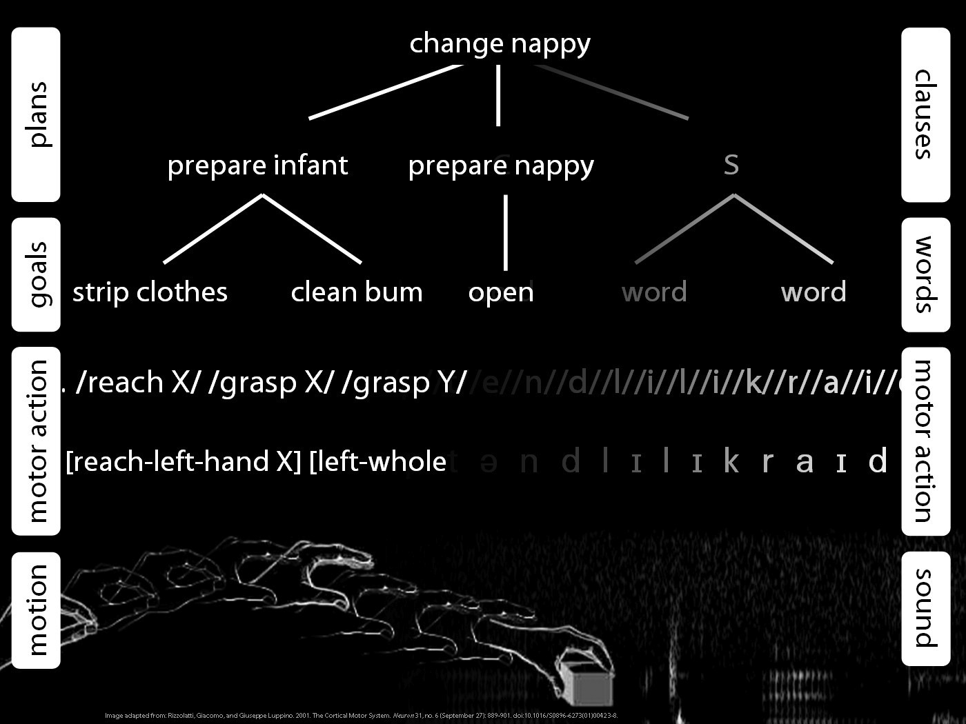

Slide 77
not adequately understanding
Notes:
don’t understand joint action ... obvious from variety of accounts (one per philosopher)

Slide 78
‘joint action [is] any form of social interaction whereby two or more individuals coordinate their actions in space and time to bring about a change in the environment.’
(Sebanz, Bekkering & Knoblich 2006: 70)

Slide 79
‘joint action [is] any form of social interaction whereby two or more individuals coordinate their actions in space and time to bring about a change in the environment.’
(Sebanz, Bekkering & Knoblich 2006: 70)

Slide 80
‘joint action [is] any form of social interaction whereby two or more individuals coordinate their actions in space and time to bring about a change in the environment.’
(Sebanz, Bekkering & Knoblich 2006: 70)

Slide 81
‘joint action [is] any form of social interaction whereby two or more individuals coordinate their actions in space and time to bring about a change in the environment.’
(Sebanz, Bekkering & Knoblich 2006: 70)

Slide 82
‘joint action [is] any form of social interaction whereby two or more individuals coordinate their actions in space and time to bring about a change in the environment.’
(Sebanz, Bekkering & Knoblich 2006: 70)

