Slide 1
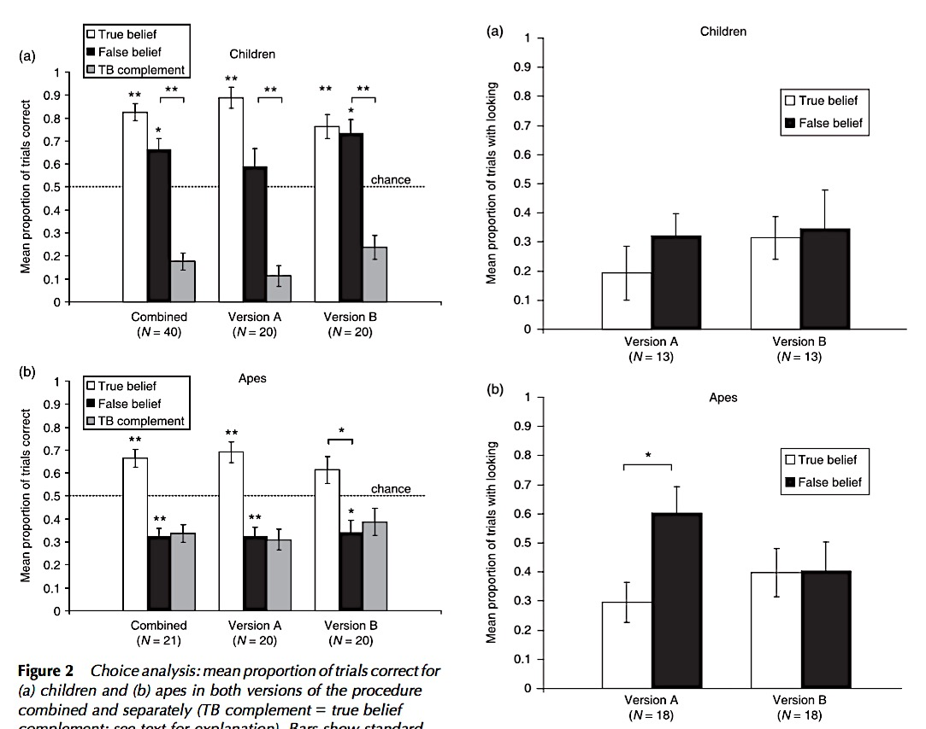
Krachun, Carpenter, Call & Tomasello, 2009
Notes:
FIRST POINT: Earlier research is consistent with the new findings.
“Looking. Our second measure was whether participants looked at least once at the container the competitor was not reaching for during the couple of seconds it took E to slide the platform towards them.”
“Note that proportions are based only on trials in which participants chose the same container as the competitor [ie: incorrect trials], and for apes in version A the measure was face rather than eye orientation. Bars show standard error.
* p < .05.”

Slide 2
Krachun, Carpenter, Call & Tomasello, 2009
Notes:
Contrast performance on a competitive object choice task. Ropey looking time measure, but nice to have looking time and action measures for a single scenario.

Slide 3
‘the present evidence may constitute an implicit understanding of belief’
^{Krupenye et al, 2016:113}
Krachun, Carpenter, Call & Tomasello, 2009
Notes:
Implicit understanding of belief?

Slide 4
‘the present evidence may constitute an implicit understanding of belief’
^{Krupenye et al, 2016:113}
Krachun, Carpenter, Call & Tomasello, 2009
Notes:
Implicit understanding. Will we find evidence of a systematic dissociation between performance on different measures of false belief understanding like that found with in humans?

Slide 5
‘the present evidence may constitute an implicit understanding of belief’
^{Krupenye et al, 2016:113}
‘to date, adult primates’ failures on search tasks appear to exactly mirror the cases in which human toddlers perform poorly.’
^{Santos & Hood, 2009 p. 17}
Krachun, Carpenter, Call & Tomasello, 2009
Notes:
Implicit understanding. Will we find evidence of a systematic dissociation between performance on different measures of false belief understanding like that found with in humans?

Slide 6
Krachun, Carpenter, Call & Tomasello, 2009
Notes:
Looking at the data with children, there’s no evidence of success on looking times. But this may be because in measuring looking time they consider only trials on which subjects fail. Or it may be that the looking measure is not very sensitive (“Looking. Our second measure was whether participants looked at least once at the container the competitor was not reaching for during the couple of seconds it took E to slide the platform towards them.”)

