Slide 1
Intentional coordination (e.g. planning to cook dinner)
You intend that we cook dinner.
I intend that we cook dinner.
You intend that we cook dinner by way of our intentions that we cook dinner and meshing subplans of these intentions.
I also intend this.
And this is all common knowledge between us.
Emergent coordination (e.g. entrainment)
We happen to be sitting side-by-side in rocking chairs.
After some time our movements become entrained.
That is, our rhythmic behaviours become synchronised with respect to phase.
Notes:
Two kinds of coordination.
Where does task co-representation fit in?

Slide 2
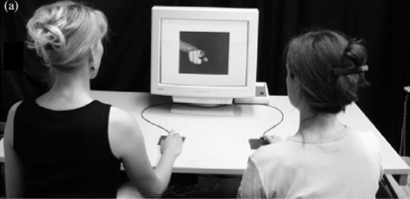
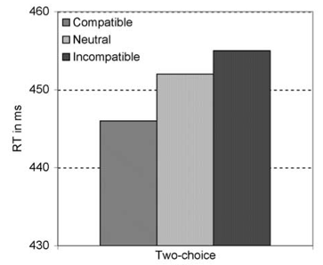
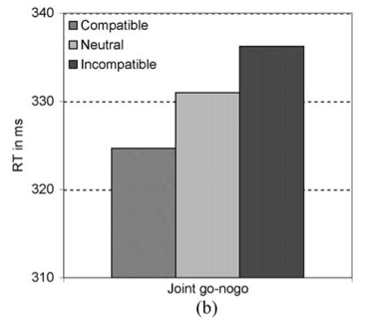
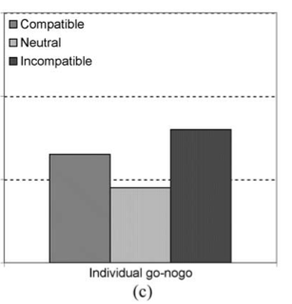
source: Sebanz et al (2003)
Notes:
task co-representation : paradigm case is joint simon task : individuals represent not only their own task but also the other’s task, or at least that part of the task is to be performed by another (actor co-representation; difference between task- and actor-co-representation doesn’t matter here).

Slide 3
If a green ring appears, press the right button
action plan
[no action]
my task is to press the right button
If a red ring appears, press the left button
left button press
action plan
task representations
action initiation
inhibition by knowledge
action

Slide 4
If a green ring appears, press the right button
action plan
[no action]
role of Agent2
my task is to press the right button
If a red ring appears, press the left button
left button press
action plan
role of Agent1
task representations
action initiation
inhibition by knowledge
action

Slide 5
If a green ring appears, press the right button
action plan
[no action]
role of Agent2
my task is to press the right button
If a red ring appears, press the left button
left button press
action plan
role of Agent1
task representations
action initiation
inhibition by knowledge
action

Slide 6
If a green ring appears, press the right button
action plan
[no action]
role of Agent2
my task is to press the right button
If a red ring appears, press the left button
left button press
action plan
role of Agent1
task representations
action initiation
inhibition by knowledge
action

Slide 7
If a green ring appears, press the right button
action plan
[no action]
role of Agent2
my task is to press the right button
If a red ring appears, press the left button
left button press
action plan
role of Agent1
task representations
action initiation
inhibition by knowledge
action
Notes:
the reason there is a spatial compatibity effect: you have to decide whether or not to respond

Slide 8
If a green ring appears, press the right button
[no action plan]
[no action]
role of Agent2
this is not my task
If a red ring appears, press the left button
left button press
action plan
role of Agent1
task representations
action initiation
inhibition by knowledge
action
Notes:
the reason there is a spatial compatibility effect: you have to decide whether or not to respond

Slide 9
Intentional coordination (e.g. planning to cook dinner)
You intend that we cook dinner.
I intend that we cook dinner.
You intend that we cook dinner by way of our intentions that we cook dinner and meshing subplans of these intentions.
I also intend this.
And this is all common knowledge between us.
Emergent coordination (e.g. entrainment)
We happen to be sitting side-by-side in rocking chairs.
After some time our movements become entrained.
That is, our rhythmic behaviours become synchronised with respect to phase.
Notes:
Two kinds of coordination.
Where does task co-representation fit in?
Is it a third kind of coordination, something different from both intentional and emergent coordination? How does it differ? How can we show that it differs?
In emergent coordination, coordination does not involve representation at all. Task co-representation differs: it involves a representation of each agent’s task.
But co-representational coordination also contrasts with intentional coordination to the extent that task representations drive coordination independently of any intentions or reasoning about coordination. Task representations may drive coordination by modulating motor cognition or perceptual processes, for instance; in such cases agents need not be aware that they are coordinating their actions. Put roughly, the contrast between intentional and co-representational coordination is the contrast between reflecting on how to coordinate two parts in an action and mentally performing both parts oneself.

Slide 10
Notes:
Two kinds of coordination.
Where does task co-representation fit in?

Slide 11
***BIN Expectation
Task: When a letter appears on the screen, press the Left Key if it is an A and the Right Key if it is a B.
Suppose subjects have been performing the task and seen this sequence:
A B B A B A B A B B B A B A A A A A A A A A
Question: what do subjects expect next?
As measured by response time: an A
As measured by verbal prediction: a B
***MUCH MORE COMPLEX THAN THIS!!!
Notes:
Two kinds of expectation

