Slide 1
Perineum会阴
山东大学医学院 解剖教研室
李振华

Slide 2
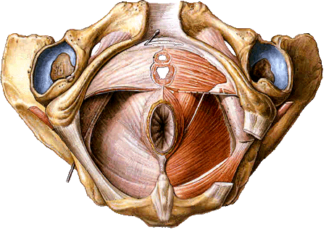
Perineum 会阴
General features
Region of below pelvic diaphragm
A diamond-shape space whose boundaries are those of the pelvic outlet
  Lower border of symphysis pubis
  Rami of pubis and ischium
  Ischial tuberosity
  Sacrotuberous ligament
  Tip of coccyx

Slide 3
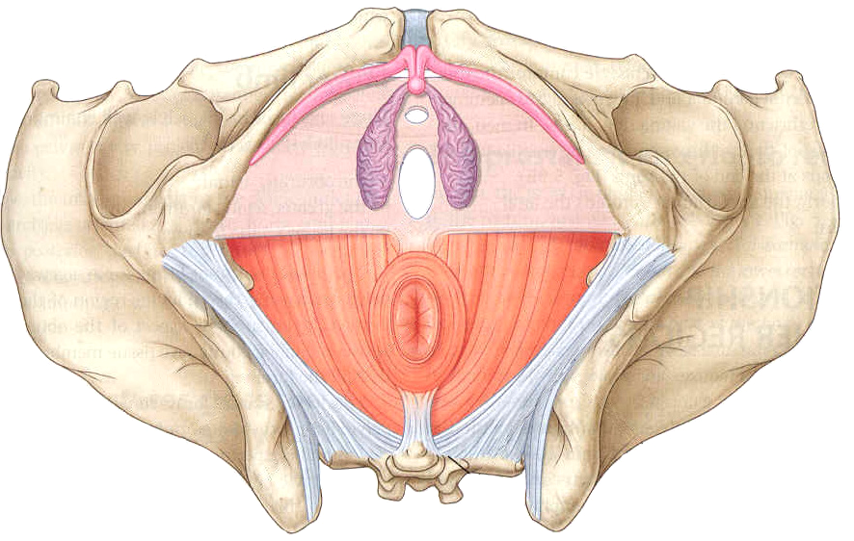
Perineum 会阴
Two triangles
The perineum is divided into anterior and posterior triangles by joining the ischial tuberosities with an imaginary line
Urogenital region 尿生殖区 (anterior)－differs in male and female
Anal region 肛区 (posterior) －similar in both sexes

Slide 4
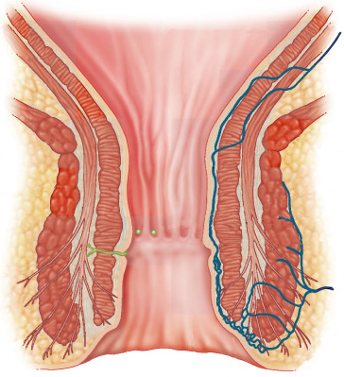
Anal region 肛区
Anal canal 肛管
Anal columns 肛柱: 6 － 11 in number
Anal valves 肛瓣
Anal sinuses 肛窦
Anorectal line 肛直肠线
Dentate line 齿状线
  Above line, of endodermal origin
  Below line, of ectodermal origin
Anal pecten 肛梳
White line 白线 (Hilton’s line)
Anus 肛门

Slide 5
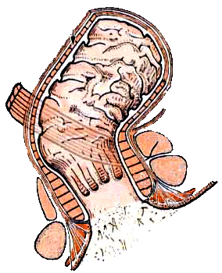
Anal region 肛区
Anal sphincters 肛门括约肌
Sphincter ani internus 肛门内括约肌
  Smooth muscle (thickened circular muscle coat)
  Surrounds upper two-thirds of anal canal
  Autonomic nerve supply
Sphincter ani externus 肛门外括约肌
  Striated muscle
  Surrounds lower two-thirds of anal canal
  Three parts－subcutaneous, superficial and deep
  Innervation by anal nerves of pudendal nerve and branches of S4

Slide 6
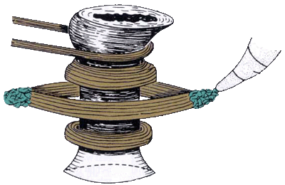
Anal region 肛区
Anorectal ring 肛直肠环
At junction of rectum and anal canal
Consists of thickened muscle
Contributing structures
  Puborectalis
  Superficial and deep parts of sphincter ani externus
  Sphincter ani internus

Slide 7
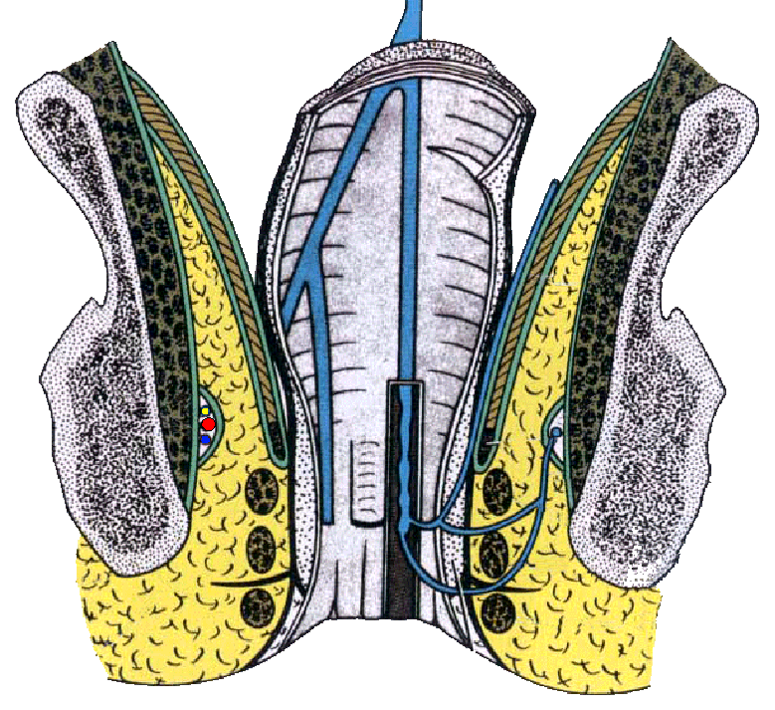
Anal region 肛区
Ischioanal fossa 坐骨肛门窝
Paired, wedge-shaped, fat-filled spaces on either side of anal canal
Boundaries
  Apex
    Conjunctive area of inferior fascia of pelvic diaphragm and fascia covering the obturator internus
  Base
    Skin of anal region
  Medially
    Sphincter ani externus, levator ani, coccygeus and inferior fascia of pelvic diaphragm
  Laterally
    Ischial tuberosity, obturator internus and fascia

Slide 8

Anal region 肛区
Ischioanal fossa 坐骨肛门窝
Boundaries
  Anteriorly
    Forward projection of anterior recess of fossa between pelvic diaphragm above and urogenital diaphragm below
  Posteriorly
    Backward projection of posterior recess of fossa between gluteus maximus, sacrotuberous ligament and coccygeus

Slide 9
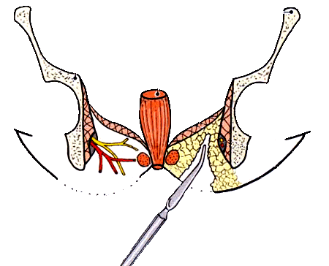
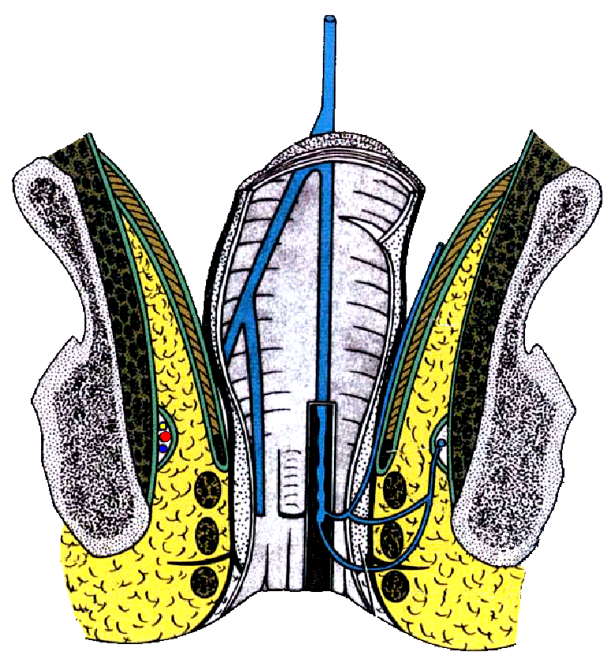
Anal region 肛区
Ischioanal fossa 坐骨肛门窝
Contents
  Fat
  Internal pudendal artery and vein and their rectal branches
  Pudendal nerve and its inferior rectal branch
  Pudental canal 阴部管 (Alcock’s) －on the lateral wall of fossa
    Pudendal n.
    Internal pudendal a. and v.

Slide 10
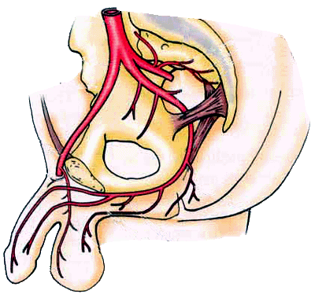
Anal region 肛区
Internal pudendal artery 阴部内动脉
Course: leaves the pelvis through the infrapiriform foramen and enters the gluteal region. It enters the perineum through the lesser sciatic foramen and then passes forward in the pudendal canal with the pudendal nerve.
Branches
  Anal artery
  Perineal artery
  Dorsal artery of penis (clitoris)

Slide 11
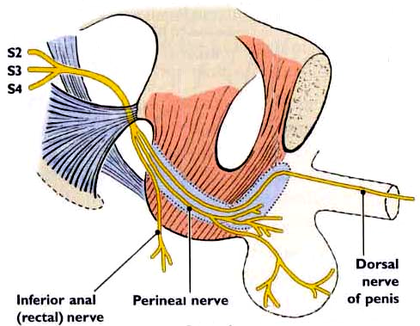
Anal region 肛区
Pudendal n. 阴部神经
leaves the pelvis through the infrapiriform foramen and enters the gluteal region.
Enters the perineum through the lesser sciatic foramen and then passes forward in the pudendal canal with the internal pudendal vessels.

Slide 12
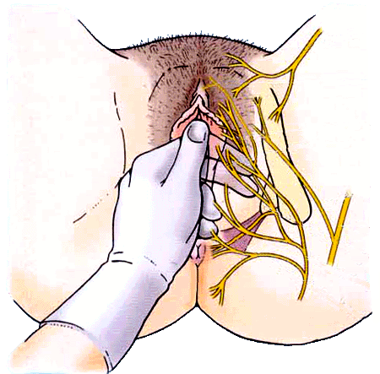
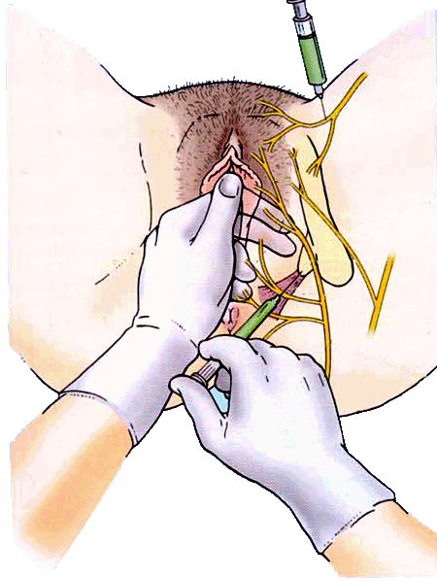
Anal region 肛区
Pudendal nerve block

Slide 13
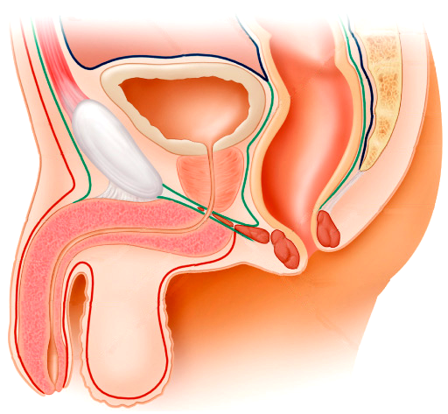
Urogenital region 尿生殖区
Superficial fascia
The fatty layer
The membranous layer － superficial fascia of perineum 会阴浅筋膜 or Colles’ fascia
  Attached posteriorly to the posterior border of the urogenital diaphragm
  Laterally to the margins of pubic arch and ischial tuberosity
  Anteriorly it is continuous with:
    Dartos of the scrotum
    Fascia of the penis
    Scarpa’s fascia

Slide 14
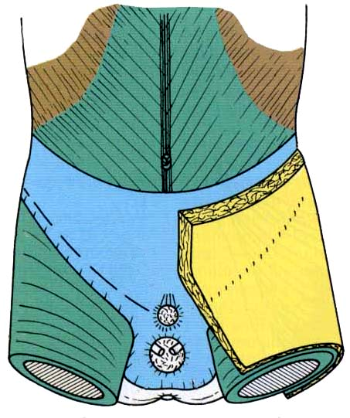
Scarpa’s fascia
Camper’s fascia
Line of fusion
Position of penis
Fascia later
superficial fascia of perineum
Position of scrotum

Slide 15
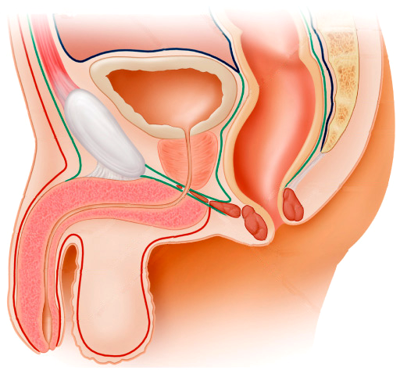
Urogenital region 尿生殖区
Deep fascia
Superior fascia of urogenital diaphragm 尿生殖隔上筋膜
Inferior fascia of urogenital diaphragm 尿生殖隔下筋膜
Attached
  posteriorly to the posterior border of the urogenital diaphragm
  Laterally to pubic arch
  In front they fuse together forming the so-called: transverse perineal ligament

Slide 16
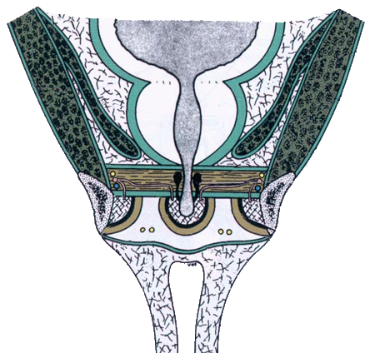
Urogenital region 尿生殖区
Two spaces
  Deep perineal space 会阴深隙
  Superficial perineal space 会阴浅隙

Slide 17
Urogenital region 尿生殖区
Superior fascia of urogenital diaphragm
Deep perineal space
Inferior fascia of urogenital diaphragm
Superficial perineal space
Scarpa’s fascia
Superficial fascia of perineum
(Colles’ fascia)
Fascia of the penis
Dartos of the scrotum
会阴深隙：上、下两层膜，中间夹着肉，四周均封闭，尿殖管穿过（如座垫）
会阴浅隙：上、下两层膜，中间东西多，三边都封闭，前上方敞着（如口袋）

Slide 18
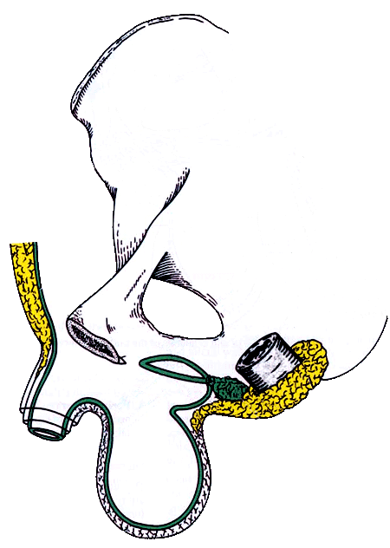
Urogenital region 尿生殖区
Superficial perineal space 会阴浅隙
Lies between inferior fascia of urogenital diaphragm and superficial fascia of perineum
It is closed behind and laterally

Slide 19
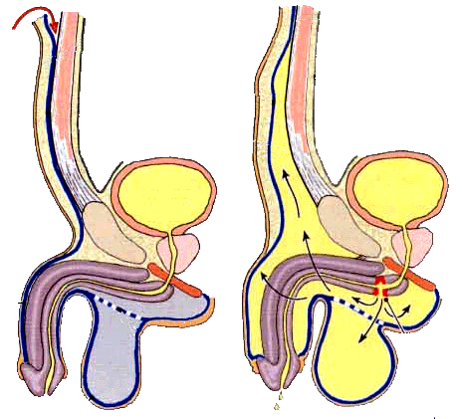
Urogenital region 尿生殖区
Superficial perineal space 会阴浅隙
Anteriorly, the space communicates with the potential space lying between the Scarpa’s fascia and the anterior abdominal muscles.
In rupture of cavernous part of urethra, urine can extravasate from scrotum upward in front of symphysis pubis into anterior abdominal wall deep to Scarpa’s fascia

Slide 20
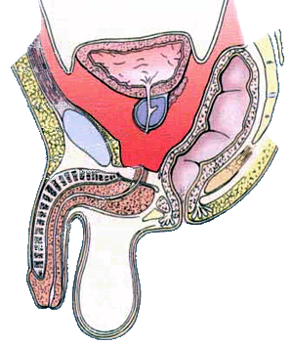
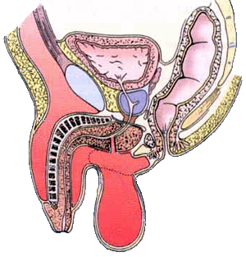
Urogenital region 尿生殖区
Superficial perineal space 会阴浅隙

Slide 21
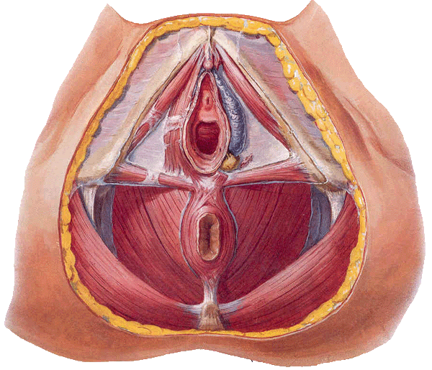
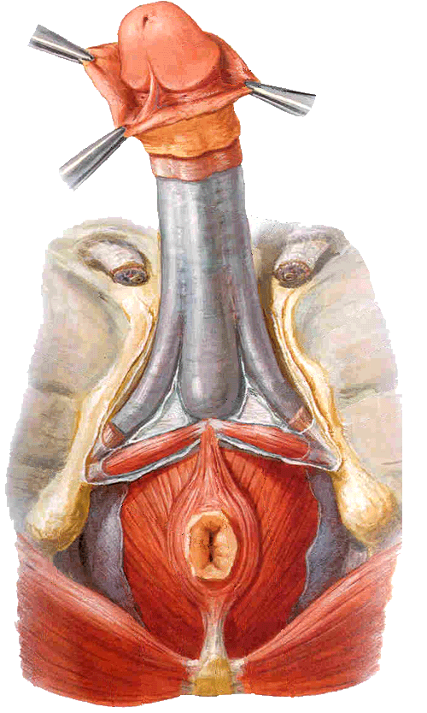
Urogenital region 尿生殖区
Superficial perineal space 会阴浅隙
Contents
  Posterior part－superficial transverse muscle of perineum
  Lateral part－crus penis (male), crus of clitoris (female) and ischiocavernousus covering them
  Central part－bulb of urethra (male), bulb of vestibule (female) and bulbocavernousus covering them
  Branches of pudendal nerves and internal pudendal vessels

Slide 22
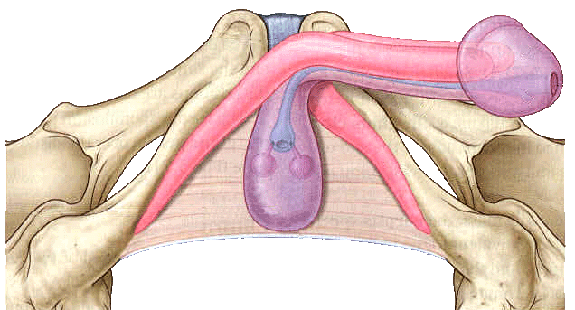
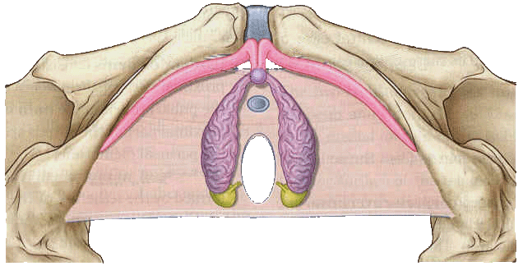
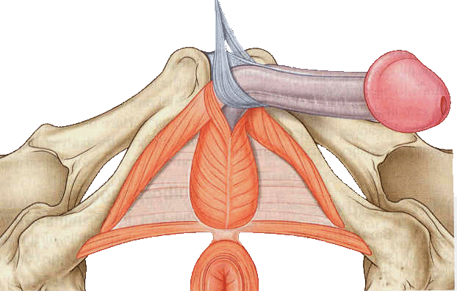
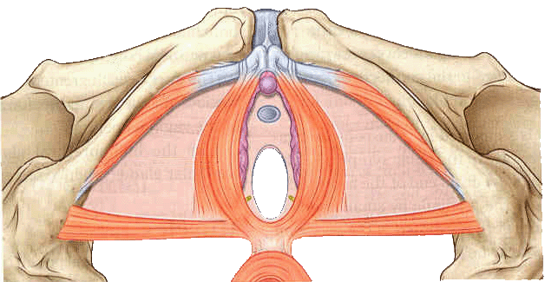
Superficial perineal space 会阴浅隙

Slide 23
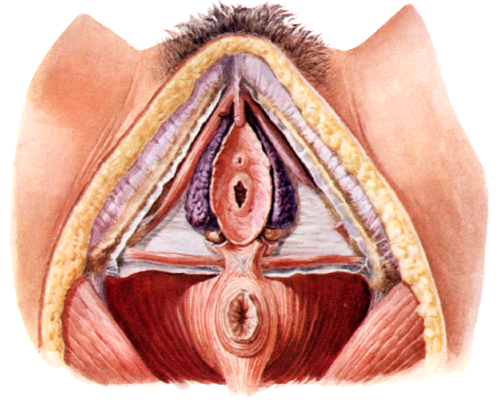
Ischiocavernousus 坐骨海绵体肌
Clitoris 阴蒂
Crus of clitoris 阴蒂脚
Bulb of vestibule 前庭球
Great vestibular gland
前庭大腺
Superficial transverse
m. of perineal 会阴浅横肌

Slide 24
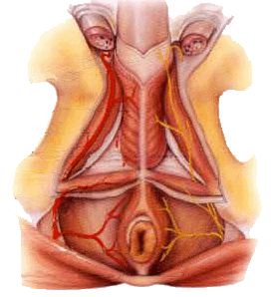

Slide 25
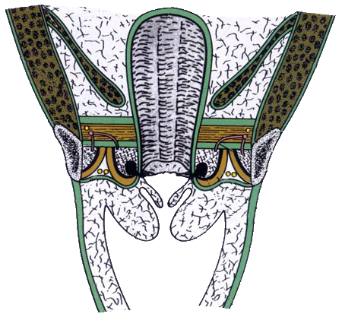
Urogenital region 尿生殖区
Superficial perineal space 会阴浅隙
Contents
  Posterior part－superficial transverse muscle of perineum
  Lateral part－crus penis (male), crus of clitoris (female) and ischiocavernousus covering them
  Central part－bulb of urethra (male), bulb of vestibule (female) and bulbocavernousus covering them
  Branches of pudendal nerves and internal pudendal vessels

Slide 26
Urogenital region 尿生殖区
Deep perineal space 会阴深隙
The closed space that is contained between superior and inferior fascia of urogenital diaphragm
Contents
  Deep transverse muscle of perineum
  Bulbourethral gland (male)
  Sphincter of urethra 尿道括约肌
  Arteries, veins and nerves

Slide 27
Urogenital region 尿生殖区
Urogenital diaphragm 尿生殖隔
Triangular in shape
Formed by sphincter of urethra, deep transverse perineal muscle, superior and inferior fascia of urogenital diaphragm

Slide 28
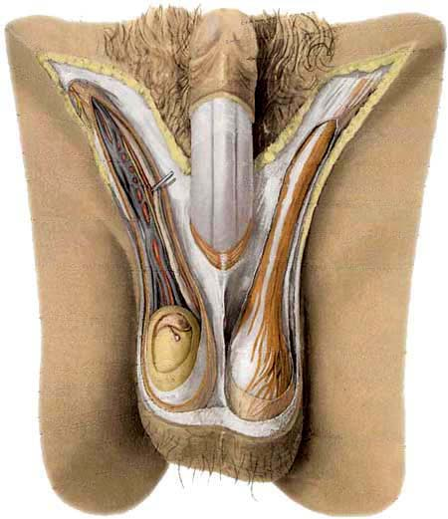
Urogenital region 尿生殖区
Scrotum 阴囊
Pouch of thin skin lying below the root of the penis
Divided into two haves by septum of scrotum, contains testes and their ducts
Walls
  Skin
  Dartos coat 肉膜
    Deep to skin
    A connective tissue layer that contains many smooth muscle fibers
    Contracts in response to cold, pulling the testes closer to the body and wrinkling the skin

Slide 29
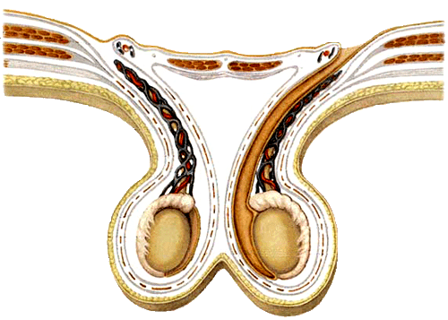
Parietal peritoneum
Transverse fascia
Trasversus abdominis
Obliquus internus
abdominis
Aponeurosis of obliquus externus abdominis
External spermatic fascia
精索外筋膜
Parietal layer
Cremaster 提睾肌
Visceral
layer
Internal spermatic fascia
精索内筋膜
Vaginal
cavity
Tunica vaginalis of testis
睾丸鞘膜

Slide 30
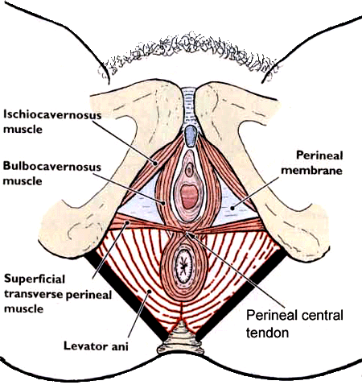
Urogenital region 尿生殖区
Perineal central tendon 会阴中心腱
  Wedge-shape fibromuscular mass
  In female, between anal canal and lower end of vagina
  In male, between anal canal and root of penis
  It is larger in the female than in the male and fine support to the posterior wall of the vagina

Slide 31
Urogenital region 尿生殖区
Perineal central tendon 会阴中心腱
  Sphincter ani externus
  Levator ani
  Superficial transverse muscle of perineum
  Deep transverse muscles of perineum
  Bulbocavernousus
  Sphincter of urethra (male) or urethrovaginal sphincter (female)

Slide 32
Perineal central tendon 会阴中心腱
Sphincter of urethra (male) or
urethrovaginal sphincter (female)
Bulbocavernousus
Deep transverse muscles of perineum
Superficial transverse muscle of perineum
Levator ani
Sphincter ani externus

Slide 33
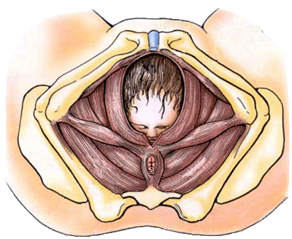
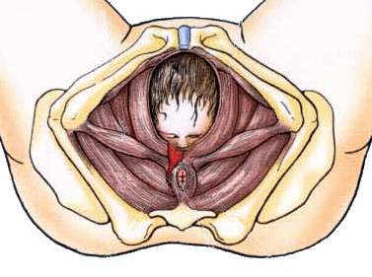
Episiotomy 会阴切开术
Tear of perineum 会阴撕裂

