Slide 1


HACKFINITI 2025
“GenAI-Powered 3D Medical Image Analysis for Automated Diagnosis and Segmentation”
Team details :
Team Name: Tears
Team Leader name: Nithya Etoori
Theme Chosen: Healthcare
Team Members details: Chetan Laxminath, Rishika Gudla, Vikas Kumar Suthari

Slide 2


PROBLEM STATEMENT
Medical imaging techniques such as X-ray, CT, PET-CT, and MRI are widely used for disease diagnosis and treatment planning.
These imaging methods generate 2D and 3D reconstructions, enabling better visualization of a patient's anatomy. However, manual interpretation of these images is time-consuming and prone to errors, leading to delays in diagnosis and treatment.
Early and accurate detection of diseases like lung disorders, liver conditions, and brain tumors is critical for improving patient outcomes.
There is a need for an intelligent, automated system that can efficiently segment medical images and classify abnormalities, assisting radiologists and surgeons in precise diagnosis and surgical planning.

Slide 3



PROPOSED SOLUTION
To address this challenge, we propose a MERN-based web application powered by GenAI and LLMs to perform automated 3D medical image analysis. The app will integrate advanced deep learning models for:
Lung caner risk
MRI-based brain tumor segmentation to enable early detection and precise localization of brain tumors.
The solution will enhance diagnosis accuracy, reduce processing time, and assist medical professionals in decision-making. By leveraging 3D medical imaging and AI-powered segmentation, the system will provide detailed visualizations, precise measurements, and support for surgical planning, ultimately improving patient care.

Slide 4



TECHNICAL APPROACH
Image Acquisition & Processing
Upload & validate image files in React
Preprocess (normalization, resampling)
AI Model Selection
Identify anatomy from metadata
Route to specialized models ( U-Net 3D, U-NetR for Lung CT, ResNet for Brain MRI)
Segmentation & Analysis
Apply deep learning models for segmentation
Extract volumetric & radiomic features
Compute clinical measurements
Result Integration
Link analysis to patient records
Generate LLM-based reports
Visualization & Interaction
Render 3D models
Enable interactive segmentation

Slide 5
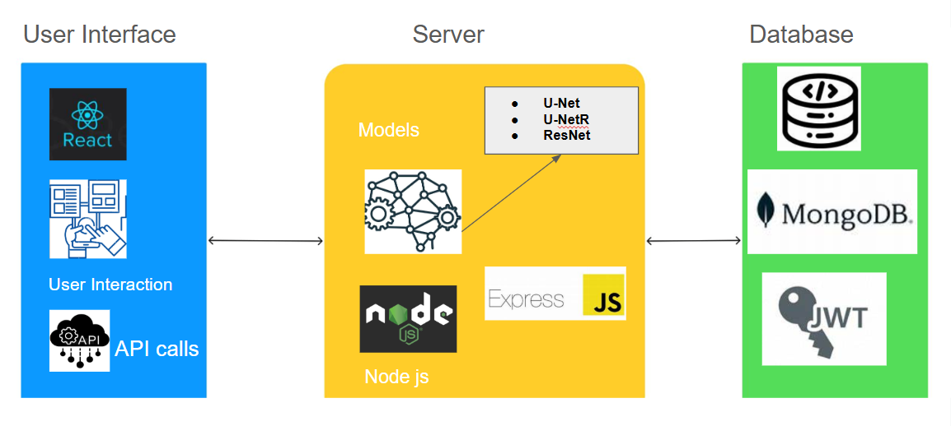
ARCHITECTURE DIAGRAM

Slide 6
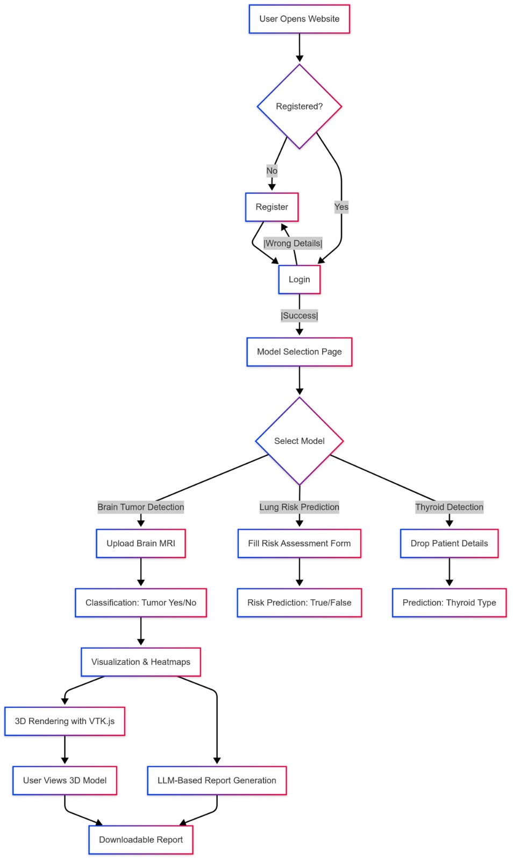
WORKFLOW

Slide 7


FEASIBILITY AND VIABILITY
Advantages of Our Approach
Enhanced Accuracy & Speed – AI reduces human error, detects small anomalies, and speeds up diagnosis.
Automated Segmentation & Classification – Lung, liver, and brain tumor analysis with AI-powered models.
AI-Driven Insights – LLMs generate explainable reports & assist radiologists in decision-making.
Cost-Effective & Efficient – Reduces hospital workload, minimizes redundant scans, and optimizes resources.
Technical Feasibility
Uses Deep Learning Models (U-Net, U-NetR, ResNet) for precise 3D segmentation.
Handles medical images.
MERN Stack Integration – AI backend (Node.js), React-based visualization.
Market Feasibility
Growing AI in Healthcare Market – High demand for AI-driven diagnostics.
Revenue Potential – SaaS-based model, API integration, enterprise licensing.
Bridges the gap between AI & healthcare professionals.

Slide 8

IMPACTS AND BENEFITS
1. Clinical Excellence
- Enhanced diagnostic accuracy with AI-detected subtle abnormalities
- Reduction in analysis time through automated segmentation.
- Comprehensive multi-organ analysis across imaging modalities.
2. Operational Efficiency
- Seamless integration with hospital systems via MERN architecture.
- Cloud-based scalability supporting increasing imaging volumes.
3. Patient-Centered Care
- Earlier detection of abnormalities improves treatment outcomes.
- Precise 3D measurements enable personalized treatment planning.
- Interactive visualizations enhance patient education and engagement.
4. Future-Ready Platform
- Continuous learning from new cases improves model accuracy.
- Integration with clinical data enables predictive analytics.
- Supports multi-institutional collaboration and research.

