Slide 2
begin
export asynchronously
register task
convert data to excel
return template id
set report task -> HANDLING
set report task -> SUCCESS
UI send request params
execute according to template statements and dynamic params
create report record,set status -> START
download file
get template strategy

Slide 3
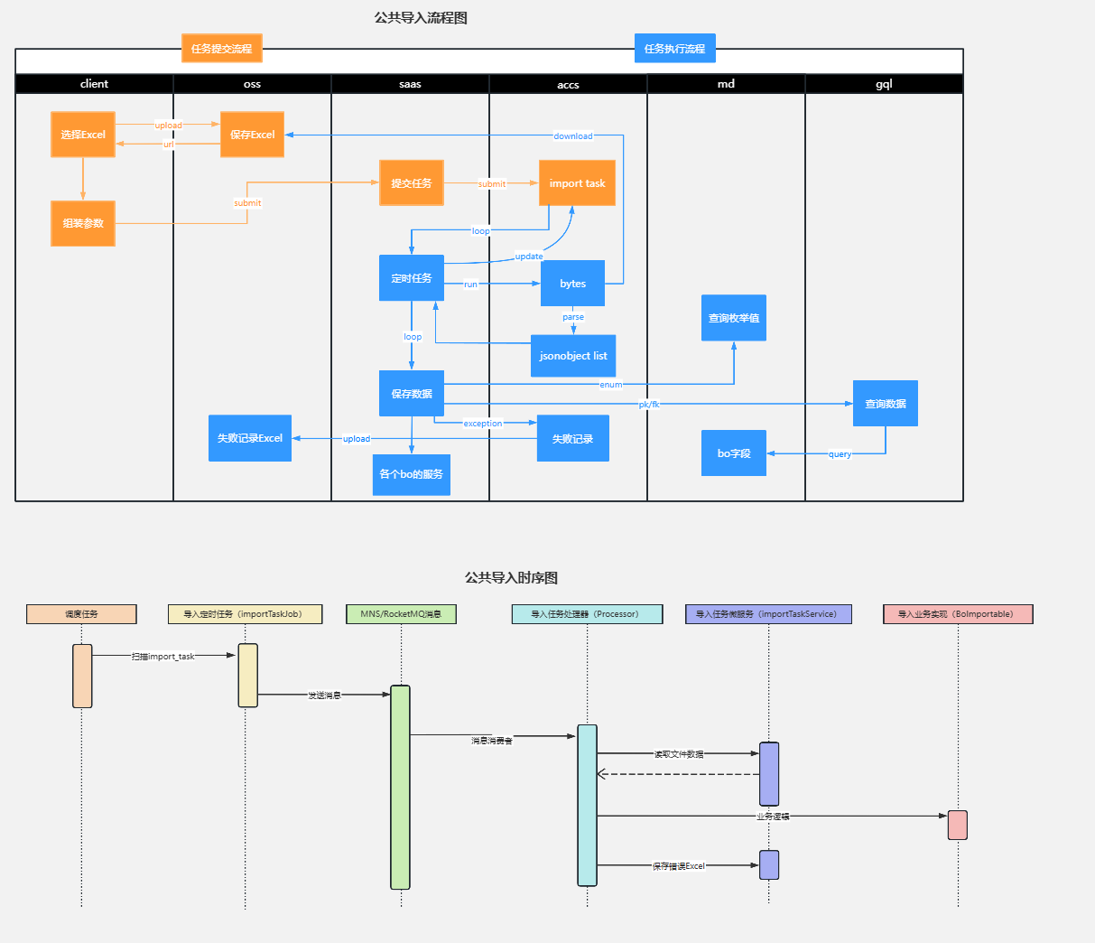

Slide 4
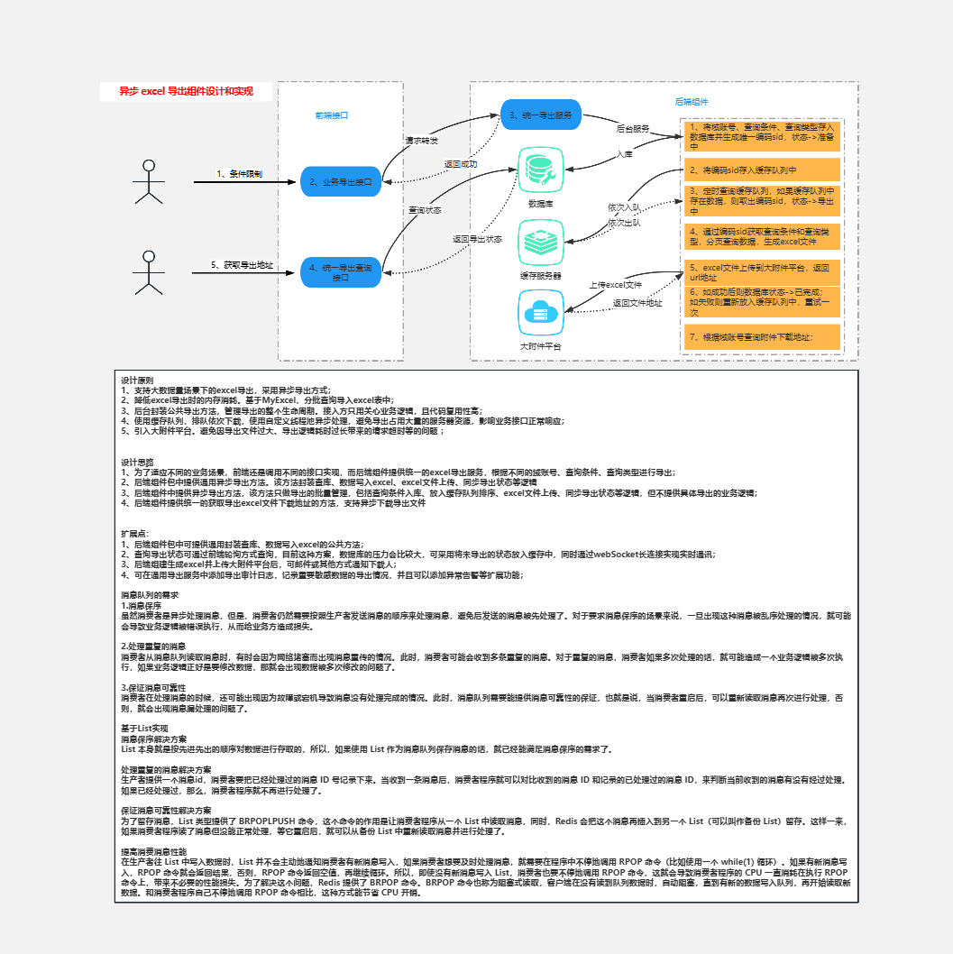

Slide 5
