Slide 1
Basic Altium Workshop
Friday, September 28th, 2007
HKN
Brandon Gilles & Chris Mintle

Slide 2
Why do a PCB?
PCBs are pretty cheap
  $33 for 2-layer boards from www.4pcb.com
Compact and Robust
Signal speed and reduced noise.
Why not?
Design is constantly being modified.
  Wire wraps
Harder to rework.

Slide 3
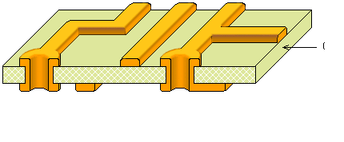
Board Makeup
1/16th inch FR4 epoxy substrate.
1 oz copper traces and plated Vias.

Slide 4
Project Makeup?
Schematic Design
  Label and connect parts.
PCB Layout
  Arrange physical components.
  Lay down the tracks.
Gerber Files
  Convention on how manufacturer will render your design.
Advanced Techniques:
  Signal Integrity Analysis.
  Spice simulations.

Slide 5
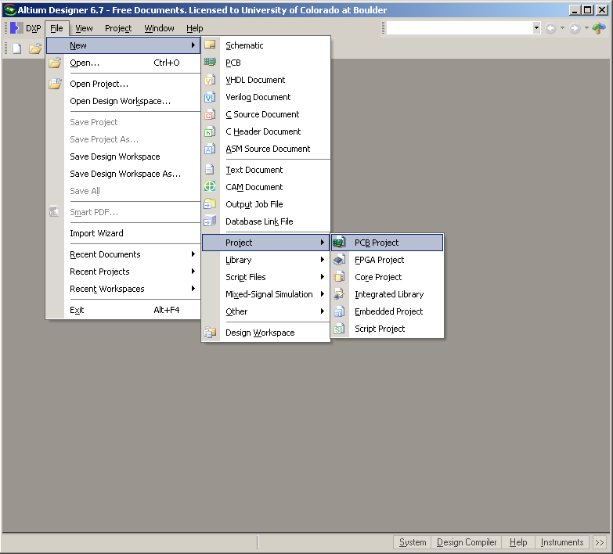
Open Altium and open a PCB Project
File -> New -> Project -> PCB Project

Slide 6
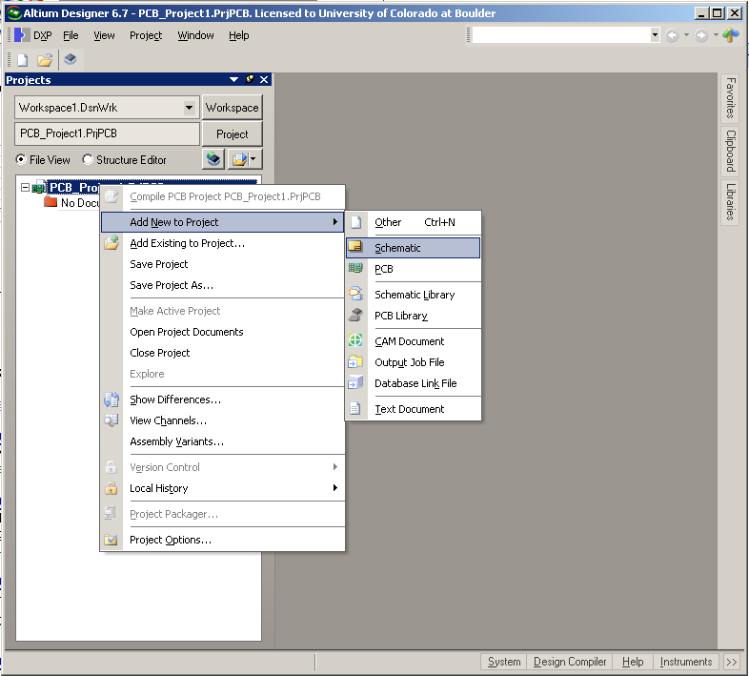
Add a Schematic file to the PCB Project
Right click “PCB Project” in left column -> Add New to Project -> Schematic

Slide 7
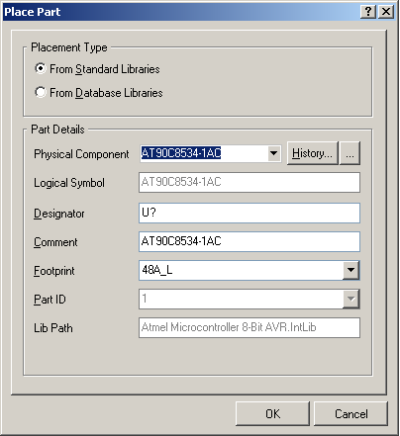
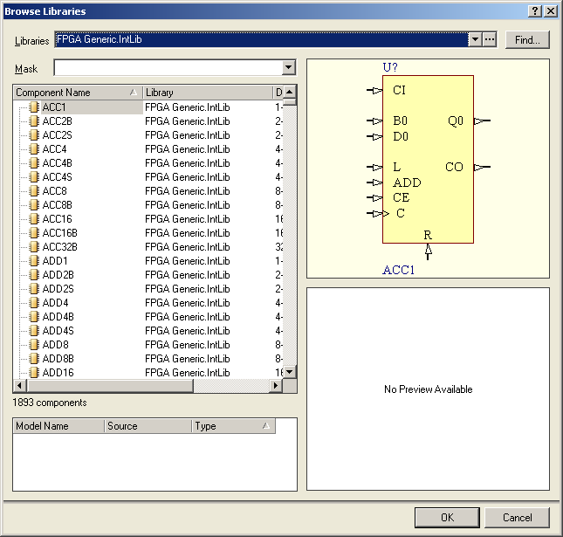
Add Atmel Library
Place -> Part -> …-> … -> Install -> Atmel
-> Atmel Microcontroller 8-bit AVR.IntLib

Slide 8
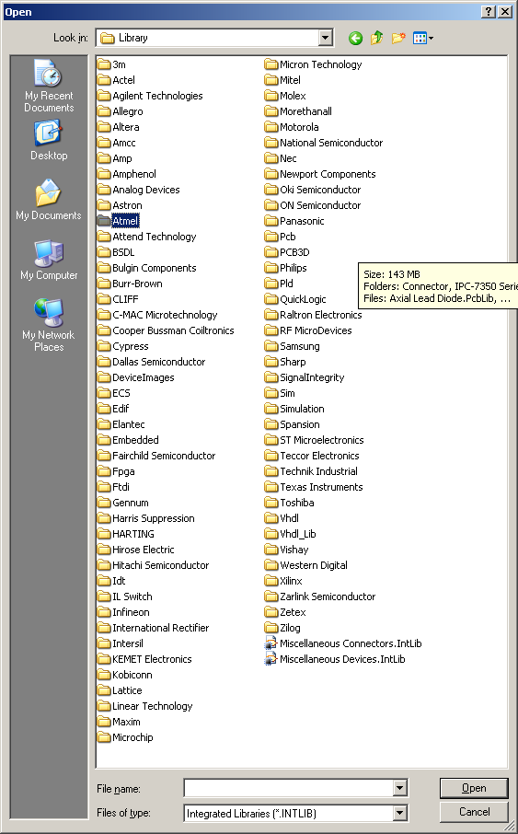
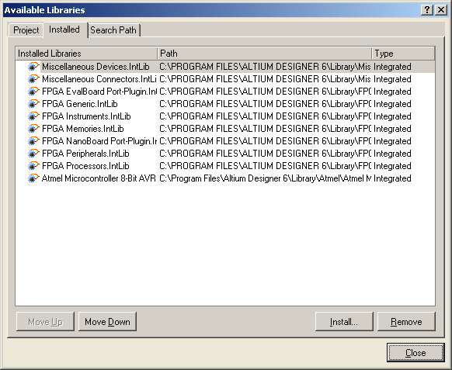
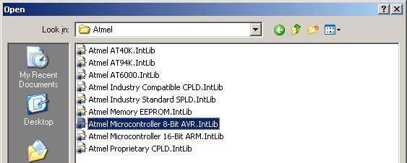
Add Atmel Library Cont…

Slide 9
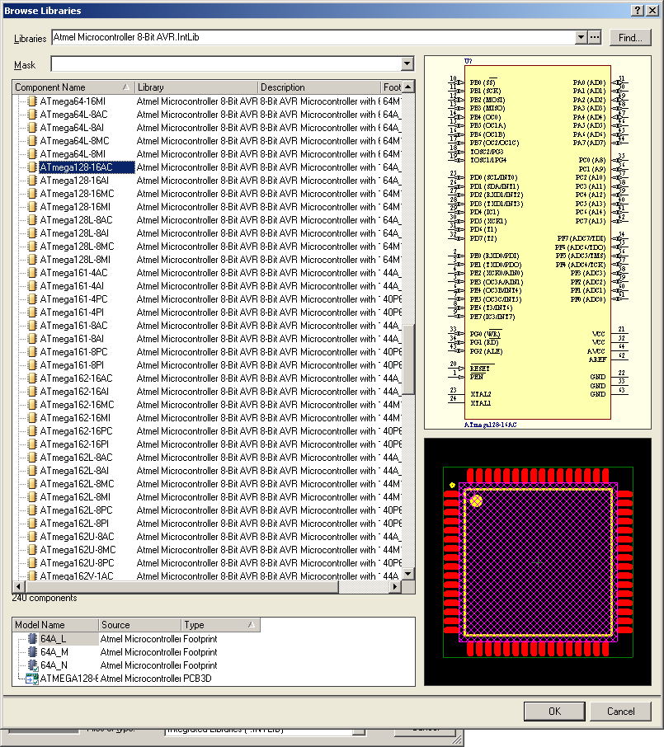
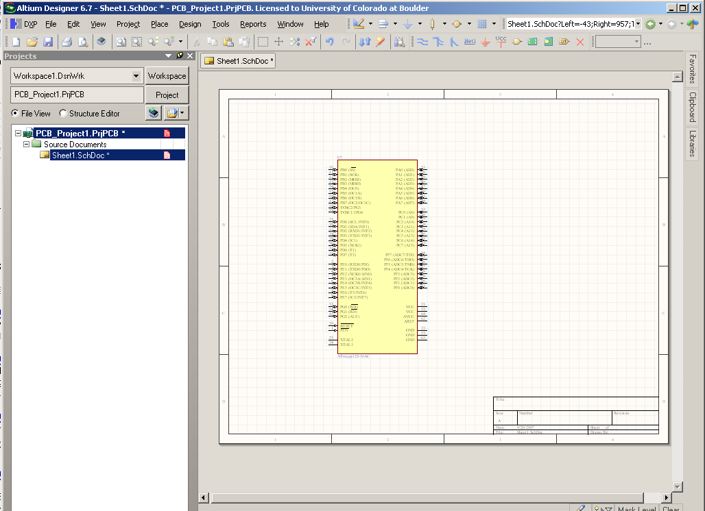
Add Atmel AVR (ATmega128-16AC)

Slide 10
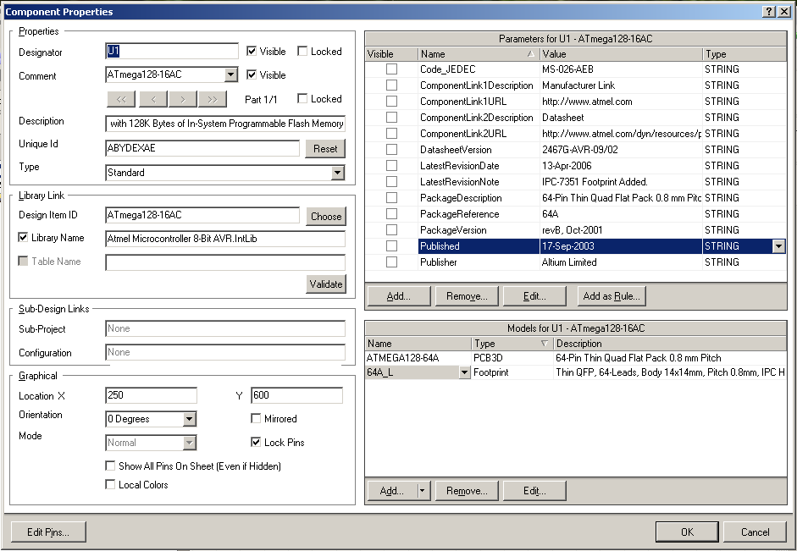
Rename Atmel AVR (ATmega128-16AC)
Double click on schematic symbol.
Change Designator

Slide 11
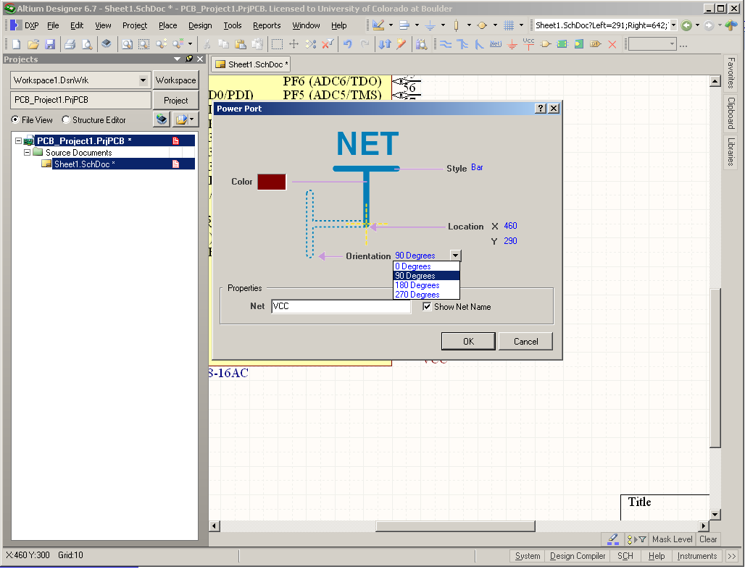
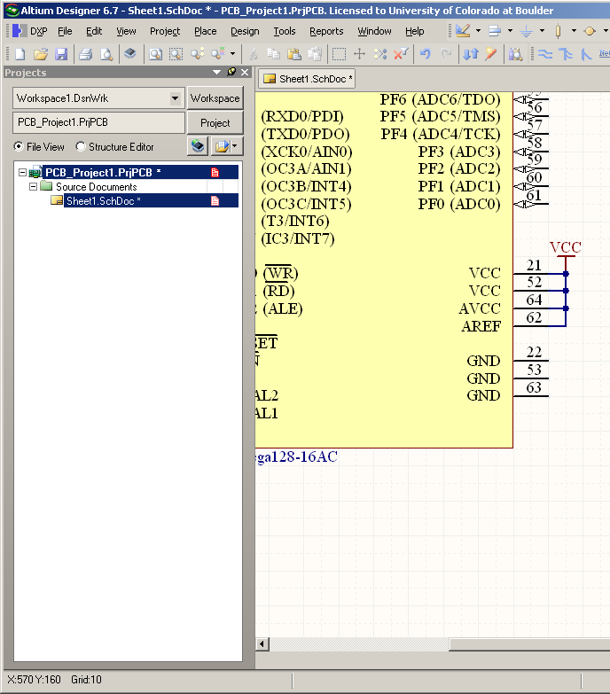
Schematic: Add Power
Place -> Power Port
Place VCC terminal and then double click to bring up properties and rotate device 90 degrees
Wire Power Terminals together (Place -> Wire)

Slide 12
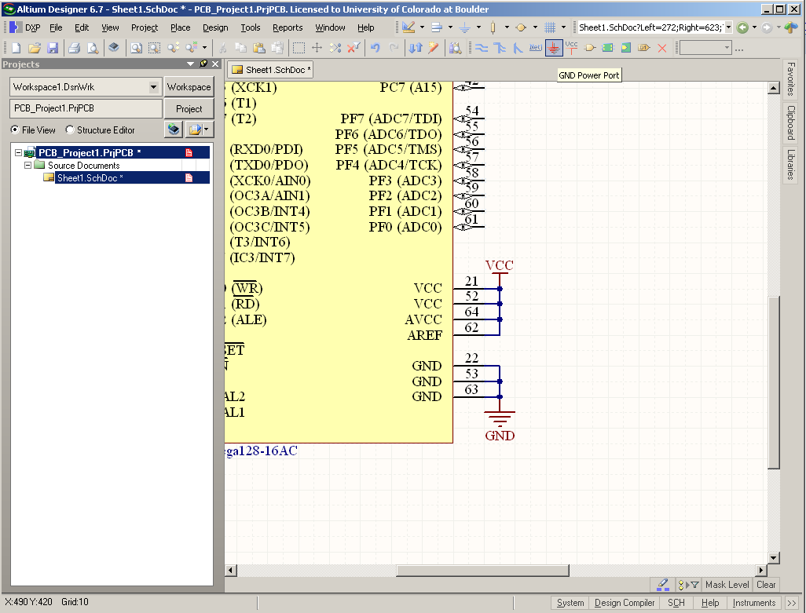
Schematic: Add Ground
Click Ground symbol in top tool ribbon
Wire Gnd together (Place -> Wire)

Slide 13
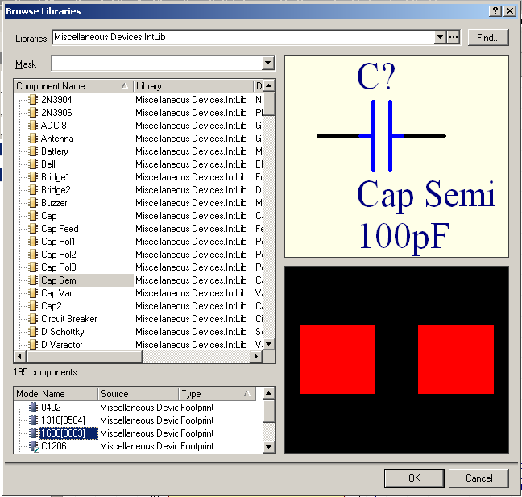
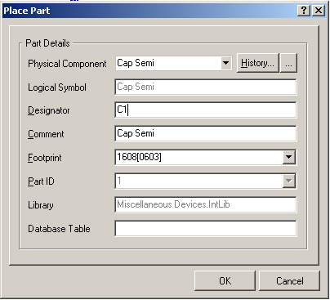
Schematic: Add Decoupling Capacitors
Place -> Part -> …
1) Select Miscellaneous Devices.IntLib from pull down menu
2) Select Cap Semi Folder
3) Select 1608[0603] capacitor and click OK
4) From Place Part Menu, change Designator. Click OK
1
4
2
3

Slide 14
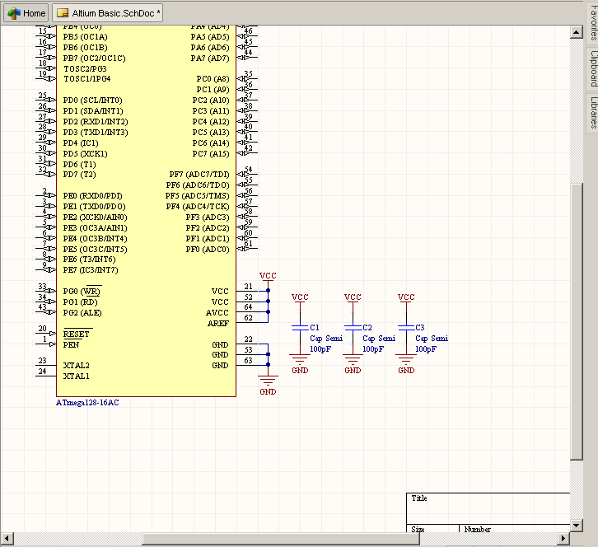
Schematic: Decoupling Capacitors Cont…
Place 3 Capacitors, C1, C2, C3
Wire top terminal of caps to VCC and bottom terminals to GND using previous power and ground techniques.

Slide 15
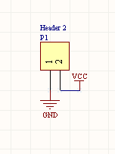
Schematic: Power Header
Add power header
Place -> Part -> …
Select Miscellaneous Connectors.IntLib then Header 2
Rename designator
Apply VCC to pin 2 and GND to pin 1

Slide 16
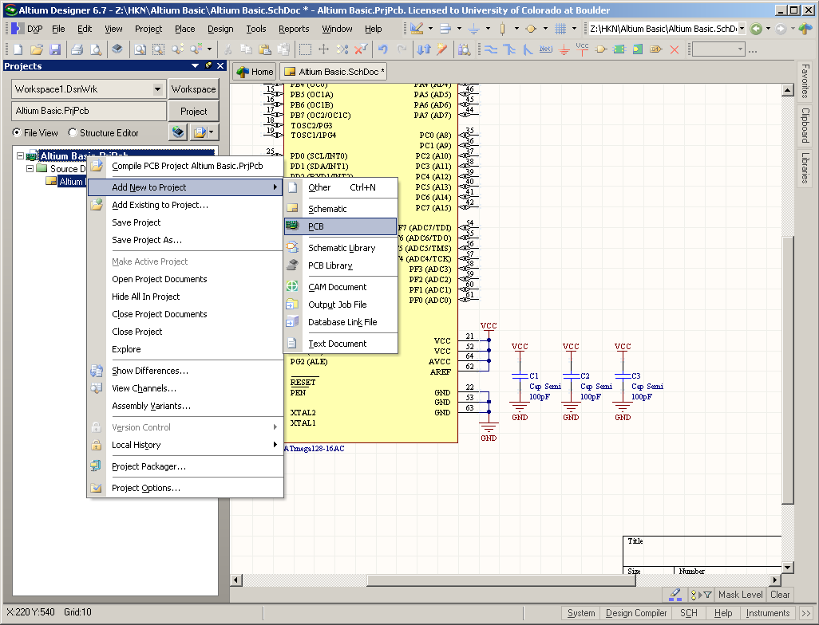
PCB Creation
Right click Project name in left column and add new PCB to project
Save
Project

Slide 17
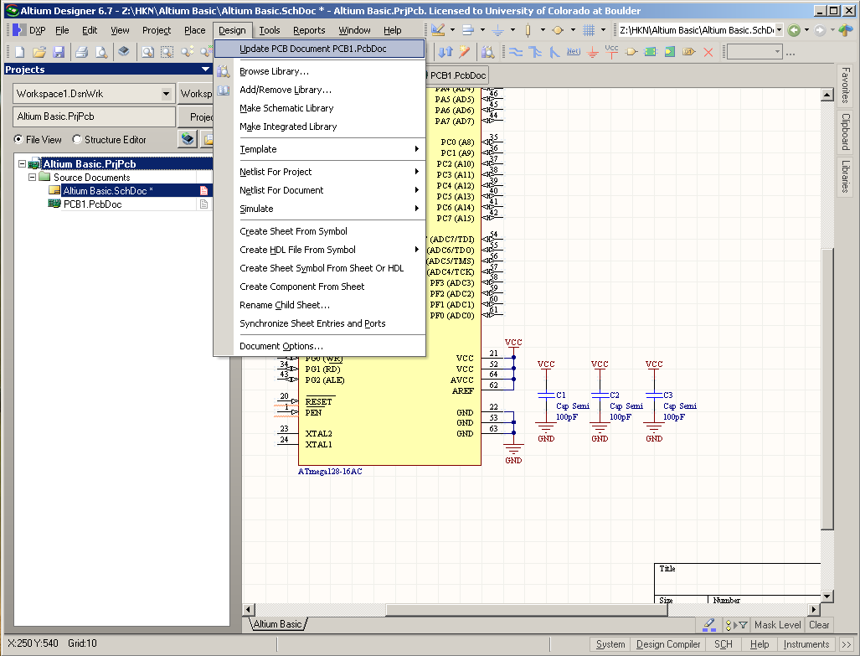
PCB Creation
Click on schematic in left column to go back to schematic view
Click Design -> Update PCB Document

Slide 18
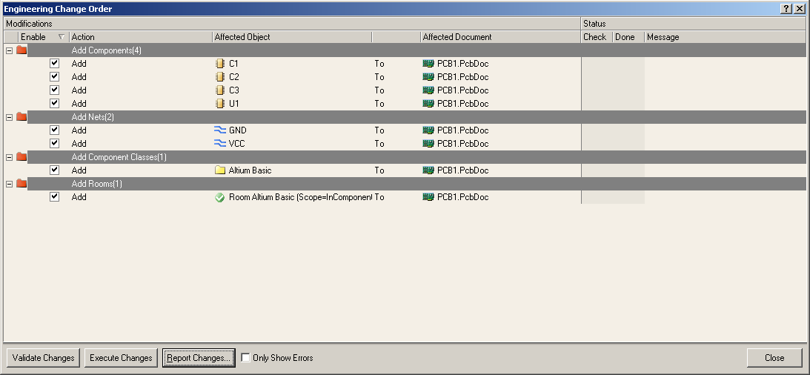
PCB Creation
Validate and then execute changes
PCB is now created
1
2

Slide 19
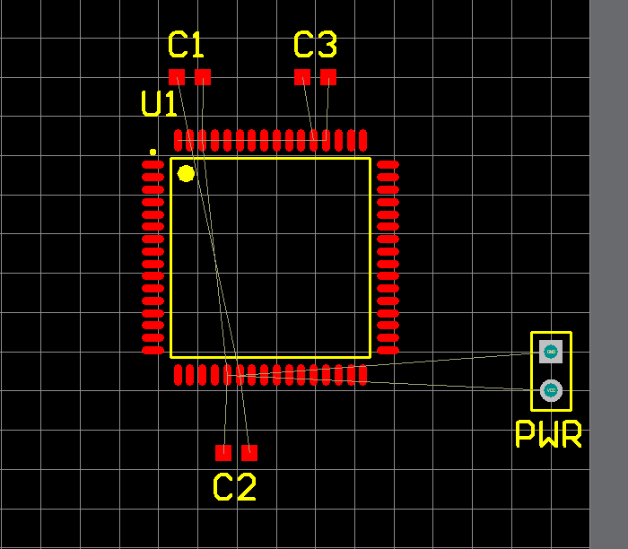
PCB – Arranging Components
Click and hold -> use space bar to rotate components

Slide 20
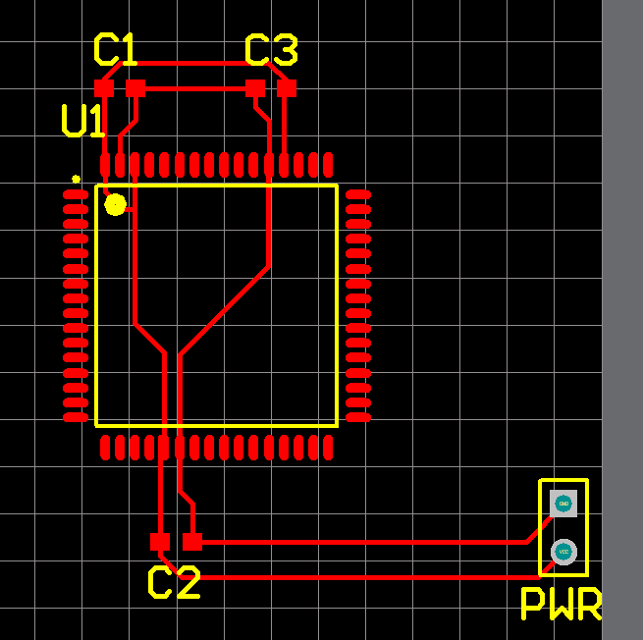
PCB – Routing Parts Together
Place -> Interactive Routing to get routing tool
Click on pads to route together

Slide 21
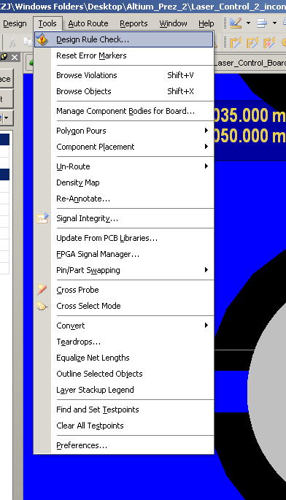
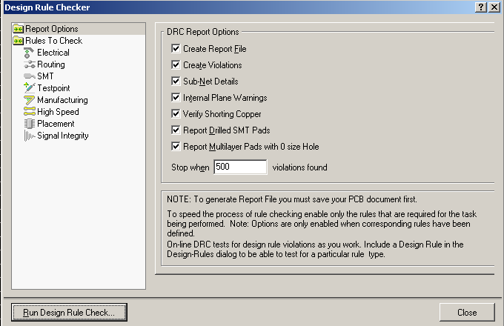
Check Design Rules
Tools > Design Rule Check

Slide 22
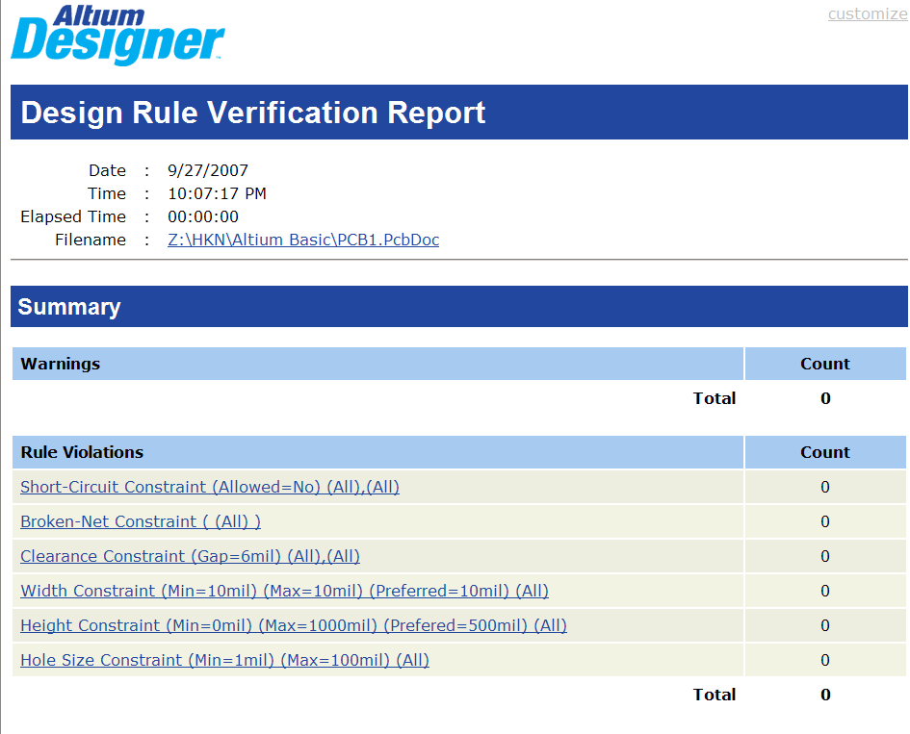
PCB – No Errors! Yeah!

Slide 23
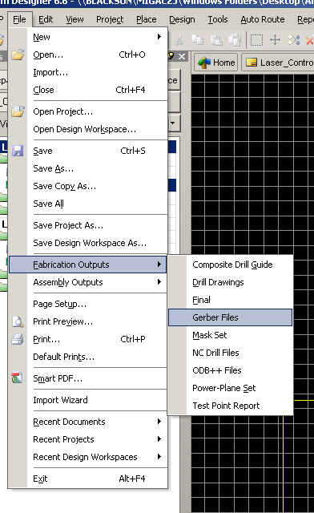
PCB – Gerber File Generation
From PCB Document: File > Fabrication Outputs > Gerber Files

Slide 24
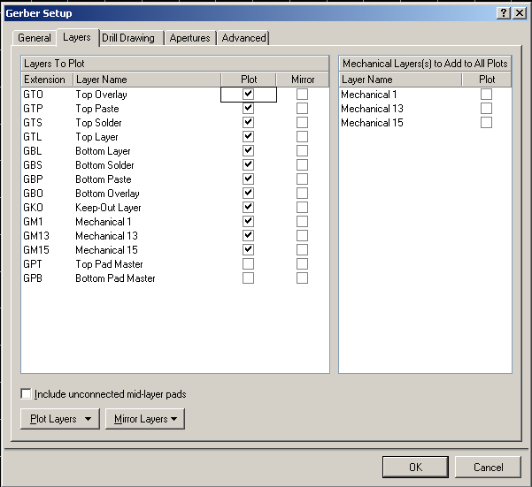
PCB – Gerber File Generation
Make sure the important Layers are plotted
- Do not add “Mechanical Layers to all Plots”
- Press OK and CAM File is generated then Save it in Projects Output folder

Slide 25
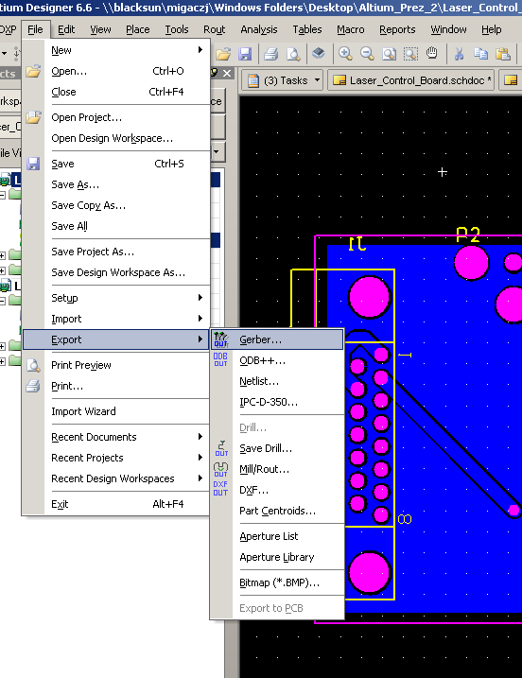
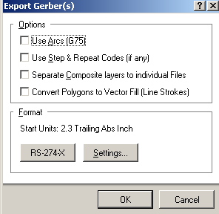
PCB – Gerber File Generation
From the CAM File:
File > Export > Gerber > OK
Gerbers should be in Project Outputs in the project folder

Slide 26
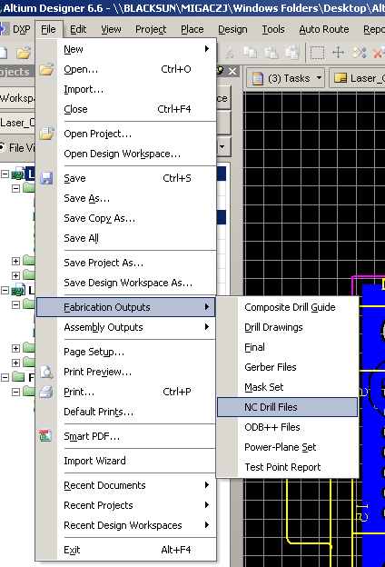
PCB – NC Drill File Generation
Part 1:
Back in PCB Document:
- File > Fabrication Outputs > NC Drill
- Press OK in new window

Slide 27
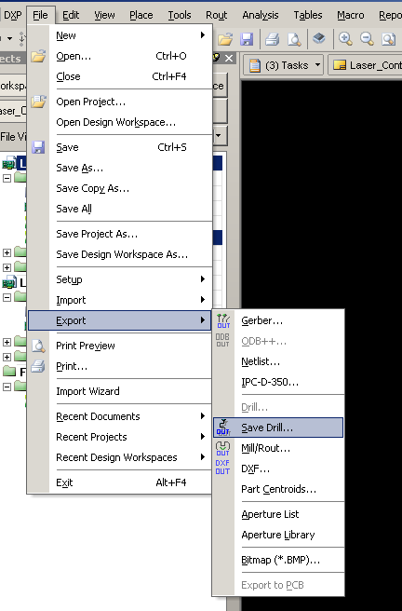
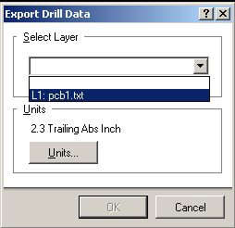
PCB – NC Drill File Generation
Part 2:
In new CAM File (not the Gerber one):
- File > Export > Save Drill
- Select the text File

Slide 28
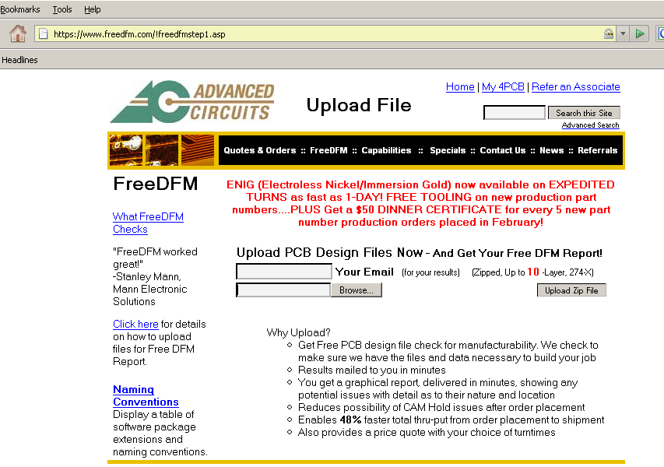
PCB – Submit to Advanced Circuits
1. Compress the “Project Outputs” file into a .zip format
- We’ve included a zipped copy in your start folder: Project_Outputs_Basic.zip
2. Go to freedfm.com, Upload the ZIP file

Slide 29
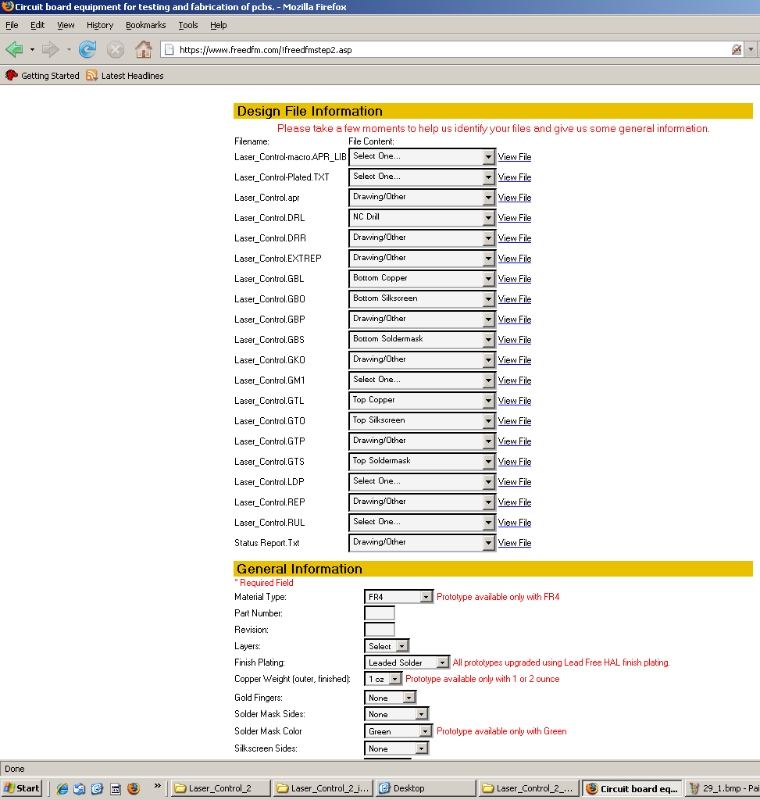
PCB – Submit to Advanced Circuits
Fill in the Form
  Replace “Select One… ” with “Drawing Other”

Slide 30
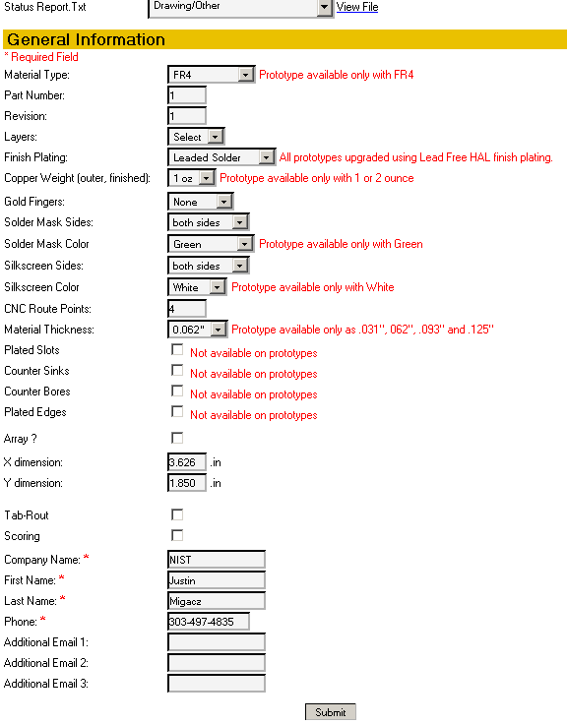
PCB – Submit to Advanced Circuits
Make “Solder Mask Sides” -> Both Sides
Make “Silkscreen Sides” -> Both Sides
Find Board Size -> Go Back to Project

Slide 31

Additional Questions?
Ask about specific tasks you want to accomplish.

Slide 32
Advanced Altium Workshop
Friday, September 28th, 2007
HKN
Brandon Gilles
Chris Mintle
Paul Kasemir

Slide 33
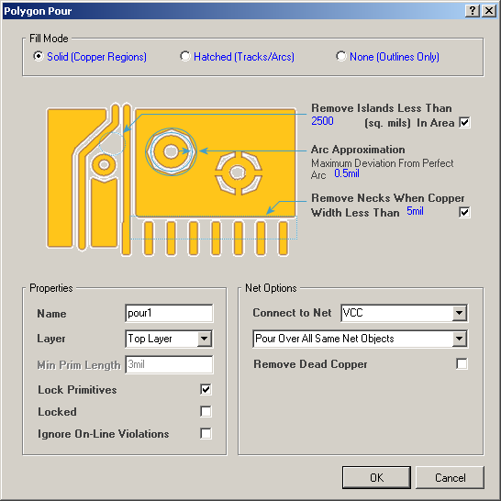
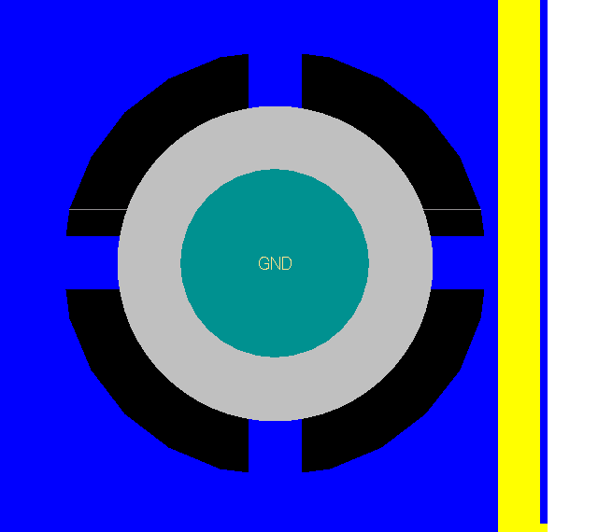
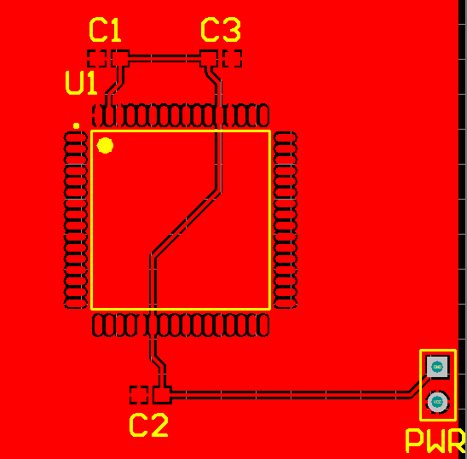
PCB – Ground and Power Pours
Place Polygon Pour (pg)
Define the Net + Layer
Define the Vertices
It will automatically connect the Net

Slide 34
Useful Tips and Tricks

Slide 35
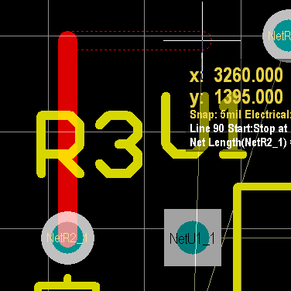
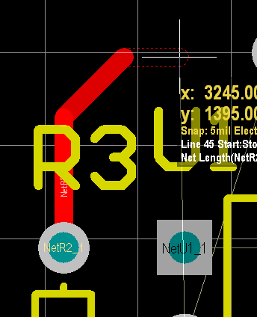
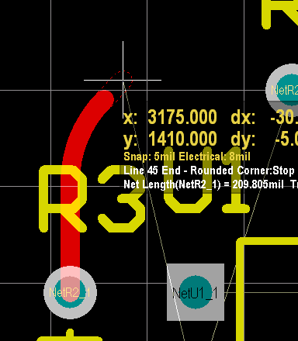
PCB – Placing Traces
Place Tracks (P, T)
Change Start Angle (Space)
Change Style (Shift-Space)
Remove Last Placement (Backspace)
Escape Action (Right Click)

Slide 36
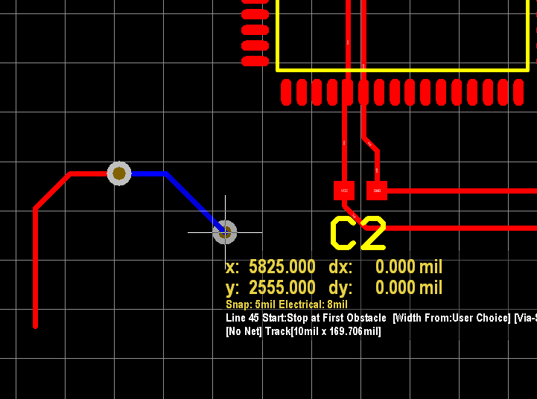
PCB – Placing Vias Quickly
Must be placing trace
Control-shift- scroll wheel
Manually scrolls between layers and automatically places via from original layer to selected layer

Slide 37
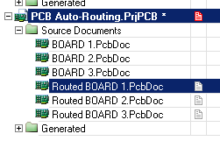
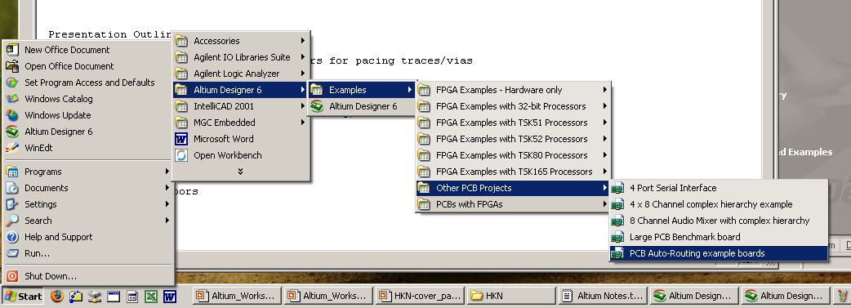
PCB – Single Layer Viewing
Open the example PCB
Start -> Altium Designer 6 -> Examples -> Other PCB Projects -> PCB Auto-Routing example boards

Slide 38
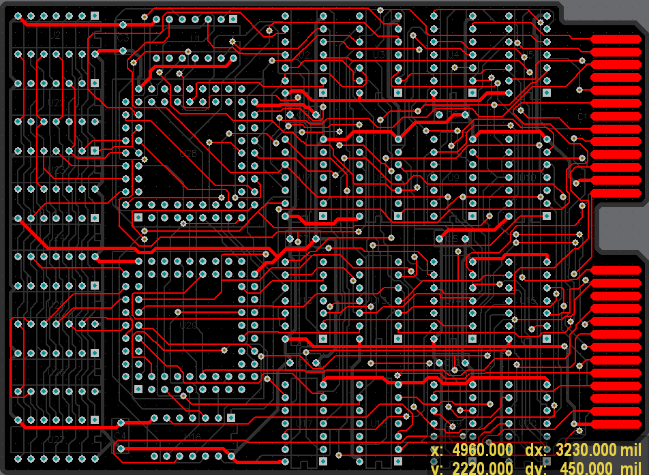
PCB – Single Layer Viewing
Press shift+s to see a single layer of the board
Use ctrl+shift+scroll-wheel to switch between layers

Slide 39
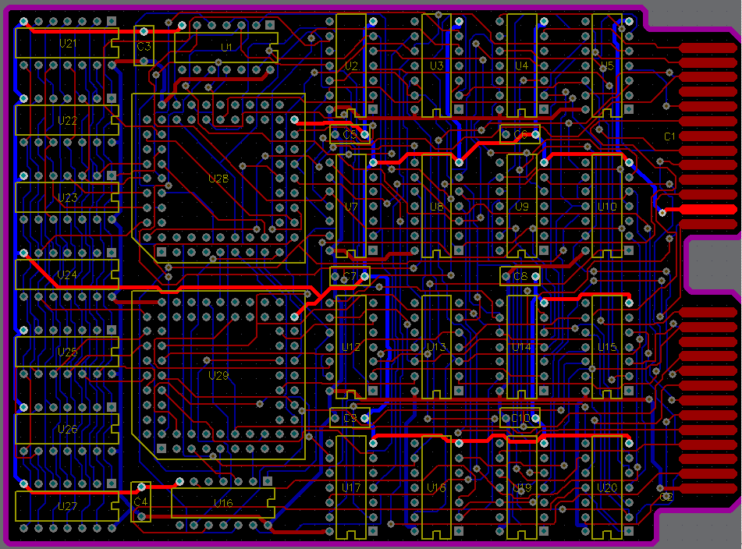
PCB – Net Highlighting
Hold ctrl and click on a trace to highlight the entire connection path

Slide 40
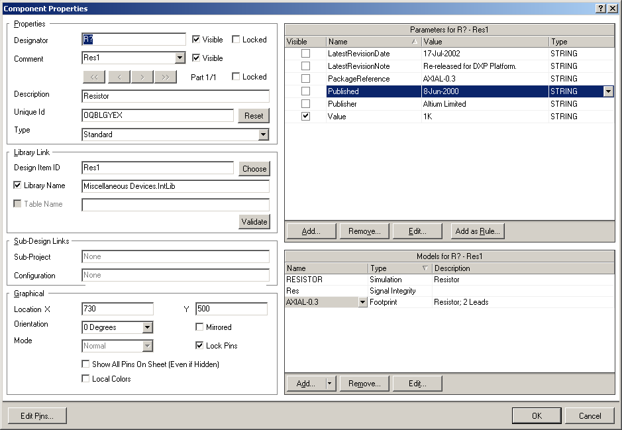
Schematic – Part Placing Tricks
Place part using your favorite method (pp)
Hit tab before placing the part in location to edit part properties

Slide 41
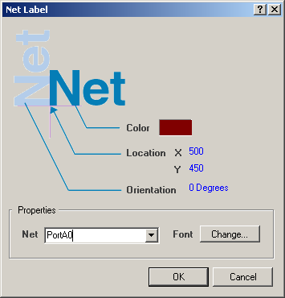
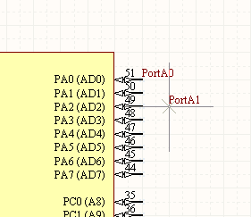
Schematic – Net Naming (wireless connections)
Place Net (pn), then hit Tab to pull up Net Properties
Notice auto-incrementing

Slide 42


Schematic – Net Naming (wireless connections)
Add Net names to both parts
Highlight all Net names on the right, ctrl-click and drag to move Nets
Notes:
TI Logic Latch

Slide 43


PCB – Your Board in 3D
View -> Board in 3D

Slide 44

Additional Questions?
Ask about specific tasks you want to accomplish.
Additional Altium Awesomeness:
http://www.altium.com/Evaluate/DEMOcenter/AltiumDesigneroverview/Componentmodels/

