Slide 1
CLOUD OPERATIONS ASSESSMENT WALKTHROUGH
with Khairi

Slide 2

Customer Overview
Architecture Design
Designing Network layer in AWS
VPC
Subnets
Internet Gateway
Route Tables
Load Balancers
Architecting Compute layer
EC2 Instances
Creating Database layer
RDS
Security
Security Groups
SPRZ Pte Ltd
Building its infrastructure in Singapore Data Center using Cloud solutions to build its Web, Application and Database Servers
Implementation

Slide 3



Resources
http://bit.ly/aws-drawio
http://bit.ly/lab-readme
https://aws.amazon.com/architecture/icons/

Slide 4
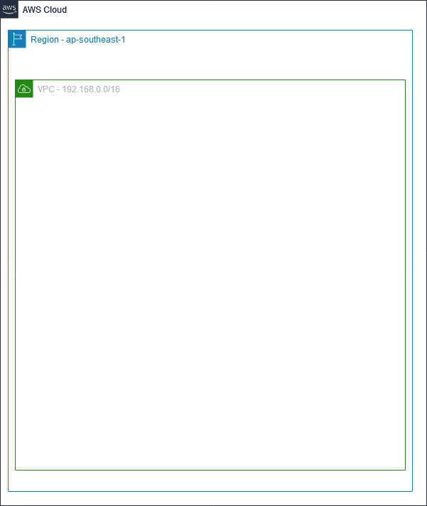

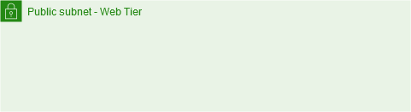


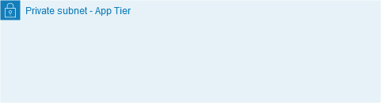
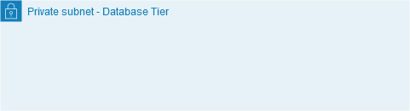

AWS Services – Networking
Amazon VPC
A slice of the Cloud pie for yourself

Slide 5
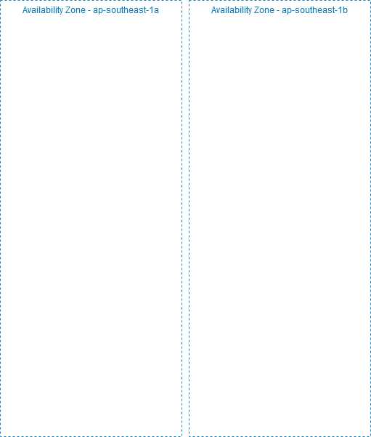
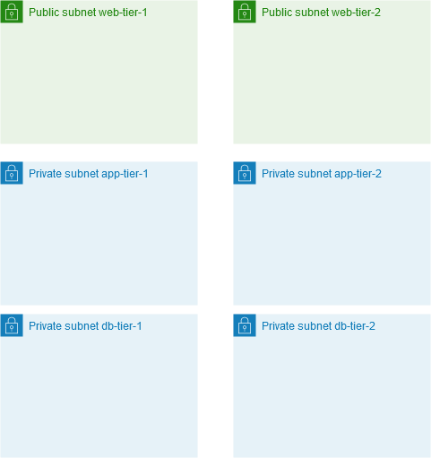
AWS Services – Networking
Subnet Name | Subnet CIDR
Public subnet web-tier-1 | 192.168.0. 0 /24
 | 192.168.0. 0 /24 …
 | 192.168.0. 255 /24
Amazon VPC
A slice of the Cloud pie for yourself
network
host
Only 251 IP Addresses are available
The first four IP addresses and the last IP address are reserved

Slide 6
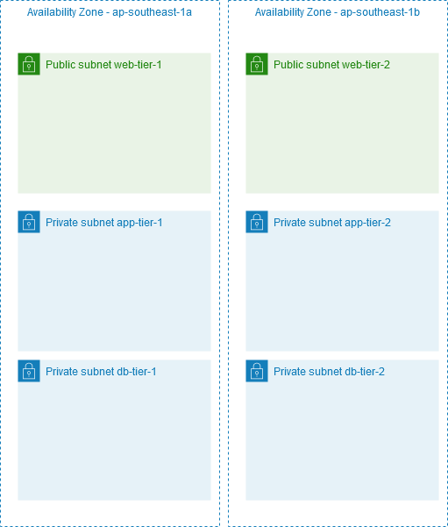
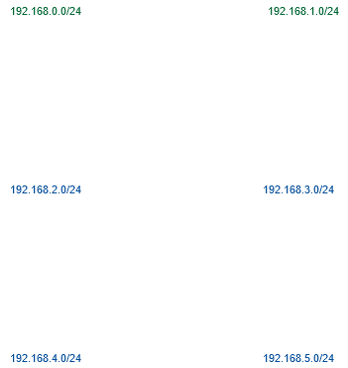
AWS Services – Networking
Amazon VPC
A slice of the Cloud pie for yourself
Subnet Name | Subnet CIDR
Public subnet web-tier-1 | 192.168.0.0 /24
Private subnet app-tier-1 | 192.168.2.0 /24
Private subnet db-tier-1 | 192.168.4.0 /24
Public subnet web-tier-2 | 192.168.1.0 /24
Private subnet app-tier-2 | 192.168.3.0 /24
Private subnet db-tier-2 | 192.168.5.0 /24

Slide 7


AWS Services – Networking
Internet Gateway
Allows access from your VPC to the Internet

Slide 8
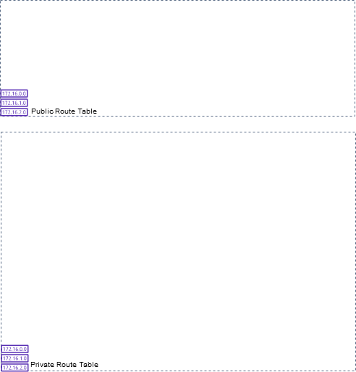
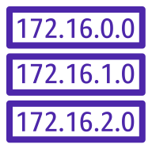
AWS Services – Networking
Public Route Table
Destination | Target
192.168.0.0/16 | local
0.0.0.0/0 | igw
Route Tables
Routes traffic within the VPC
Private Route Table
Destination | Target
192.168.0.0/16 | local

Slide 9



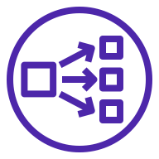
AWS Services – Networking
Load Balancers
Splits the traffic loads among the instances
 | Application Load Balancer | Network Load Balancer
Info | Operates at OSI Layer 7 | Operates at Layer 4
Use Case | Flexible application management | Extreme performance and static IP is needed
Supported Protocols | HTTP and HTTPS | TCP, UDP

Slide 10


AWS Services – Compute
Amazon EC2
Your computing power

Slide 11
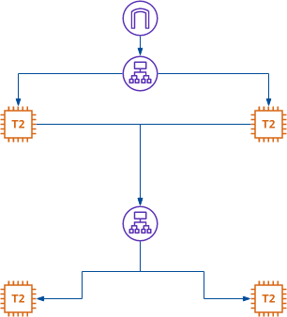
AWS Services – Compute
Amazon EC2
Your computing power

Slide 12
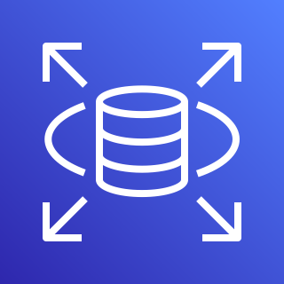

AWS Services – Database
Amazon RDS
The go-to relational database

Slide 13
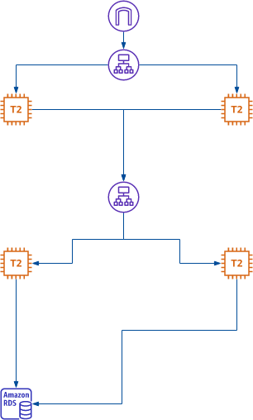
AWS Services – Database
Amazon RDS
The go-to relational database

Slide 14





Security in Depth – Security Groups
SG Name | Inbound rules
 | Type | Port range | Source
sg-ext-lb | HTTPS HTTP | 443 80 | 0.0.0.0/0
sg-web-tier | HTTPS HTTP SSH | 443 80 22 | sg-ext-lb My IP
sg-int-lb | HTTPS HTTP ICMP | 443 80 | sg-web-tier
sg-app-tier | HTTPS HTTP ICMP | 443 80 | sg-int-lb
sg-rds-tier | Custom TCP | 3306 | sg-app-tier

Slide 15
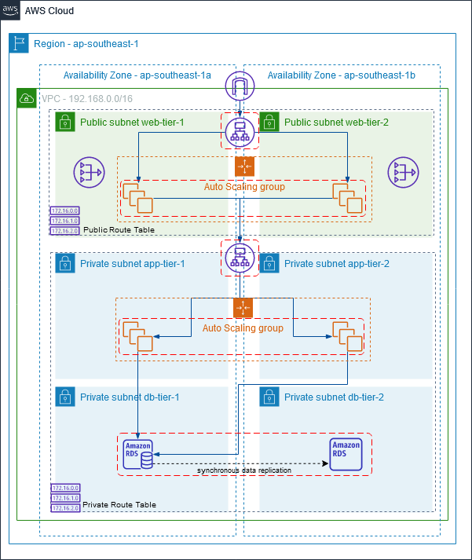
Improving Architecture - Auto Scaling Groups & RDS Multi-AZ

Slide 16
DEMO

Slide 17
THANK YOU!

