Slide 1
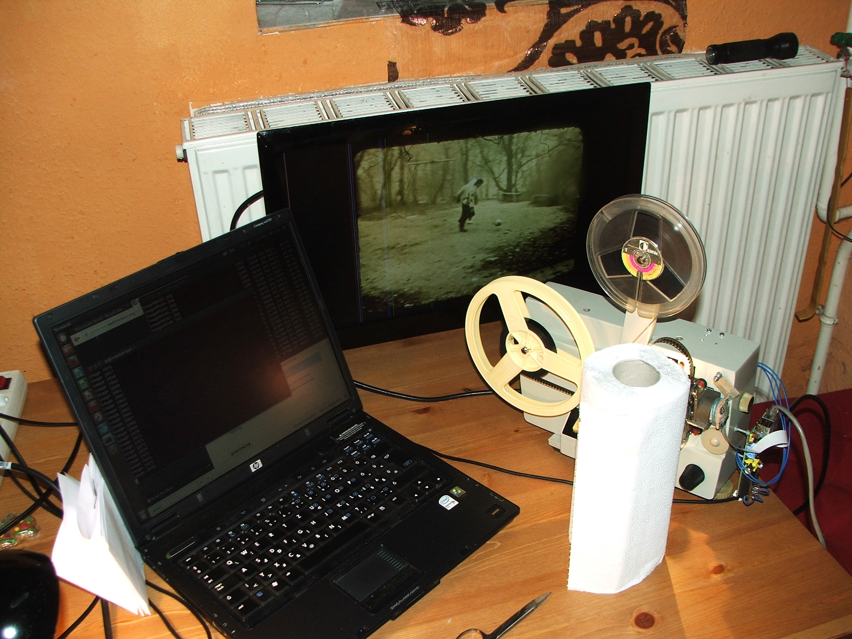
MovScan
8mm movie scanner/digitalizer with Raspberry Pi, RaspiCam, and an old Russian cine-projector.

Slide 2
Motivation
I have a large suitcase of 8mm movies. To see one, I must prepare projector and environment which is too complicated.

Slide 3
ToDo
To prevent flashing of video, all slides must be shooted, and join them to a video.
Flashing video example:
http://youtu.be/WmCGSHX4Mqk
This was created by a 30fps video camera.

Slide 4
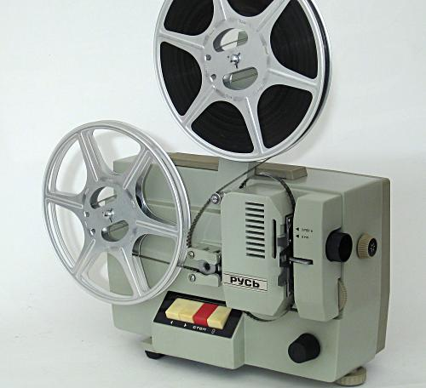
Cine-projector
I used the Russian projector what I have

Slide 5
Camera
Target to have a camera which
Has remote shoot possibility
Has enough resolution
Cheap

Slide 6
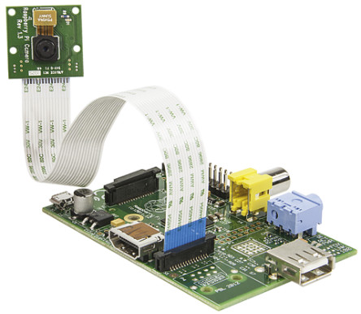
Best: Raspberry Pi with RaspiCam

Slide 7
Speed
8mm movie is 12...15 fps.
Should be do as fast as possible
raspistill needs 1s to do an image
PiCamera python interface can make image every 650ms
Calling capture_sequence with “use_video_port = True﻿” option, it can make image every 140ms

Slide 8
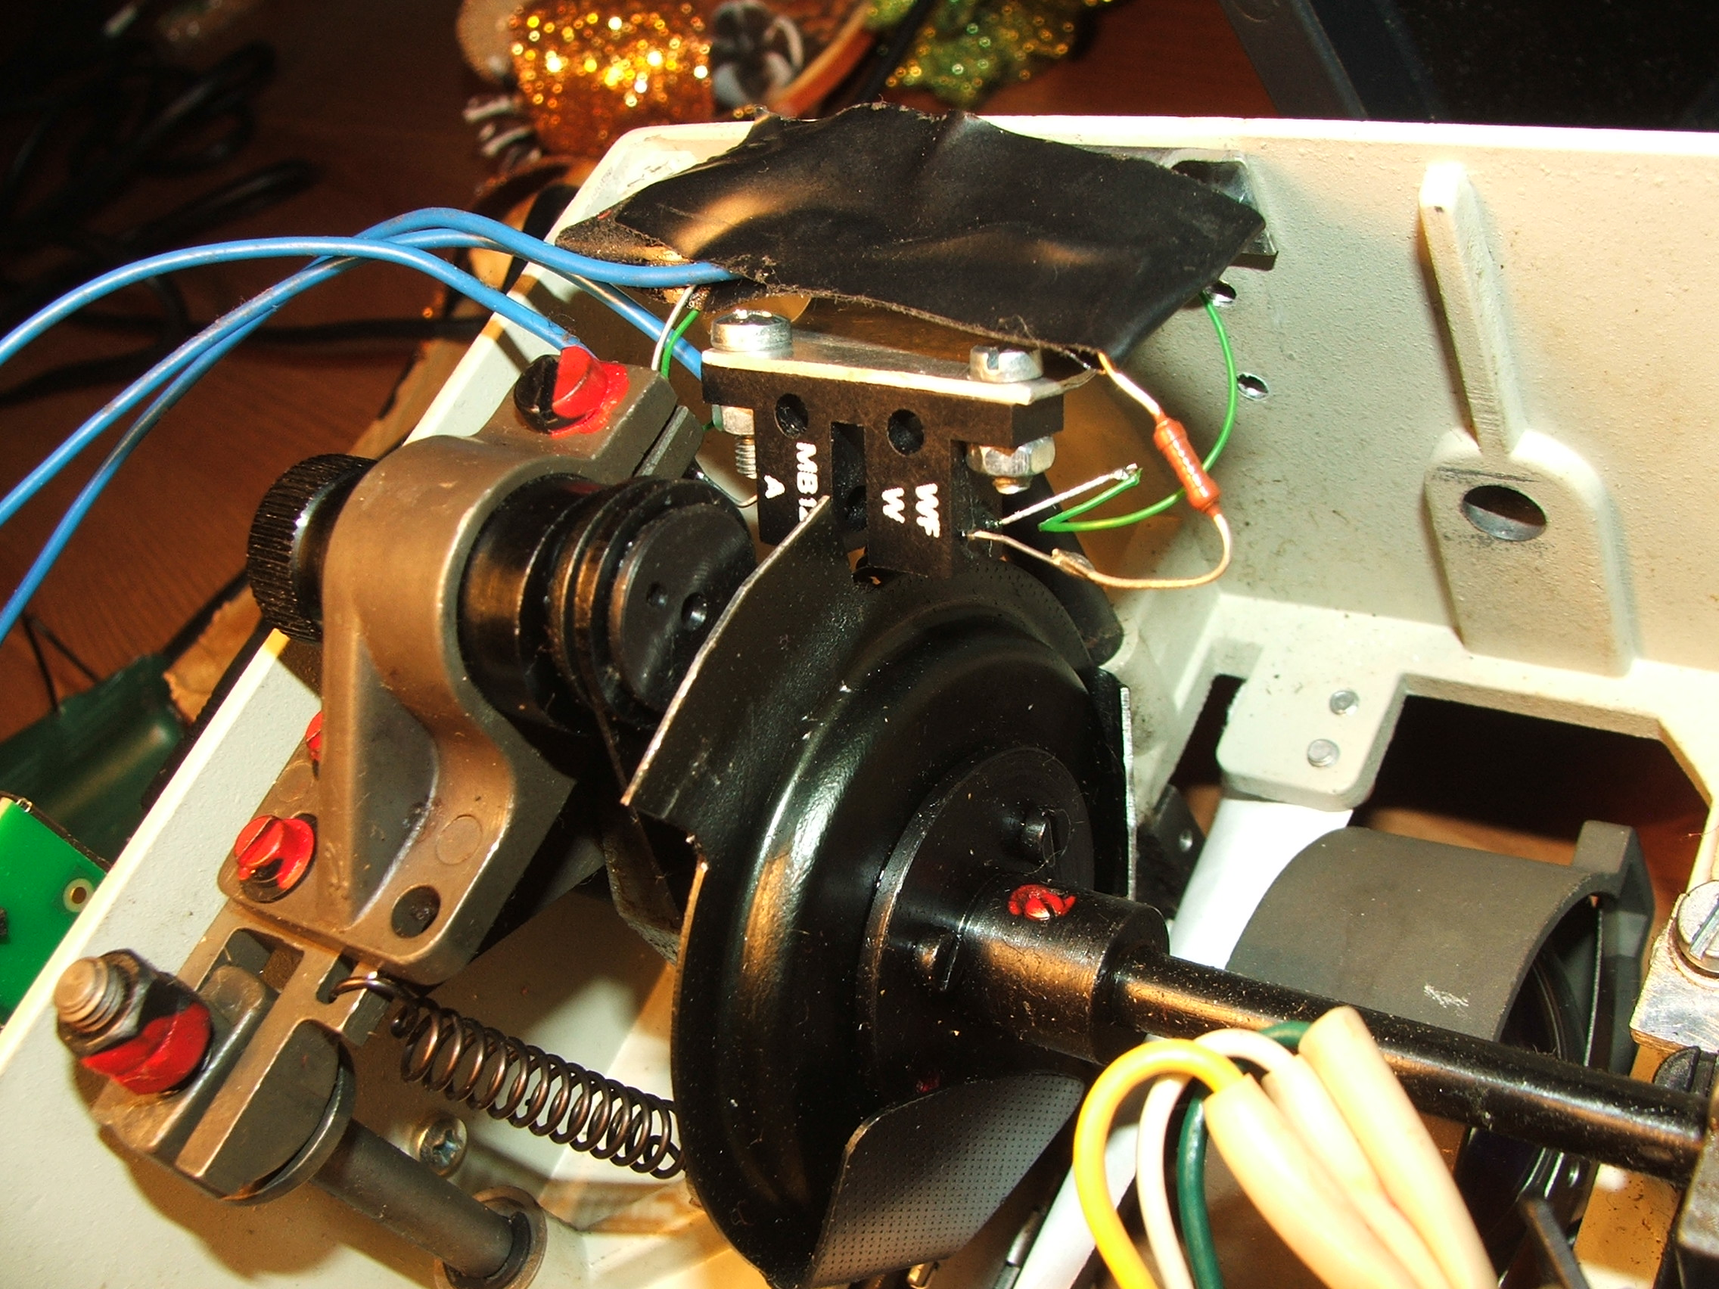
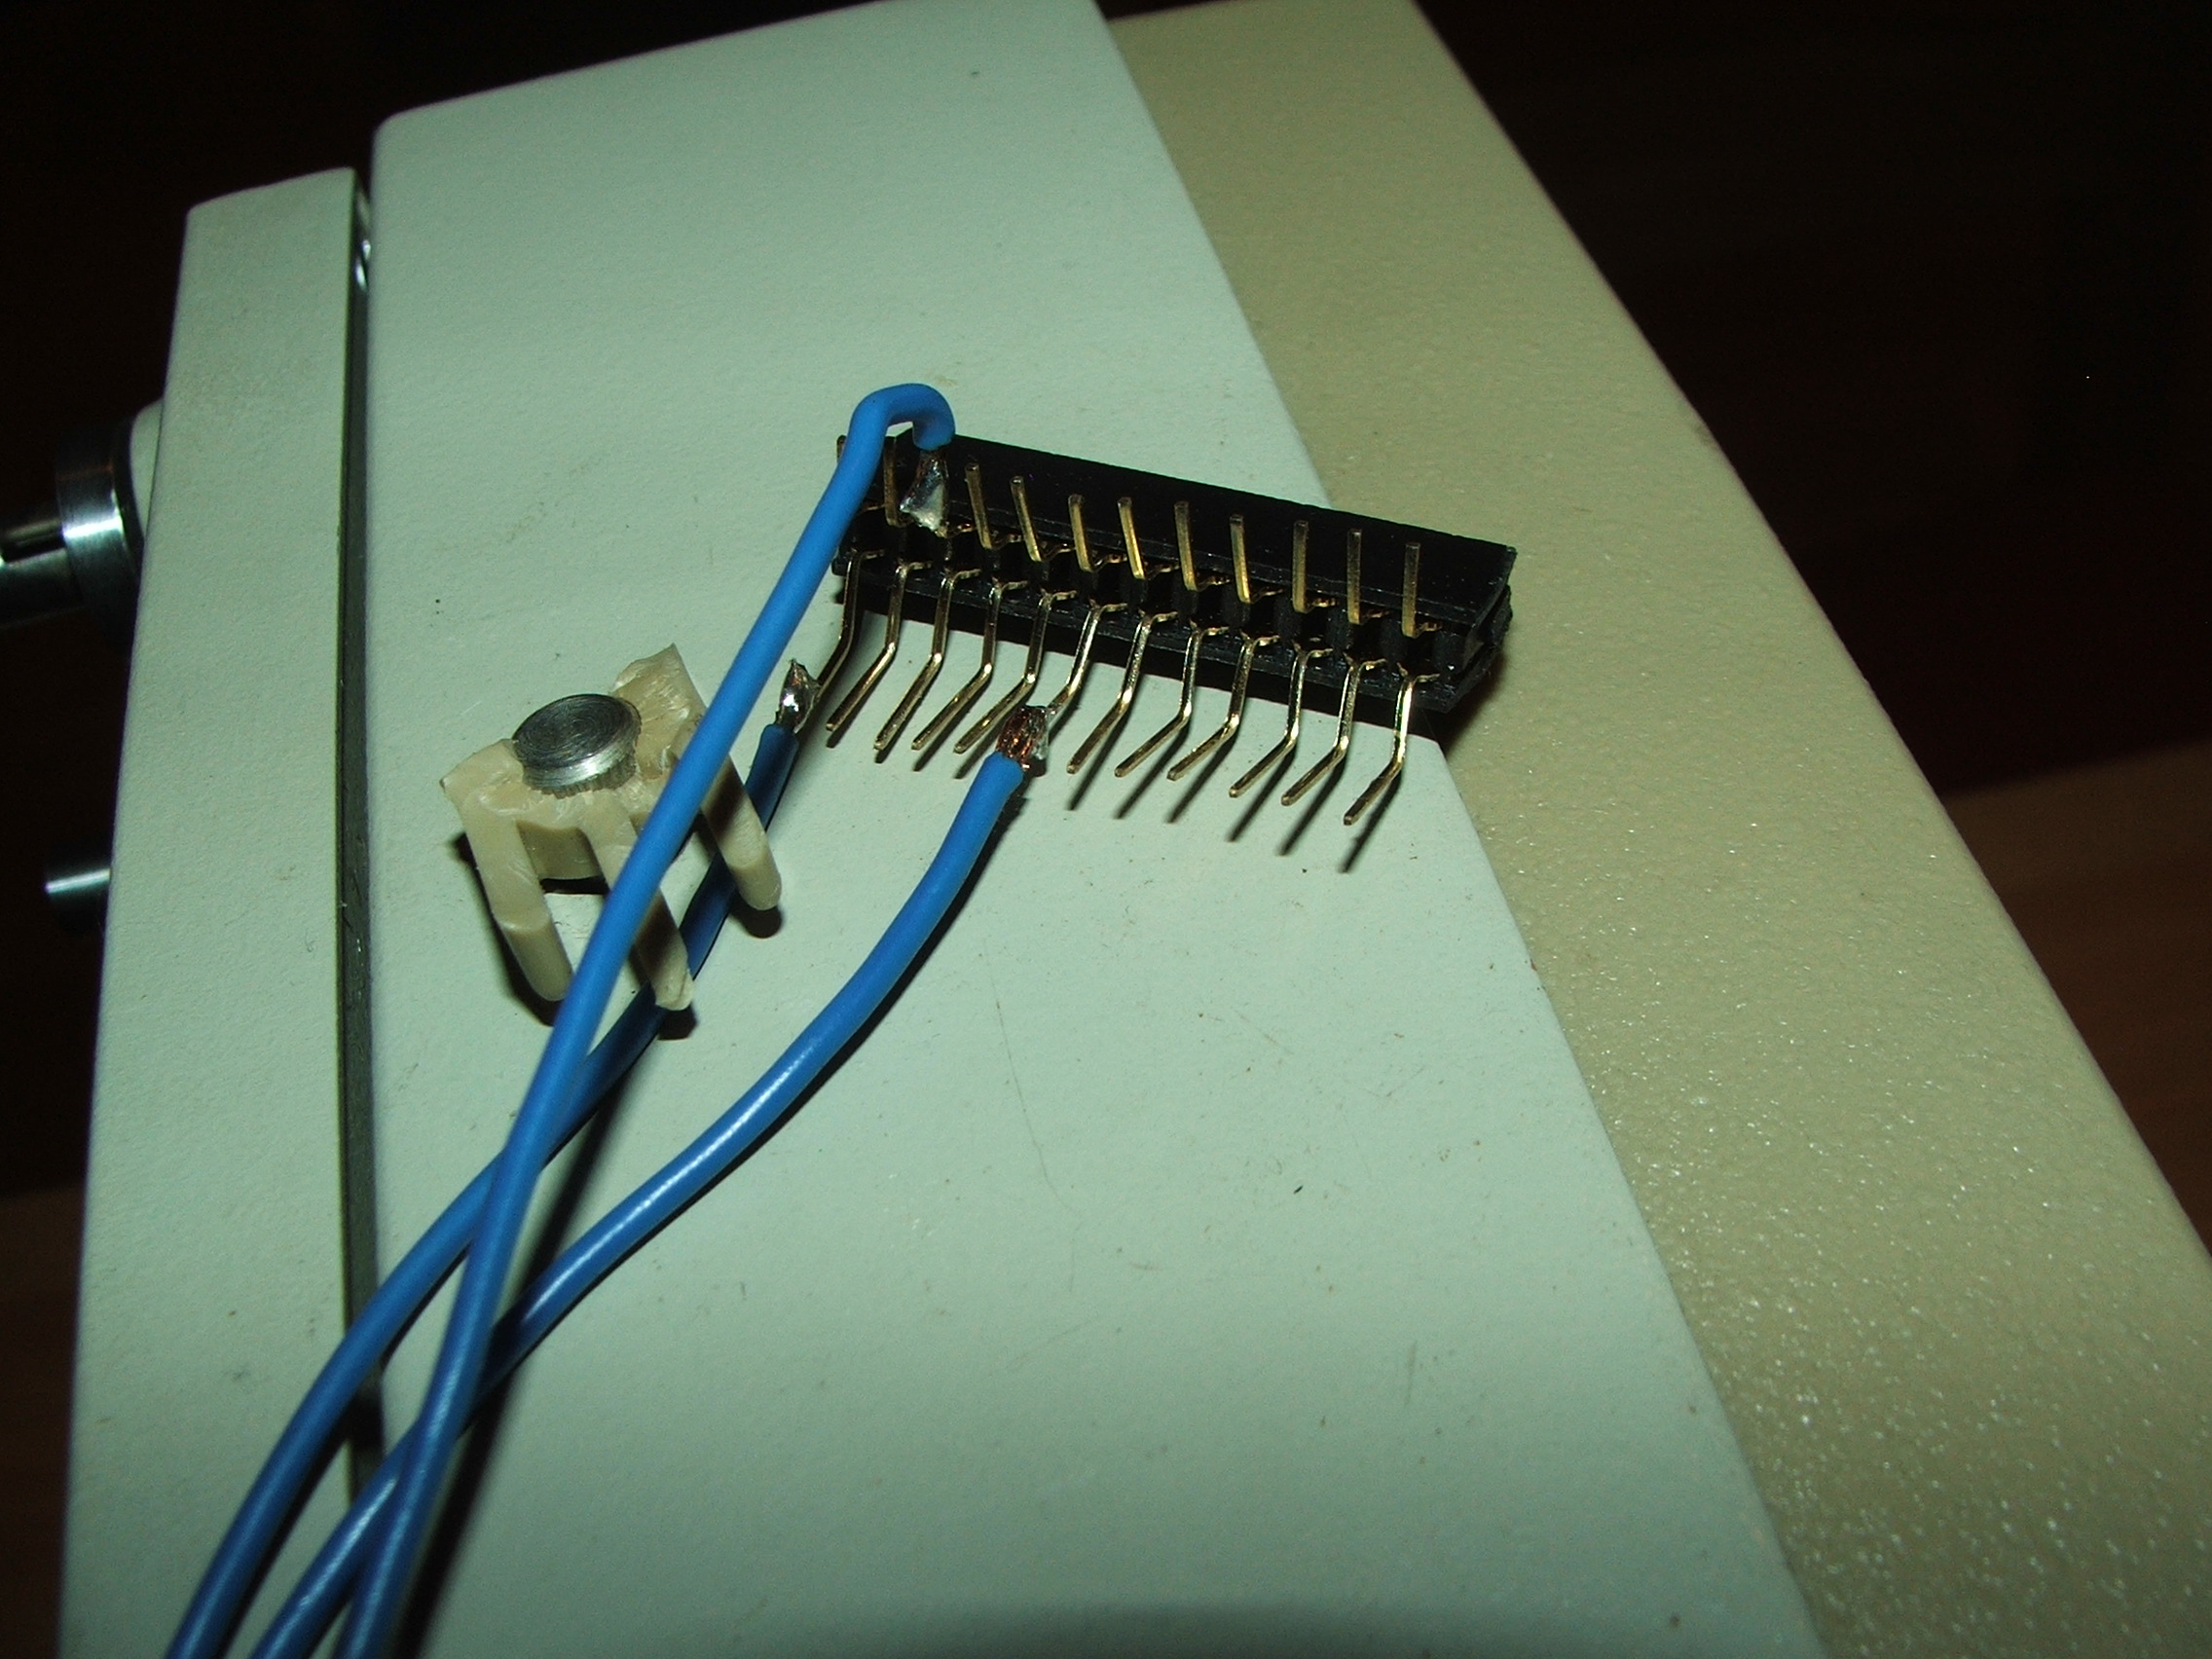
Shoot sensor
Opto gate was built in into the machine, which gives one pulse for every movie slide.

Slide 9
Difficulties
When PiCamera worked, I have written a python script to try GPIO also. Name io.py. After that PiCamera python stopped to work. “io.open - AttributeError: 'module' object has no attribute 'open' ”
Solution: my io.py in home folder overwrote the original python io module.
:-)

Slide 10
RaspiStill
While python did not worked, I have tried RaspiStill signal control. With -s option it waits for SIGUSR1 to shoot.
I have written a C module to send SIGUSR1 signal when edge occurred on GPIO input.
Of course this was slow (1fps)
(movscan.c)

Slide 11
PiCamera python again
With WEB help io.py was renamed, Python gets working again.
Turned out, that in PiCamera, resolution change realises digital zoom (uses center part of CCD) → fast shot with high resolution → :-)
(movscan.py)

Slide 12
Thousand of images
In case of B&W movies, images must be converted to B&W:
convert orig.jpg -type Grayscale ff.jpg
Auto white balance can be applied:
./autowhite.sh orig.jpg corr.jpg
central point mirroring due to optic:
convert orig.jpg -flip flipped.jpg
group commands above: find *.jpg -exec … \;

Slide 13
Create Video
Create 15fps video from images:
avconv -r 15 -f image2 -i image%05d.jpg -vcodec libx264 -crf 15 -preset slower ~/video.avi
It is so slow (1...2 fps)

Slide 14
Result
First test scanning result:
http://youtu.be/uJuZ71KQGfk
How to done it video:
http://youtu.be/zBhdDtUluQk

Slide 15
Thank you for attention!
V1.00
Butyi PlusPlus
2014.01.11.
www.butyi.hu
www.butyi.mooo.com
https://github.com/butyi

