Slide 1
Text Mining & Natural Language Processing
Buu NGUYEN

Slide 2

Introduction
In this study, we analyzed the data of 50 doctoral dissertations and 7000 phrases of English.
The goal was to successfully apply the basics of text mining and natural language processing techniques such as Bag-of-Words and Part-of-Speech Tagging.

Slide 3
Methods
The data was handled by the instructors.
Python and its libraries such as nltk, sklearn, and spacy-stanza was used.

Slide 4
Methods
The text data from 50 doctoral dissertations were read as pre-processing. Then the cosine similarity between dissertations was calculated and plotted into a graph.
7000 English phrases were extracted from the dataset. The POS-Tagging technique was used to detect the verbs inside each phrase. Then, a multi-choice question database was created for further studies.

Slide 5
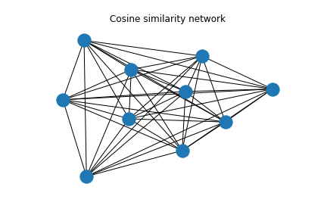
Results
Each nodes is a doctoral dissertation.
Distances between nodes are the cosine similarities between them.

Slide 6
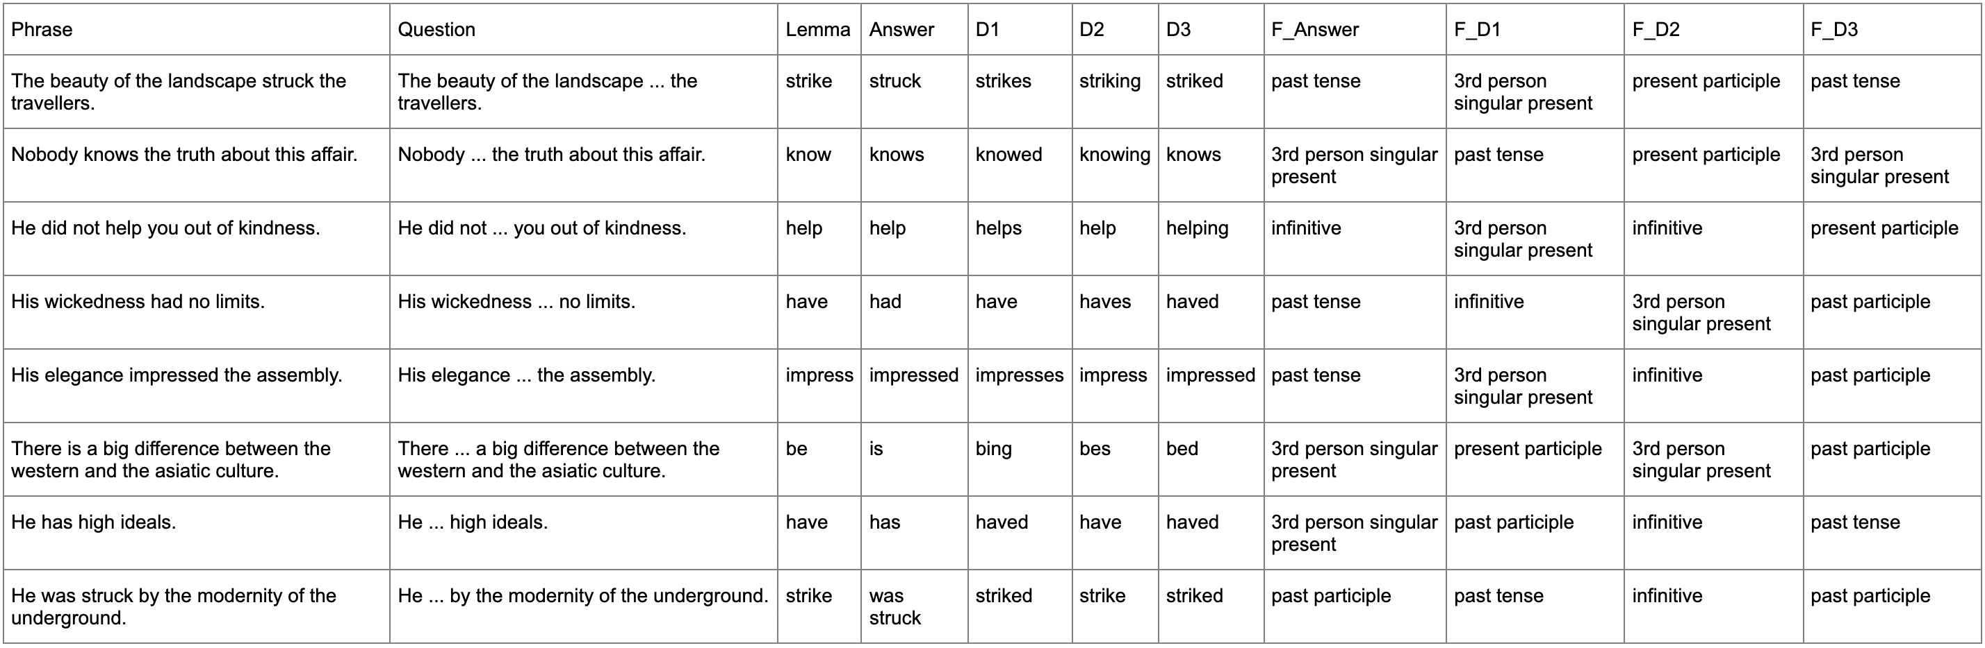
Results

Slide 7
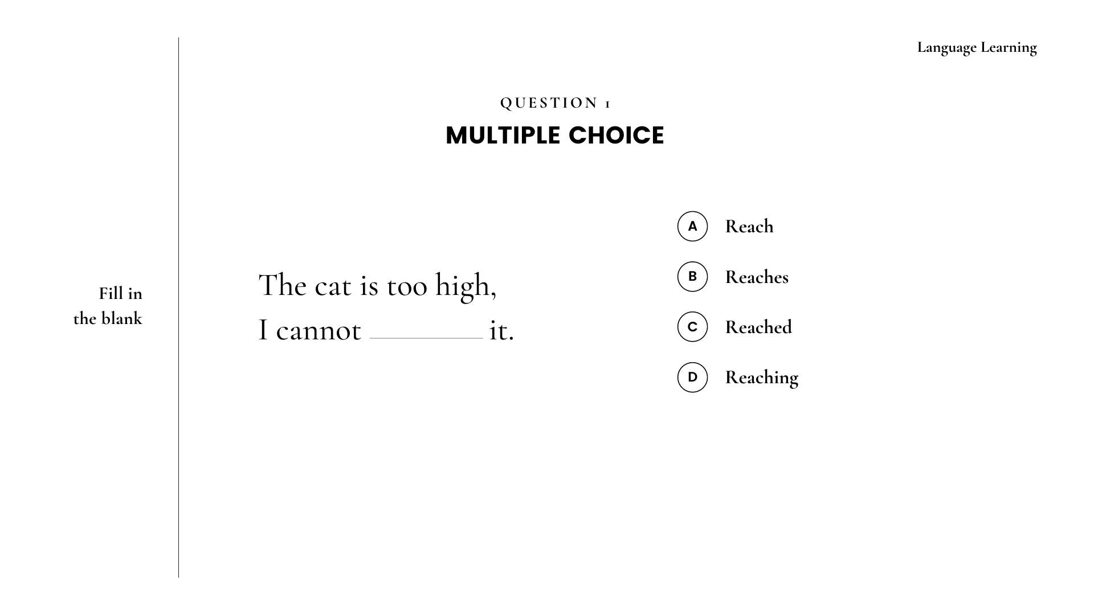

Slide 8
