Slide 1
Social Network Analysis
French Higher Education edition
Buu NGUYEN

Slide 2
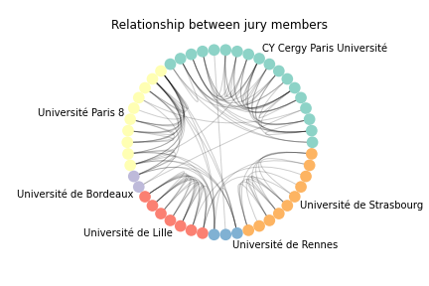
RESULTS ANALYSIS
Most of the relationship is in the same University.
There are numerous connections between Université Paris 8 and Université de Rennes.

Slide 3
Internal jury members

Slide 4
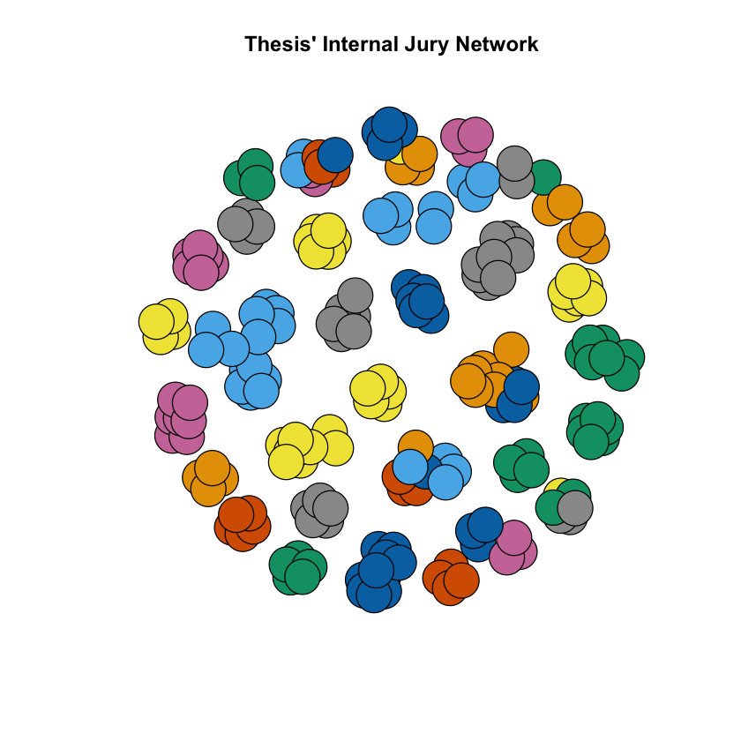

Slide 5
RESULTS ANALYSIS
In the previous Figure, each color represents a different University. We can see that most of the clusters contain members of the same institute, which makes sense because we are analyzing the internal jury members.
The clusters containing members from different institutes need investigation to determine whether they are errors or fascinating phenomenons.

Slide 6
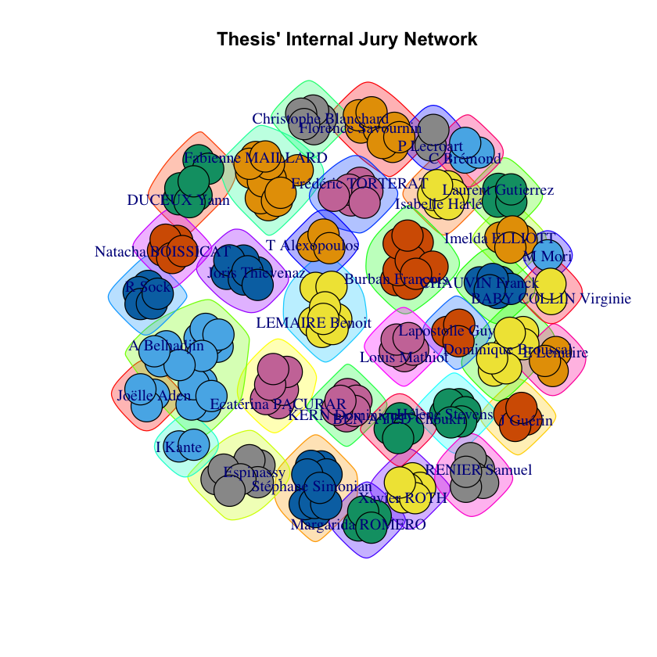

Slide 7
RESULTS ANALYSIS
We put the network through the Louvain Community Detection algorithm and achieved 36 clusters. Thus, it is close to the number of institutions in the network which is 38.

Slide 8
External jury members

Slide 9
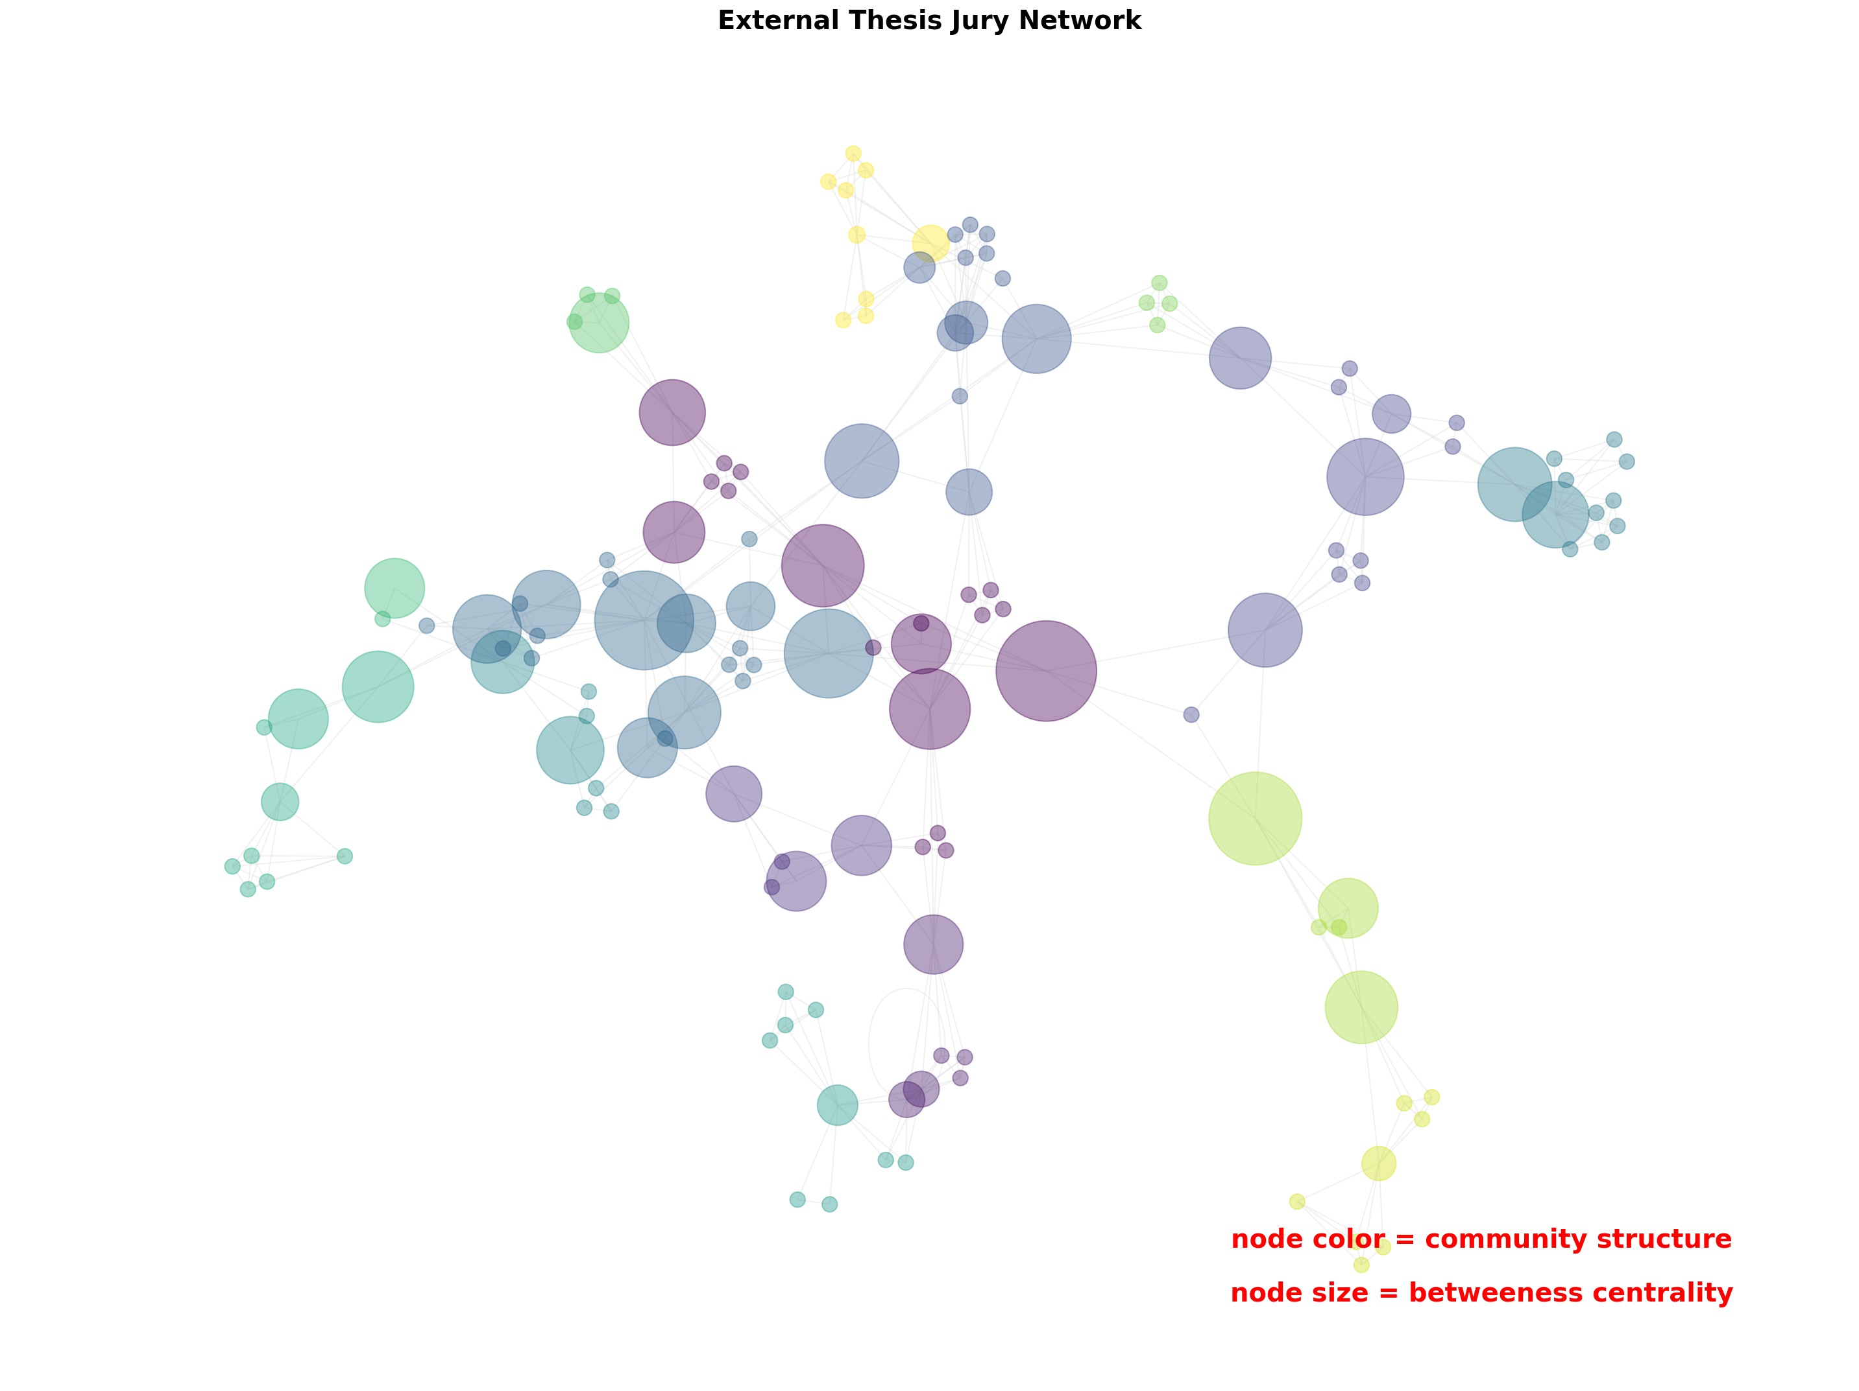

Slide 10
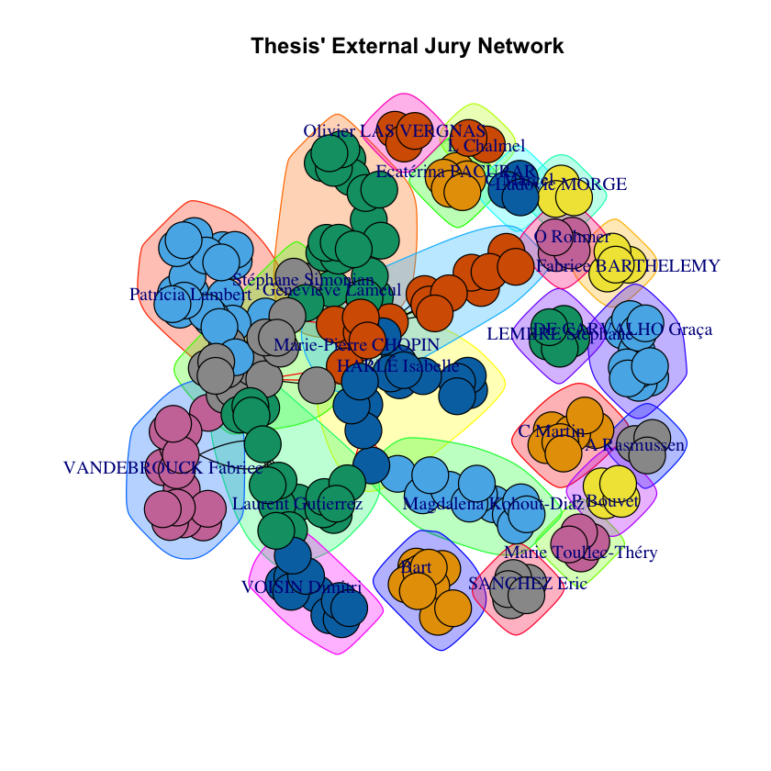

Slide 11
RESULTS ANALYSIS
Unlike the internal network, the external one has more links between jury members, and we can not cluster quickly like with the internal network.
The Louvain Community Detection algorithm returns 24 clusters. Fifteen of them are not connected to other clusters. Nine other forms a huge linked network. In further studies, we will investigate members with the most centrality degree in this network.

Slide 12
Association rules between different disciplines

Slide 13
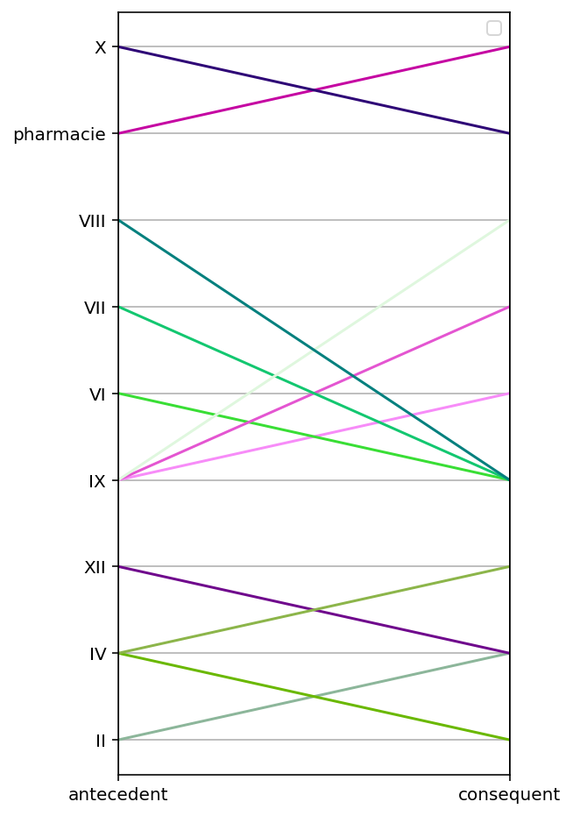
We have 3 groups of association rules:
X -> Pharmacie
IX -> VI, VII, VIII
XII -> IV ; IV -> IXX, II ;
II -> IV

Slide 14
CY Tech’s IB

Slide 15
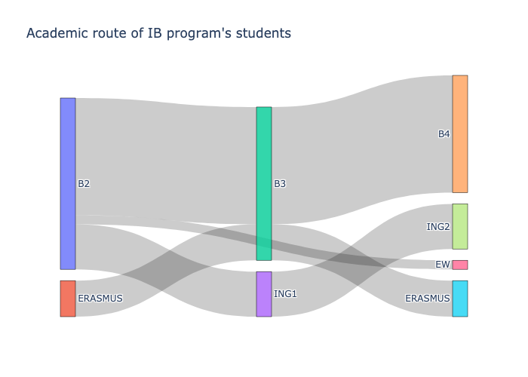

Slide 16
RESULTS ANALYSIS
68%
26%
6%
Switch to the Engineering program
Stay in the Bachelor program
Disappear

Slide 17
THANKS!

