Slide 1
Reflective Regret Adventures in Nintendo 64 Homebrew development

Slide 2
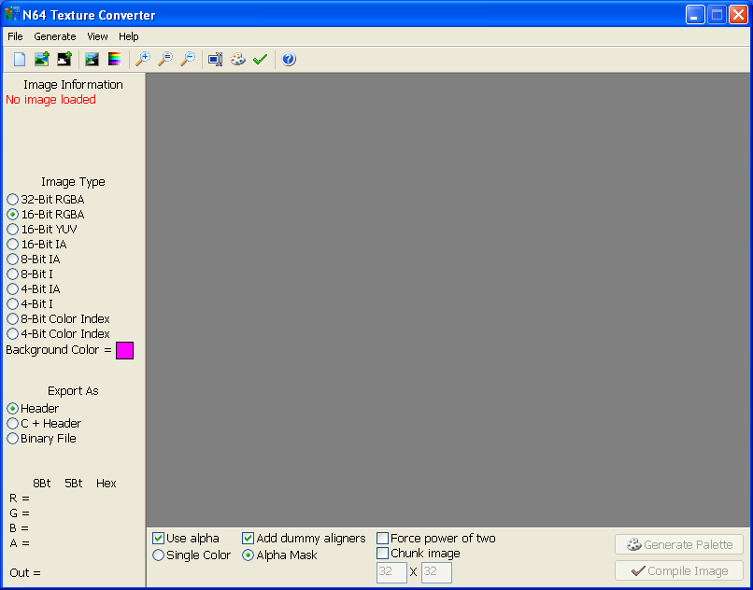
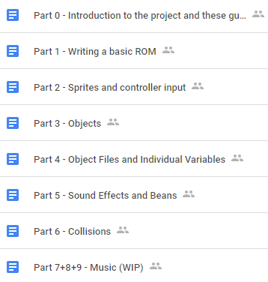
Who are you, and why should I care?

Slide 3
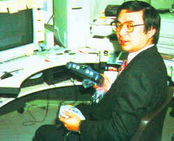
反省
https://nintendowire.com/news/2017/04/27/genyo-takeda-announces-retirement-nintendo/

Slide 4

A Case Study of Stockholm Syndrome The Nintendo 64 Development Community
https://www.istockphoto.com/photo/crazy-woman-wearing-a-straight-jacket-in-an-asylum-gm117144609-16633602

Slide 5
Why do this to yourself?
The N64 is in that era where an entire game could still be made in a reasonable time frame by a single person and not look out of place.
No assembly experience required (but it helps)!
No need for specialized hardware, just get a 200$ flashcart and you’re all set (or don’t, but I wouldn’t recommend it).
It feels awesome to see your custom code running off the system.

Slide 6
The Hardware
The boring, but necessary evil
RCP
CPU
RAM
RAM

Slide 7
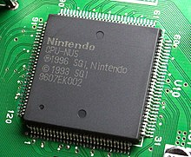
The CPU
NEC VR4300 (MIPS R4300i)
Runs at 93.75 MHz.
16 KB instruction cache
8 KB writeback data cache
Pretty good at floating point arithmetic. Actually faster than fixed point!
Can do 64-Bit operations, but the system bus is 32-Bits wide so games are designed with 32-Bit calling conventions to maximize performance.
No blast processing. Sorry!
Photo by Yaca2671

Slide 8
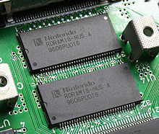
The RAM
250 MHz Rambus DRAM
4 (4.5) MB split as 1 MB banks
9th bit is not exposed to the CPU, it’s
used by the RCP for Z-Buffering and
Anti-Aliasing
8-Bit (9-Bit) data bus
High access latency
Peaks at 562.5 MB/s
Stores literally everything
Unified Memory Architecture
Can be expanded to 8MB with an Expansion Pak
Photo by Yaca2671

Slide 9

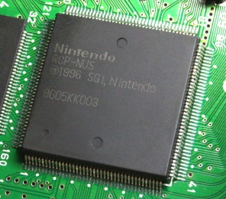
The RCP
Reality Co-Processor
???
Created by Silicon Graphics
Does everything that comes out of your TV, and then some (audio, graphics, I/O, etc…)
Runs parallel to the CPU, at 62.5 MHz
Acts like a whiny brat
Literally magic. GLHF debugging it.
Split into three parts:
Reality Display Processor
Reality Signal Processor
IO Interfaces
RCP photo by Yaca2671

Slide 10
Reality Display Processor
Fixed-pipeline rasterizer + shader
Supports Z-buffering, mip-mapping, anti-aliasing, lots of other futuristic stuff
Tiny texture cache (4KB!?). Manual syncing.
HD 640x480 experience (though usually 320x240)
90% chance your game is fill rate limited, not geometry limited
No vertex/fragment shaders, but you can do some cool effects with the Color Combiner and the Blender

Slide 11
Reality Signal Processor
Vector processor that controls the RDP and many other things
Programmable to do whatever you want via microcode
Be it graphics, audio, video, decompressing assets, or crash your console (requiring a full power cycle)
Audio isn’t great (16-Bit), but can do up to 48,000hz stereo.
Use fixed-point numbers over floats for best performance

Slide 12
How it’s organized, and why you should care
CART
CPU
RCP
RAM
RAM
Your TV

Slide 13
Cartridges
The N64 uses cartridges over disks. Cartridges were a great idea because:
Cartridges are fast! No loading screens because you can almost stream data from it.
You can fit extra hardware in the cartridges. Built in game saves! Real Time Clock!? MODEM!!!
Can probably survive a nuclear blast.
Cartridges were a terrible idea because:
Expensive to make.
Game size can balloon the cartridge cost.
Blow into it to make it work... After the 2nd try.

Slide 14
Official Development Kits
Direct support line to Nintendo.
All compatible with that Silicon Graphics Indy or Onyx you have lying around.
Lots of cool hardware.
Very cheap, lets go over it!

Slide 15
Official Silicon Graphics Setup
Part | Price (USD)
SGI Indy | $5,000
ROM Emulator and Debugger | $3,600
Multigen 3D Modeler License | $9,000
Total | $17,600
Official PC Setup
Part | Price (USD)
Personal Computer (Win95 to XP) | You might have one lying around
ROM Emulator and Debugger | $1,600
Sound Tools | $1,500
3DS Max License | $4,000
Total | $7,100

Slide 16
Jank Back Alleyway Deal Setup
Part | Price (USD)
Personal Computer (Win95 to XP) | You might have one lying around
Doctor V64 | $450
A copy of any N64 game to bypass the lockout chip | $20
Anim8or | Free
Total | $470
Modern Setup
Part | Price (USD)
Personal Computer (A modern OS) | You already owned one.
A flashcart (with USB) | $200
Blender | Free
OpenMPT or Anvil Studio | Free
Total | $200

Slide 17
Software Development Kit
As of making this presentation, you currently have two reliable options for SDK’s:
Libultra - The official SDK
Obtainable from your local company liquidation auction or shady trench coat guy. Proprietary.
Works on Windows 95 to XP out of the box, but we have modern alternatives that run off DOSBox, Wine, Windows 10 via WSL, or Linux/macOS.
Libdragon – A free and open source SDK
Currently only supports 2D but this is changing very soon!!!
Will work on any modern system. You can even get it for Docker!
Easier to use as it doesn’t expose much of the OS.

Slide 18
Flashcarts
In case I haven’t said it enough, get a Flashcart with USB!
64Drive
EverDrive X7
DIY options: SummerCart64
With USB, not only do you get debugging, but you get a faster workflow (no fiddling with SD cards).
UNFLoader ☺
Don’t trust emulators
No, really
Not even CEN64

Slide 19
Programming Languages
C
C++
MIPS Assembly
BASS, armips, or GAS.
Unlikely you ever need it. Welcome to the future of Game development.
If you’re so inclined (Don’t expect any support!):
Rust
Zig

Slide 20
Other Development Tools
It’s unlikely you’ll have access to official hardware or software (not that it helps, a lot of it is finicky or annoying to use).
You’ll pretty much DIY everything, but you have community tools for:
Textures conversion
Modeling and Animating
Sound and Music
https://n64.dev
There is no generic game engine for N64 (IE Unity).
If you want to hack or mod games, you’re asking the wrong person, but they have their own tools.

Slide 21
Development Process
The boring stuff is out of the way, let’s get to the fun part!

Slide 22
Threads and Tasks
Preemptive scheduler
Threads only yield when they want to, you don’t have something like a round-robin scheduler.
The CPU generates tasks for the RCP to perform.
The RCP will interrupt the CPU when it’s done with a task.
Threads communicate with each other via messages.
Libdragon doesn’t have threads (yet).

Slide 23
Microcode
When generating tasks for the RCP, the CPU chooses which microcode (µcode) will execute on the RSP to perform the task.
Non comprehensive list of µcode (bold is proprietary):
3D: F3DEX2, Fast3D, ugfx, libhfx
2D: S2DEX
Audio: naudio, RSP Mixer
Video: HVQM2, H264
The Cool Kids Club™ was given access to the source code for the original µcodes and documentation scribbled on a used paper napkin.
r64emu

Slide 24
Framebuffer
No VRAM, Framebuffer and whatnot must be stored in RAM.
Different sizes and framerates based on region (PAL vs NTSC)
320x240 vs 320x288
640x480 vs 640x576
16-Bit or 32-Bit
Gets outputted as 24-Bit color, so probably not worth the memory penalty going 32-Bit
Position in RAM is important!!!

Slide 25
1MB limit on code
The bootcode only loads the first MB of code into RAM and executes it.
Don’t link your assets to the codesegment. Load them as you need them from the cartridge.
1MB of code is a lot, you probably won’t hit it
If you do hit it, are solutions:
Overlays
Relocatable Modules
Libdragon has a built in filesystem.

Slide 26
CPU Cache and Addresses
Applications run in Kernel mode.
CPU uses virtual addresses, RCP wants physical addresses.
CPU virtual address translation by either:
Direct mapping
Translation lookaside buffer
Writeback and Invalidate when using DMA

Slide 27
Basic Graphics Programming
Does N64 use OpenGL?
Display Lists
Vertex Cache
Explicitly managed. Size depends on microcode.
Matrix Stack
Vertex colors
Texture Memory
4 Kilobytes!?
Half if using Mip-Mapping

Slide 28
Color + Alpha Combiner
Closest thing to a fragment shader available
Very simple equation:
Can be done in two passes
$$\left(a −b\right)×c+d$$

Slide 29

Blender
Blends colors set from CC to the ones in the framebuffer. Also does Anti-Aliasing and Z-Buffering.
Many equations, but the main one is:
Also supports two passes.
Way too much to talk about, read the manual.
$$\frac{a×p +b×m}{a+b}$$

Slide 30
Model Animation
Sausage links
Entire models of animation frames
Hybrid
Skeleton system
Vertex cache hack

Slide 31
Sound and Music
Affected by region!
You can just put whatever you want in an audio buffer
Prepare data to avoid popping, use a queue. Helps to write a scheduler to interleave audio and graphic tasks.
naudio
ADPCM
MIDI
No limit on channels
RSP Mixer
Tracker Music (XM)
MP3?
Probably will eat up your ROM size

Slide 32
My Game Runs Like Crap!
Yes it does. Get used to it.
Only one commercial game runs at a near stable 60FPS (50FPS on PAL), everything else pretty much runs at 30 or lower.
Most games are fillrate limited.
Optimize your texture calls.
Optimize your drawing order.
Selectively disable the Z-Buffer.
Cull. LODs.
Align data as much as possible.
Use compiler optimizations. Duh.
RTFM ☺

Slide 33
Homebrew, Demos, and the future of N64 Development
History lesson time!
Terms of Use
Last Updated: May 24, 2016
Welcome to Nintendo.com! These Terms of Use (the "Terms") apply to your access to, and use of, www.Nintendo.com, and any other website or service that links to these Terms (collectively, the "Services"). The Services are provided by Nintendo of America Inc. ("Nintendo" or "we") and your use of the Services is subject to these Terms. These Terms do not alter, in any way, the terms or conditions of any other agreement you may have with Nintendo for products, services or otherwise.
PLEASE READ THESE TERMS OF USE CAREFULLY. BY ACCESSING OR USING OUR SERVICES, YOU AGREE TO BE BOUND BY THE TERMS AND CONDITIONS DESCRIBED HEREIN AND ALL TERMS INCORPORATED BY REFERENCE. IF YOU DO NOT AGREE TO ALL OF THESE TERMS, DO NOT USE OUR SERVICES.
Eligibility.
The Services may not be used by anyone under the age of 18 without the supervision of a parent or legal guardian who agrees to be bound by these Terms. You represent and warrant that you are at least 18 years of age (or the age of legal majority under applicable law), or, if not, that you have reviewed these Terms with your parent or legal guardian and that he or she has agreed to be bound by these Terms.
Privacy.
Please refer to our Privacy Notice for information about how we collect, use and share information about users of our Services.
Ownership.Nintendo Materials. The Services contain content including, without limitation, Nintendo’s logos, and all designs, text, graphics, pictures, information, data, software, sound files, other files and the selection and arrangement thereof (collectively, the "Materials") that are the proprietary property of Nintendo or Nintendo’s licensors and are protected by U.S. and international copyright laws.
User Content. The Services may permit you or other users to create, post, send or store messages, photos, text and other materials ("User Content"). Nintend
Nintendo
Cease && Desist
CLASSIC
Nintendo
Cease && Desist
CLASSIC

Slide 34
The Humble Beginnings: Dextrose
1997 – Dextrose is created.
1998 – Presence of Mind, the first N64 Development competition.
1999 – PoM #2
Lots of demos and intros are released during this timeframe.

Slide 35
The Great Depression
1999 – T̴͈̍̚͝h̶̻͓̽ę̷̓ ̴͙͌͑O̸̹̘͑͗̈m̶̬͆̇̋a̶͍̋̕n̵̫̙͈̐ ̶͚̹̭̏Ǎ̵̺̰͜ŕ̴̖̬̗̐c̸̡̳̍̀͜͝h̴̰͖̆ͅi̶̹̱̅v̵̫͚̈́ė̶̖̹̮̓̀ş̴͔̳̈́͝
2001 – Project64 is released.
2002 – N64 is discontinued
Interest in making new stuff for the system was very small, pretty much kept alive by a handful of users.
Infighting in the emulation scene.
Preservation of games, hacks and translations.

Slide 36
The Renaissance
Collectors get ahold of the original disks and hardware
2008 – Alt_libn64 is released
2010 – Libdragon merges with alt_libn64
2011 – marshallh’s MGC demo, CIC is RE’d, 64Drive is released
2016 – N64Brew is created
2018 – Pyoro64
2019 – SM64 RE project goes public
2020 – The first N64 Homebrew game Jam happens, 20 years after the last PoM.
Creation of the wiki at https://n64brew.dev

Slide 38
Communities
#n64dev @ EFnet IRC
Oldest active community
N64brew @ Discord
Discord64, iQueBrew, Hack64
Lots of dedicated hacking and decompilation servers
/r/N64Homebrew

Slide 39
Thanks for putting up with me!
Lots of ways of getting in touch:
buu342@hotmail.com
https://github.com/buu342 ← Presentation source
www.youtube.com/c/Buuu342/
Buu342#1427
Special thanks to:
Rasky, Bigbass, Hazematman, Meeq, mikeryan for proofreading, correcting me, and answering questions.
marshallh, krom, mikeryan, hcs, Dragonminded, Zoinkitty, Zilmar + angrylion for keeping the N64 community alive.
N64brew for being an awesome community <3
Inércia for inviting me and hosting such a wonderful event!

Slide 40
Sources
N64 Programming Manual
https://n64brew.dev
http://en64.shoutwiki.com/wiki/N64_Memory
https://www.copetti.org/writings/consoles/nintendo-64/
https://www.retroreversing.com/n64/
https://www.moria.us/tags/nintendo-64
https://web.archive.org/web/20021017102203/http://www.dextrose.com/dx_index.htm
https://en.wikipedia.org/wiki/Nintendo_64_programming_characteristics
https://en.wikipedia.org/wiki/Nintendo_64_technical_specifications

