Slide 1
Finding pedestrians in static image
Đặng Trương Khánh Linh
0612743

Slide 2
Problem statement
Build up a system which automatically detects and localizes pedestrians in static image.
Constraints:
Pedestrians stand up and fully visible people.
Size of pedestrian is not less than 64x128 pixels.

Slide 3
Applications
Using in smart car system, or smart camera in general.
Build a software to categorize personal album images to proper catalogue.

Slide 4
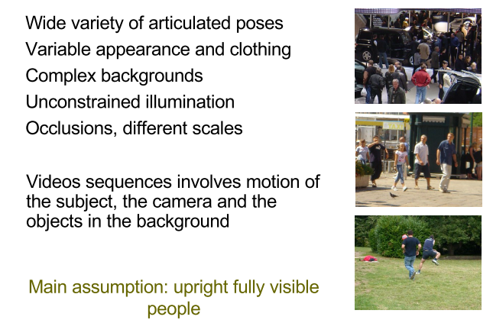
Challenges

Slide 5
Outline
Literature review.
Motivation.
Overview of methodology.
HOG
Spatial & oriented histogram
Learning phase
Detection phase
Non-maximum suppression
Some contributions:
Four regions based approach
Non-uniform based approach
Multi-level based approach

Slide 6
Existing approaches
Haar wavelets + SVM: Papageorgiou & Poggio, 2000; Mohan et al 2000
Rectangular differential features + adaBoost: Viola & Jones, 2001
Model based methods: Felzenszwalb & Huttenlocher, 2000; Loffe & Forsyth, 1999
Lowe, 1999 (SIFT).
LBP, HOG, …

Slide 7
Motivation of choosing HOG
Use the advantage of rigid shape of object.
Low complexity and fast running time.
Has a good performance.

Slide 8
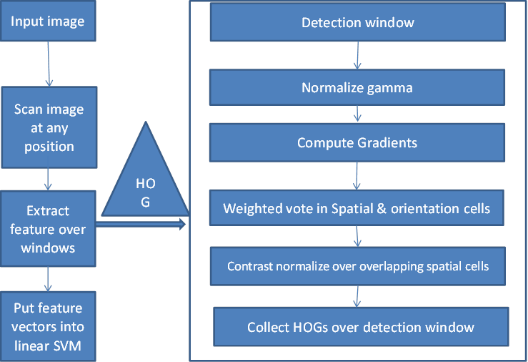
Overview of methodology

Slide 9
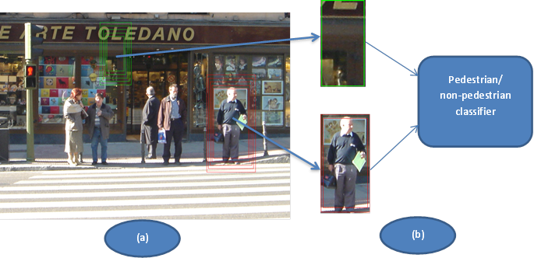
Example

Slide 10
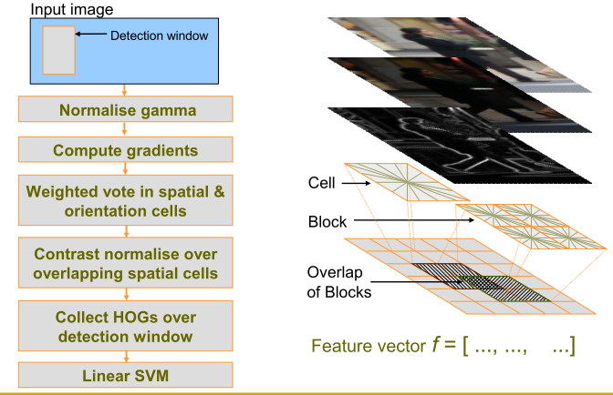
HOG: feature extraction algorithm

Slide 11
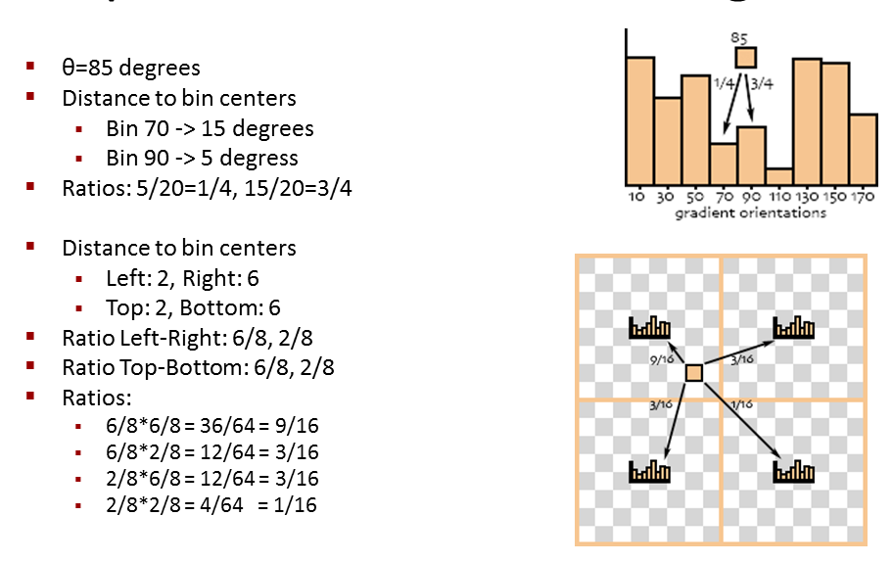
Spatial & oriented histogram

Slide 12
Learning phase
Prepare the training set of positive and negative windows
Densely scan through negative image to find false positive windows
Calculate the feature vector of training set windows
Assemble all FP windows into original negative training set
Put the positive and negative feature vector of training set into SVM
Use SVM to learn in second time.

Slide 13
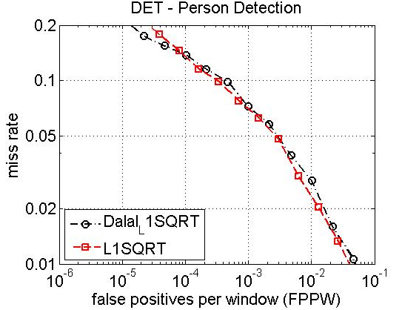
Result of experiment

Slide 14
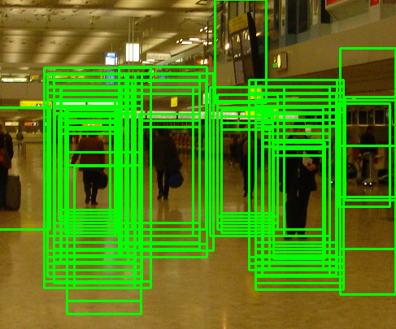
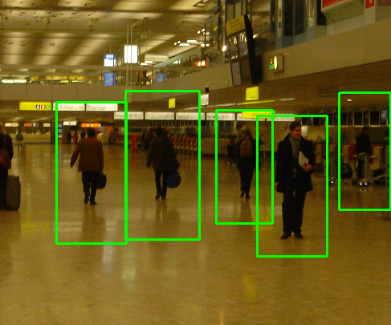
Non-maximum suppression
Using non-maximum suppression such as mean shift to find the modes.

Slide 15
Demo of Mean shift

Slide 16
Mean shift
Region of
interest
Center of
mass
Mean Shift
vector
Slide by Y. Ukrainitz & B. Sarel

Slide 17
Mean shift
Region of
interest
Center of
mass
Mean Shift
vector
Slide by Y. Ukrainitz & B. Sarel

Slide 18
Mean shift
Region of
interest
Center of
mass
Mean Shift
vector
Slide by Y. Ukrainitz & B. Sarel

Slide 19
Mean shift
Region of
interest
Center of
mass
Mean Shift
vector
Slide by Y. Ukrainitz & B. Sarel

Slide 20
Mean shift
Region of
interest
Center of
mass
Mean Shift
vector
Slide by Y. Ukrainitz & B. Sarel

Slide 21
Mean shift
Region of
interest
Center of
mass
Mean Shift
vector
Slide by Y. Ukrainitz & B. Sarel

Slide 22
Mean shift
Region of
interest
Center of
mass
Slide by Y. Ukrainitz & B. Sarel

Slide 23
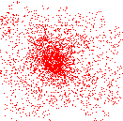
Mean shift clustering
Cluster: all data points in the attraction basin of a mode
Attraction basin: the region for which all trajectories lead to the same mode
Slide by Y. Ukrainitz & B. Sarel

Slide 24
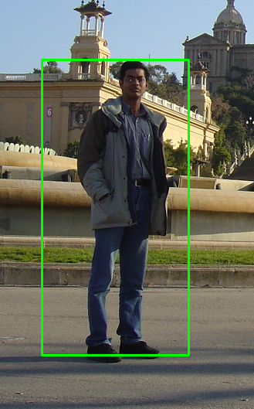
Some examples

Slide 25
Some slight contributions
Four regions based approach
Non-uniform based approach
Multi-level based approach

Slide 26
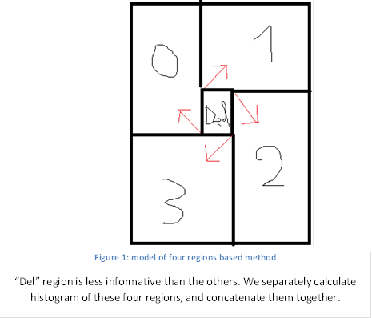
Four regions based approach

Slide 27
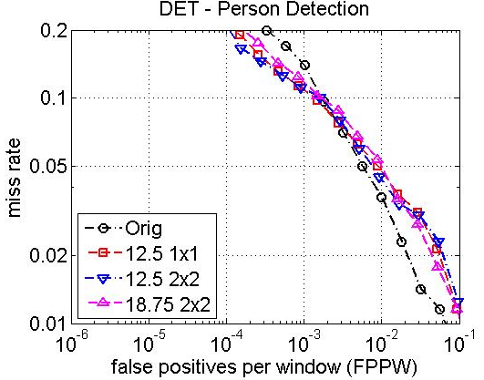
Result

Slide 28
Non-uniform based approach

Slide 29
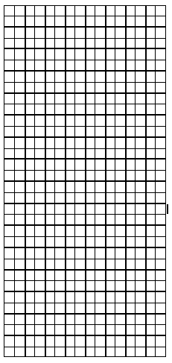
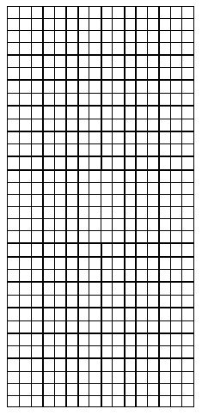
105
84

Slide 30
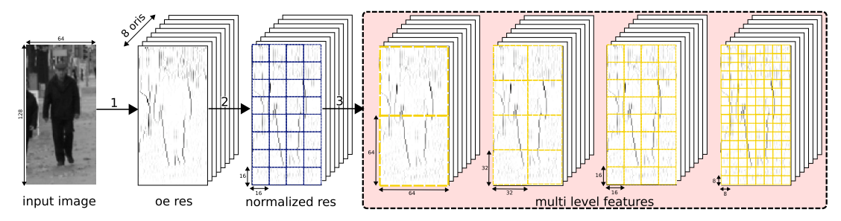
Multi-level based approach

Slide 31
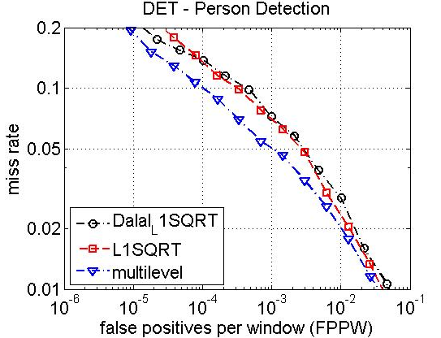
Result

Slide 32
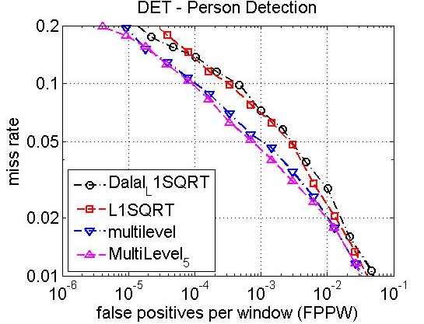
Result(cont…)

Slide 33
Positive samples
Negative samples
False positive windows
Training samples
Classifier
Training negative image set

