Slide 1
MOBILE COMPUTING PROJECT
Real-Time Mobile
Boxing Coach
Butemj Bat-Orshikh · Assem Sagyndykova
Seoul National University · 2026-1

Slide 2
Motivation & Goal
THE PROBLEM
OUR GOAL
Detect & classify punches in real time using smartphone camera
Run entirely on-device
Provide AI-powered coaching feedback after each session
Supports jab · cross · hook (3-class + idle)
Boxing technique is hard to self-correct without a trainer
Commercial apps (FightCamp, Nike) require wearables or offer only generic tracking
No vision-based, on-device coaching app exists for combat sports

Slide 3
Data Collection Pipeline
5
30
~3s
1,280
Punch Classes
Clips / Class
Clip Duration
Balanced Windows
CLASSES
RECORDING SETUP
JAB
Lead hand forward extension
Custom walk-up-and-go recorder
(using python)
Countdown timer — press once, walk to position
Southpaw stance, consistent camera height
Multiple punch reps per clip — windowed later
Front-facing camera at 2–2.5m distance
CROSS
Power hand with shoulder rotation
HOOK
Lateral arc, either hand
UPPERCUT
Upward drive (removed)
IDLE
Guard, slipping, no punch

Slide 4
Approach 1: On-Device 1D-CNN Classifier
Input: (30 frames × 85 features) = keypoints + velocity
Conv1D(32) → BN → ReLU → Dropout(0.4)
Conv1D(64) → BN → ReLU → Dropout(0.4)
GlobalAveragePooling → Dense(32) → Dense(5)
INT8 quantization via TFLite
MODEL ARCHITECTURE
WHY IT FAILED IN PRACTICE
Mixed dataset: different camera heights in same training set. Model couldn't generalize.
Too little data: 30 clips × 5 classes = 1,024 train samples. Model collapsed to single class repeatedly
Uncontrolled recording environment: limb detector was constantly being confused by wall and table

Slide 5
1D-CNN: Iterative Failures
Attempt 1
Val acc: 20% — model predicts only 'uppercut'
50 clips/class, mixed camera heights
Mixed dataset: first 30 clips at high camera, last 20 at low camera. Two different distributions labeled the same.
Attempt 2
Val acc: 28% — model predicts only 'idle' (100%)
Added 30 more idle clips → imbalanced
Idle class dominated with 3× more windows. Model learned to always predict majority class.
Attempt 3
Val acc: 21% — collapses to 'jab' or 'uppercut'
Balanced classes + 20 clips/class, consistent height
Only 1,024 training samples for 5 classes. Insufficient diversity for generalization.
Root Cause
Punch depth (z-axis) not captured by 2D pose
Front-facing monocular camera limitation
Jab and idle share similar x/y keypoint positions. Model can't distinguish without depth info.

Slide 6
Approach 2: LLM-Based Session Analysis
Why switch to Claude API?
1
Data limitation
1D-CNN needs hundreds of clean, consistent samples per class. Hard to collect solo with consistent conditions.
2
Depth ambiguity
2D pose distinguish jab vs idle reliably — both show minimal x/y wrist displacement. LLM can reason about context.
3
Richer feedback
A classifier outputs one label. Claude outputs structured coaching: counts, strengths, improvements, guard analysis.
4
Architecture insight
Post-session analysis is more useful than real-time classification — mirrors how coaches review footage.

Slide 7
System Architecture
Camera
(CameraX)
Frame
Sampler
MoveNet
Lightning
Keypoint
Buffer
Feature
Extractor
Claude
Haiku API
Results
Screen
→
→
→
→
→
→
30fps front
camera feed
Every 10th
frame (3fps)
17 keypoints
@ 192×192px
Stores keypoints
+ timestamps
Velocity peaks
guard + shoulder
Motion summary
→ JSON output
Counts + feedback
+ guard tips
MoveNet Lightning runs fully on-device (TFLite) · Claude API called once per session

Slide 8
Keypoint Buffer & Feature Extractor
KEYPOINT BUFFER
FEATURE EXTRACTOR
Accumulates MoveNet output during the session
Each entry: (timestamp, FloatArray[51])
51 = 17 keypoints × 3 values (y, x, confidence)
Sampled at ~3fps → 45 entries for 15s session
Stored in memory until session ends
Session ends → entire buffer sent to Feature Extractor
normalizeHipBased() — centers keypoints on hip midpoint, scales by torso height → body-relative positions
velocityPeaks() — finds frames where wrist speed spikes then drops (punch signature) → timestamp + direction + speed
wristActivity() — sums wrist displacement per 1s window → shows active vs idle periods
shoulderRotations() — detects shoulder width changes > 0.05 → cross/hook indicator
analyzeGuard() — counts % frames wrists dropped below chin or elbows flared
No ML model used in this step. Output is compact text sent to Claude

Slide 9
LLM Pipeline: Feature Engineering → Claude
FEATURES SENT TO CLAUDE
STRUCTURED OUTPUT
Wrist velocity peaks — timestamps where wrist speed spikes then decelerates (punch signature)
Per-second motion summary — lead vs power wrist activity level each second
Shoulder rotation events — closing/opening shoulder width (cross/hook indicator)
Guard analysis — % frames where wrists drop below chin level, elbow flare detection
Sampled at ~3fps — compact, Claude-readable format
{
"jab_count": 5,
"cross_count": 3,
"hook_count": 2,
"punch_events": [
{"time": 2.3, "type": "jab"},
...
],
"overall_feedback": "...",
"strengths": [...],
"improvements": [...],
"guard_feedback": "..."
}

Slide 10
Android Application
MAIN SESSION SCREEN
Punch counts: Jab / Cross / Hook
Coach feedback — 2–3 sentence summary
Strengths (green ✓)
Areas to improve (orange →)
Guard feedback — raised if hands dropped below chin
Punch timeline — collapsible, shows each detected punch with timestamp
RESULTS SCREEN
Stance selector: Orthodox / Southpaw
Duration selector: 10s / 15s / 30s
START → countdown → auto-record → analyze
Live camera preview with real-time skeleton overlay
MoveNet Lightning runs on-device (TFLite)
Keypoints sampled at ~3fps during session
·
·
·
·
·

Slide 11
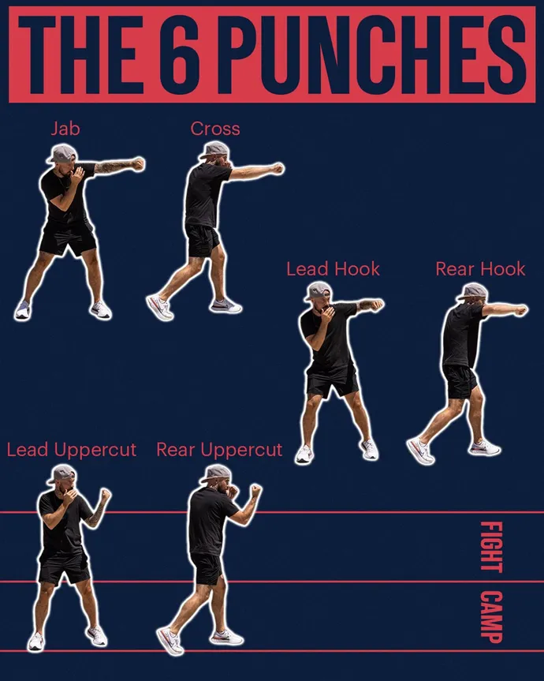
Technical Issues
BOXING PUNCH TYPES
Upward movement isn’t unique to uppercut
Uppercuts are often thrown at short range and can complete very quickly
The upward arc is very short
POSSIBLE REASONS FOR UPPERCUT FAILURES
·
·
·
·
·

Slide 12
Limitations & Future Work
CURRENT LIMITATIONS
FUTURE WORK
Monocular camera cannot capture depth (z-axis)
Claude API requires internet — cannot work offline
No combo detection (e.g., jab-cross sequence)
Uppercut excluded due to technical limitation
Collect 100+ clips per class from multiple athletes for robust on-device model
IMU sensor fusion (accelerometer + gyroscope) to recover depth signal
Fine-tune lightweight vision-language model for fully on-device analysis
Left/right hook and uppercut detection with dual-camera depth
Session history tracking and progress over time

Slide 13
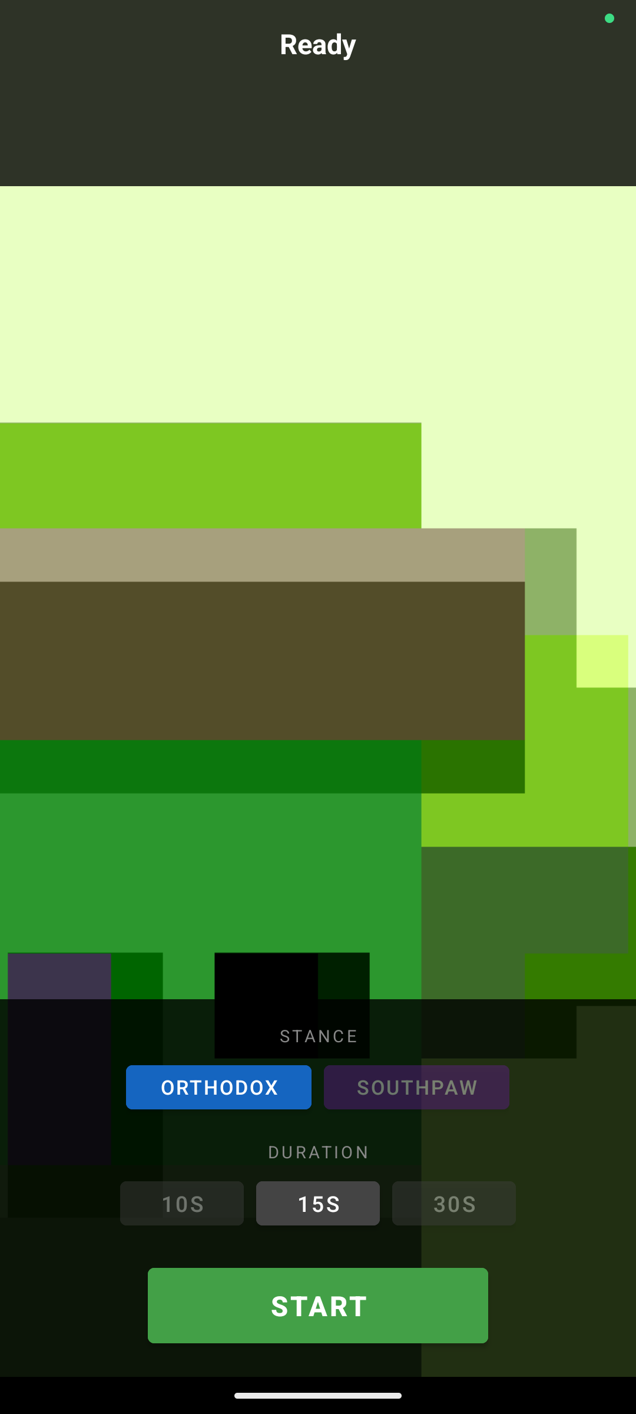
Demo
ANDROID EMULATOR SCREEN CAPTURE
https://drive.google.com/file/d/1o1zmVS6h81l7k__KkR0bFJWW5xLQHLdO/view?usp=sharing
DEMO SHADOWBOX RECORDING

Slide 14
