Slide 1
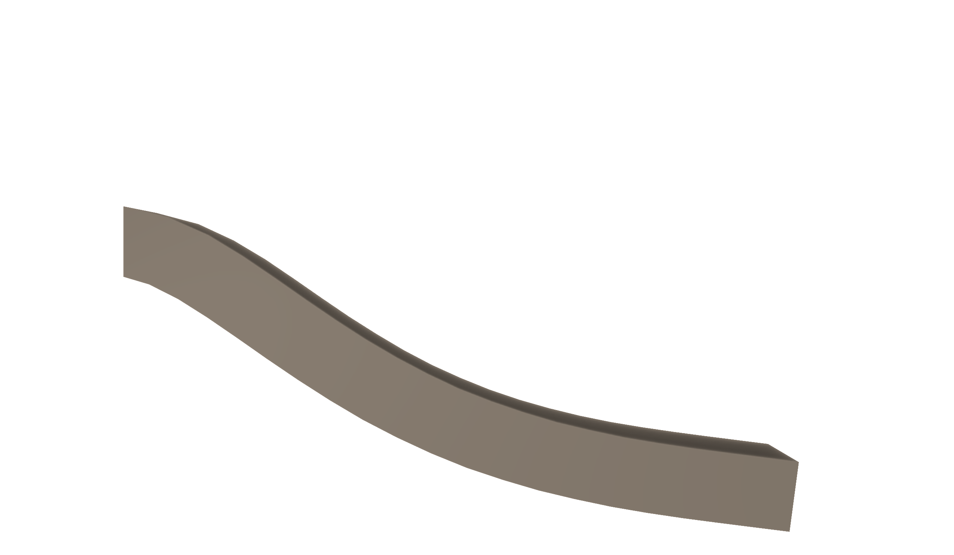
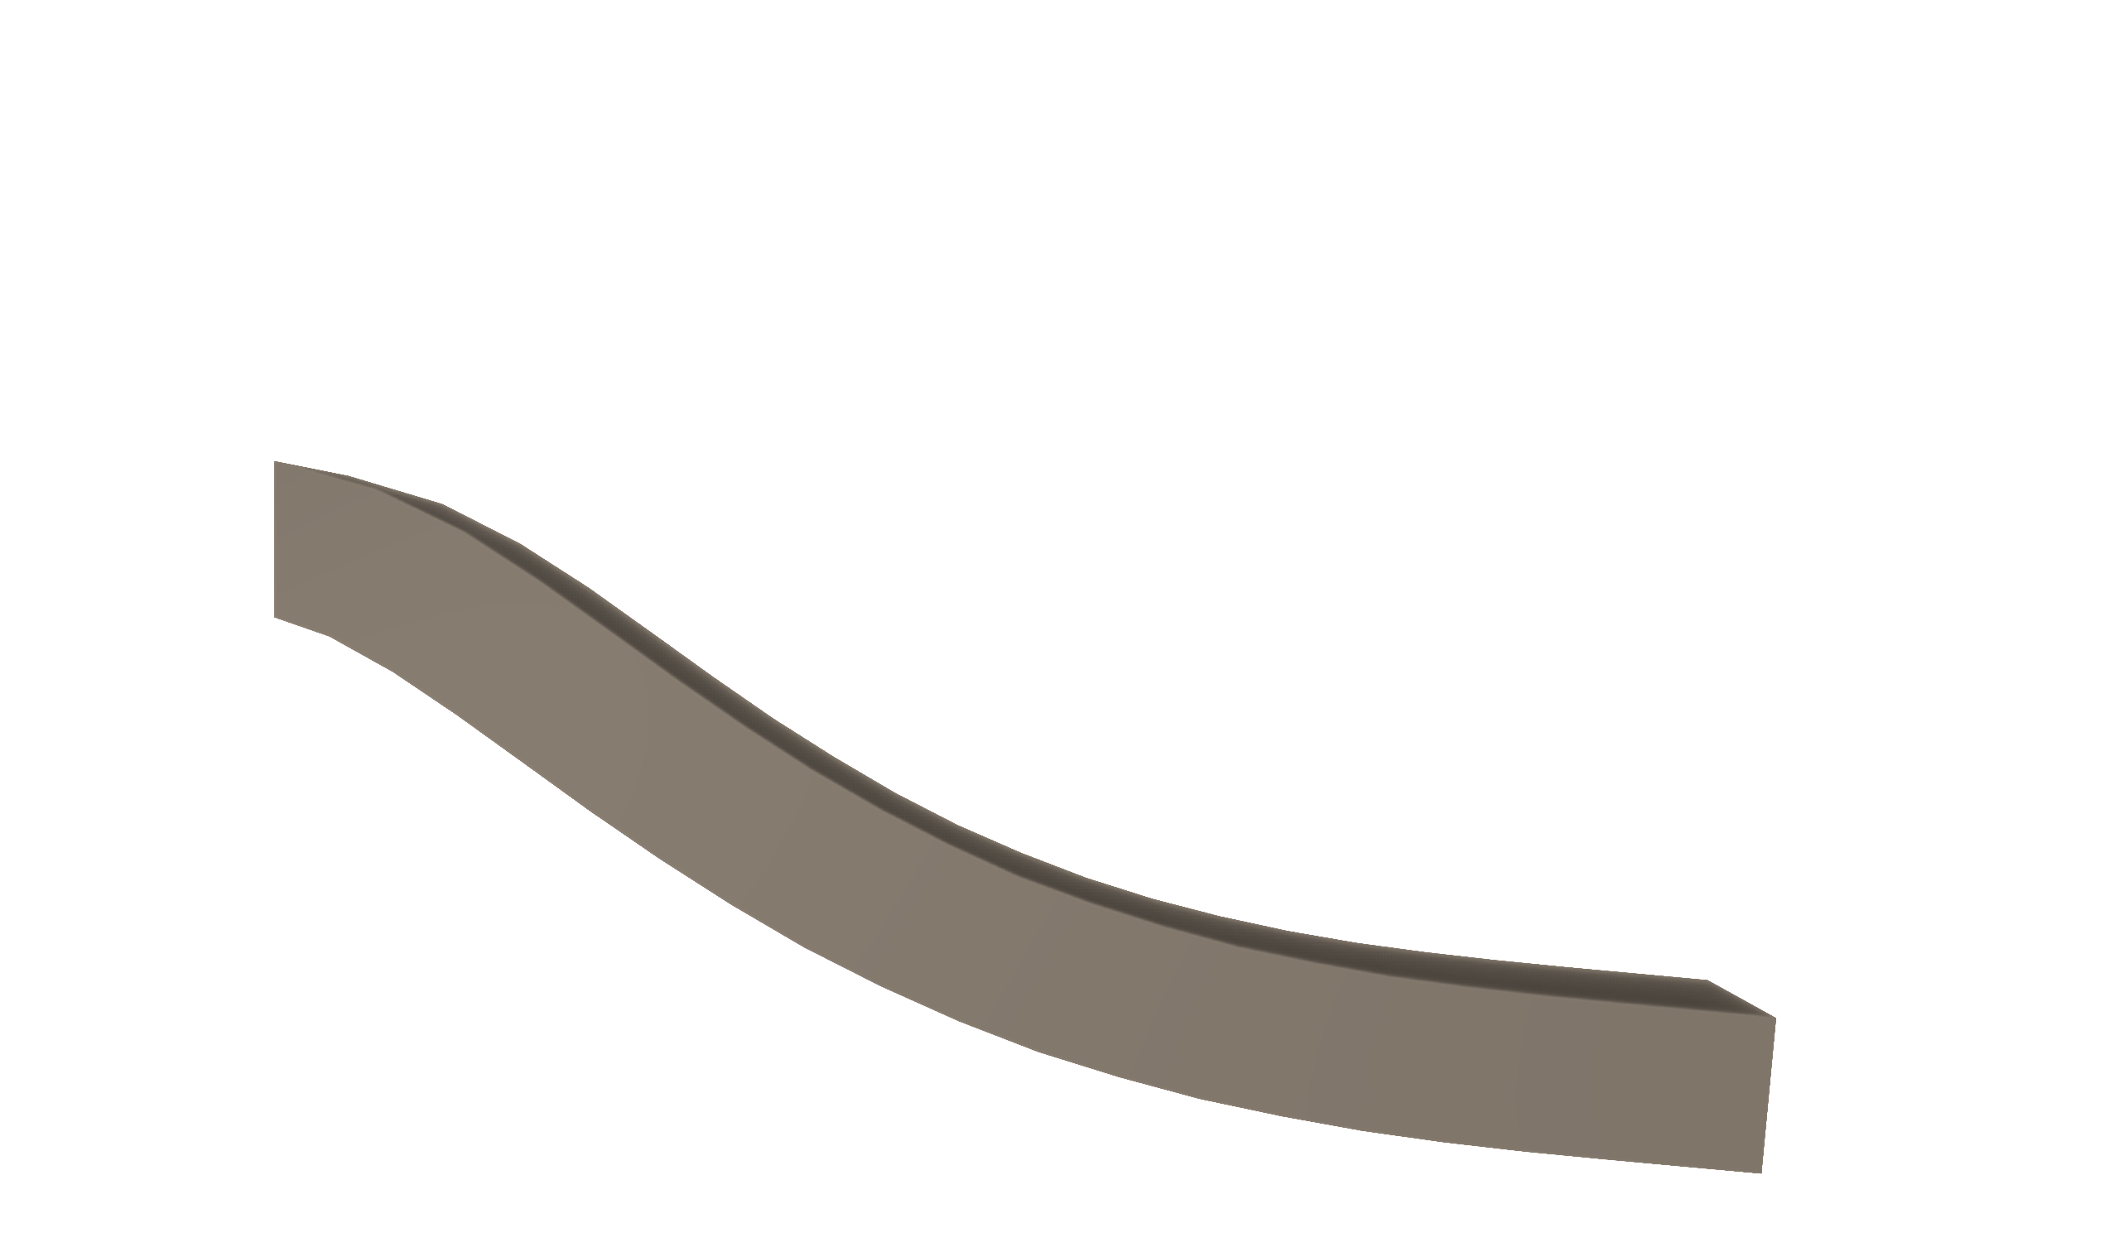
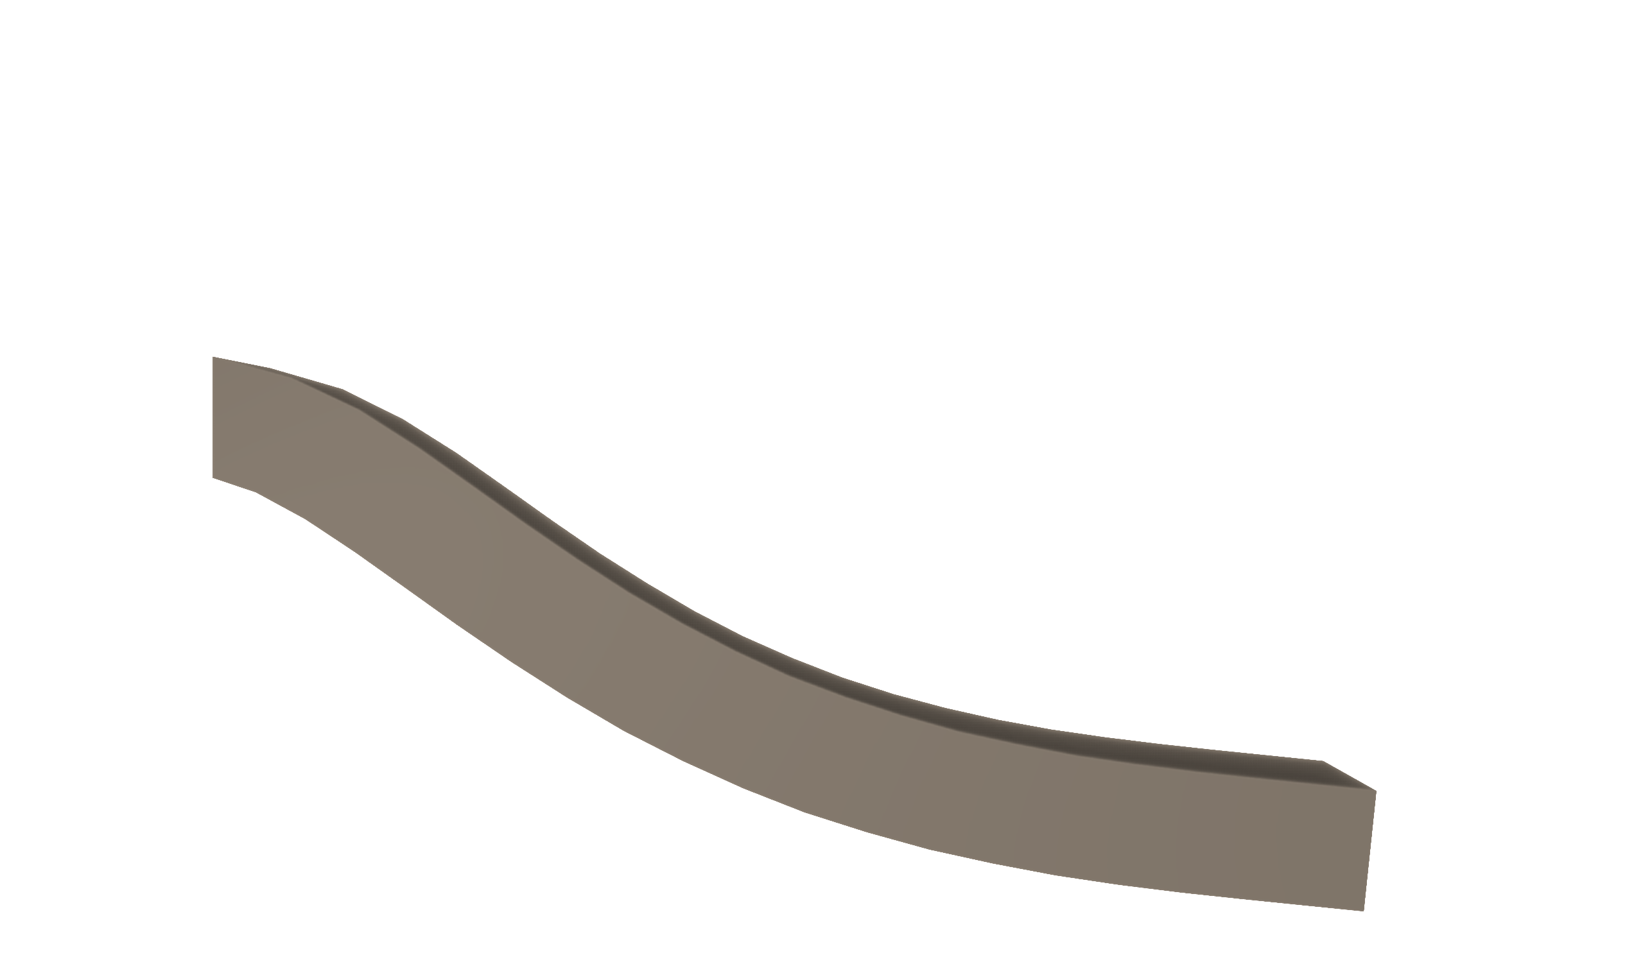
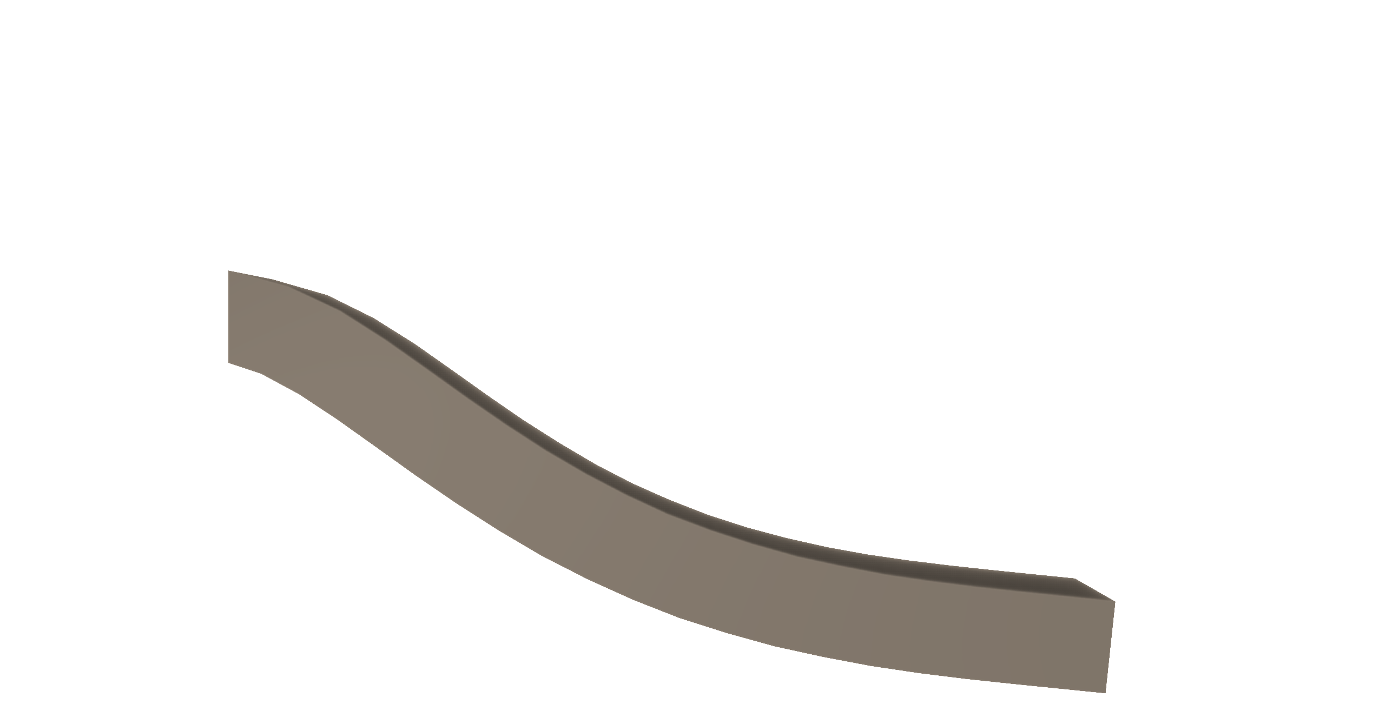
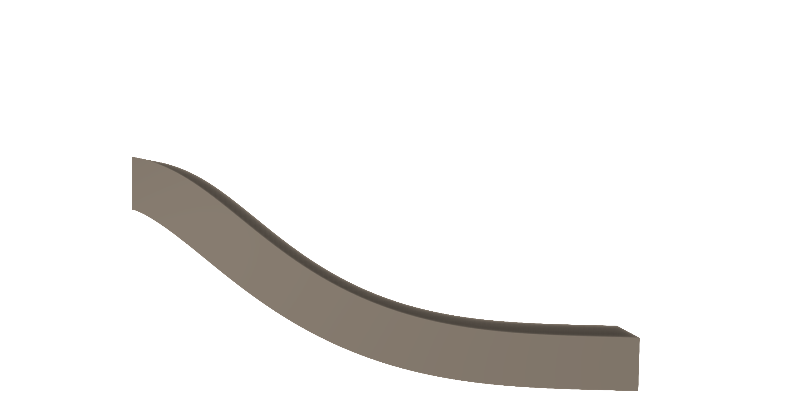
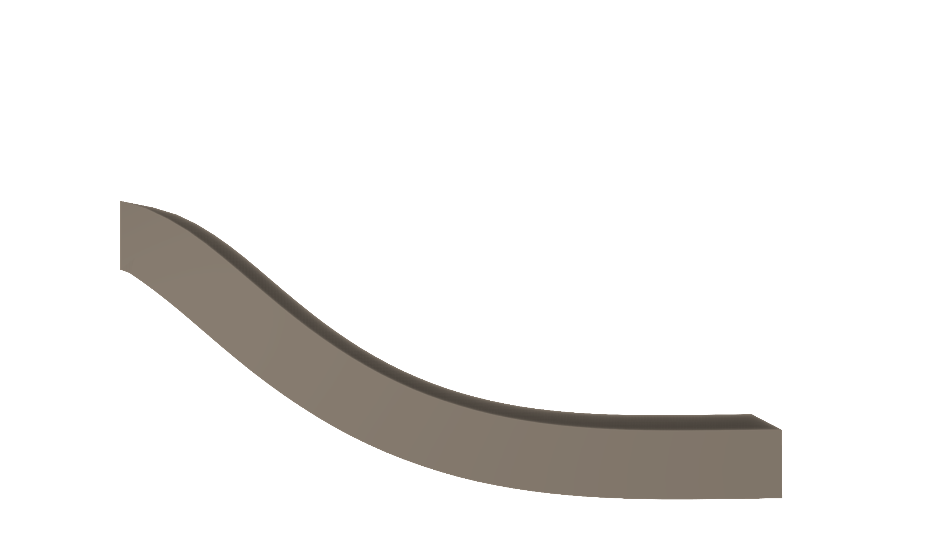
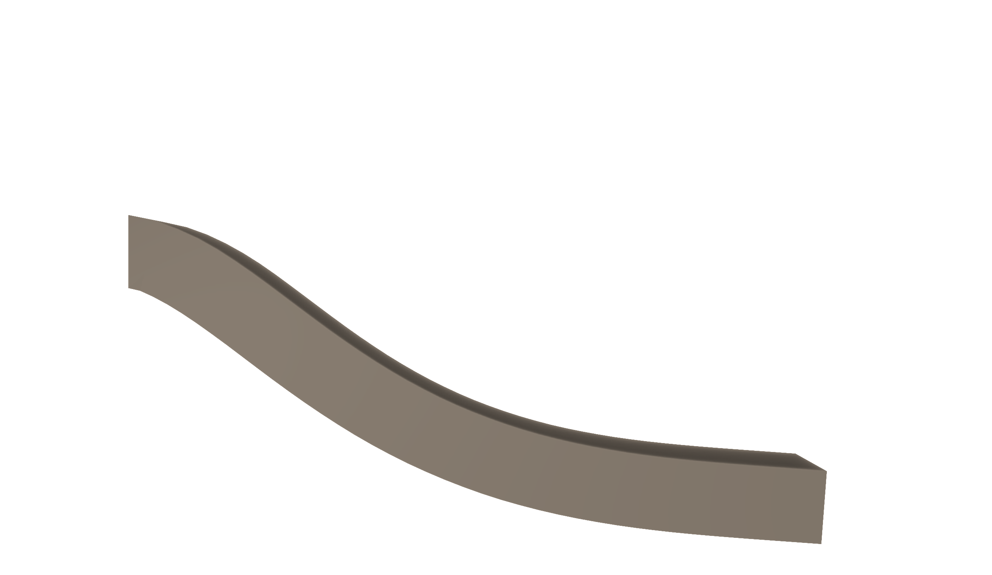


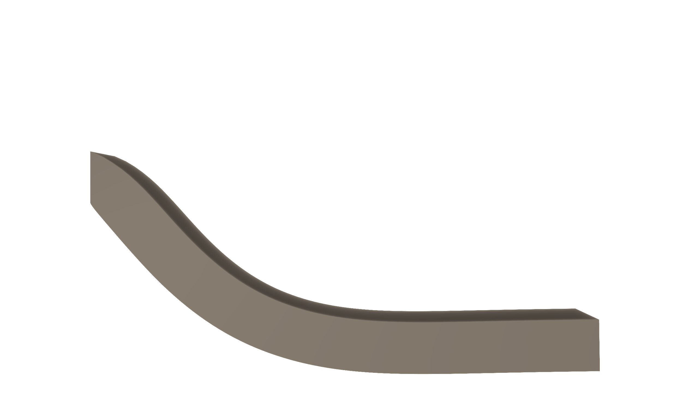
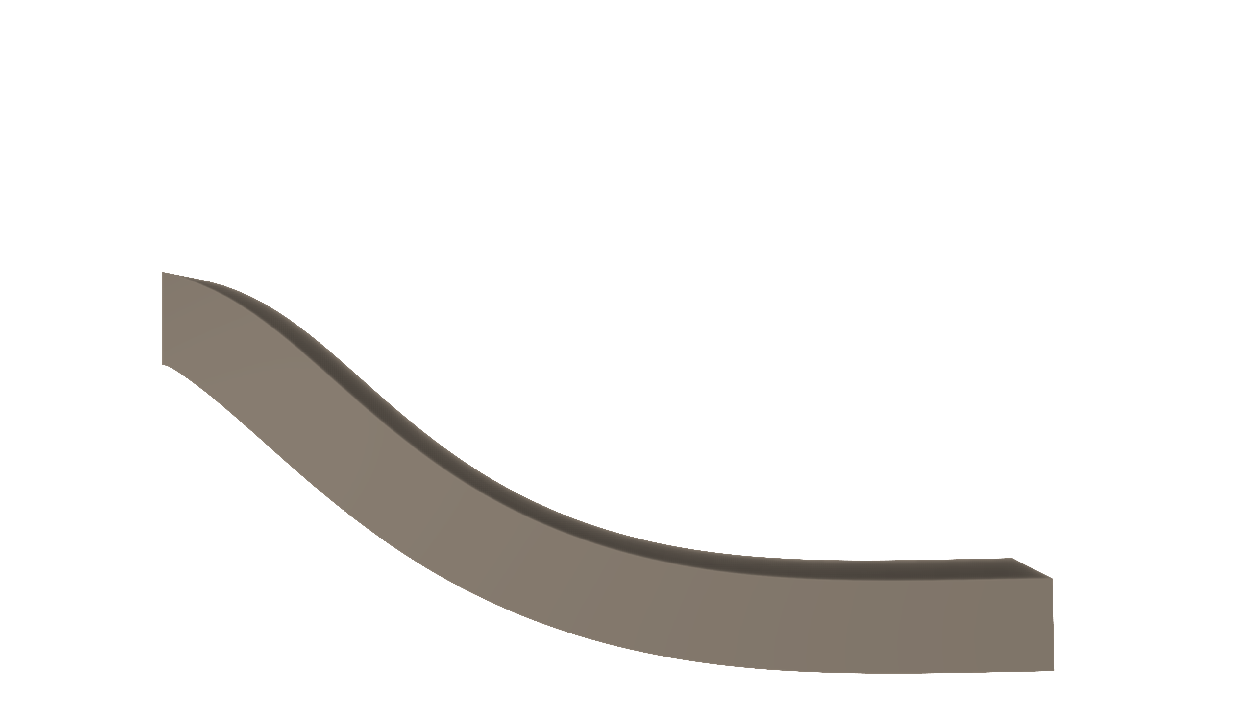

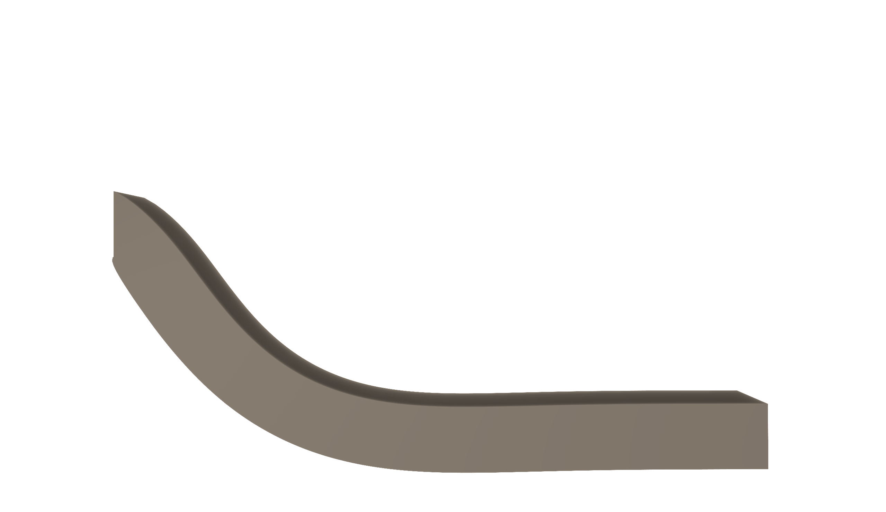
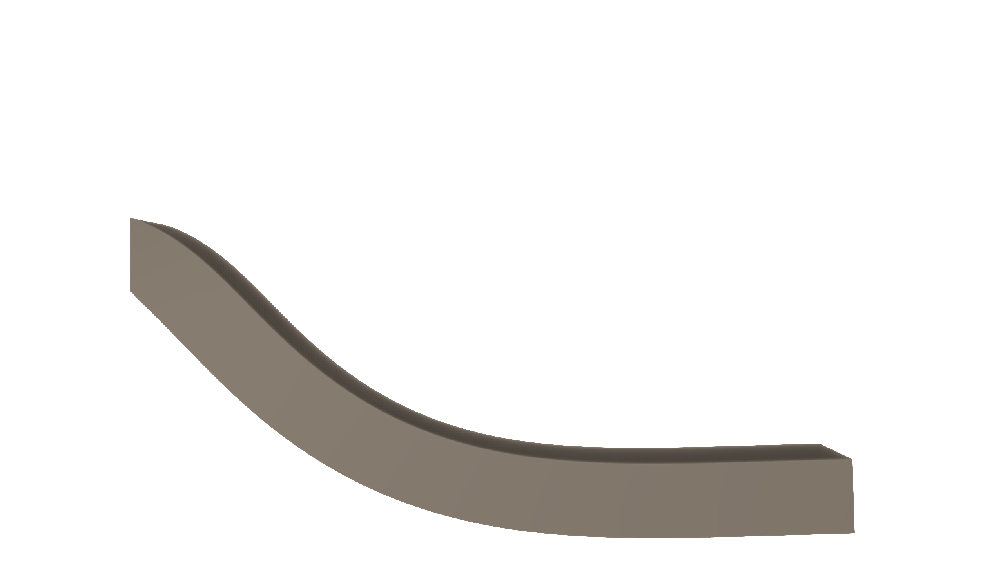
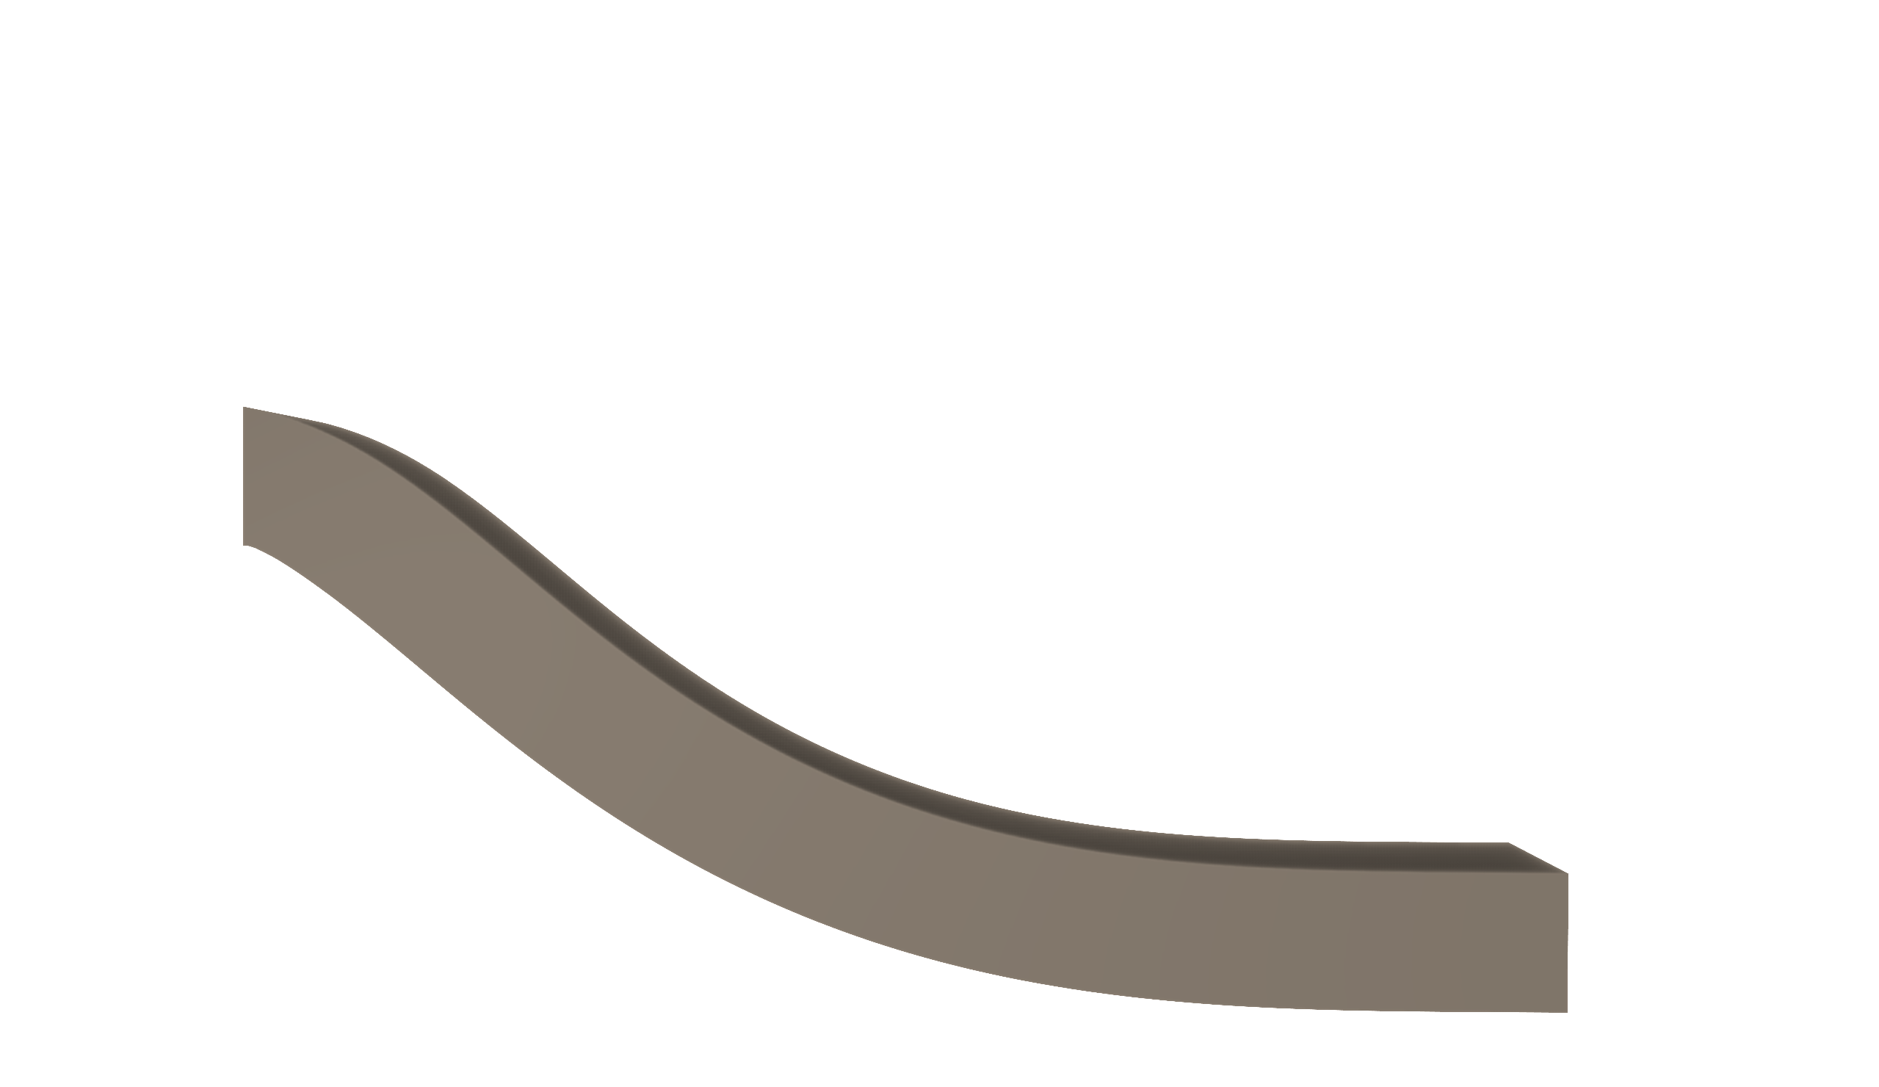
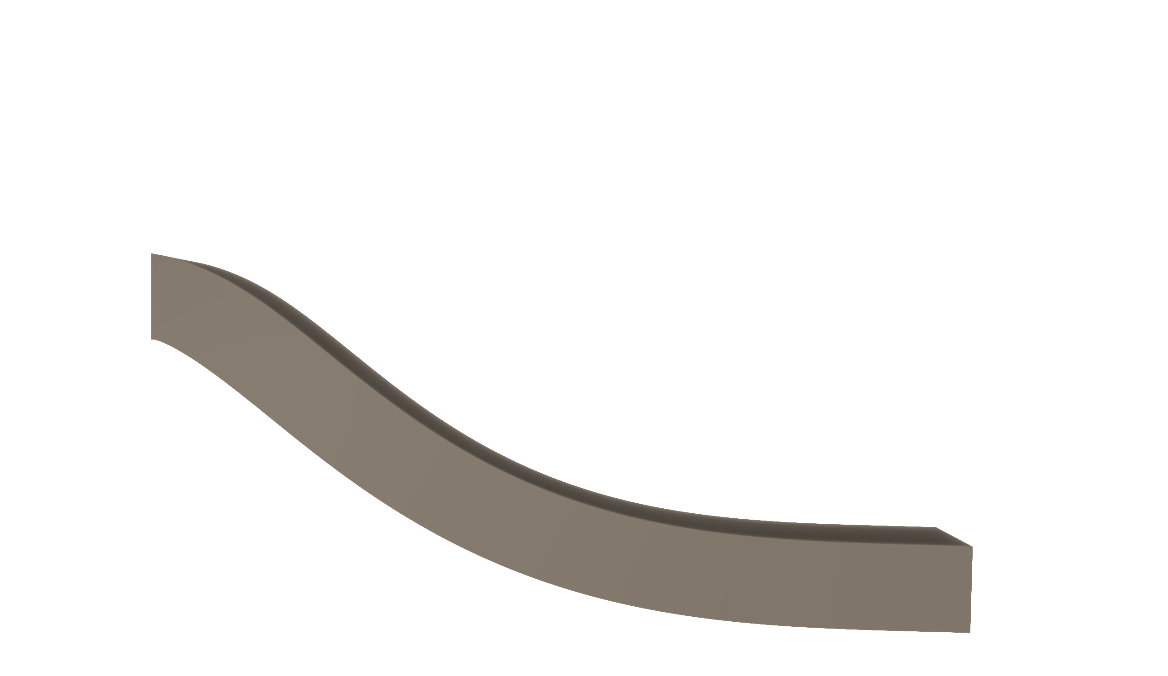



dt = 1/30s
300 frame
iter = 8
iter = 16
iter = 32
64
128
20_2_2
vert 190
tet 842
128
40_4_4
vert 806
tet 3884
80_8_8
vert 4020
tet 21257
iter = 40
120_12_12
vert 10937
tet 60183
60
iter = 24
Notes:
之前的模型是 vert 10250 tet 44178 iter = 12，显然不可能收敛

Slide 2

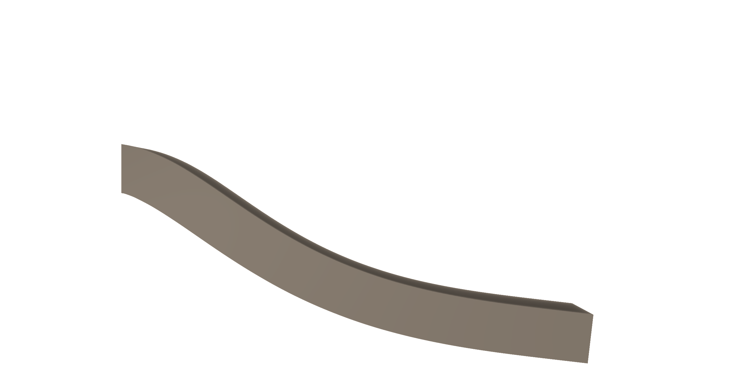
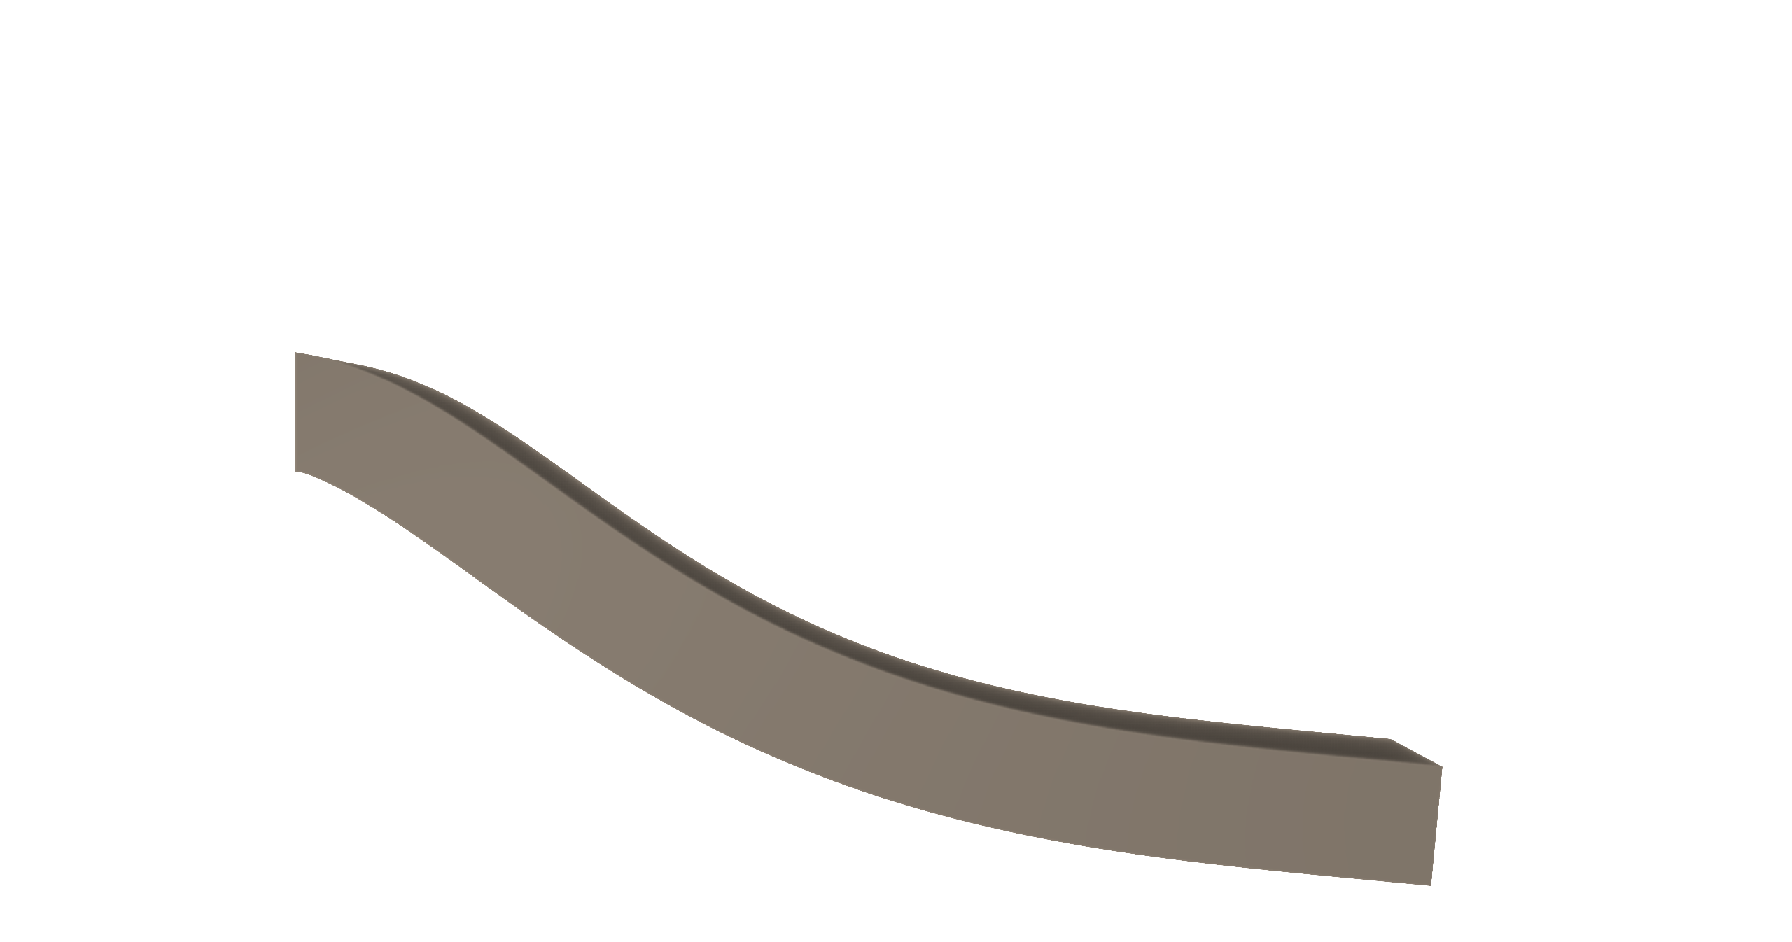

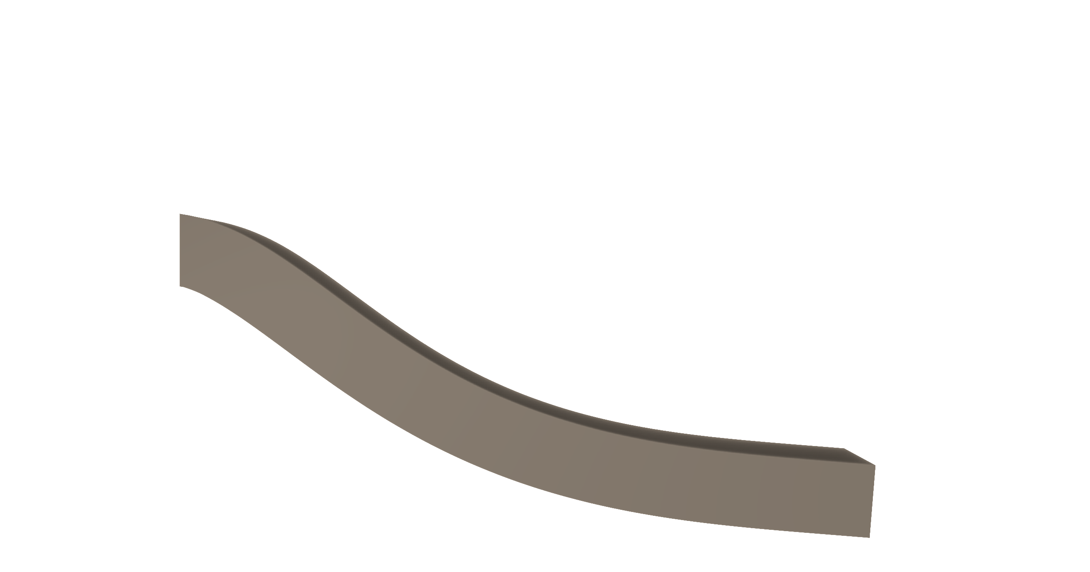


dt = 1/30s
300 frame
iter = 8
15.34 15.25
iter = 16
6.99 6.79
iter = 32
3.84 3.52
iter = 48
3.46 3.10
iter = 64
3.62 3.26
120_12_12
vert 10937
tet 60183
40_16
iter = 8
3.02 2.63
iter = 16
3.17 2.79
iter = 32
3.62 3.26
60_24
iter = 8
3.19 2.81
iter = 16
3.31 2.94
iter = 64
3.73 3.39

Slide 3

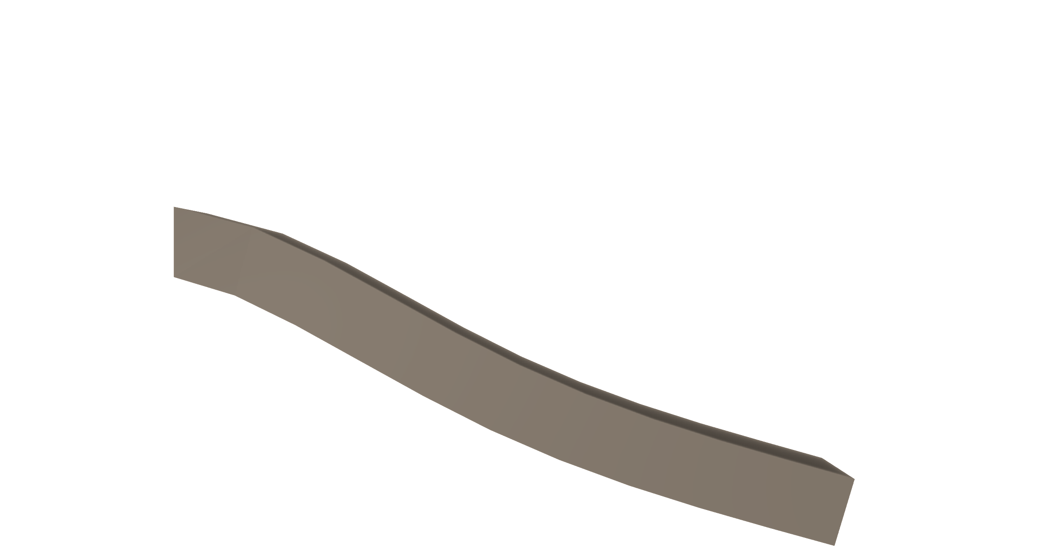
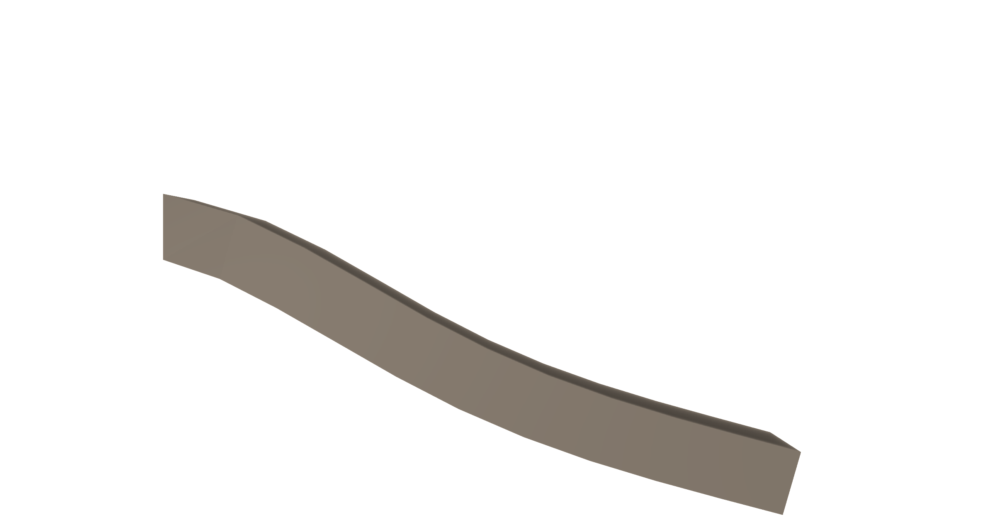
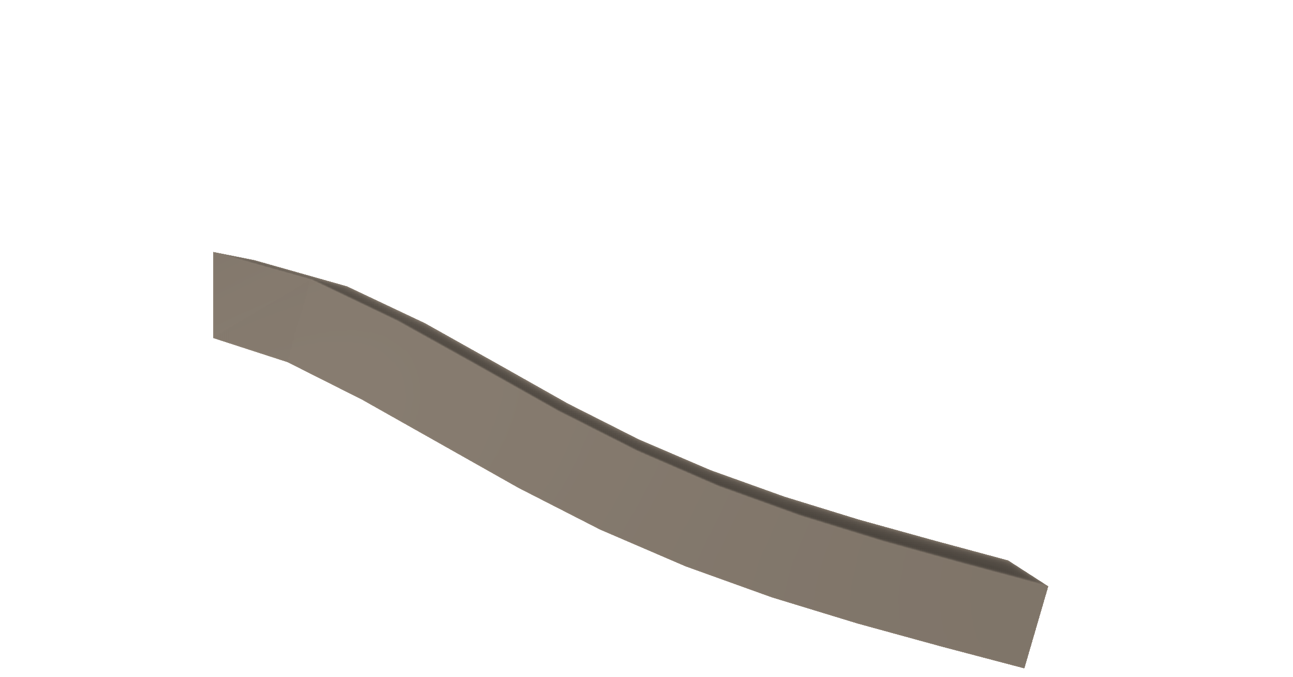
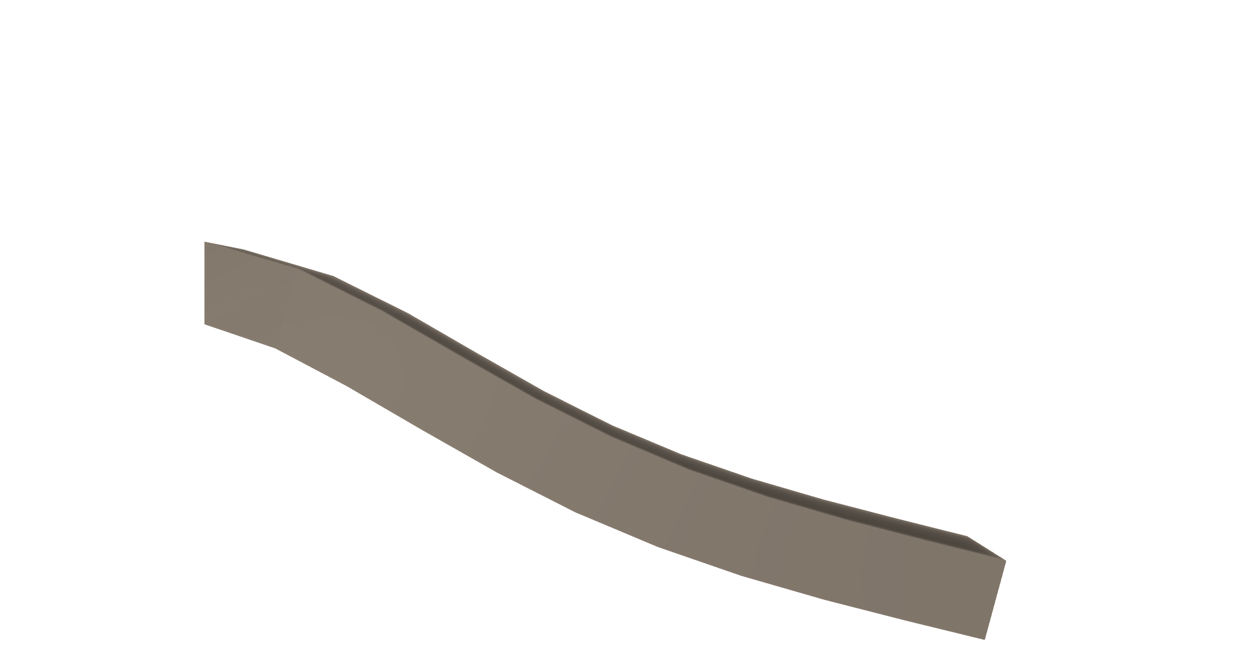
4
8
16
32
2
10

