Slide 1

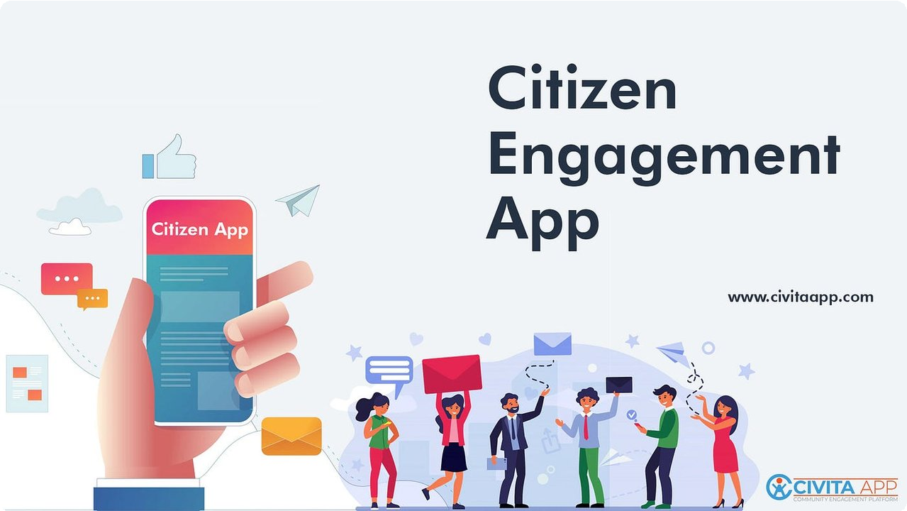





Civic Connect
Bridging Citizens and Government
6 S D G
A Digital Bridge for Action, Accountability, and Trust

Slide 2




The Problem
Reporting Challenges
Citizens face difficulties reporting local issues (roads, sanitation, safety, infrastructure)
Lack of Structure
Schools and communities notice problems daily but lack a structured reporting system
Feedback Gap
Government authorities often don't get verified and transparent feedback
Trust Deficit
Public trust is low because issues are unresolved or delayed without accountability

Slide 3
Matching SDGs
UN Sustainable Development Goals aligned with CivicConnect
SDG 3
Good Health & Well-Being
Addressing community health concerns and sanitation issues
SDG 4
Quality Education
Involving schools in civic learning and community development
SDG 6
Clean Water & Sanitation
Reporting and resolving water and sanitation infrastructure issues
SDG 11
Sustainable Cities & Communities
Building resilient, inclusive and sustainable urban environments
SDG 16
Peace, Justice & Strong Institutions
Promoting accountability, transparency and effective governance
SDG 17
Partnerships for the Goals
Fostering collaboration between citizens, schools and government
CivicConnect aligns with key SDGs to create sustainable local impact
Made with Genspark

Slide 4



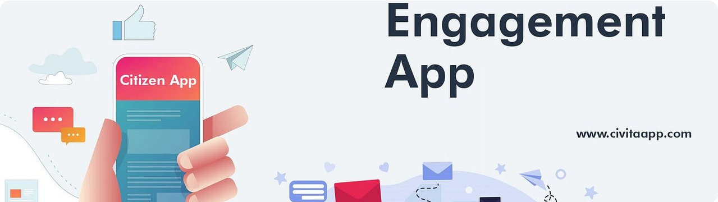
The Solution
Digital Platform
A comprehensive web and mobile application enabling civic engagement and issue reporting
School Surveys
Schools conduct surveys in a 2–4 km radius to identify and document local issues
30-Day Action
Local authorities review reports and commit to action within 30 days
Transparency
Public can view, track, and comment on issues for complete transparency

Slide 5
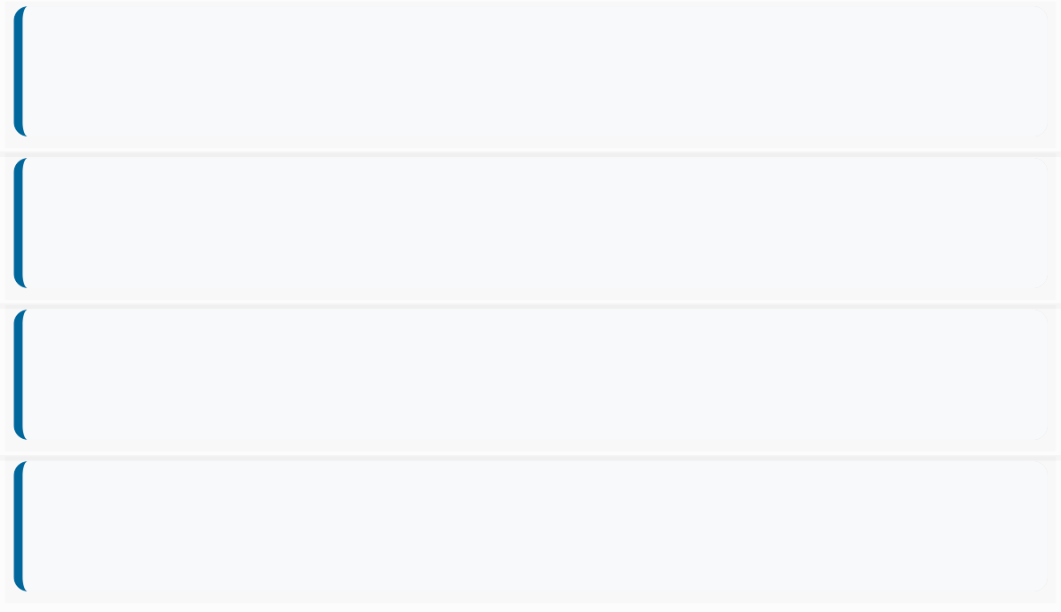
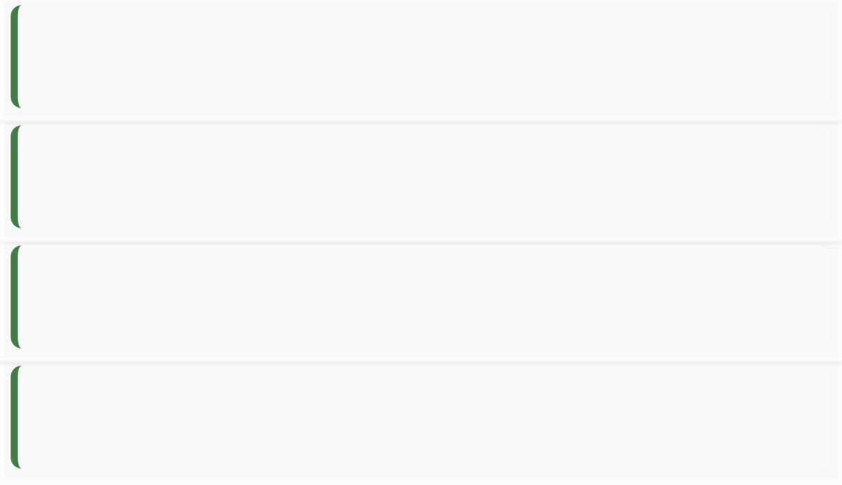







The Motive & Relatable Topics
Our Motive
Relatable Topics
Increase civic participation and accountability
E-Governance & Smart Cities
Empower schools and communities to contribute
Digital Public Platforms in India
Build trust between government and citizens
Citizen Engagement for Sustainable Development
Ensure faster, transparent resolution of local problems
Role of Youth and Schools in Nation Building

Slide 6
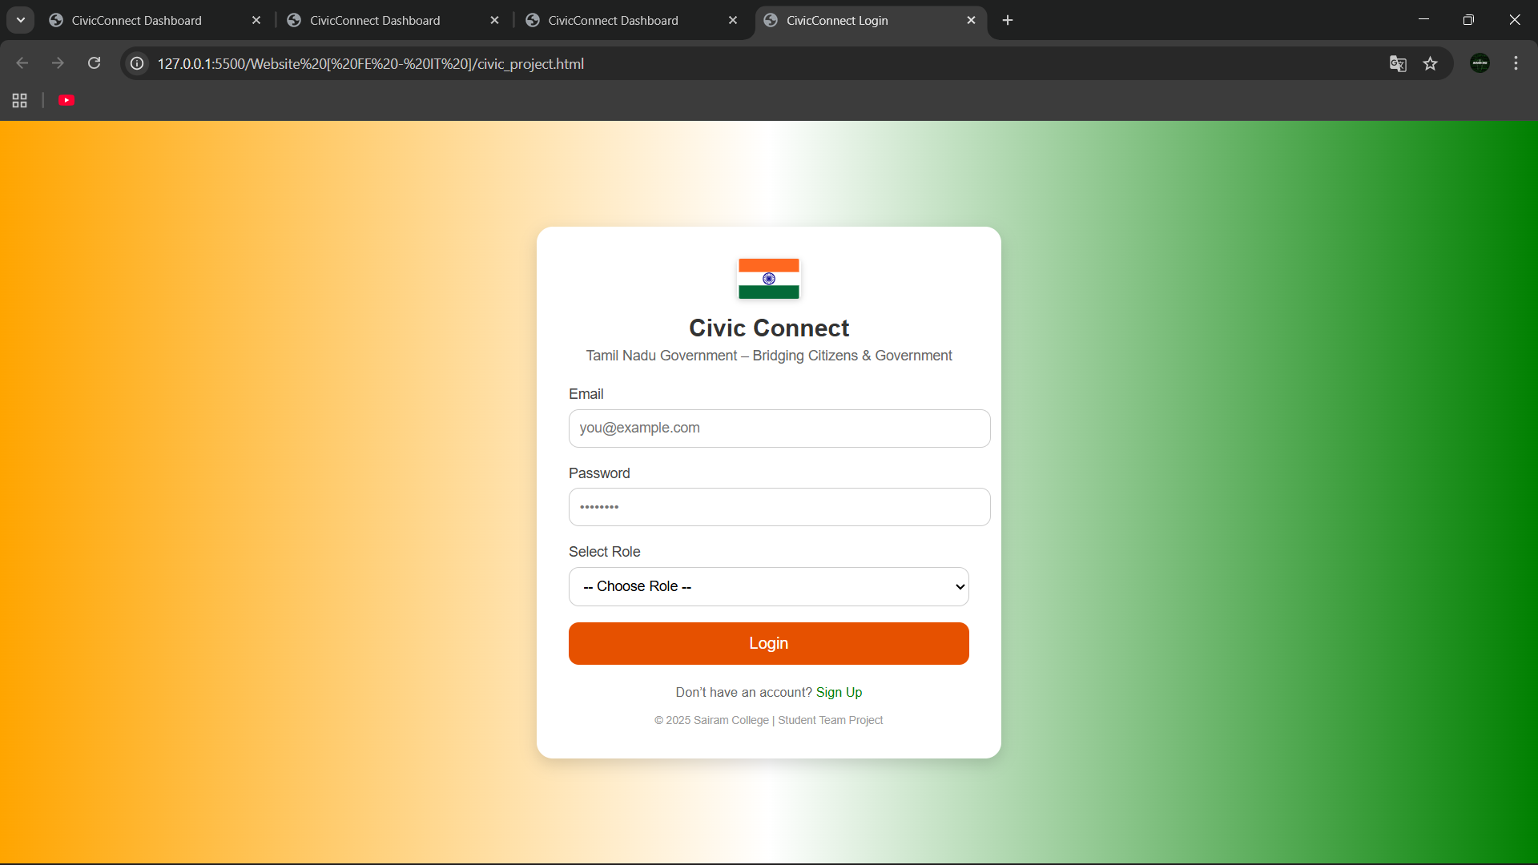
Login Site
( Login Site Hosted on Local Server )

Slide 7
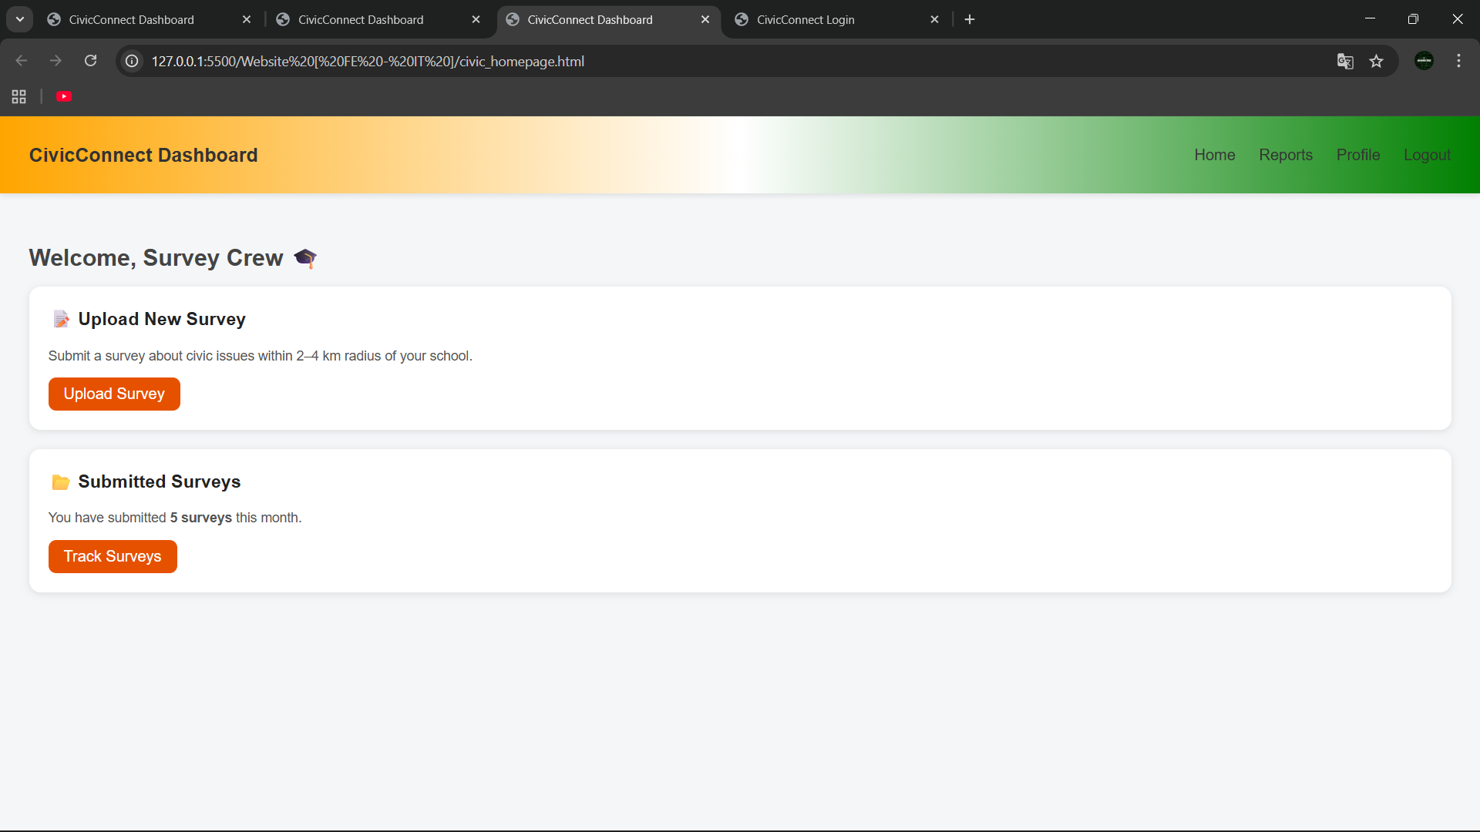
Survey Page
( Login Site Hosted on Local Server )

Slide 8
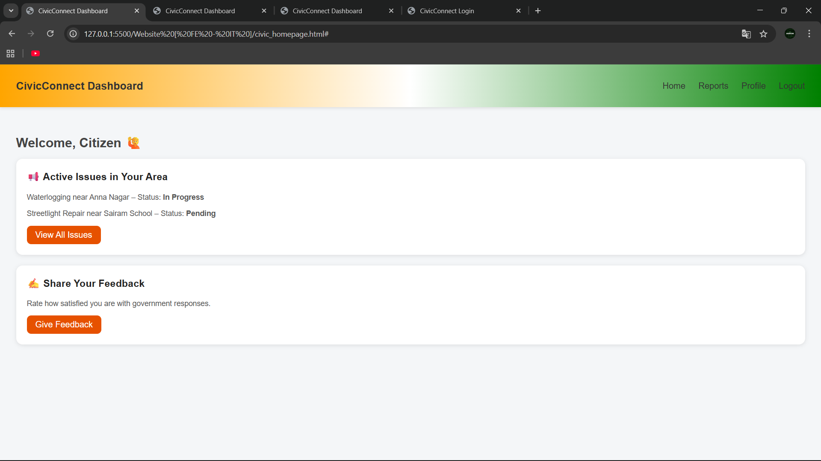
Citizen’s Page
( Login Site Hosted on Local Server )

Slide 9
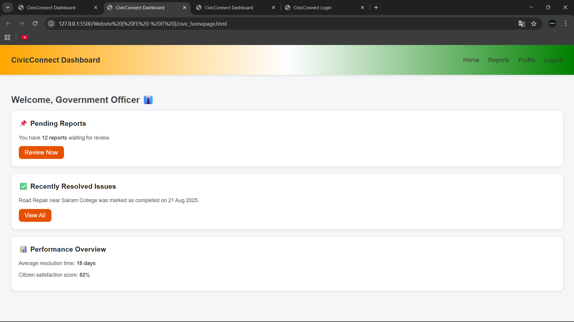
Officer/Woker’s Page
( Login Site Hosted on Local Server )

Slide 10

Copyright
© 2025 Team Delta – Civic Connect. All Rights Reserved. Team Members: Buvan | Nivedith | Giriprasad | Arthi

