Slide 1
Digital Portfolio
STUDENT NAME: BUVANESH.S
REGISTER NO AND NMID: 1DC3CE3FDD130E4A3C54BA97D17981C9
DEPARTMENT: BCA
COLLEGE: APOLLO ARTS AND SCIENCE COLLEGE CHENNAI/
MADRAS UNIVERSITY

Slide 2
PROJECT TITLE
PERSONAL PORTFOLIO WEBSITE
USING FRONTEND DEVELOPMENT

Slide 3


AGENDA
Problem Statement
Project Overview
End Users
Tools and Technologies
Portfolio design and Layout
Features and Functionality
Results and Screenshots
Conclusion
Github Link
3/21/2024 Annual Review

Slide 4

PROBLEM STATEMENT
Many students and aspiring developers struggle to present their skills, projects, and personal achievements in a professional and organized way. Traditional resumes are often limited in showcasing practical work like web projects, coding skills, or design capabilities. There is a need for a digital platform that allows individuals to effectively display their work, skills, and contact information in a visually appealing and accessible manner..

Slide 5

PROJECT OVERVIEW
This project is a Personal Portfolio Website built using frontend development (HTML, CSS, JavaScript).
It serves as a digital resume to showcase my skills, projects, and personal details.
The portfolio contains:
About Section – short introduction about me
Skills Section – highlights my technical abilities.
Projects Section – showcases my completed works.
Contact Section – provides ways to connect with me.
Main idea : To create a professional online platform where others (professors, recruiters, or clients) can easily view my work and abilities

Slide 6

WHO ARE THE END USERS?
1.College Professors / Evaluators – to assess your projects, skills, and web development knowledge
2. Potential Employers or Recruiters – to quickly view your work, skills, and contact information.
3.Clients or Collaborators – to understand your capabilities and previous projects for freelance or team opportunities.
4. Anyone Interested in Your Work – friends, peers, or online visitors who want to learn about your skills and projects

Slide 7

TOOLS AND TECHNIQUES
Frontend Development:
HTML – to structure the website content.
CSS – to style the website, including layouts, colours, and fonts.
JavaScript – to add interactivity and dynamic features.
Code editor: visual studio code
2. Design & Icons:
Font Awesome or similar icon libraries – for skill and social media icons.
Custom Images / Profile Photo – for personalization.
3. Hosting & Version Control:
GitHub – to store project code and manage version control.
GitHub Pages – to host the portfolio live online.
4 .Techniques / Features Implemented:
Responsive design for desktop and mobile.
Smooth scrolling navigation.
Interactive buttons for projects and contact.
Organized sections: About, Skills, Projects, Contact.

Slide 8
POTFOLIO DESIGN AND LAYOUT
Clean and Simple design: The portfolio uses a minimalistic design to make content easy to read and navigate.
Sections Included:
Home / Hero Section – Name, role, and profile photo for first impression.
About Me – Short bio highlighting personal background and goals.
Skills – Shows technical skills clearly, sometimes with icons or progress indicators
Projects – Displays projects with descriptions, technologies used, and links
5. Contact – Contact form or direct links to email/social media.
Responsive Layout: Adjusts automatically for mobile, tablet, and desktop screens.
Navigation: Smooth scrolling and easy-to-access menu for quick section jumps.
Visual Appeal: Uses colors, fonts, and background gradients to create a modern and professional look.
8

Slide 9
FEATURES AND FUNCTIONALITY
Navigation bar with smooth scrolling
About, Skills, Projects, Contact sections
Project showcase with details/screenshots
Contact form / direct links
Responsive design for all devices

Slide 10
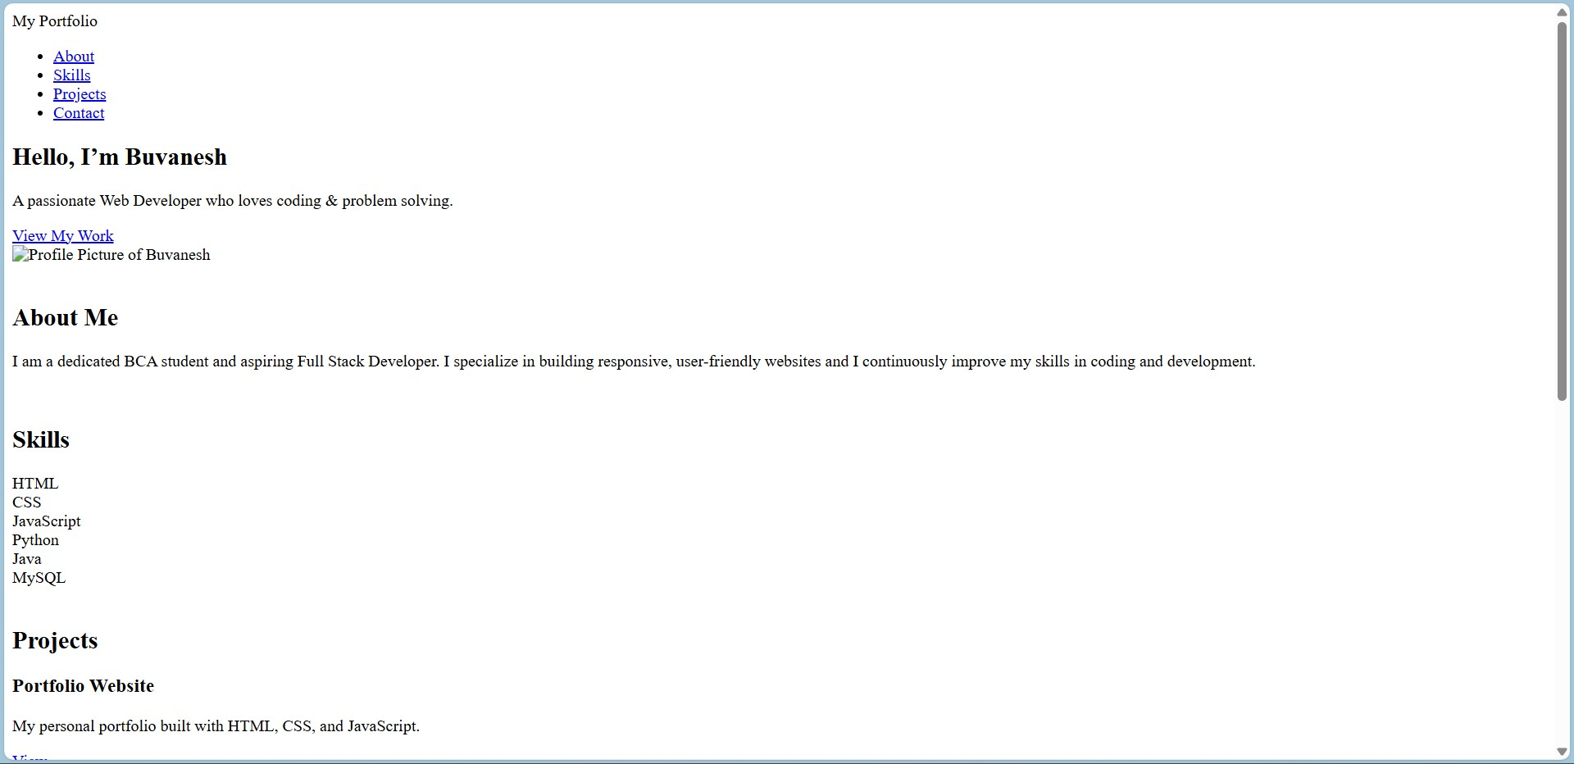
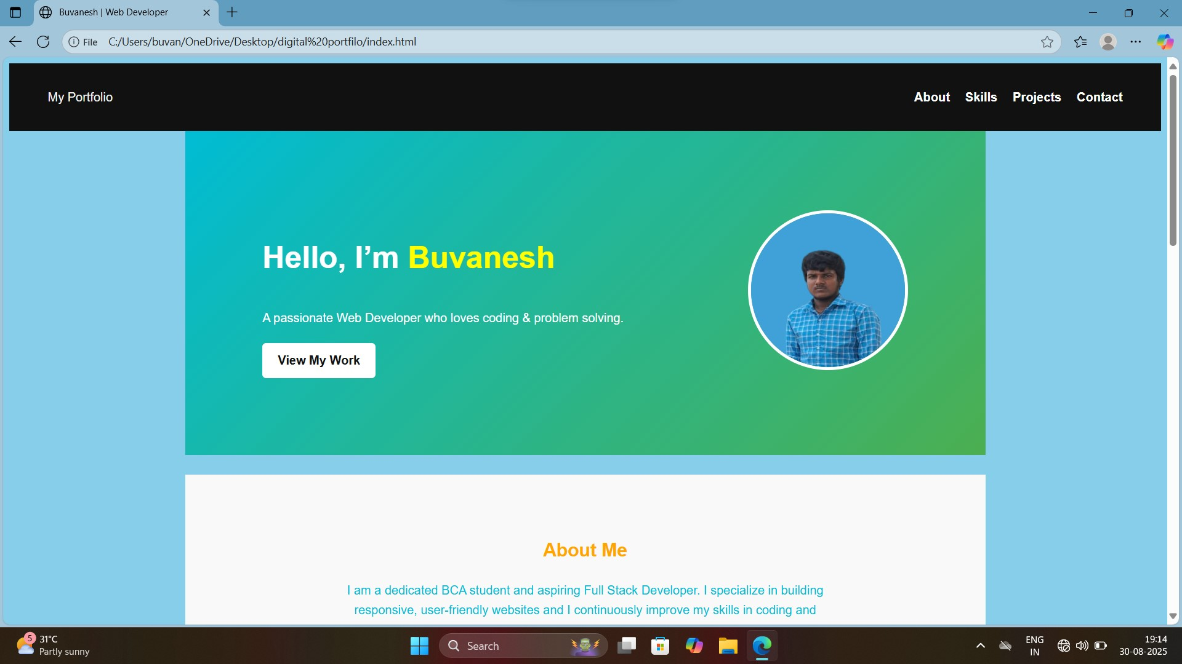
RESULTS AND SCREENSHOTS
Before Adding css: After Adding css:
3/21/2024 Annual Review
10

Slide 11
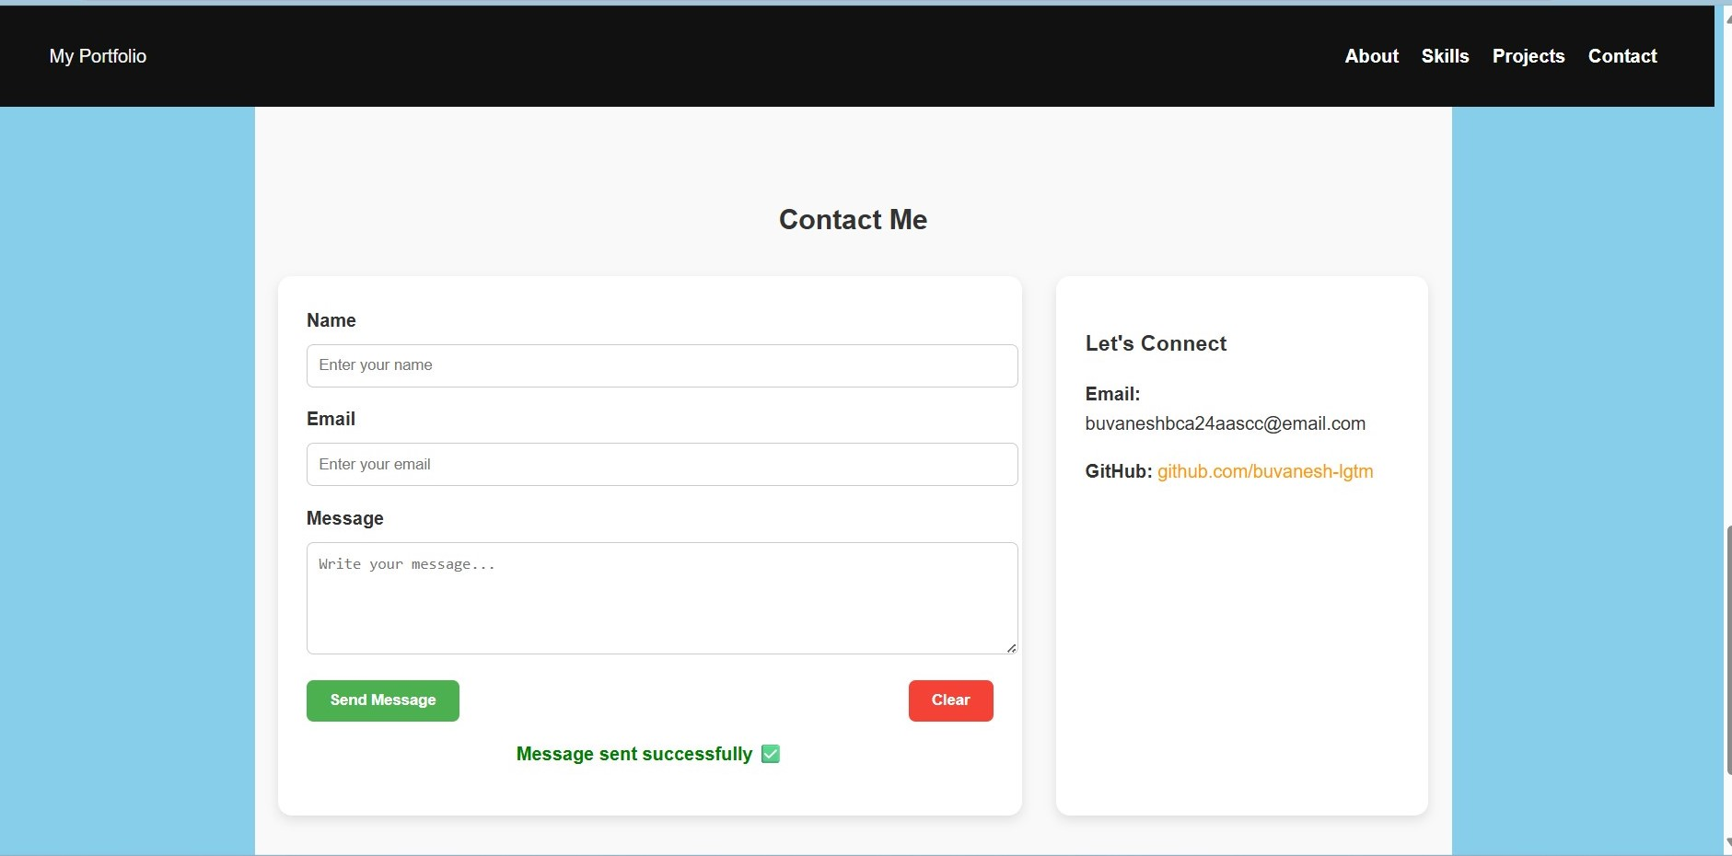
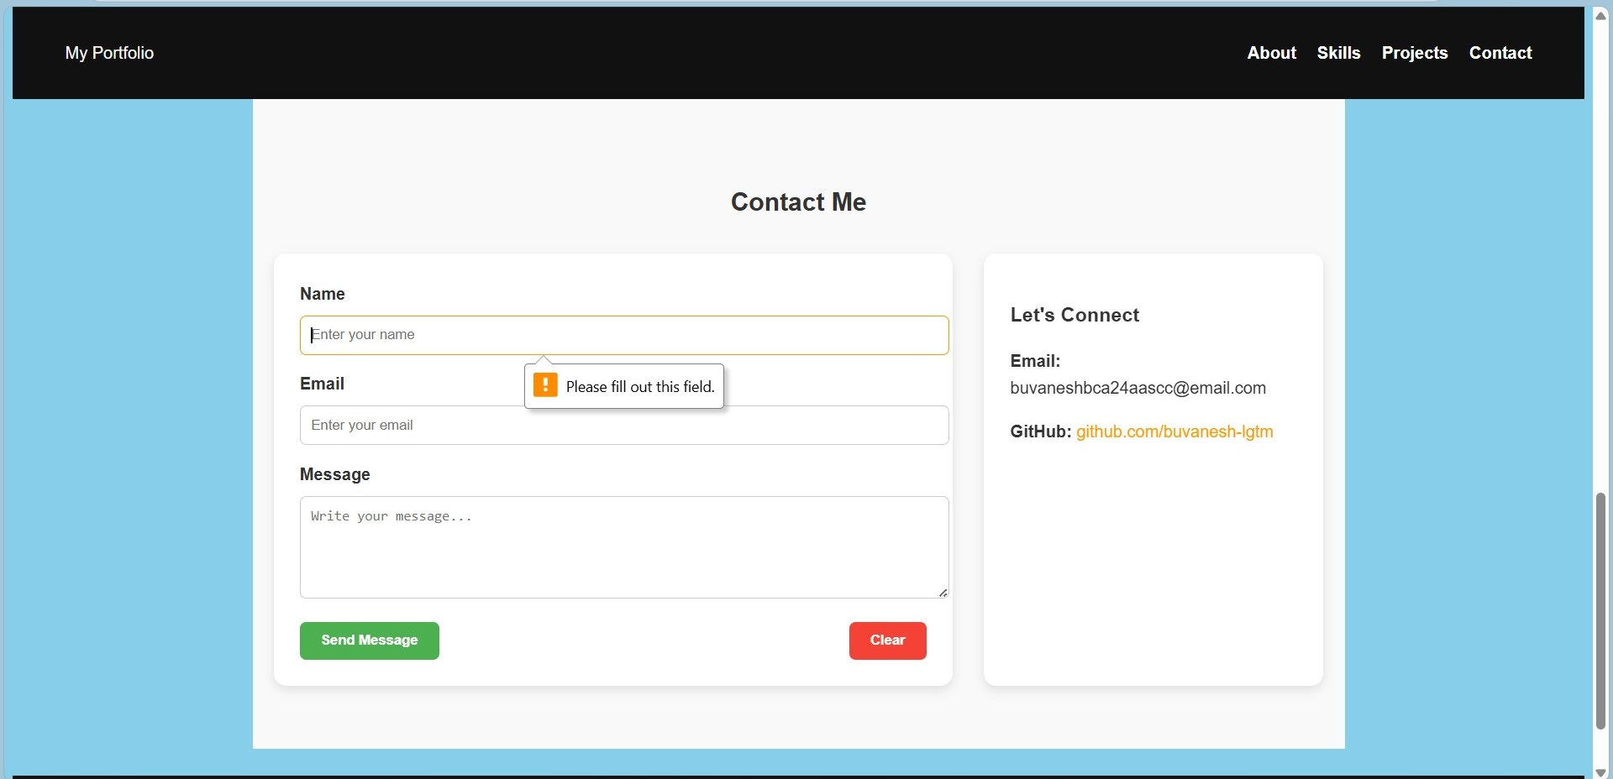
Javascript implementation
Contact validation message using Javascript:

Slide 12
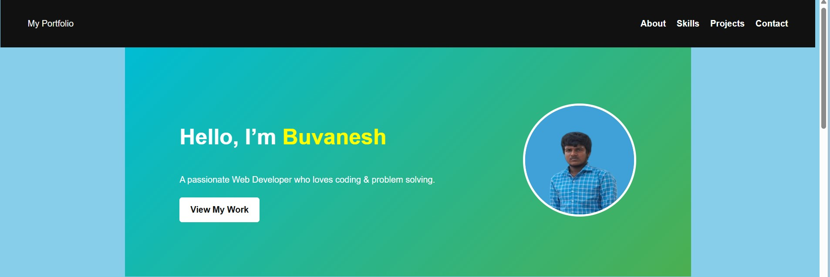
Home section:

Slide 13

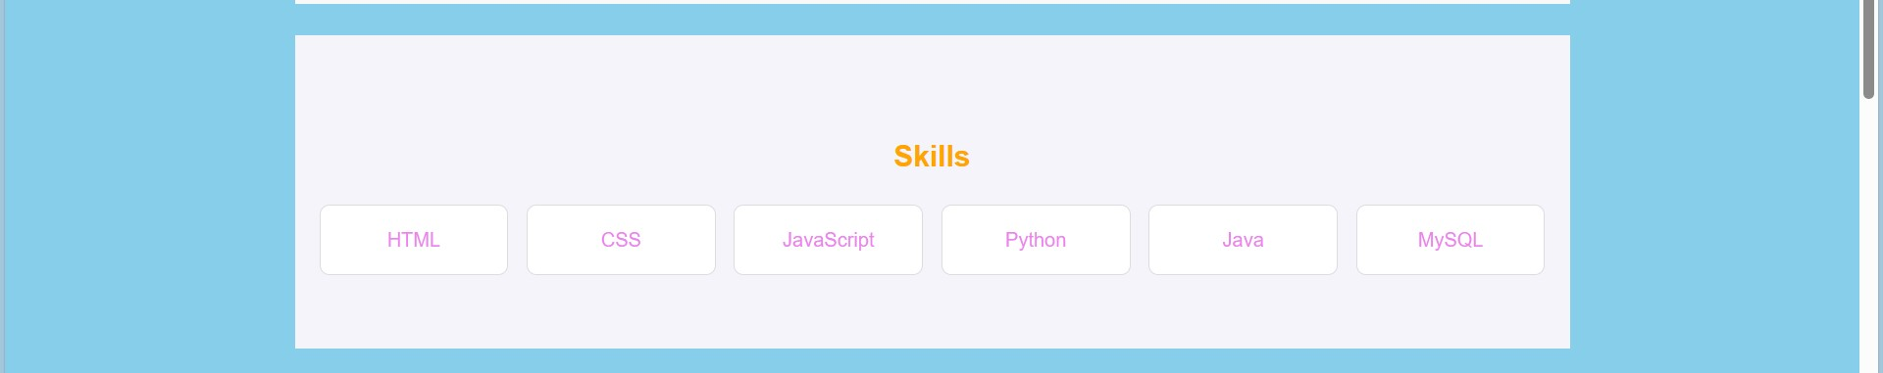
About section:
Skill section:

Slide 14
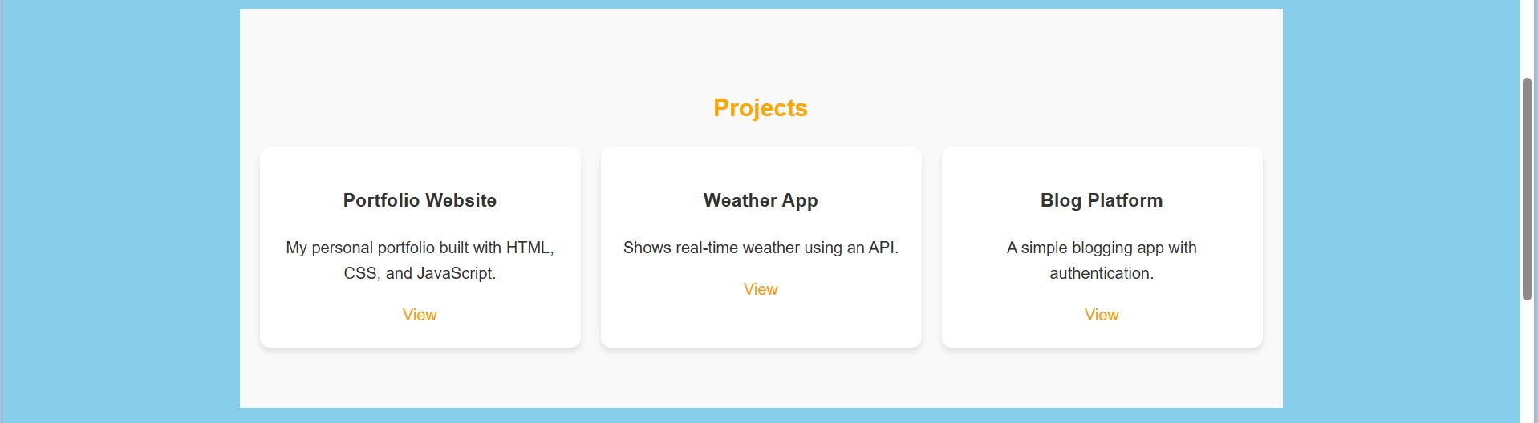
Project section:

Slide 15
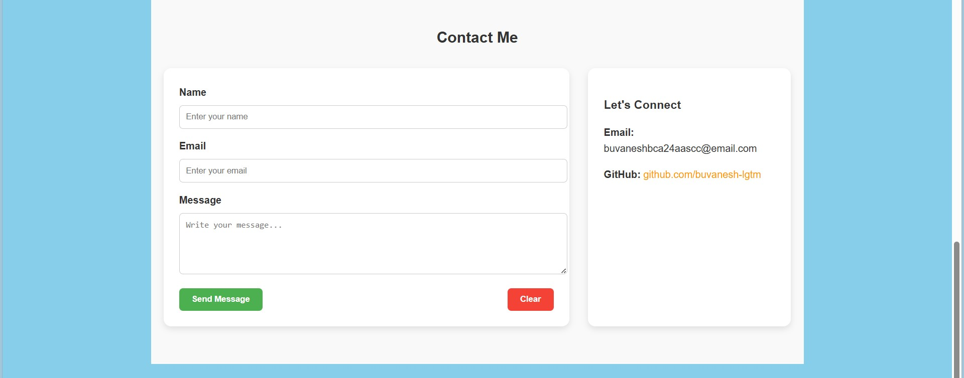
Contact section:

Slide 16
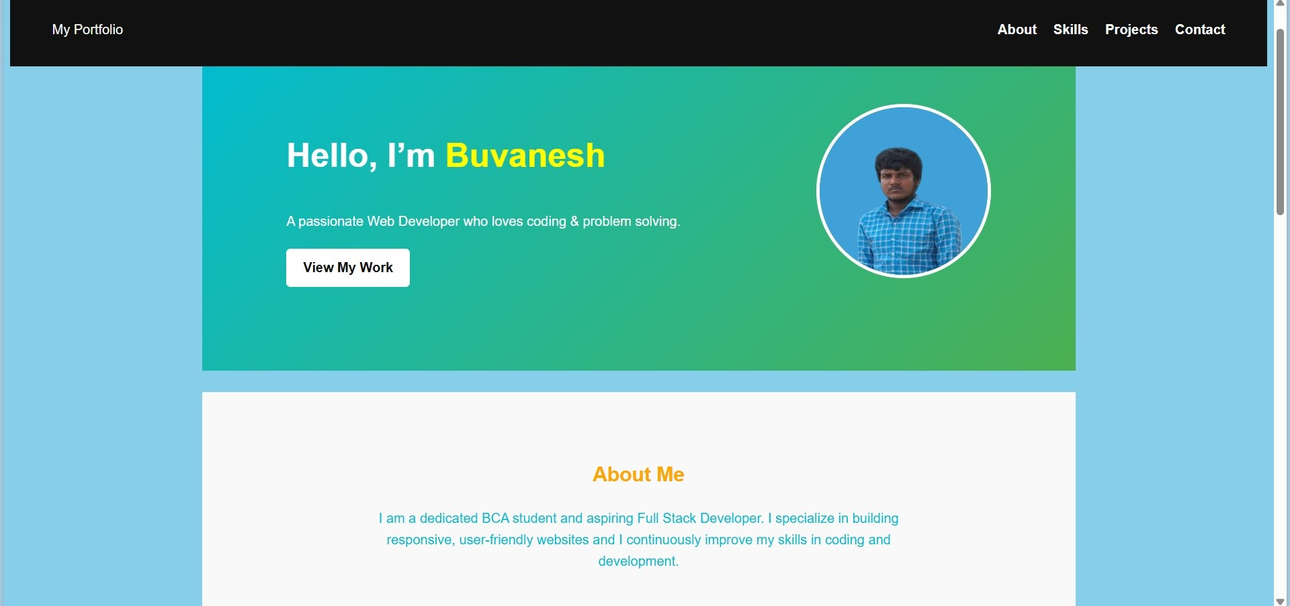
Final result:

Slide 17
CONCLUSION
The Personal Portfolio Website effectively showcases my skills, projects, and personal information in a professional and organized way.
It serves as a digital resume, making it easy for professors, employers, or clients to view my work.
The project demonstrates web development capabilities using HTML, CSS, and JavaScript.
The portfolio is responsive, interactive, and easy to update, allowing for future additions of projects and skills.
17

Slide 18
Github link:
https://buvanesh-lgtm.github.io/TNSDC-FWD-Digitialportfilo/

