Slide 1
Climate Change Modeling using Data Science and NLP
Analysis of Public Engagement on Climate Change using NASA Social Media Data
Prepared by: Buvi
Tools: Python | Machine Learning | NLP

Slide 2
Introduction & Background
Climate change is a major global issue requiring effective communication.
Social media platforms provide insight into public perception and engagement.
NASA actively communicates climate-related information to the public.
Understanding engagement helps evaluate the impact of scientific communication.
Objective:
- Analyze climate-related social media comments
- Apply data science and NLP techniques
- Predict user engagement based on comment content

Slide 3
Dataset Description
Source: NASA Climate Change Facebook Page
Size: 522 comments (2020–2023)
Key Columns:
- Date of comment
- Likes count
- Comments count
- Comment text
- Anonymized user ID
Note: Dataset is small but suitable for NLP and engagement analysis.

Slide 4
Data Science Applications
Potential Applications:
- Engagement Analysis (Primary focus)
- Sentiment Analysis (future scope)
- Trend Analysis
- Topic Modeling
Chosen Focus: Engagement analysis using text and metadata

Slide 5
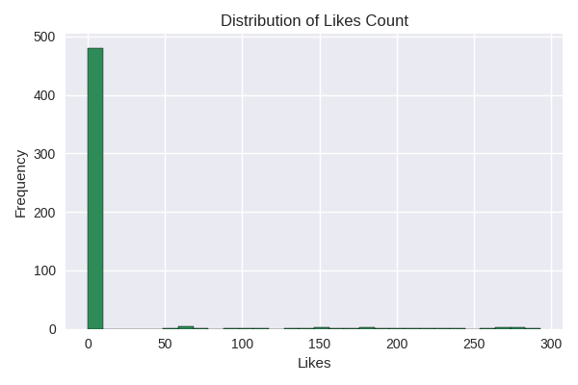
Distribution of Likes Count

Slide 6
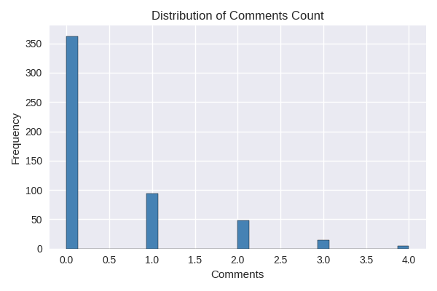
Distribution of Comments Count

Slide 7
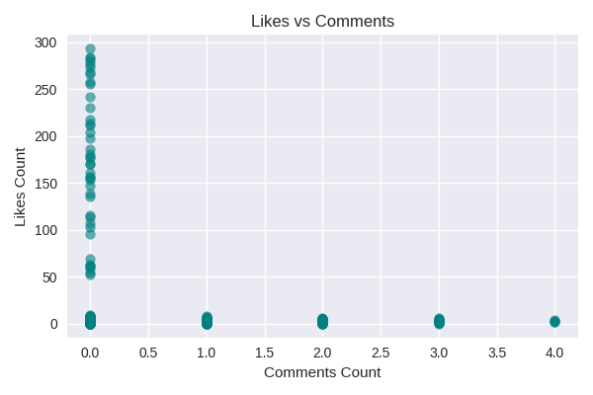
Likes vs Comments Scatter Plot

Slide 8
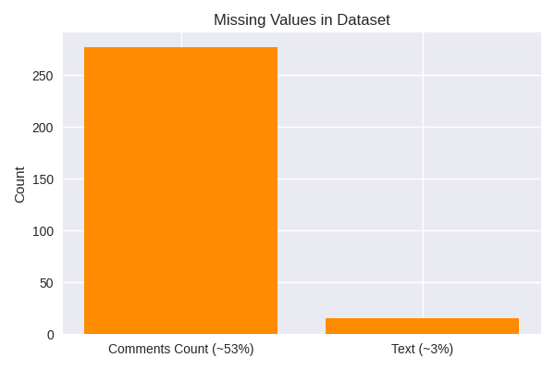
Missing Values Analysis

Slide 9
Data Preprocessing
Converted date column to datetime
Created time-based features (year, month, day)
Cleaned text data:
- Lowercasing
- URL removal
- Punctuation removal
Created text length feature
Purpose: Prepare data for NLP and machine learning models

Slide 10
Feature Engineering & NLP
TF-IDF Vectorization (Top 1000 features)
Combined with numerical features:
- Comments count
- Text length
- Year and month
Final Feature Size: 1004 features
Why TF-IDF? Converts text into meaningful numerical representations

Slide 11
Model Selection & Training
Model: Random Forest Regressor
Why Random Forest?
- Handles non-linear data
- Robust to noise
- Suitable for mixed features
Training:
- Train-test split: 80% / 20%
- Trained on combined features

Slide 12
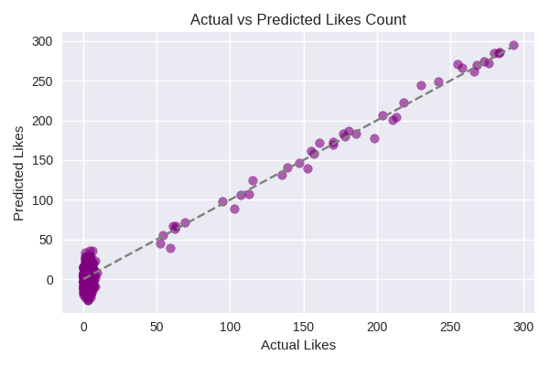
Actual vs Predicted Likes Count

Slide 13
Conclusion
Successfully implemented an end-to-end data science workflow
Engagement is influenced by multiple external factors
Text content alone is not sufficient for strong prediction
Demonstrates real-world NLP challenges

Slide 14
Future Scope
Possible Improvements:
- Sentiment analysis
- Topic modeling
- Deep learning models
- Inclusion of post-level metadata
Focus on methodology, transparency, and practical analysis

