Slide 1
Data Spark: Illuminating Insights for Global Electronics

Slide 2
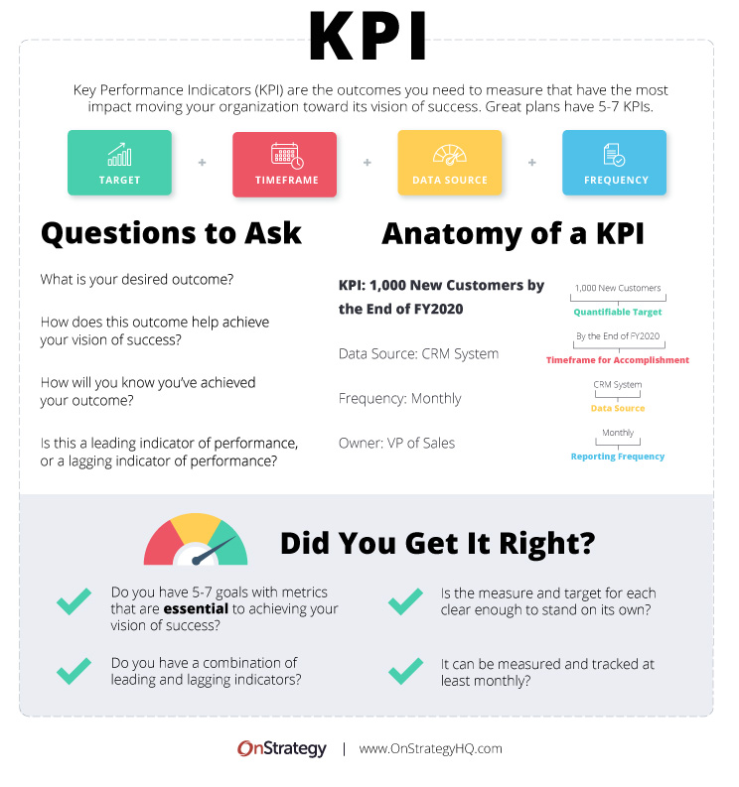
Executive Summary
Purpose: "This presentation analyzes key performance indicators for the Global Electronics business to identify trends and opportunities for growth."

Slide 3
Data Spark: Illuminating Insights for Global Electronics

Slide 4
Executive Summary
Purpose: "This presentation analyzes key performance indicators for the Global Electronics business to identify trends and opportunities for growth."

Slide 5

Executive Summary
Key Finding 2
Customer demographics show a near 50/50 split between male and female customers.

Slide 6

Executive Summary
Key Recommendation 1
Focus on strategies to address the recent decline in total revenue.

Slide 7

Executive Summary
Key Recommendation 2
Explore targeted marketing campaigns to leverage the balanced gender demographic.

Slide 8
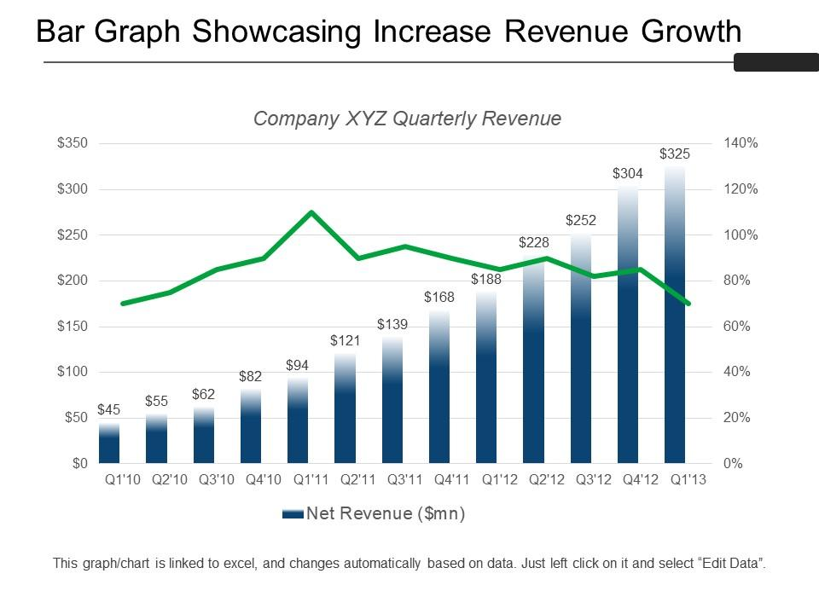
Total Revenue Trend
"As shown in the chart, revenue peaked in 2019 and has declined in subsequent years."

Slide 9
Total Revenue Trend
"Refer to the table on page 1 for specific YoY changes."

Slide 10
Executive Summary
$55.76M
-
-
-
Total revenue
Top-performing category
Additional insights
Future projections

Slide 11
Total Revenue Trend
$55.76M
-
-
Total revenue over the period
Year-on-year revenue growth
Comparison with previous periods

