Slide 1
IBM HR Analytics – Attrition & Performance
Visual Report + Key Insights
Dataset: IBM HR Analytics (1,470 × 35)

Slide 2
Executive Summary
Overall Attrition Rate: 16.12% (~1 in 6 employees)
Average Tenure: 7.0 years
Higher attrition among younger employees (<30)
Sales shows higher attrition vs R&D/HR
Lower MonthlyIncome correlates with attrition

Slide 3
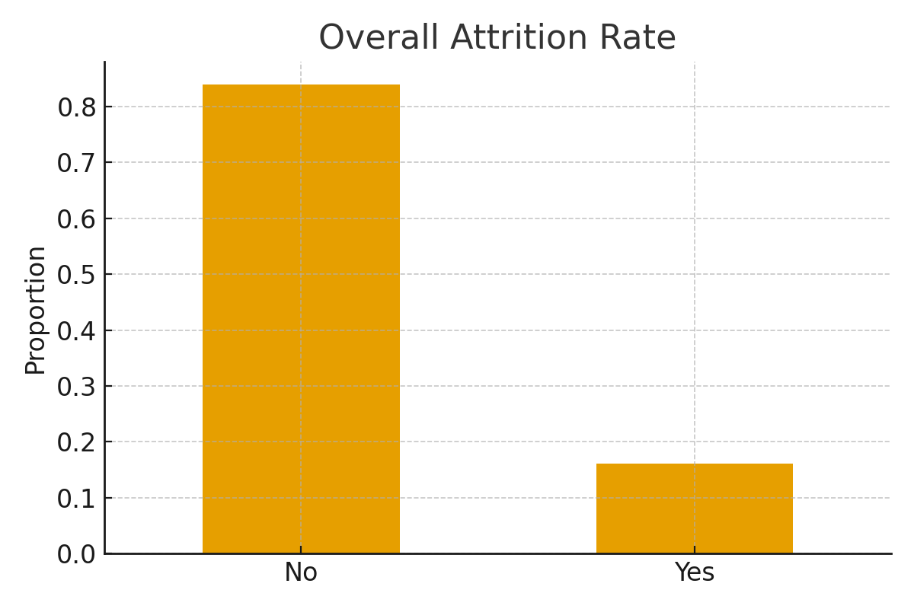
Overall Attrition Rate

Slide 4
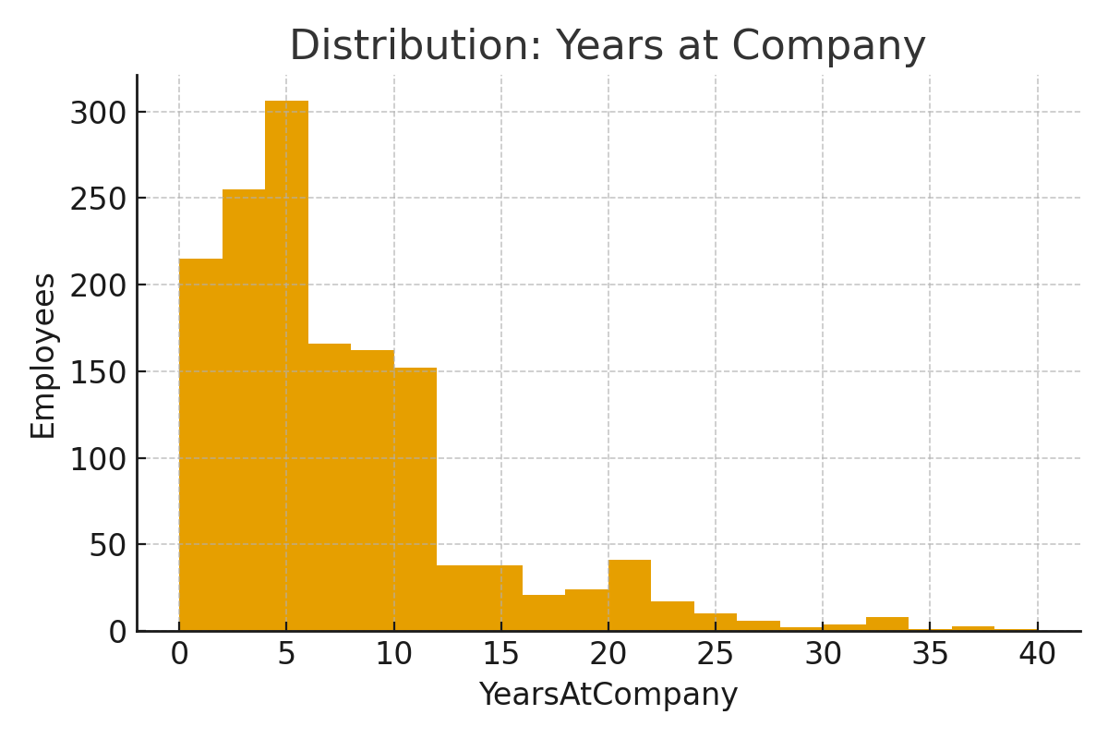
Distribution: Years at Company

Slide 5
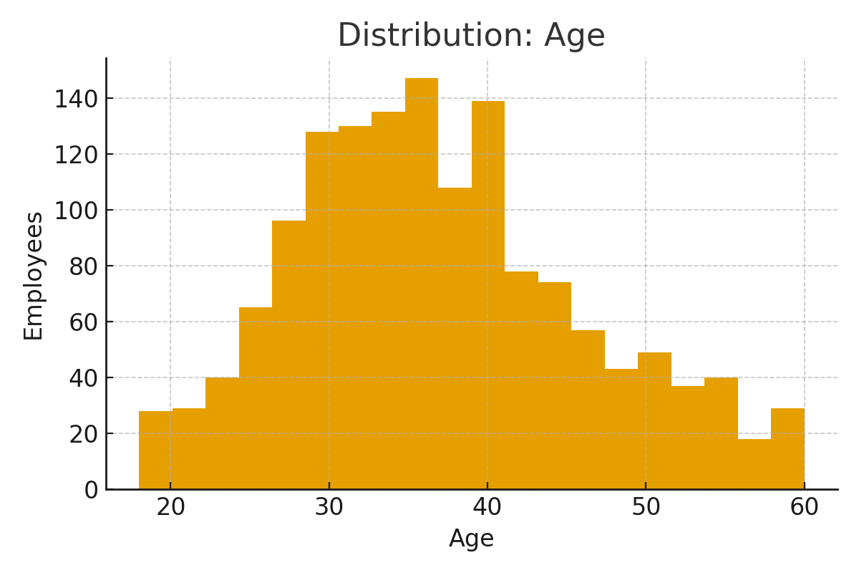
Distribution: Age

Slide 6
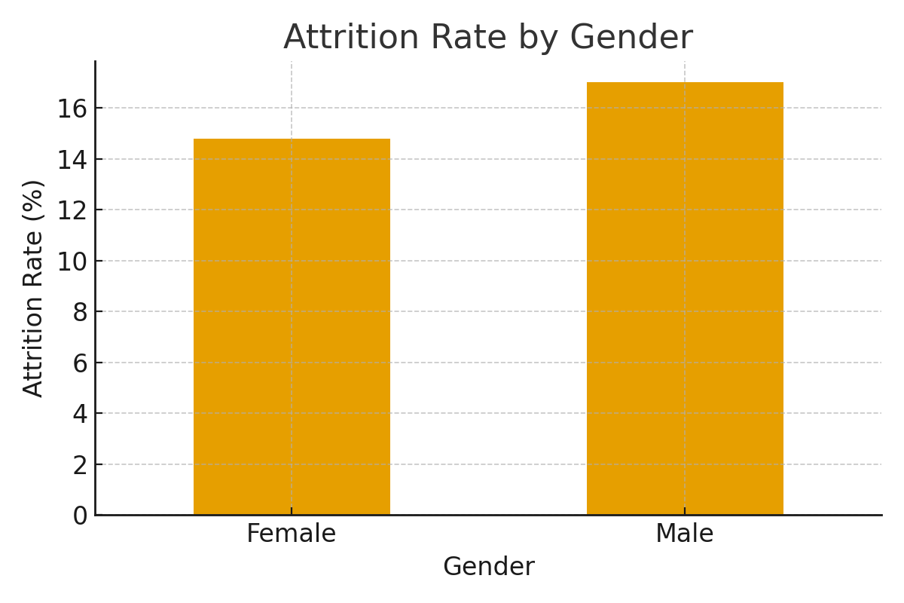
Attrition Rate by Gender

Slide 7
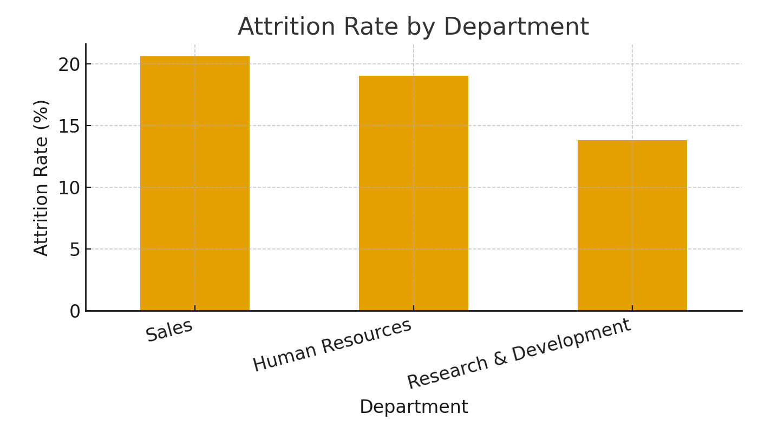
Attrition Rate by Department

Slide 8
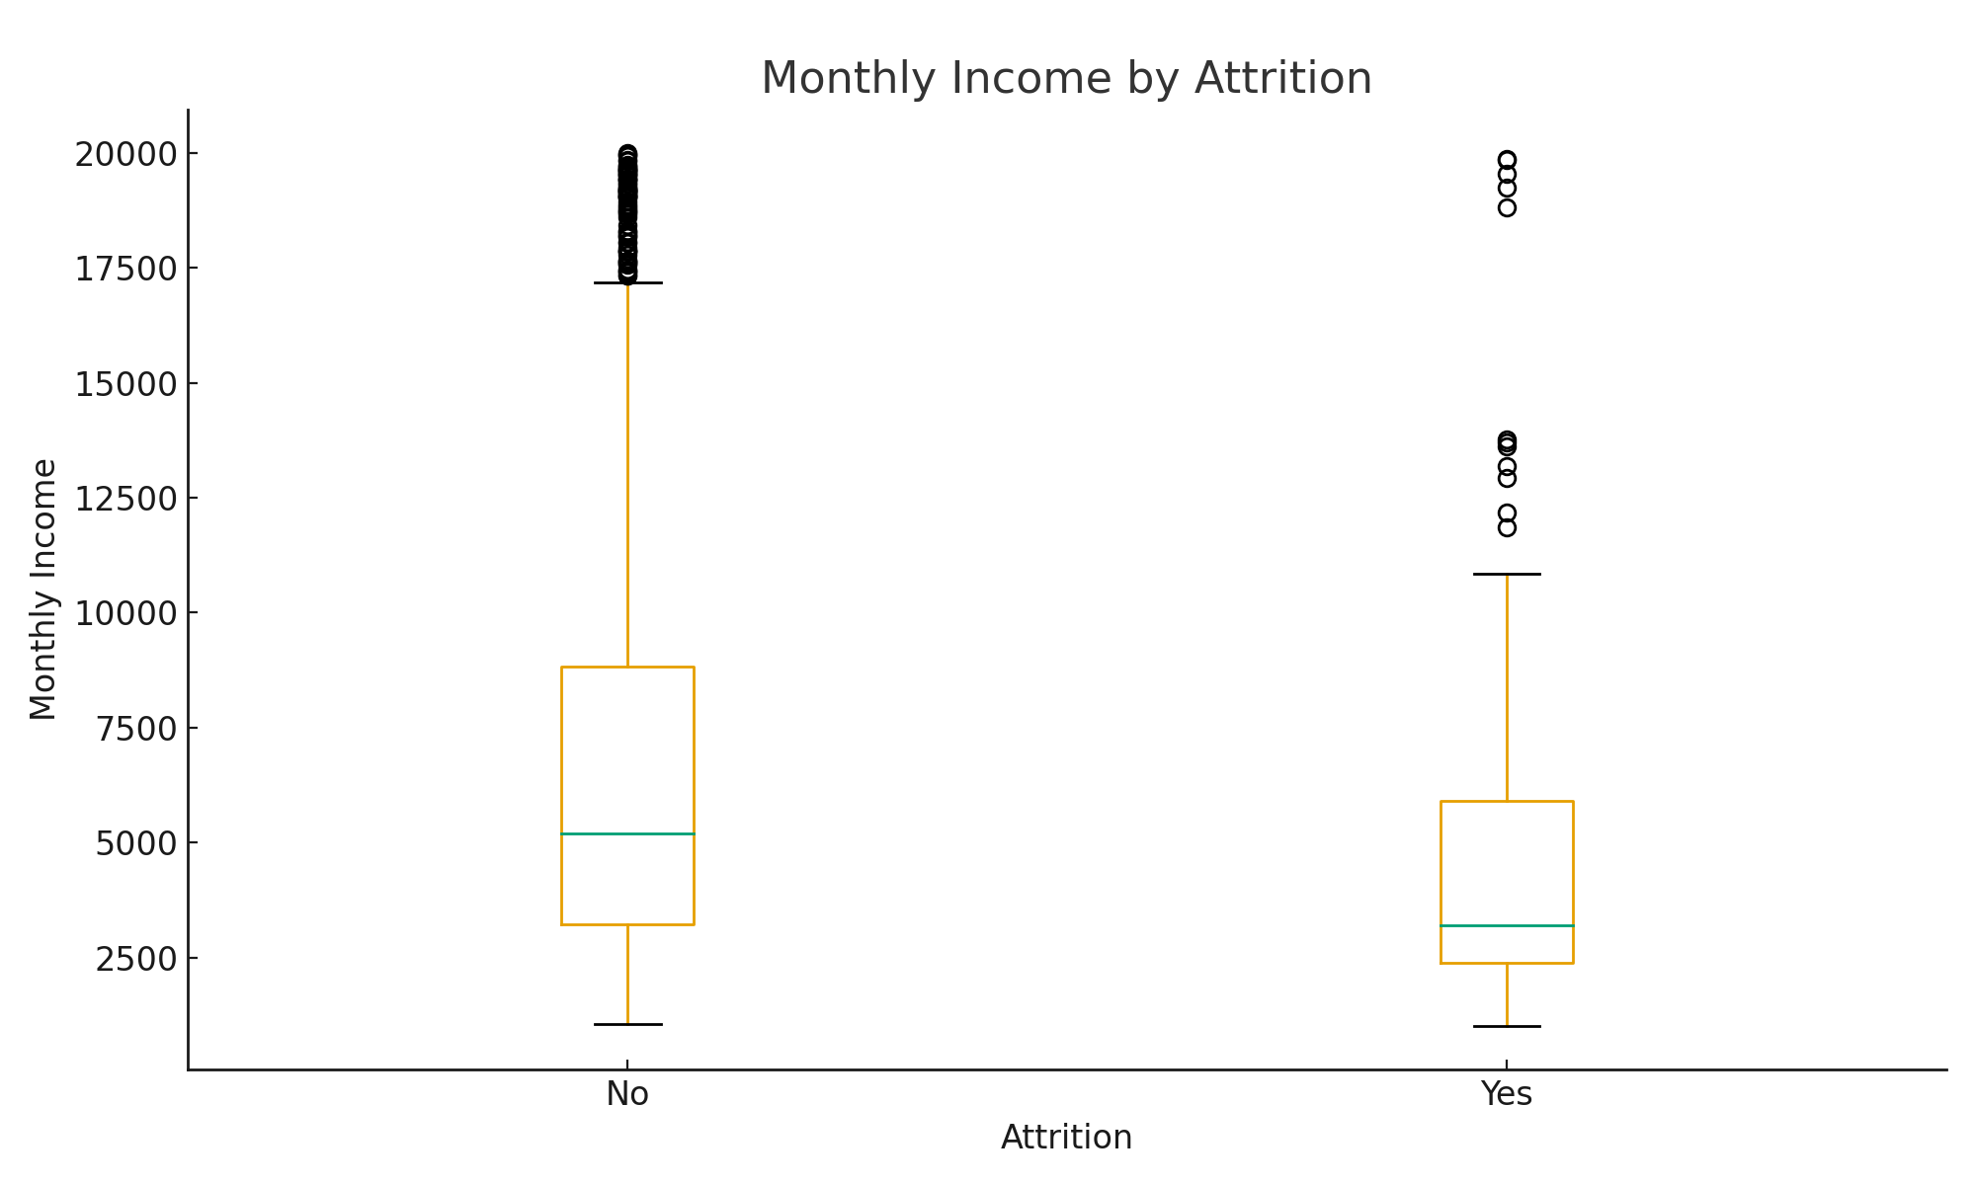
Monthly Income by Attrition

Slide 9
Key Drivers & Recommendations
Drivers:
• Younger age groups and Sales roles show higher attrition
• Lower monthly income and frequent business travel increase risk
• Low Work‑Life Balance and Job Satisfaction scores drive exits
Recommendations:
• Review salary bands and incentives for early‑career roles
• Reduce travel or compensate with flexible policies
• Improve engagement: mentoring, recognition, growth paths

Slide 10
Conclusion
Attrition at ~16% is meaningful and actionable.
Focus on early‑career retention, sales org, and work‑life balance.
Implement targeted compensation and engagement strategies.

