Slide 1
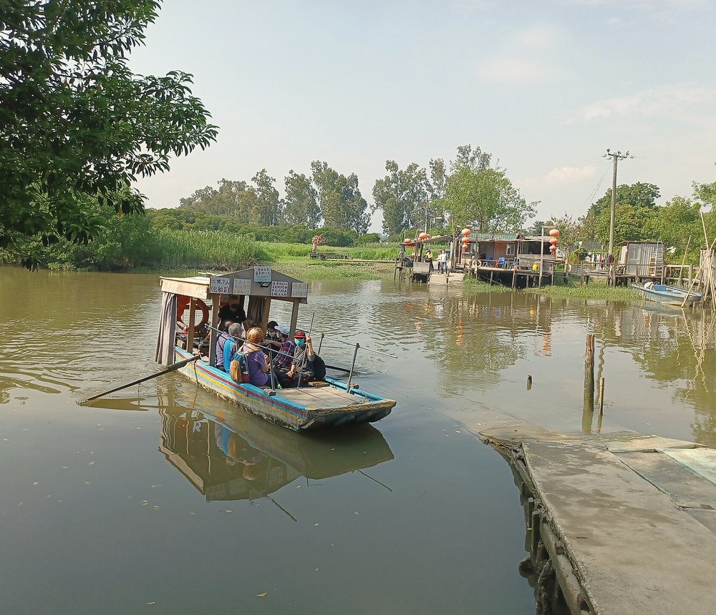
HONG KONG INTER-UNIVERSITY GENAI HACKATHON FOR SDGS 2026
Voices of the
North
北方之聲
"Development moves people out.
Memory has to be carried with them."
Team HumanLoop · Douglas · Zheng · Dat · Steven · Boris
The kind of place the stories come from — a village ferry crossing, Yuen Long District.
Track — Smart Living, Culture and Belonging
Photo: 姒姓賢寧 · CC BY-SA 4.0 · via Wikimedia Commons · cropped and colour-graded.
Final report · 18 October 2026
All stories in this deck are role-played for demonstration.

Slide 2
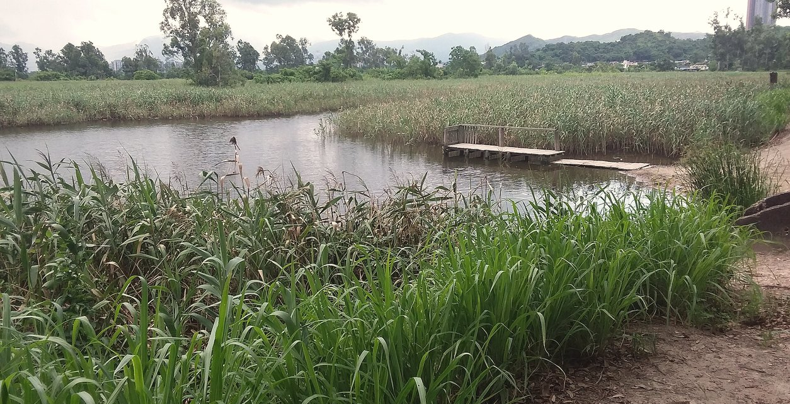
THE PROBLEM
Two clocks, one village
REDEVELOPMENT CLOCK
Runs on a published schedule
MEMORY CLOCK
Runs on a human one
Capture
One large button; consent stays on screen as a promise.
Understand
Per-word confidence marks uncertain words — nothing is ever silently corrected.
Share
Grounded answers — each bound to a timestamp that plays the original audio.
Fish ponds and reed beds, Yuen Long District.
Voices of the North · HumanLoop — role-played stories · no real geography · demo-scope metrics only
Photo: FHKE · CC BY-SA 2.0 · Wikimedia Commons
02 / 14

Slide 3
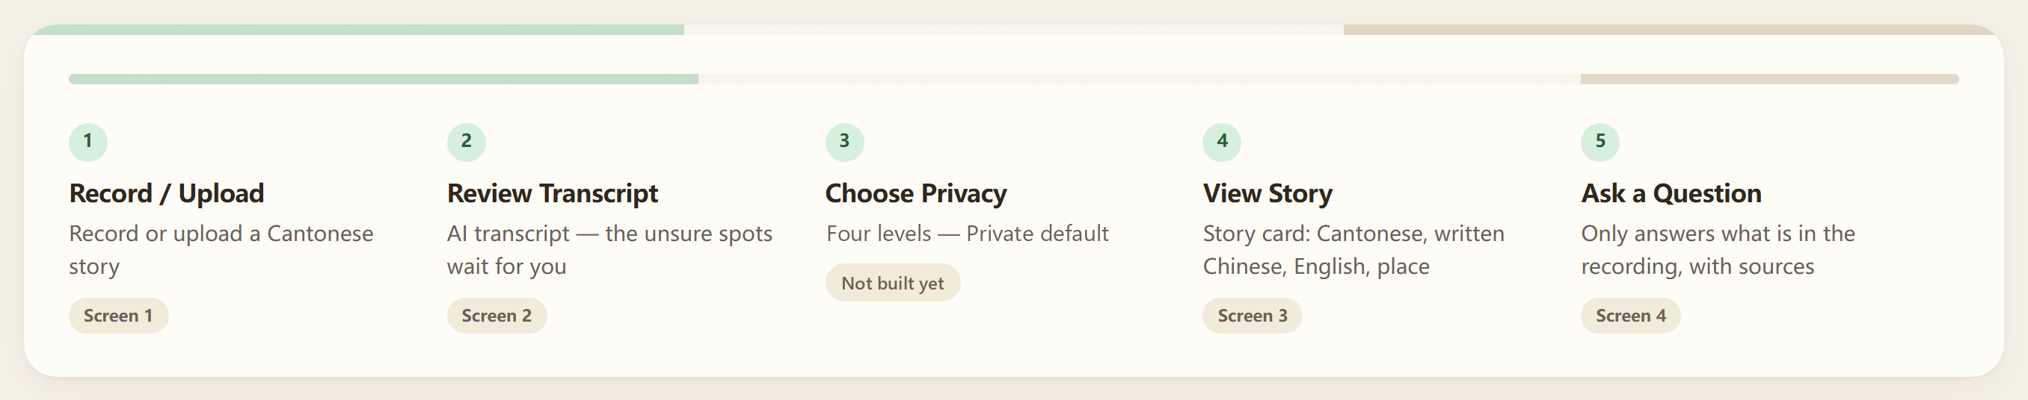
PRODUCT · CORE FUNCTION CHAIN
One story, five steps, three layers
01
Record / Upload
Presses one button and speaks, or uploads a file that already exists
Keeps the silences, uploads on stop, runs speech-to-text
The storyteller picks the language; consent is captured on screen, not in a pop-up
02
Review Transcript
Reads at 23px, taps a marked passage, types or speaks a correction
Marks low confidence and suggests candidate words with timestamps
The storyteller confirms or corrects — nothing is ever silently corrected
03
Choose Privacy
Picks one of four audience levels; Private is the default
Writes the level onto the story record and keeps the original audio
The storyteller owns the level and can change or withdraw it in one tap
04
View Story
Reads the cover, the transcript and the place
Extracts theme and place, then shows village-level fuzzy precision only
A volunteer confirms the suggested location before it is displayed
05
Ask a Question
Asks in plain language and listens to the answer
Answers only from recordings, each bound to a timestamp
The asker can play the original audio behind every single answer
Capture · Understand · Share — the third column is where a person, not the model, decides · step 03 privacy is designed, not yet wired
03 / 14

Slide 4
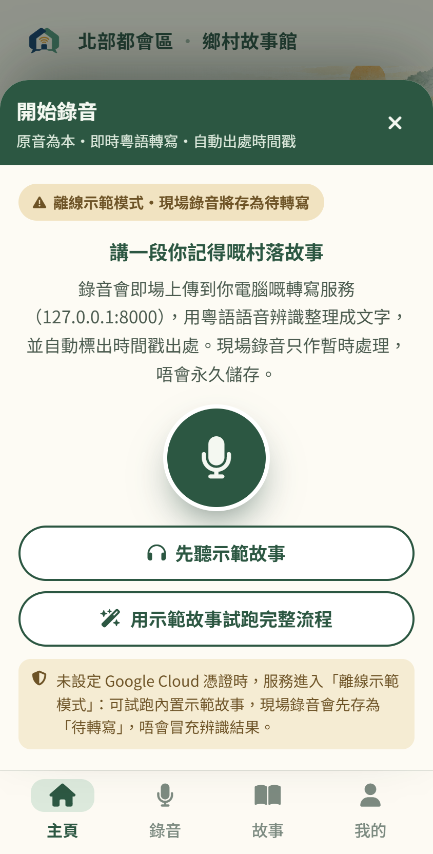
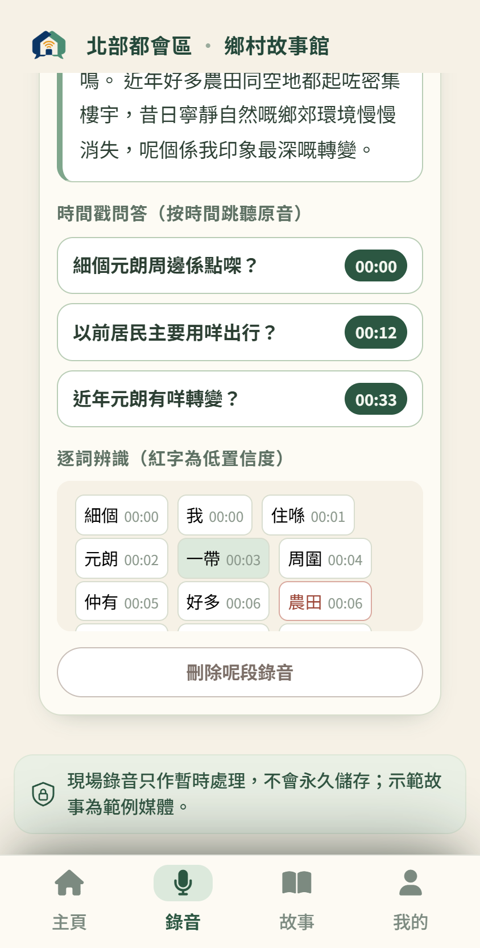
PRODUCT · STEP 01 AND STEP 02
Record in one press, then see what the machine doubts
01
Record / Upload
Language is chosen by a person, never guessed: Cantonese, Waitau, Hakka or Hoklo.
One large button, a running timer, topic prompts as gentle questions — capture has to feel like a conversation, not a form.
Consent sits at the bottom of the screen rather than in a dismissible pop-up, because it is a promise, not terms.
02
Review Transcript
Speech-to-text returns a confidence score per word. Two words in our demo recording came back low: 農田 at 71.4% (ambient noise) and 雀鳥 at 62.8% (renovation drilling).
Both are flagged in the transcript and offered for correction. The build marks them in red today; we are moving that mark to a reserved uncertainty colour. The original audio is never altered.
Screen 1 · Record / Upload
Screen 2 · Transcript Review
Voices of the North · HumanLoop — demo values shown, not accuracy claims
04 / 14

Slide 5
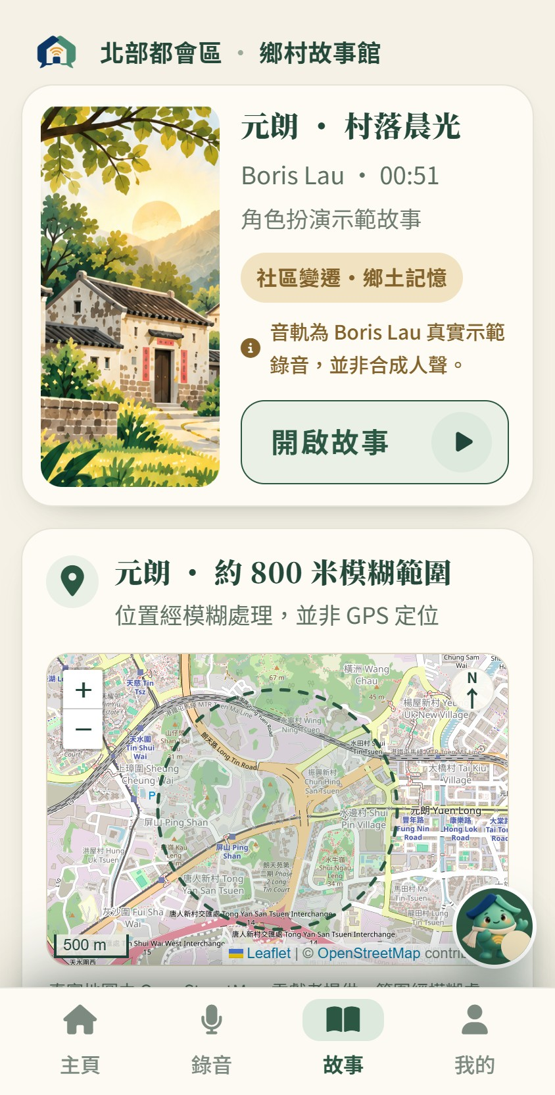
PRODUCT · STEP 03 AND STEP 04
The story card carries the ethics
03
Choose Privacy
04
View Story
Private
Only the storyteller
DEFAULT
THREE VERSIONS, STORED SEPARATELY
Cantonese
Family
Family members
Kept as it was spoken. The voice is never replaced.
Community
Community groups and schools
Written Chinese
Cleaned of filler words, with the original still playable.
Public
Everyone, including visitors
English
A separate, clearly labelled version — not a replacement.
In the build this is not a settings page either: it is reached from 我的 as one of three management entries. Private is already the default; the picker itself is not built yet.
The place block reads 位置經模糊處理，並非 GPS 定位 and shows a village-level fuzzy area of about 800 m — never an exact GPS point.
Withdrawal removes the story from shared surfaces but keeps the audio with the storyteller.
If the place cannot be resolved, the block says "not yet located" rather than inventing a pin.
Screen 3 · Story Card + Place
Voices of the North · HumanLoop — AI suggests, a human confirms
05 / 14

Slide 6
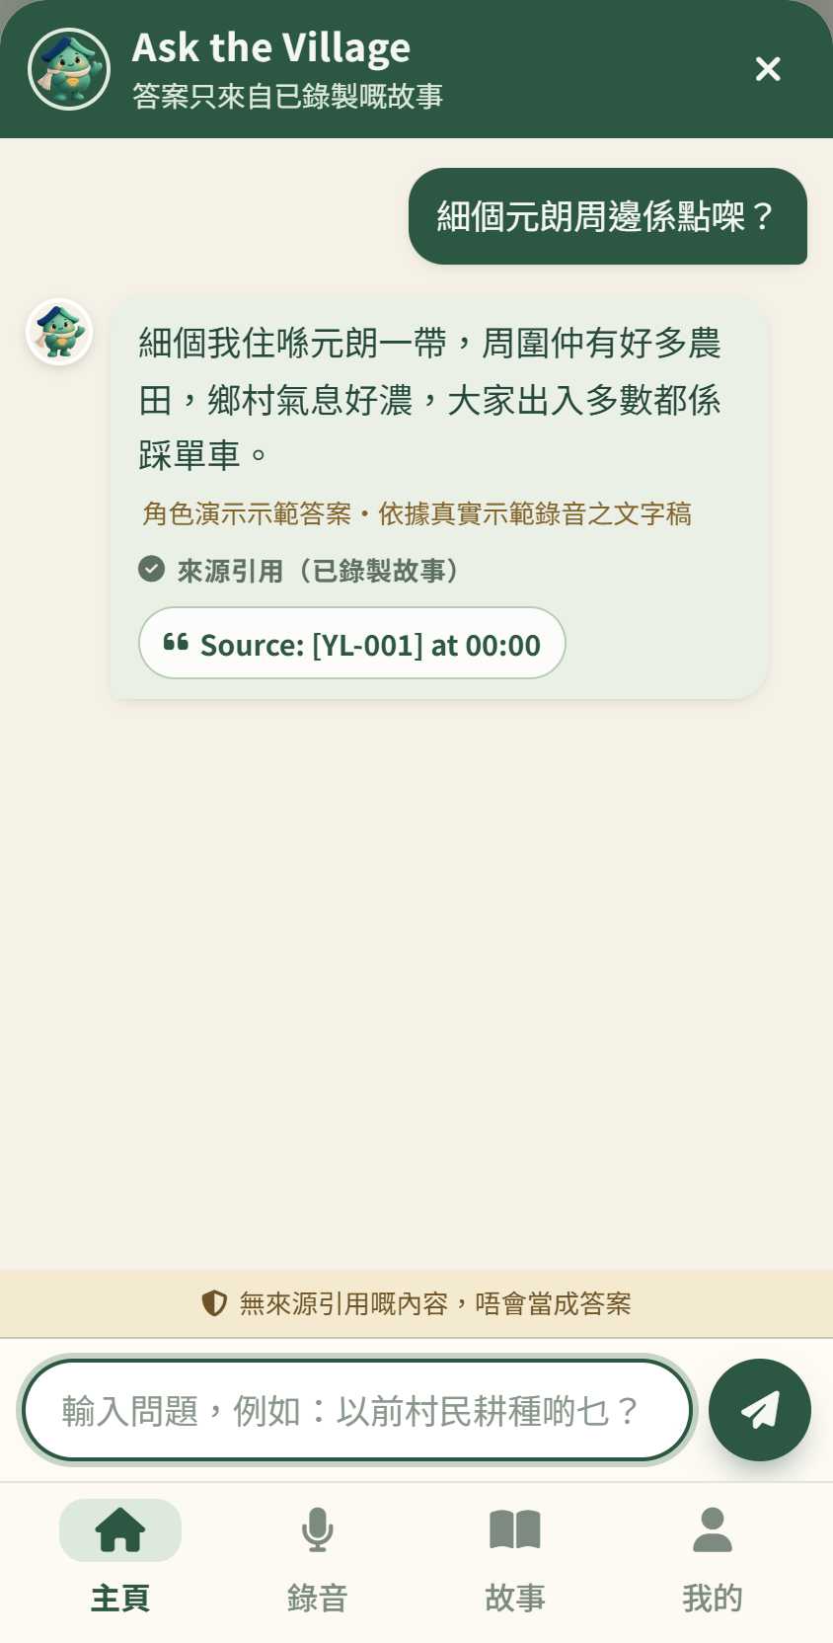
PRODUCT · STEP 05
Ask the village — and always get the receipt
Retrieval never leaves the recorded corpus
00:08 – 00:16
The mornings, the birds, and the fish ponds at the edge of the village
00:19 – 00:32
Who lived nearby, and how the neighbours shared the mud path
00:39 – 00:45
What changed on the fields, and when the digging started
Every answer carries the label "Source from recorded story", and one tap plays the original audio. A question spanning several stories returns one answer per source.
THE DESIGNED NO-ANSWER
"This recording never mentions it. We will not guess."
Screen 4 · Ask the Village
A confident wrong answer is worse than an honest blank — so the blank is designed, not treated as a failure
06 / 14

Slide 7
SYSTEM · PIPELINE
Six stages from a voice to a sourced answer
1
Browser audio ingestion
2
Cloud speech-to-text
3
Uncertainty-marked transcript
A recording captured in the browser; it survives a dropped connection
A transcript with a confidence score attached to every single word
Every doubtful passage is visibly marked before anything is shown
IF IT FAILS
Poor audio is flagged low-confidence — it is never refused
IF IT FAILS
Capture keeps working locally and the upload is queued
IF IT FAILS
An unreadable passage is skipped and stays marked
4
LLM normalisation & extraction
5
Timestamp-linked indexing
6
Grounded question answering
Cleaned written Chinese, English, theme tags and a place candidate
Searchable units, each carrying the time range it came from
Answers restricted to the corpus, each with a playable source
IF IT FAILS
A place that cannot be resolved stays "not yet located"
IF IT FAILS
Recordings over five minutes are processed in chunks
IF IT FAILS
No source means the designed no-answer, not a guess
A person is inside the pipeline at four points: choosing the language, correcting the transcript, confirming the place, and giving consent before anything becomes public. No stage publishes on its own.
Voices of the North · HumanLoop
07 / 14

Slide 8
SYSTEM · UNCERTAINTY
The machine shows its doubt instead of hiding it
71.4%
農田
62.8%
雀仔叫
Disturbed by ambient noise at the fish ponds. Marked, offered for correction, left visible in the story.
Disturbed by renovation drilling next door. The storyteller confirmed it in one tap; the audio was never rewritten.
per-word confidence
per-word confidence
CONFIDENCE, WORD BY WORD
One bar = one word in the transcript
THE BOUNDARY WE HOLD
These two figures are observations from one 51-second role-played demo recording. They are not an accuracy claim, and we will not quote a general accuracy figure for Cantonese speech recognition that we have not measured.
Voices of the North · HumanLoop
08 / 14

Slide 9
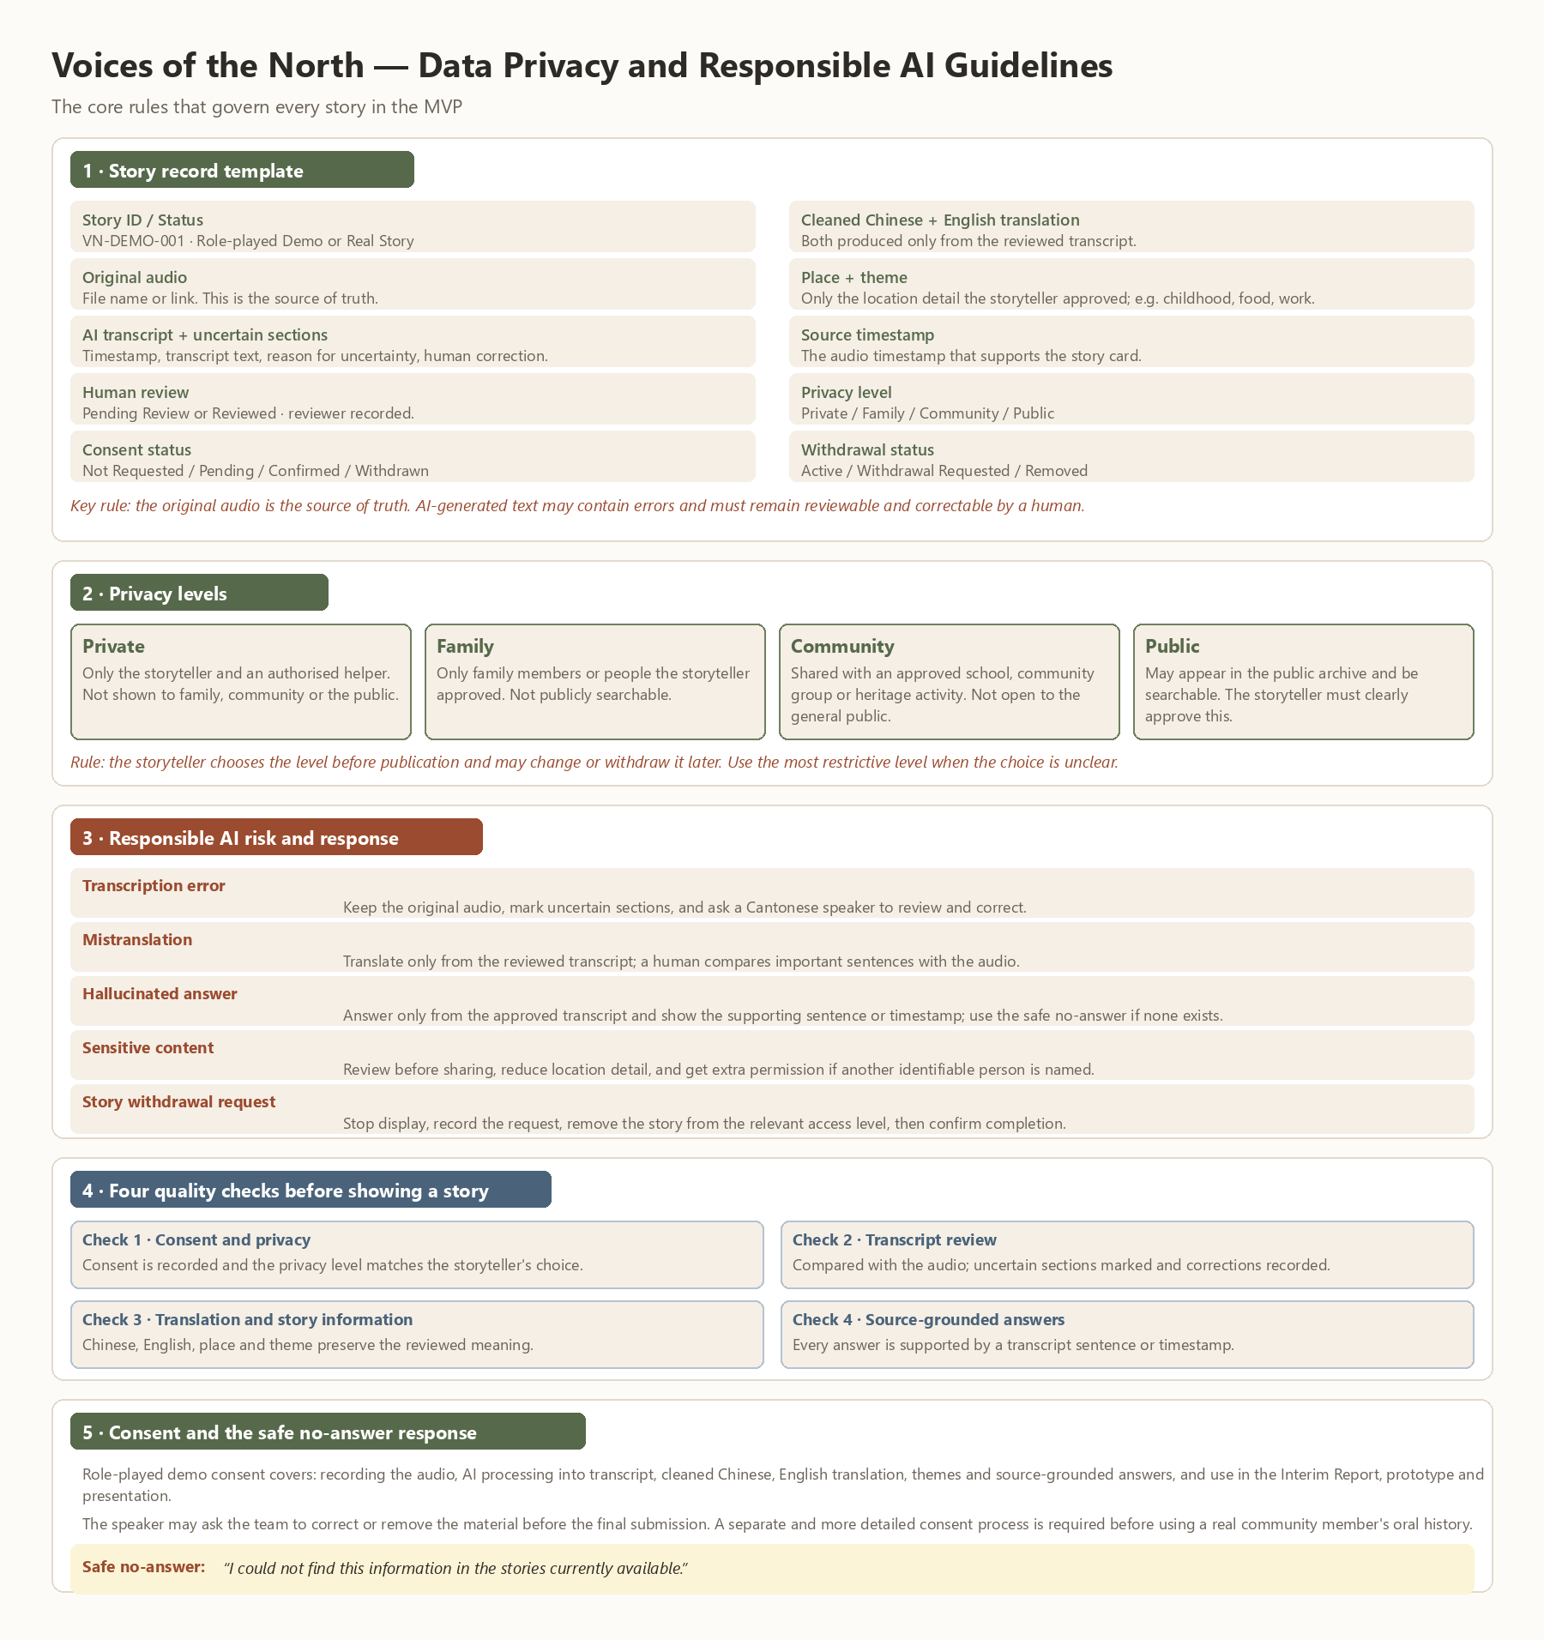
SYSTEM · GROUNDING AND PRIVACY
Grounded by construction, not by good intentions
HOW AN ANSWER IS PRODUCED
WHO CAN HEAR A STORY
Private
Only the storyteller
Default
Family
Family members
—
Community
Community groups and schools
—
Public
Everyone, including visitors
—
Our privacy and AI-responsibility rules — written for the MVP, not yet a screen in the build.
The build already renders Leaflet with OpenStreetMap tiles, and draws only a village-level fuzzy circle of roughly 800 m — there is no GPS pin anywhere in the app. The basemap licence must still be verified before launch.
Voices of the North · HumanLoop
09 / 14

Slide 10
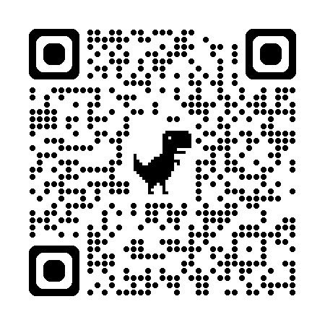

DEMO · WALKTHROUGH
One story, end to end: 元朗村落晨光與魚塘回憶
TRY THE WORKING BUILD
掃碼開啟演示 · Scan to open the demo
https://voices-of-the-north.onrender.com/voices-of-the-north-app.html
01 · Record
02 · Review
03 · Story card
04 · Ask
WHAT HAPPENS, IN ORDER
01
02
03
04
05
Boris records 51 seconds of Cantonese on Screen 1.
Two words return low-confidence and are corrected, not overwritten.
Privacy tiers are not built yet — the default stays Private.
The card shows three labelled versions and a village-level fuzzy place.
Three sourced answers come back, and one honest blank.
Role-played recording · consent verified 29 Sep 2026 · 51 seconds
10 / 14

Slide 11
LIMITS · STATED PLAINLY
What we will not claim
Not real interviews
Not an exact location
Not enforced yet
Every story in this deck is role-played for demonstration. No elder’s recording is used, and no community partnership has been signed.
The map is real OpenStreetMap imagery, but the only thing drawn on it is a fuzzy circle of roughly 800 m. No GPS pin, no address, no exact point.
The four privacy tiers and the consent controls are specified in the interface but are not yet enforced by a backend.
Status — role-played
Status — coarse by design
Status — interface only
No general accuracy claim
Never automatic
The two confidence figures come from one 51-second demo recording. We do not quote a Cantonese recognition accuracy rate that we have not measured, and the demo metrics are reproducible only within the demo.
Nothing is published without a human confirming it. Dialects are not auto-translated, and there is no face detection, no speaker identification, no social feed and no editing of someone else’s story.
Status — demo scope only
Status — by design
Four rules the flow obeys: one screen, one job · uncertainty stays visible · every answer has a source · consent stays with the elder
11 / 14

Slide 12
ROADMAP · WHAT COMES AFTER THE DEMO
Expansion we deliberately did not build yet
NOW
NEXT
LATER
BEYOND
In the hackathon build
0 – 3 months
6 – 12 months
Only if the rest works
Guided Cantonese capture
Backend enforcement of privacy tiers
Hakka, Hoklo and Wai Tau recognition
A cross-district, then cross-border dialect archive
built
Uncertainty-marked transcript
needs a real account and storage model
no training data or ASR model exists for them yet
depends on the dialect branch
built
Real map on Leaflet + OpenStreetMap
Paid transcription and hosting for NGOs and heritage offices
Four privacy tiers
Handover to a library, museum or district NGO
interface only
basemap licence must be verified first
needs a consent and compliance framework
Volunteer review queue for unrecognised dialects
needs a custodian and a data agreement
Three-version story card
School and community-curated collections
An open metadata schema other archives can federate
built
needs a partner running sessions
Grounded Q&A with timestamps
Longer and multi-session recordings
depends on the tiers being enforced
no schema agreed yet
built
chunking is specified, not built
Offline-first capture for field volunteers
capture works offline; sync does not
Nothing in the last three columns is in the demo. Each item carries the reason it is not built yet, so the gap between what we showed and what we promise stays visible.
Voices of the North · HumanLoop
12 / 14

Slide 13
FUTURE BRANCH · LANGUAGE
Cantonese works. The other three do not — yet.
PATH A
PATH B
PATH C
Fine-tune a dialect ASR model
Multilingual normalisation
Volunteer manual transcript
Several hours of transcribed audio per dialect, plus fluent speakers to verify it.
A large model that already handles related Sinitic varieties, with Cantonese as the bridge.
A person writes the transcript; everything downstream stays exactly as it is today.
Most accurate if it works. Slowest and most expensive to obtain — this is the honest blocker.
Fastest to try, least certain. We would mark its output as uncertain by default, for a human to confirm.
Works now. It does not scale, and it puts the labour on the community rather than the system.
How we would know it works: measure per-word confidence on a held-out set of that dialect, published with its size and its speakers, before we claim anything about it.
Voices of the North · HumanLoop — this page describes work not yet done
13 / 14

Slide 14
IMPACT · HOW WE WOULD MEASURE IT
Three goals, three countable definitions
11
SDG 11
4
SDG 4
16
SDG 16
Sustainable cities and communities
Quality education
Peace, justice and strong institutions
Measured as
Measured as
Sourced answers played back in school and community sessions, counted per session — never downloads, never likes.
Measured as
The number of village stories that carry a verified transcript and a confirmed privacy tier before clearance.
The share of answers traceable to a timestamp, and the share of stories where consent was changed or withdrawn without friction. Target: 100% traceability.
A community that loses its buildings can still hold a queryable record of what was there.
Students hear the original voice, not somebody’s summary of it.
An archive that can prove where every claim came from is far harder to misuse.
"Development can rebuild a place. Only people can remember it."
Voices of the North · Team HumanLoop
Final report · 18 October 2026
All figures in this deck are demo-scope observations, not general accuracy claims.
14 / 14

