Slide 1
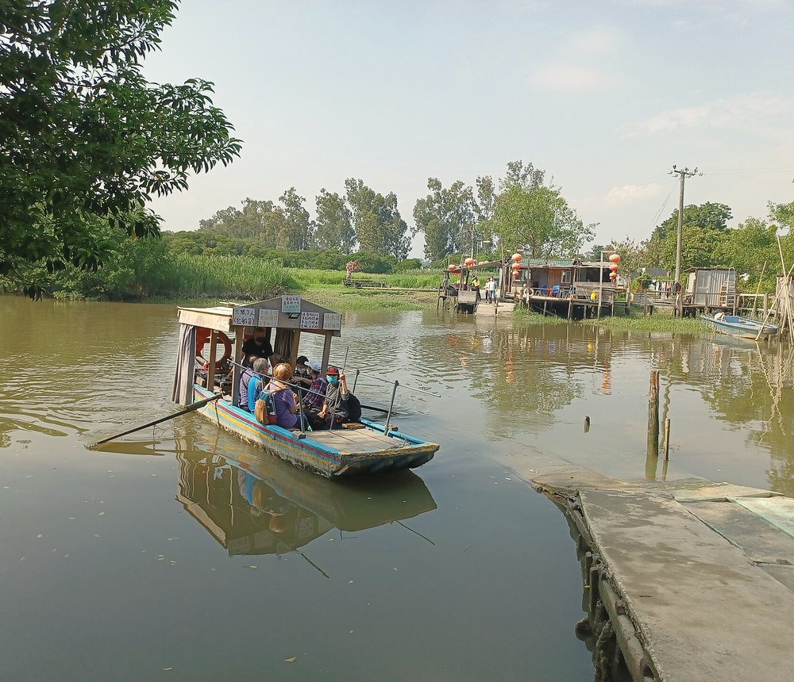
HONG KONG INTER-UNIVERSITY GENAI HACKATHON FOR SDGS 2026
Voices of the
North
北方之聲
"Development moves people out.
Memory has to be carried with them."
Team HumanLoop · Douglas · Zheng · Dat · Steven · Boris
The kind of place the stories come from — a village ferry crossing, Yuen Long, in the Northern Metropolis.
Track — Smart Living, Culture and Belonging
Photo: 姒姓賢寧 · CC BY-SA 4.0 · via Wikimedia Commons · cropped and colour-graded.
Final report · 18 October 2026
All stories in this deck are role-played for demonstration. The demo audio is a 46-second Yuen Long recording.

Slide 2
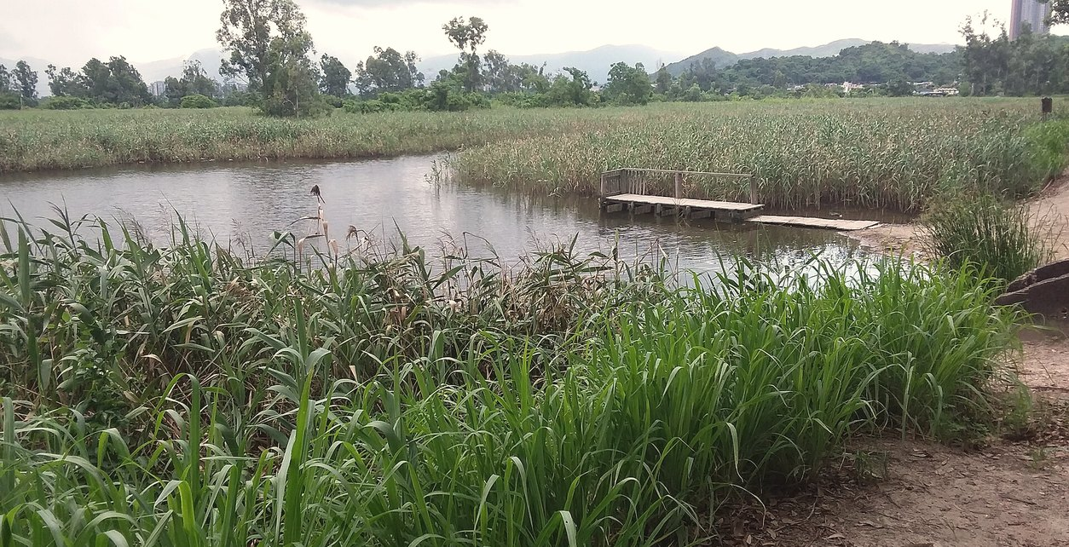
THE PROBLEM
Two clocks, one village
REDEVELOPMENT CLOCK
Runs on a published schedule
MEMORY CLOCK
Runs on a human one
Capture
One large button; consent opens as a required form before anything records.
Understand
Sentence confidence and a word-by-word timestamp — no silent corrections.
Share
Grounded answers — each bound to a timestamp that plays the original audio.
Fish ponds and reed beds, Yuen Long, in the Northern Metropolis.
Voices of the North · HumanLoop — role-played stories · no real geography · demo-scope metrics only
Photo: FHKE · CC BY-SA 2.0 · Wikimedia Commons
02 / 14

Slide 3
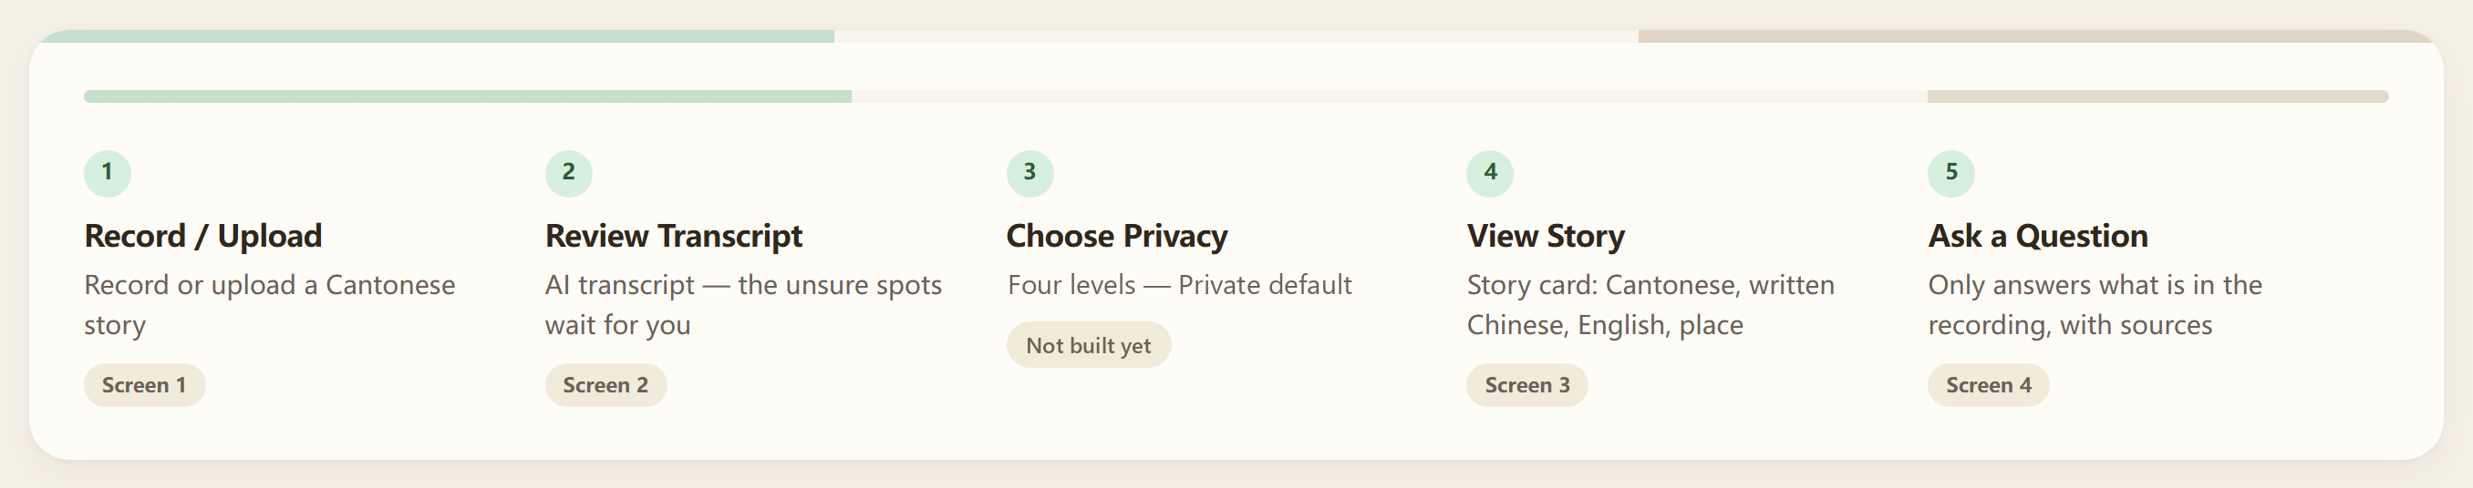
PRODUCT · CORE FUNCTION CHAIN
One story, five steps, three layers
01
Record / Upload
Presses one button and speaks, or uploads a file that already exists
Keeps the silences, uploads on stop, runs speech-to-text
The storyteller picks the language; consent is a required form before the mic opens
02
Review Transcript
Reads at 23px, taps a marked passage, types or speaks a correction
Shows the sentence confidence and lets any word be tapped to hear it
The storyteller confirms or corrects — nothing is ever silently corrected
03
Choose Privacy
Picks one of four audience levels; Private is the default
Writes the level onto the story record and keeps the original audio
The storyteller owns the level — not the model, not the volunteer
04
View Story
Reads the cover, the transcript and the place
Extracts theme and place, then shows village-level fuzzy precision only
A volunteer confirms the suggested location before it is displayed
05
Ask a Question
Asks in plain language and listens to the answer
Answers only from recordings, each bound to a timestamp
The asker can play the original audio behind every single answer
Capture · Understand · Share — the third column is where a person, not the model, decides · step 03 privacy is designed, not yet wired
03 / 14

Slide 4
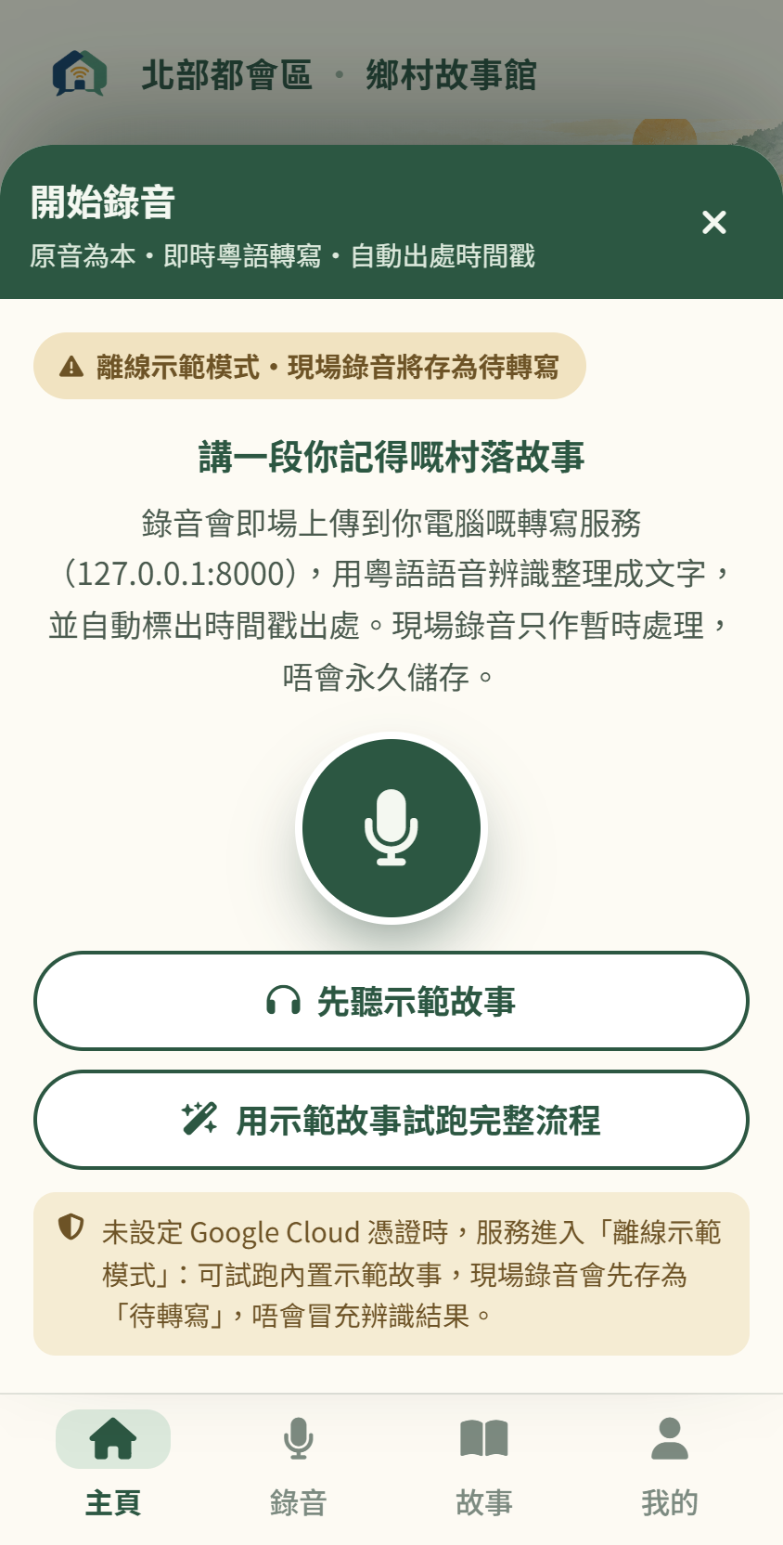
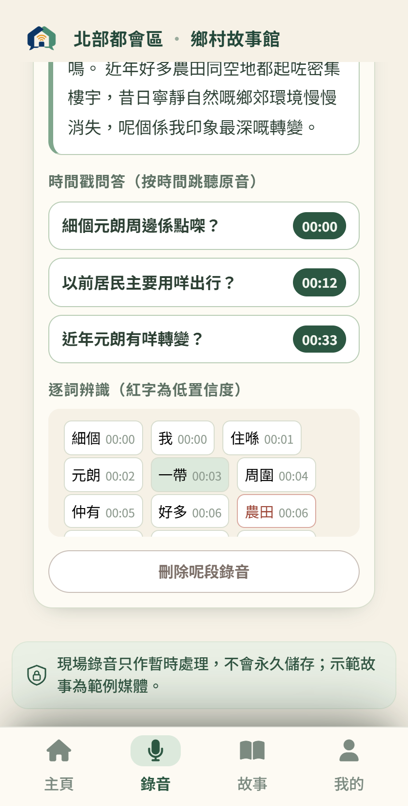
PRODUCT · STEP 01 AND STEP 02
Record in one press, then check every word against the audio
01
Record / Upload
Language is chosen by a person, never guessed: Cantonese, Waitau, Hakka or Hoklo.
One large button, a running timer, topic prompts as gentle questions — capture has to feel like a conversation, not a form.
Consent is a gate, not a footnote: pressing 開始錄音 opens the 長者口述歷史知情同意書 form, and nothing records until it is confirmed.
02
Review Transcript
Speech-to-text returns one sentence-level confidence score for the whole recording — 0.94 on our demo — plus a timestamp on every word.
Every word is aligned to the audio, so any passage can be tapped and played back instantly. The storyteller confirms or corrects; the original audio is never altered.
Screen 1 · Record / Upload
Screen 2 · Transcript Review
Voices of the North · HumanLoop — 0.94 is one demo recording, not an accuracy claim
04 / 14

Slide 5
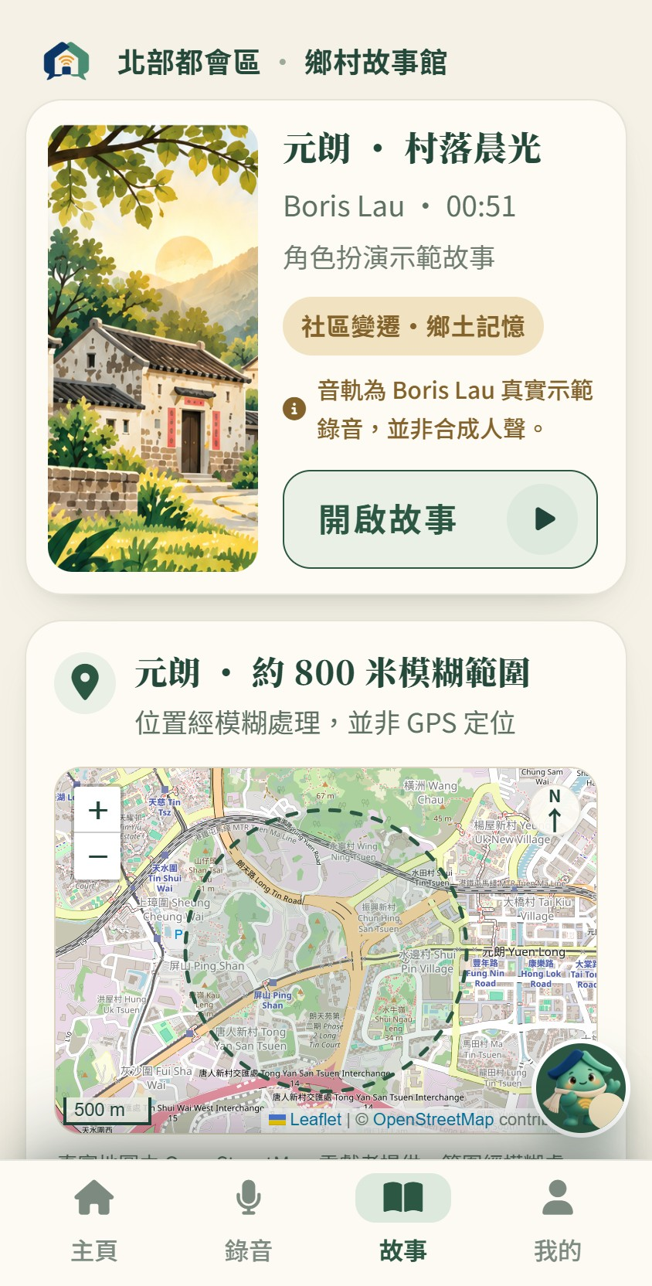
PRODUCT · STEP 03 AND STEP 04
The story card carries the ethics
03
Choose Privacy
04
View Story
Private
Only the storyteller
DEFAULT
THREE VERSIONS, STORED SEPARATELY
Cantonese
Family
Family members
Kept as it was spoken. The voice is never replaced.
Community
Community groups and schools
Written Chinese
Cleaned of filler words, with the original still playable.
Public
Everyone, including visitors
English
A separate, clearly labelled version — not a replacement.
In the build this is not a settings page either: it is reached from 我的 as one of three management entries. Private is already the default; the picker itself is not built yet.
The place block reads 位置經模糊處理，並非 GPS 定位 and shows a village-level fuzzy area of about 800 m — never an exact GPS point.
Withdrawal removes the story from shared surfaces but keeps the audio with the storyteller — interface only for now.
If the place cannot be resolved, the block says "not yet located" rather than inventing a pin.
Screen 3 · Story Card + Place
Voices of the North · HumanLoop — AI suggests, a human confirms
05 / 14

Slide 6
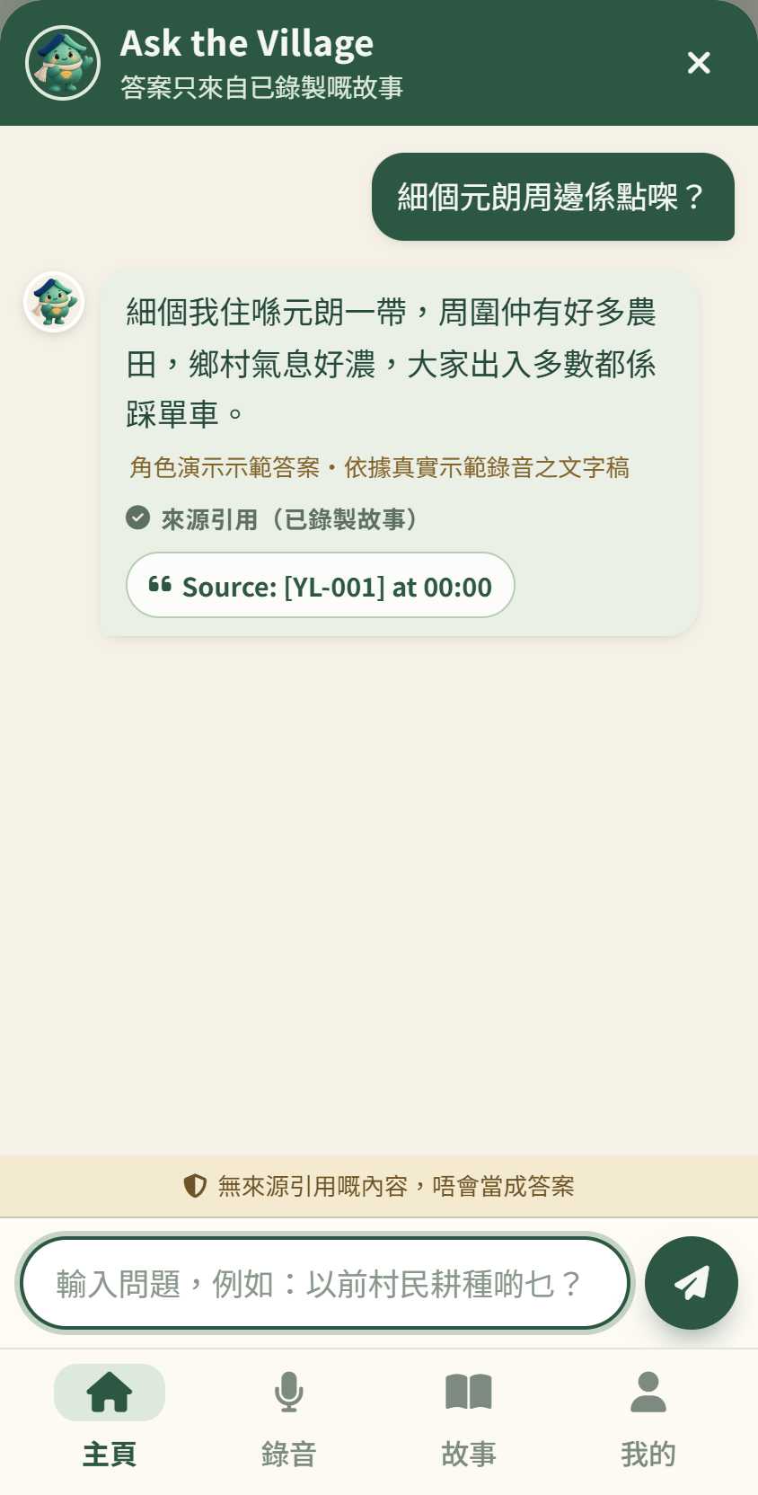
PRODUCT · STEP 05
Ask the village — and get the receipt
Deterministic grounded retrieval, cited by timestamp
00:08 – 00:16
The mornings, the birds, and the fish ponds at the edge of the village
00:19 – 00:32
Who lived nearby, and how the neighbours shared the mud path
00:39 – 00:45
What changed on the fields, and when the digging started
Every answer carries the label "Source from recorded story", and one tap plays the original audio. A question spanning several stories returns one answer per source.
THE DESIGNED NO-ANSWER
"This recording never mentions it. We will not guess."
Screen 4 · Ask the Village
It reduces unsupported answers and declines what the corpus does not cover — an honest blank beats a confident guess
06 / 14

Slide 7
SYSTEM · PIPELINE
Six stages from a voice to a sourced answer
1
Browser audio ingestion
2
Cloud speech-to-text
3
Human-verified transcript
A recording captured in the browser; it survives a dropped connection
A transcript with a sentence-level confidence score and a timestamp on every word
The storyteller reads and corrects before anything is shown
IF IT FAILS
Poor audio is flagged low-confidence — it is never refused
IF IT FAILS
Capture keeps working locally and the upload is queued
IF IT FAILS
An unreadable passage stays flagged for the storyteller
4
Normalisation & extraction
5
Timestamp-linked indexing
6
Grounded question answering
Cleaned written Chinese, English, theme tags and a place candidate — pre-computed for the demo
Searchable units, each carrying the time range it came from
Answers restricted to the corpus, each with a playable source
IF IT FAILS
A place that cannot be resolved stays "not yet located"
IF IT FAILS
Recordings over five minutes are processed in chunks
IF IT FAILS
No source means the designed no-answer, not a guess
A person is inside the pipeline at four points: choosing the language, correcting the transcript, confirming the place, and confirming consent before the microphone opens. No stage publishes on its own.
Voices of the North · HumanLoop
07 / 14

Slide 8
SYSTEM · CONFIDENCE AND ALIGNMENT
Every word is traceable back to the moment it was spoken
0.94
一個示範錄音
46 s
元朗 · 示範
Google Cloud Speech-to-Text returns one score for the whole recording. It is not an accuracy rate.
One take, recorded for the demo. No elder's voice is used and no field interview is claimed.
sentence-level confidence
role-played demo recording
WORD-LEVEL ACOUSTIC ALIGNMENT
One bar = one word, timestamped
THE BOUNDARY WE HOLD
0.94 is sentence-level confidence from one 46-second role-played demo recording — not an accuracy rate, and not a separate per-word score. We quote no Cantonese accuracy figure we have not measured.
Voices of the North · HumanLoop
08 / 14

Slide 9
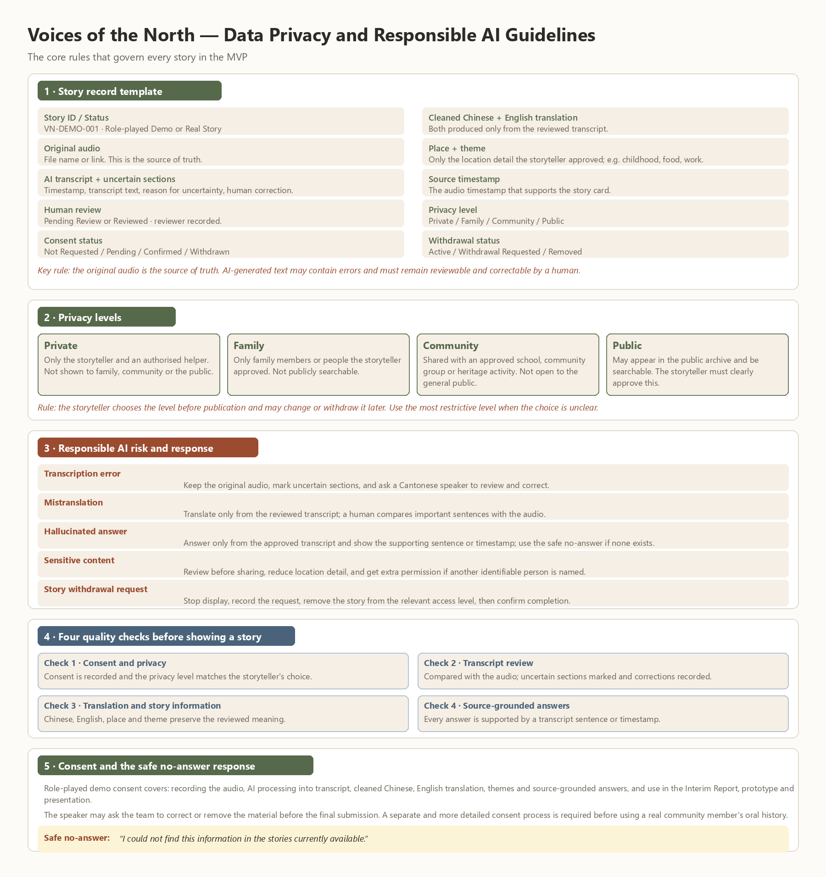
SYSTEM · GROUNDING AND PRIVACY
Grounded by construction, not by good intentions
HOW AN ANSWER IS PRODUCED
WHO CAN HEAR A STORY — INTERFACE ONLY
Private
Only the storyteller
Default
Family
Family members
—
Community
Community groups and schools
—
Public
Everyone, including visitors
—
No permanent server storage: recordings are processed, not archived. A failed take may stay in the user's browser until it is removed.
The build already renders Leaflet with OpenStreetMap tiles, and draws only a village-level fuzzy circle of roughly 800 m — there is no GPS pin anywhere in the app. The basemap licence must still be verified before launch.
Voices of the North · HumanLoop
09 / 14

Slide 10
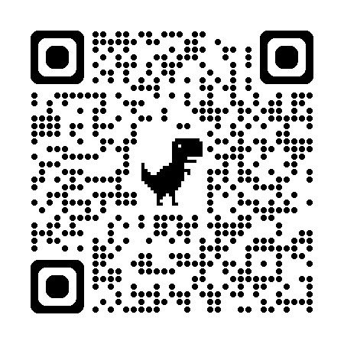

DEMO · WALKTHROUGH
One story, end to end: 元朗村落晨光與魚塘回憶
TRY THE WORKING BUILD
掃碼開啟演示 · Scan to open the demo
https://voices-of-the-north.onrender.com/voices-of-the-north-app.html
01 · Record
02 · Review
03 · Story card
04 · Ask
WHAT HAPPENS, IN ORDER
01
02
03
04
05
The demo plays the 46-second Yuen Long recording on Screen 1.
The transcript returns at 0.94; every word is timestamped and playable.
Privacy tiers are not built yet — the default stays Private.
The card shows three labelled versions and a village-level fuzzy place.
Three sourced answers come back, and one honest blank.
46-second role-played demo · consent gate confirmed before recording
10 / 14
Notes:
PRESENTER NOTES — before recording or presenting:
1. Open and refresh the site 1-2 minutes early. Render free tier sleeps after 15 min idle; cold start takes 30-60 s.
2. Keep a tab open and refresh every ~10 min before judging so the container stays warm.
3. The pre-recorded demo video is the backup if the live site is slow.
4. Do not type /recording.html into the address bar — it is a single-page app; use the #recording hash route.
5. The recording is a 46-second role-played Yuen Long demo track, not a field interview.

Slide 11
LIMITS · STATED PLAINLY
What we will not claim
Not real interviews
Not an exact location
Not enforced yet
Every story in this deck is role-played for demonstration. No elder’s recording is used, and no community partnership has been signed.
The map is real OpenStreetMap imagery, but the only thing drawn on it is a fuzzy circle of roughly 800 m. No GPS pin, no address, no exact point.
The four privacy tiers and story withdrawal are interface-level only, not enforced by a backend. The consent gate is different: it works, and it blocks recording.
Status — role-played
Status — coarse by design
Status — tiers interface only · consent live
No general accuracy claim
Never automatic
The 0.94 figure is sentence-level confidence from one 46-second demo recording. We do not quote a Cantonese recognition accuracy rate that we have not measured.
Nothing is published without a human confirming it. Dialects are not auto-translated, and there is no face detection, no speaker identification, no social feed and no editing of someone else’s story.
Status — demo scope only
Status — by design
Four rules the flow obeys: one screen, one job · every word stays checkable · every answer has a source · consent stays with the elder
11 / 14

Slide 12
ROADMAP · WHAT COMES AFTER THE DEMO
Expansion we deliberately did not build yet
NOW
NEXT
LATER
BEYOND
In the hackathon build
0 – 3 months
6 – 12 months
Only if the rest works
Guided Cantonese capture
Backend enforcement of privacy tiers
Hakka, Hoklo and Wai Tau recognition
A cross-district, then cross-border dialect archive
built
Word-level audio alignment
needs a real account and storage model
no training data or ASR model exists for them yet
depends on the dialect branch
built
Real map on Leaflet + OpenStreetMap
Paid transcription and hosting for NGOs and heritage offices
Four privacy tiers
Handover to a library, museum or district NGO
interface only
basemap licence must be verified first
needs a consent and compliance framework
Volunteer review queue for unrecognised dialects
needs a custodian and a data agreement
Three-version story card
School and community-curated collections
An open metadata schema other archives can federate
built
needs a partner running sessions
Grounded Q&A with timestamps
Longer and multi-session recordings
depends on the tiers being enforced
no schema agreed yet
built
chunking is specified, not built
Offline-first capture for field volunteers
capture works offline; sync does not
Nothing in the last three columns is in the demo. Each item carries the reason it is not built yet, so the gap between what we showed and what we promise stays visible.
Voices of the North · HumanLoop
12 / 14

Slide 13
FUTURE BRANCH · LANGUAGE
Cantonese works. The other three do not — yet.
PATH A
PATH B
PATH C
Fine-tune a dialect ASR model
Multilingual normalisation
Volunteer manual transcript
Several hours of transcribed audio per dialect, plus fluent speakers to verify it.
A large model that already handles related Sinitic varieties, with Cantonese as the bridge.
A person writes the transcript; everything downstream stays exactly as it is today.
Most accurate if it works. Slowest and most expensive to obtain — this is the honest blocker.
Fastest to try, least certain. We would mark its output as uncertain by default, for a human to confirm.
Works now. It does not scale, and it puts the labour on the community rather than the system.
How we would know it works: measure sentence-level confidence on a held-out set of that dialect, published with its size and its speakers, before we claim anything about it.
Voices of the North · HumanLoop — this page describes work not yet done
13 / 14

Slide 14
IMPACT · HOW WE WOULD MEASURE IT
Three goals, three countable definitions
11
SDG 11
4
SDG 4
16
SDG 16
Sustainable cities and communities
Quality education
Peace, justice and strong institutions
Measured as
Measured as
Sourced answers played back in school and community sessions, counted per session — never downloads, never likes.
Measured as
The number of village stories that carry a verified transcript and a confirmed privacy tier before clearance.
The share of answers traceable to a timestamp, and the share of stories where consent was changed or withdrawn without friction. Target: 100% traceability.
A community that loses its buildings can still hold a queryable record of what was there.
Students hear the original voice, not somebody’s summary of it.
An archive that can prove where every claim came from is far harder to misuse.
"Development can rebuild a place. Only people can remember it."
Voices of the North · Team HumanLoop
Final report · 18 October 2026
All figures in this deck are demo-scope observations, not general accuracy claims.
14 / 14

