Slide 1
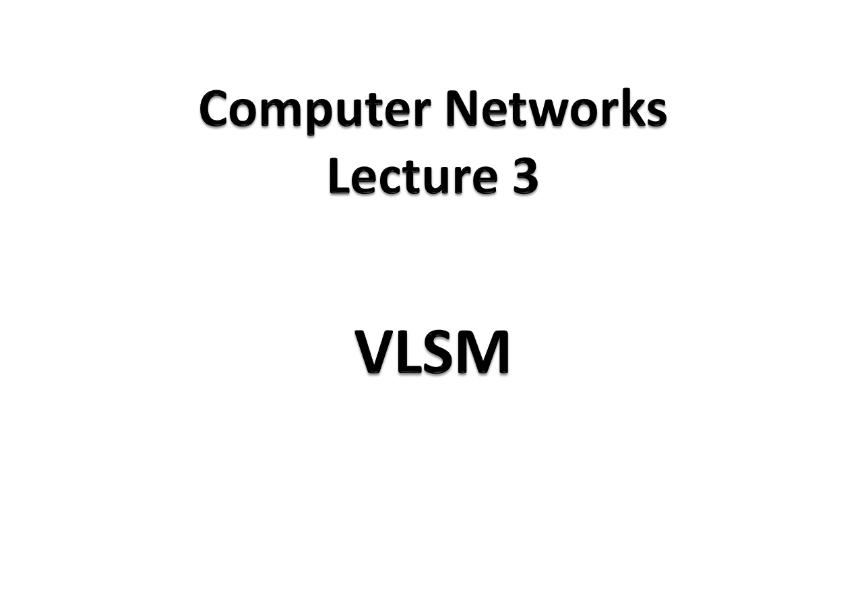

Slide 2
An organization is granted the block 130.34.12.64/26. The organization needs 4 subnets. What is the subnet prefix length?
Solution
We need 4 subnets, which means we need to add two more bits (log₂ 4 = 2) to the site prefix. The subnet prefix is then /28.
TCP/IP Protocol Suite

Slide 3
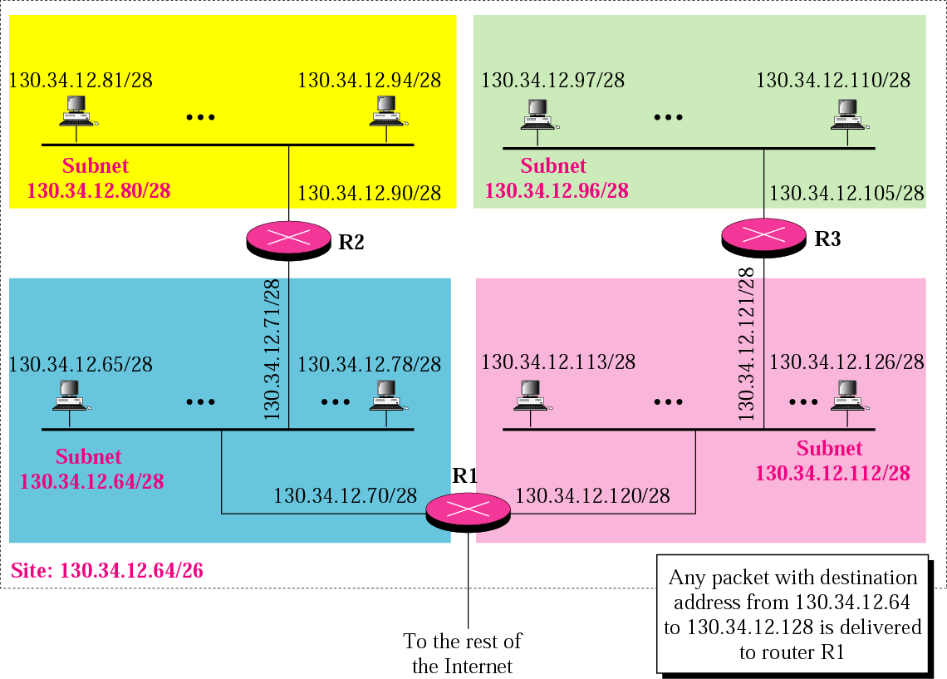

Slide 4
VLSM
Variable Length subnet Masking
The number of devices are not equal in all the subnets
Prefixes vary for separate subnets

Slide 5
Class-full routing
  Only allows for one subnet mask for all networks
VLSM & Classless routing
  The process of subnetting a subnet
  More than one subnet mask can be used
  More efficient use of IP addresses as compared to classfull IP addressing

Slide 6
An organization is granted a block of addresses with the beginning address 14.24.74.0/24. There are 2³²⁻²⁴= 256 addresses in this block. The organization needs to have 11 subnets as shown below:
a. 2 subnets, each with 64 addresses.
b. 2 subnets, each with 32 addresses.
c. 3 subnets, each with 16 addresses.
d. 4 subnets, each with 4 addresses.
Design the subnets.
TCP/IP Protocol Suite

Slide 7
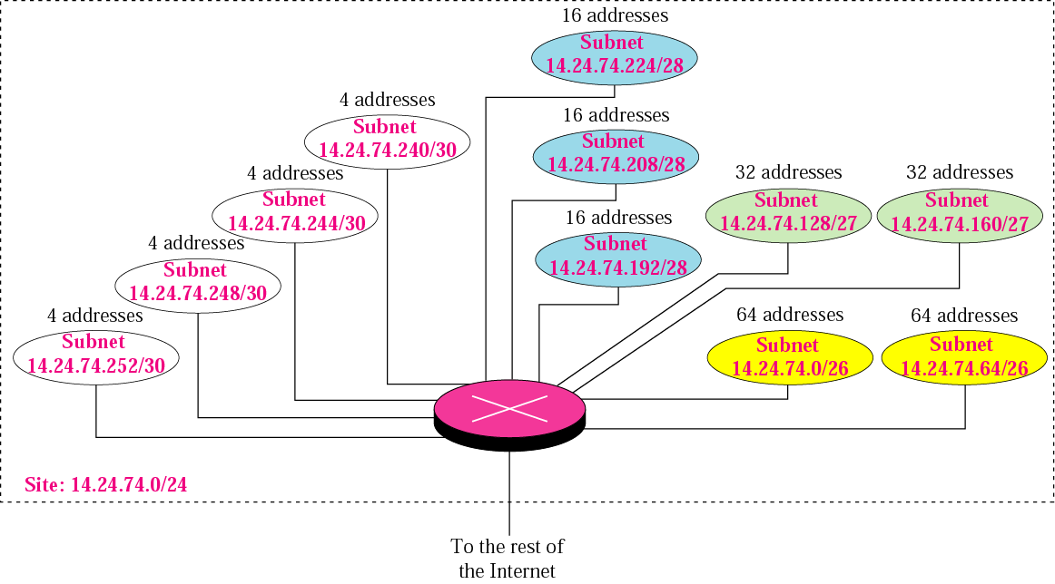
TCP/IP Protocol Suite

Slide 8
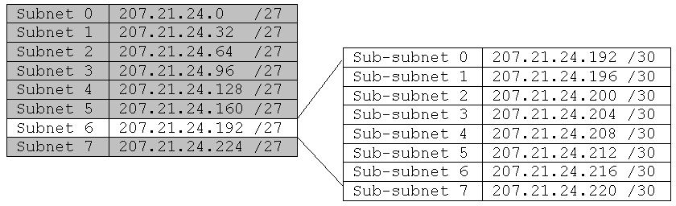
VLSM Example using /30 subnets
207.21.24.0/24 network subnetted into eight /27 (255.255.255.224) subnets
207.21.24.192/27 subnet, subnetted into eight /30 (255.255.255.252) subnets
This network has seven /27 subnets with 30 hosts each AND eight /30 subnets with 2 hosts each.
/30 subnets are very useful for serial networks.
Rick Graziani graziani@cabrillo.edu

Slide 9
207.21.24.192/27 207.21.24. 11000000
/30 Hosts Bcast 2 Hosts
0 207.21.24.192/30 207.21.24. 110 00000 01 10 11 .193 & .194
1 207.21.24.196/30 207.21.24. 110 00100 01 10 11 .197 & .198
2 207.21.24.200/30 207.21.24. 110 01000 01 10 11 .201 & .202
3 207.21.24.204/30 207.21.24. 110 01100 01 10 11 .205 & .206
4 207.21.24.208/30 207.21.24. 110 10000 01 10 11 .209 & .210
5 207.21.24.212/30 207.21.24. 110 10100 01 10 11 .213 & .214
6 207.21.24.216/30 207.21.24. 110 11000 01 10 11 .217 & .218
7 207.21.24.220/30 207.21.24. 110 11100 01 10 11 .221 & .222
Rick Graziani graziani@cabrillo.edu

Slide 10

207.21.24.192/30
207.21.24.204/30
207.21.24.192/30
207.21.24.204/30
207.21.24.216/30
207.21.24.216/30
207.21.24.96/27
207.21.24.128/27
207.21.24.64/27
207.21.24.64/27
207.21.24.208/30
207.21.24.196/30
207.21.24.196/30
207.21.24.200/30
207.21.24.212/30
207.21.24.160/27
207.21.24.224/27
207.21.24.32/27
207.21.24.0/27
207.21.24.160/27
207.21.24.224/27
This network has seven /27 subnets with 30 hosts each AND seven /30 subnets with 2 hosts each (one left over).
/30 subnets with 2 hosts per subnet do not waste host addresses on serial networks .
Rick Graziani graziani@cabrillo.edu

Slide 11
VLSM and the Routing Table
Displays one subnet mask for all child routes. Classful mask is assumed for the parent route.
Routing Table without VLSM
RouterX#show ip route
207.21.24.0/27 is subnetted, 4 subnets
C 207.21.24.192 is directly connected, Serial0
C 207.21.24.196 is directly connected, Serial1
C 207.21.24.200 is directly connected, Serial2
C 207.21.24.204 is directly connected, FastEthernet0
Routing Table with VLSM
RouterX#show ip route
207.21.24.0/24 is variably subnetted, 4 subnets, 2 masks
C 207.21.24.192 /30 is directly connected, Serial0
C 207.21.24.196 /30 is directly connected, Serial1
C 207.21.24.200 /30 is directly connected, Serial2
C 207.21.24.96 /27 is directly connected, FastEthernet0
Each child routes displays its own subnet mask. Classful mask is included for the parent route.
Parent Route shows classful mask instead of subnet mask of the child routes.
Each Child Routes includes its subnet mask.

