Slide 1

ΛK Femtoscopy in Pb-Pb collisions at 2.76 TeV
Update:
Non-femtoscopic background, THERMINATOR, Stavinsky method, etc.

Slide 2
Outline
Significant non-femtoscopic, non-flat background observed in all Cfs at large k*
  Increases with decreasing centrality
  Same amongst all ΛK^{ch} pairs
  More pronounced for ΛK⁰_{S} system
Suggested effect is due primarily to particle collimation associated with elliptic flow
  Background results from mixing events with unlike event-plane (EP) angles
  A Kisiel, Acta Physica Polonica B, 48
How does the background behave at low k*?
  How should we handle this contribution in the fit?

Slide 3
Main Points
THERMINATOR does a good job of matching the observed backgrounds
Stavinsky method does a good job of ridding the experimental data of the backgrounds

Slide 5
All Cfs out to large k*
ΛK
0-10%
ΛK
0-10%
ΛK
10-30%
ΛK
10-30%
ΛK
30-50%
ΛK
30-50%
Difference in ΛK^{ch} and ΛK⁰_{S} due to kinematic cuts

Slide 6
Background Treatment
Ideal world (1): rotate events to align EP angles
  Not applicable: azimuthal angle acceptance not perfectly uniform and finite EP resolution
Ideal world (2): bin events in EP angle, and only mix events within a given bin
  Not applicable: finite EP resolution
  Slight decrease in background observed when using EP bin size = π/8 (BACKUP s.32)
    No additional reduction observed when using bin size = π/16
Real world:
  (a) account for the background in our fit
    THERMINATOR model or linear fit
  (b) eliminate background (Stavinsky method)

Slide 7
Background with THERMINATOR

Slide 8
THERMINATOR
By default, all Ψ_{EP} = 0°
  i.e. all EPs aligned, and no background observed
Remedy: Rotate events by a random angle to simulate experiment
  i.e. rotate momenta and positions of all particles in an event by a common, random, angle
After rotation THERMINATOR matches data background very well

Slide 9
THERM vs Data (ALL)

Slide 10
THERM vs Data (ΛK+ 30-50%)

Slide 11
THERMINATOR
Simulation Only: Interaction achieved by assuming scattering parameters, and weighting the numerators in the simulation
!!
6th order polynomial fit

Slide 12
Quantitative use of THERM
From the previous slide:
Proposed fit solution
  (1) Generate THERMINATOR events needed to build backgrounds for all centrality bins
  (2) Before fit: Fit the THERMINATOR background, over all k* (0-2 GeV/c) to obtain F_{bgd}
    Adam, in paper, suggests 6th order polynomial
  (3) Scale F_{bgd} to match data
  (4) Keep F_{bgd} constant while fitting over the signal region

Slide 13
THERMINATOR Question

Slide 14
THERMINATOR
Full
  no discrimination in origin on Λ or K in pair
PrimaryOnly
  both particles must be identified as primary by THERMINATOR
SecondaryOnly
  both particles must NOT be identified as primary by THERMINATOR
Who cares?
  In ΛK⁰_{S} and ΛK+ cases, the background looks roughly the same regardless of subset used
  For ΛK- case, background at low-k* looks very different between PrimaryOnly and SecondaryOnly
    Large enhancement at low-k* when using SecondaryOnly subset
    Effect leaks somewhat into Full set

Slide 15
Subset Comparisons:
THERMINATOR Backgrounds
Full
PrimaryOnly
SecondaryOnly
Enhancement at low-k* in ΛK-
Any ideas what causes this?
Ω- & Ξ(1690)
Ξ(1820)

Slide 16
Stavinsky Method

Slide 17
Stavinsky Method
Do not use mixed-event pairs for background
Instead, use same-event pairs with one particle rotated by 180° in the transverse plane
  Rid pairs of any femtoscopic correlations
  Maintains correlations due to elliptic flow (v₂)
    Due to symmetry of the flow
  Does not eliminate contributions from higher order flow
In figures/slides, numerators built with this method identified as Num_{Stav}

Slide 18
Issue
For ΛK+ especially, at low-k*, same-event Num_{Stav} distribution looks very different from mixed-event Den distribution (BACKUP s.33)
  Expect high-k* behavior to differ, as we hope this method will eradicate non-flat background
Not much difference for ΛK- or ΛK⁰_{S} (BACKUP s.34-35)
ΛK+ and ΛK- Den distributions look very different (BACKUP s.36)
  Initially, very surprising, and maybe even troubling
This difference, and issue, is due to the pair cut
  Average separation cut
When pair cut is turned off
  ΛK+ and ΛK- Den distributions look the same (BACKUP s.37)
  ΛK+ Num_{Stav} agrees with Den at low-k* (BACKUP s.38)

Slide 19
Solution
When using the Stavinsky method, after particle in pair is rotated, the new pseudo-pair should be run through the pair cut used in the analysis
  Ideal world: pair cut only remove truly bad pairs resulting from splitting and merging effects
  Real world: pair cut throws out some of the good with the bad
    For pseudo-pairs, also need to include this loss of “good” pairs → must also use pair cut
Achieved by simply rotating nominal TPC points of tracks by 180° in transverse plane
Without doing this, the Stavinsky method differs greatly from usual Num/Den method
After implementing, the two methods agree at low-k*
  ΛK+ Num_{Stav} agrees with Den at low-k* (BACKUP s.39)

Slide 20
Effect of Additional Pair Cut
NO additional pair cut
WITH additional pair cut
Num/Den
Num/Num_{Stav}

Slide 21
Effect of Additional Pair Cut
NO additional pair cut
WITH additional pair cut
Num/Den
Num/Num_{Stav}

Slide 22
Effect of Additional Pair Cut
NO additional pair cut
WITH additional pair cut
Num/Den
Num/Num_{Stav}

Slide 23
Stav. Method with THERM

Slide 24
THERM: Normal
No v₃ present in THERMINATOR simulation
EP = Ψ₂

Slide 25
THERM: v₃ added
Artificially add v₃ signal
EP = Ψ₂

Slide 26
THERM: More v₃ added
Artificially add MORE v₃ signal
EP = Ψ₂

Slide 27
THERM: No v₂, all v₃
Convert ENTIRE v₂ signal to v₃
EP = Ψ₃

Slide 28
New Dual Fitter
Old, single fitter
  Fit pair with conjugate across all centralities
    Ex: ΛK+ with ΛK- across (0-10%, 10-30%, 30-50%)
      All share: Re[f₀], Im[f₀], d₀
      Like centralities share: R
      Unique to each: Norm, λ
New, Dual Fitter
  Combine all Λ(Λ)K^{ch} analyses
    Radii shared amongst all
    Possible to share single λ for given centrality bin across all four analyses, ΛK+, ΛK-, ΛK-, ΛK+

Slide 29
Comparing Fit Methods
Parameter sharing
Shared R
  Share radii between ΛK+ (with ΛK-) and ΛK- (with ΛK+) for like centralities
  Shared λ → share single λ for each centrality across all [ΛK+, ΛK-, ΛK-, ΛK+]
    3 total λ parameters
    Shared λ_{Conj} → share λ for each centrality amongst only pair and conjugate
      ex. λ₁ for ΛK+ (with ΛK-) in 0-10% centrality, λ₂ for ΛK+ (with ΛK-) in 0-10% centrality, etc
      6 total λ parameters
Separate R
  ΛK+ (with ΛK-) radii unique from ΛK- (with ΛK+)
  Shared λ → share λ for each centrality across pair and conjugate (ex. single λ for ΛK+ with ΛK- in 0-10% centrality bin)
  Separate λ → each analysis gets unique λ parameter
Background treatments
Poly. Bgd
  Use THERMINATOR2 to model background with 6th-order polynomial
  Scale to match data
  Apply background as scale factor to fit
Lin. Bgd
  Use a linear form to model the background
  Fit background to data, outside of signal region (0.6 < k* < 0.9 GeV/c)
  Apply background as scale factor to fit
Stav. (No Bgd)
  Use Stavinsky method
  Assume no background in correlations and fit

Slide 30
Compare Background Treatments

Slide 31
Shared R, shared λ

Slide 32
Shared R, shared λ_{Conj}

Slide 33
Separate R, shared λ

Slide 34
Separate R, separate λ

Slide 35
Compare Parameter Sharing

Slide 36
Separate vs Shared R

Slide 37
BACKUP

Slide 38
Binning Events in EP Angle
Data
ΛK+
0-10%
ΛK-
0-10%
ΛK+
10-30%
ΛK-
10-30%
ΛK+
30-50%
ΛK-
30-50%

Slide 39
ΛK+ Num_{Stav} / ΛK+ Den
No additional pair cuts in Num_{Stav}

Slide 40
ΛK- Num_{Stav} / ΛK- Den
No additional pair cuts in Num_{Stav}

Slide 41
ΛK⁰_{S} Num_{Stav} / ΛK⁰_{S} Den
No additional pair cuts in Num_{Stav}

Slide 42
ΛK+ Den / ΛK- Den
Normal pair cuts implemented in Den

Slide 43
ΛK+ Den / ΛK- Den
No pair cuts in Den

Slide 44
ΛK+ Num_{Stav} / ΛK+ Den
No pair cuts in Den, No pair cuts in Num_{Stav}

Slide 45
ΛK+ Num_{Stav} / ΛK+ Den
Pair cuts in Den and additional pair cuts in Num_{Stav}

Slide 46
Fit Results:
Parameter Plots and Tables

Slide 47
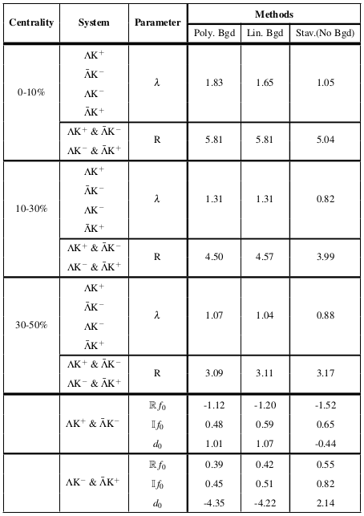
Comparing Bgd Treatments
Shared radii and shared, single, λ parameter for each centrality
Poly. Bgd
  Use THERMINATOR to model background with 6th-order polynomial
  Scale model fit to data
  Apply background as scale factor to fit
Lin. Bgd
  Use a linear form to model the background
  Fit background to data, outside of signal region (0.6 < k* < 0.9 GeV/c)
  Apply background as scale factor to fit
Stav.(No Bgd)
  Use Stavinsky method
  Assume no background in correlations
Fits in BACKUP slides

Slide 48
Shared R, shared λ

Slide 49
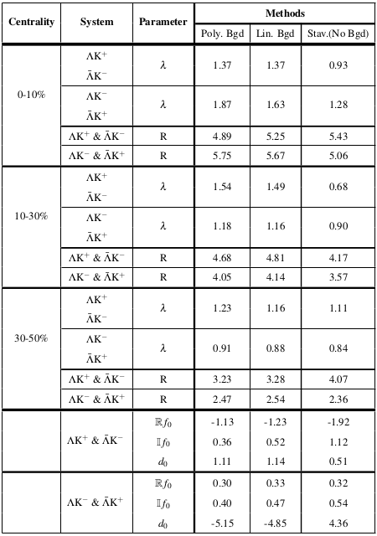
Comparing Bgd Treatments
Separate radii and shared λ parameter for pair & conjugate for each centrality
Poly. Bgd
  Use THERMINATOR to model background with 6th-order polynomial
  Scale model fit to data
  Apply background as scale factor to fit
Lin. Bgd
  Use a linear form to model the background
  Fit background to data, outside of signal region (0.6 < k* < 0.9 GeV/c)
  Apply background as scale factor to fit
Stav.(No Bgd)
  Use Stavinsky method
  Assume no background in correlations
Fits in BACKUP slides

Slide 50
Separate R, shared λ

Slide 51
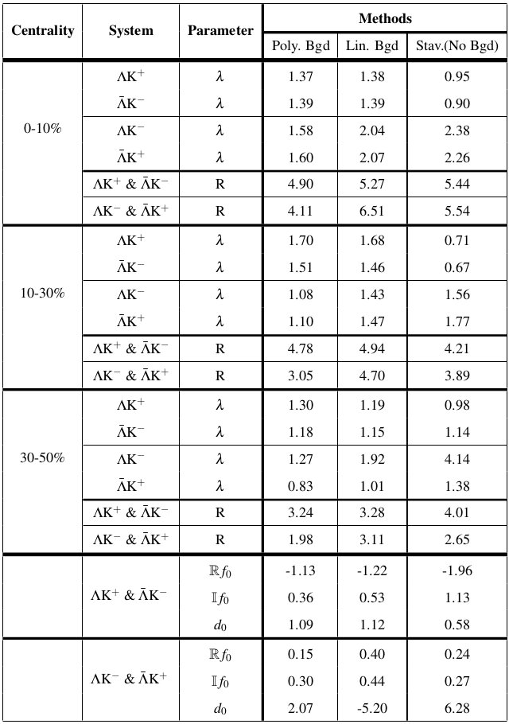
Comparing Bgd Treatments
Separate radii and unique λ parameter for all
Poly. Bgd
  Use THERMINATOR to model background with 6th-order polynomial
  Scale model fit to data
  Apply background as scale factor to fit
Lin. Bgd
  Use a linear form to model the background
  Fit background to data, outside of signal region (0.6 < k* < 0.9 GeV/c)
  Apply background as scale factor to fit
Stav.(No Bgd)
  Use Stavinsky method
  Assume no background in correlations
Fits in BACKUP slides

Slide 52
Separate R, separate λ

Slide 53
Separate vs Shared R

Slide 54
Fit Results:
Separate Radii, separate λ

Slide 55
Fit Results:
Shared Radii, shared λ

Slide 56
Share R, share λ, Poly. Bgd

Slide 57
Share R, share λ, Poly. Bgd

Slide 58
Share R, share λ, Lin. Bgd

Slide 59
Share R, share λ, Lin. Bgd

Slide 60
Share R, share λ, Stav.(No Bgd)

Slide 61
Share R, share λ, Stav.(No Bgd)

Slide 62
Fit Results:
Separate Radii, shared λ

Slide 63
Sep. R, share λ, Poly. Bgd

Slide 64
Sep. R, share λ, Poly. Bgd

Slide 65
Sep. R, share λ, Lin. Bgd

Slide 66
Sep. R, share λ, Lin. Bgd

Slide 67
Sep. R, share λ, Stav.(No Bgd)

Slide 68
Sep. R, share λ, Stav.(No Bgd)

Slide 69
Fit Results:
Separate Radii, separate λ

Slide 70
Sep. R, sep. λ, Poly. Bgd

Slide 71
Sep. R, sep. λ, Poly. Bgd

Slide 72
Sep. R, sep. λ, Lin. Bgd

Slide 73
Sep. R, sep. λ, Lin. Bgd

Slide 74
Sep. R, sep. λ, Stav.(No Bgd)

Slide 75
Sep. R, sep. λ, Stav.(No Bgd)

