Slide 1

ΛK Femtoscopy in Pb-Pb collisions at 2.76 TeV λ parameters

Slide 2
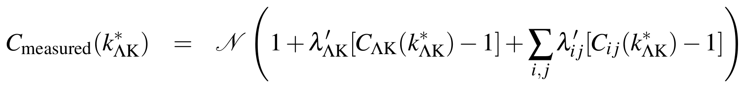
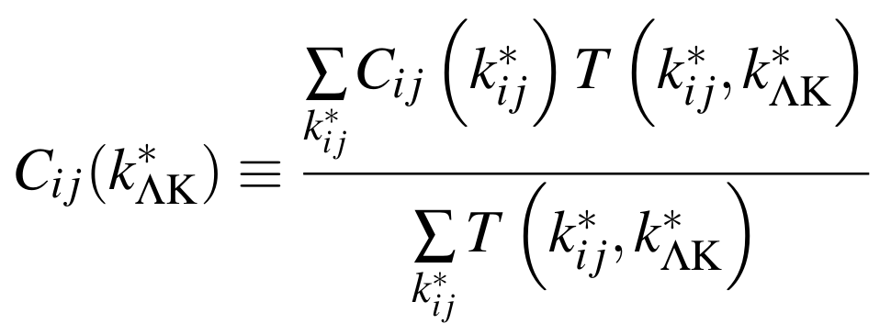
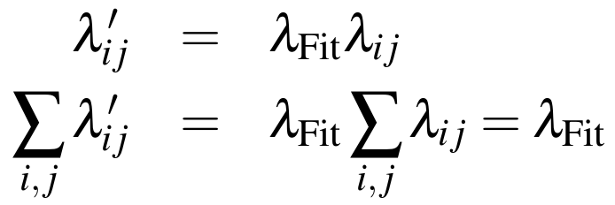
Residual Correlations
Residual Correlations
Not all particles in pairs are primary
Measured CF is combination of primary signal and transformed residuals
λ parameters control strength of contribution
Modeling parent CF
  Assume same source size and scattering parameters as primary (daughter) system
  Ξ-K data
  Coulomb-only simulation
Pair System | λ-factor
ΛK+ | 0.154
Σ⁰K+ | 0.099
Ξ⁰K+ | 0.072
Ξ-K+ | 0.069
Other | 0.558
Fakes | 0.048

Slide 3
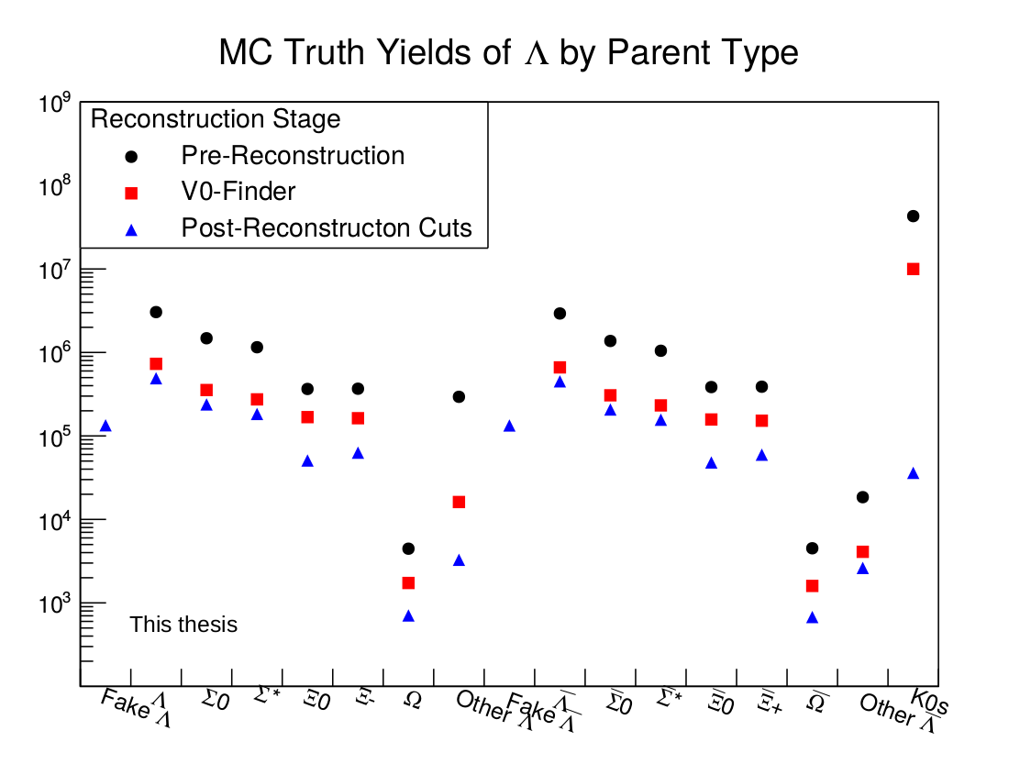
Jai’s Rec. Efficiency

Slide 4
Effect of Efficiency
Previously, assumed reconstruction efficiency (R) was equal for all contributors
  Good approximation EXCEPT possibly for “Other” category
    Confusing results in Jai’s thesis
    Currently, trying to reproduce myself
IF “Other Λ” from previous slide is correct
  R_{other} is an order of magnitude smaller than all
  other contributors
  This would effectively increase the λ parameters
  of all other contributors, while reducing that of “Other”
  L_{fit} (i.e. scale factor) naturally decreases
  All other parameters remain approximately the same
IF “Other Λ” from previous slide is correct
  Method previously used, assuming equal
  reconstruction efficiencies, is mostly correct
Is it possible reconstruction efficiency for “Other Λ” vs “Other Λ” differ by order of magnitude?
  Probably not...
Pair System | λ-factor | λ-factor
ΛK+ | 0.154 | 0.371
Σ⁰K+ | 0.099 | 0.239
Ξ⁰K+ | 0.072 | 0.107
Ξ-K+ | 0.069 | 0.145
Other | 0.558 | 0.090
Fakes | 0.048 | 0.048

Slide 5
My CPA for Λ

Slide 6
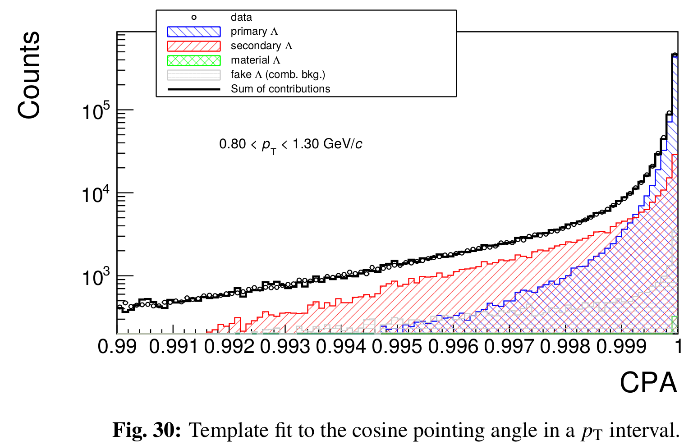
Laura’s CPA for Λ

Slide 7
My DCA for Λ

Slide 8
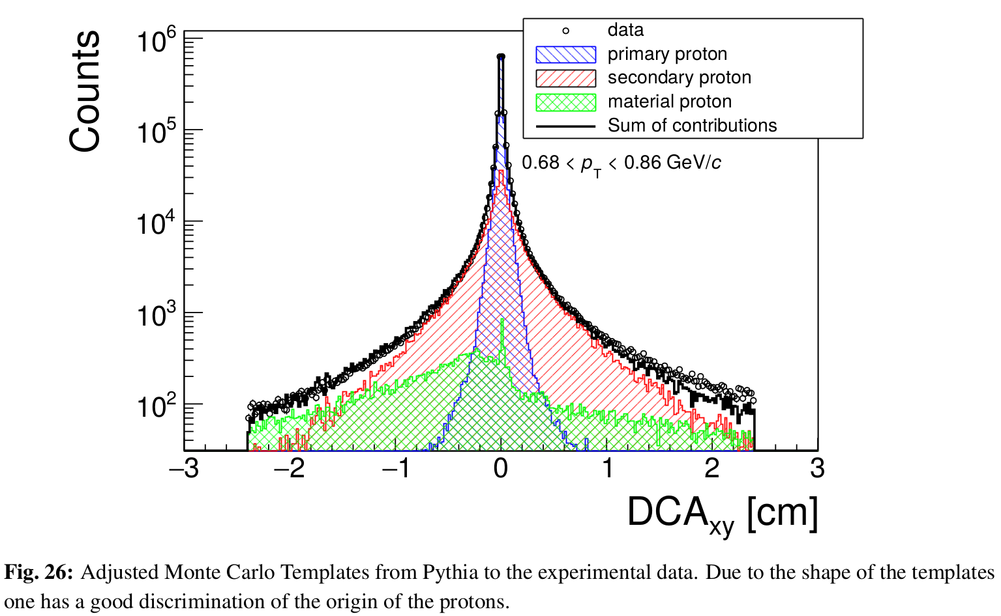
Laura’s DCA for p

Slide 9
λ Parameters
Λ values for the components of ΛK+, assuming various maximum values of cτ for parent systems to be considered primary
Initially, used D.C._{max} = 5 fm
  Probably not best, as this splits Σ*¹³⁸⁵(cτ = 5.33 fm) and K*⁸⁹²(cτ = 4.11 fm)
Suggested I use D.C._{max} = 4 fm
  For better “apples-to-apples” comparison of 3 residuals vs 10 residuals
Should probably use, at least D.C._{max} = 6 fm, so both Σ* and K* considered “Primary” when using only 3 residuals

Slide 10
3 Residual

Slide 11
NRes=3; D.C._{max} = 4 fm

Slide 12
NRes=3; D.C._{max} = 5 fm

Slide 13
NRes=3; D.C._{max} = 6 fm

Slide 14
NRes=3; D.C._{max} = 10 fm

Slide 15
NRes=3; D.C._{max} = 100 fm

Slide 16
10 Residual

Slide 17
NRes=10; D.C._{max} = 4 fm

Slide 18
NRes=10; D.C._{max} = 5 fm

Slide 19
NRes=10; D.C._{max} = 6 fm

Slide 20
NRes=10; D.C._{max} = 10 fm

Slide 21
NRes=10; D.C._{max} = 100 fm

