Slide 1
First Average Separation Plots

Slide 2
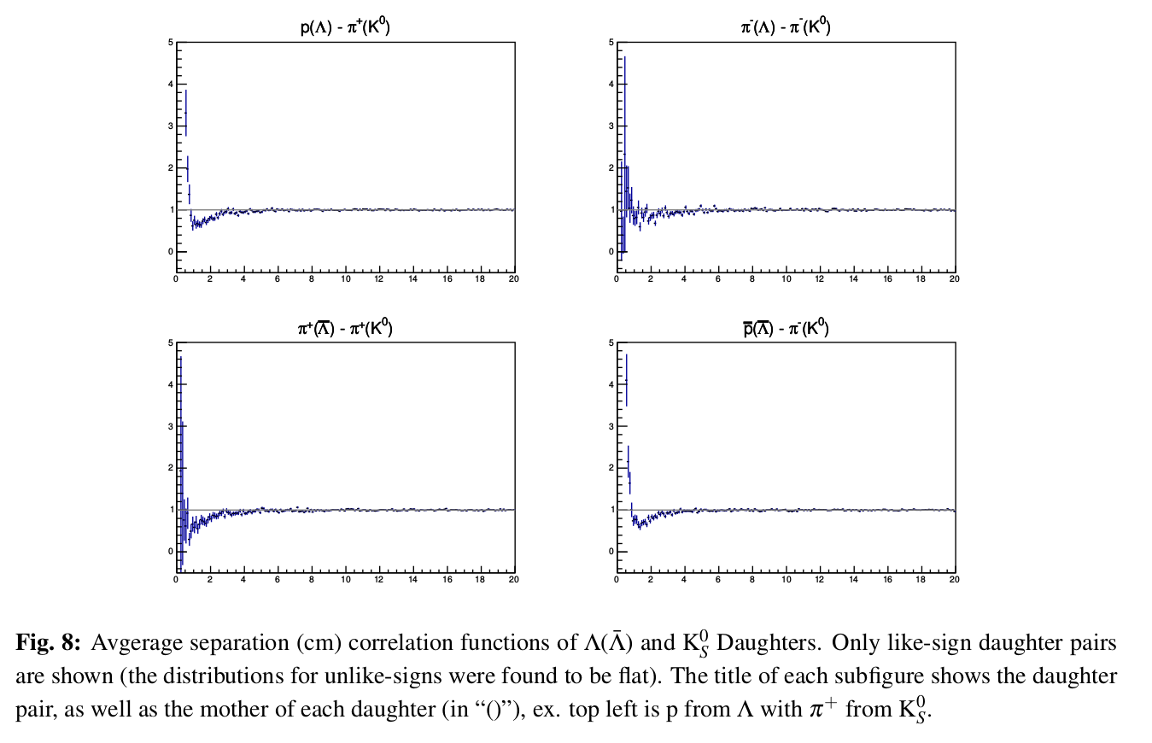
ΛK⁰_{S} Reminder

Slide 3
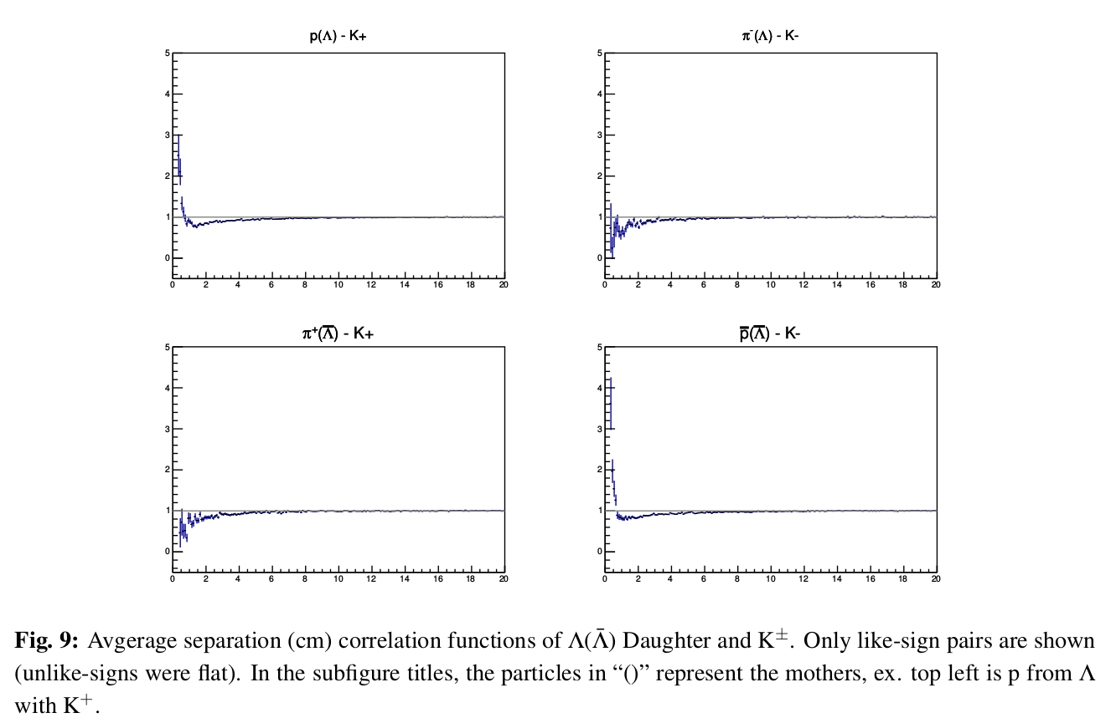
ΛK^{ch} Reminder

Slide 4
Ξ-K+ and
Ξ+K-
Avg. Sep

Slide 5
Ξ-K- and
Ξ+K+
Avg. Sep

