Slide 1
Operation Quality Report
Comprehensive ITIL Service Dashboard
2024-04-19 — 2025-07-06
1

Slide 2
Executive Summary
HEALTH SCORE
💡 AI INSIGHT
33
AI insight not available
🔴 At Risk
8977
50
Incident Management
Change Management
50
50
Service Requests
Problem Management
2

Slide 3
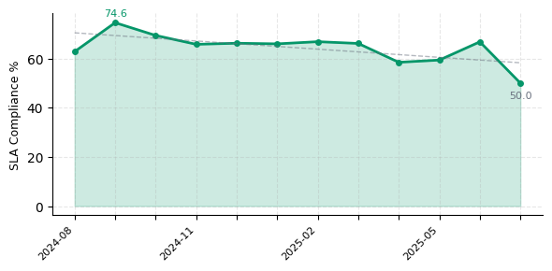
Incident Management
💡 AI INSIGHT
AI insight not available
3

Slide 4
Change Management
84.0%
18.0%
50
Success Rate
Incident Rate
Total
Failed Changes
• CHG20250100004: Enable two-factor authentication for age | • CHG20250100011: Configure disaster recovery replication | • CHG20250100015: Implement rate limiting on self-service
💡 AI INSIGHT
AI insight not available
4

Slide 5
Service Requests
3.6/5
💡 AI INSIGHT
AI insight not available
★★★☆☆ CSAT Score
75.8%
50
Request SLA
Total
5

Slide 6
Problem Management
5
48.0%
96.0%
Open Problems
Closure Rate
RCA Rate
• PRB20250100002: SMS notification delivery delays • PRB20250100004: Payment gateway timeout for credit ... • PRB20250100008: Web portal CSS rendering issues on ...
💡 AI INSIGHT
AI insight not available
6

Slide 7
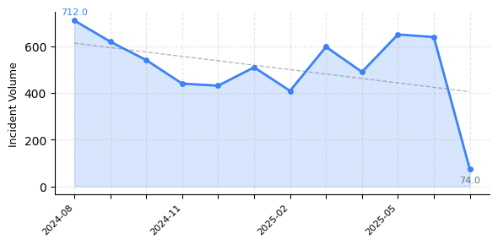
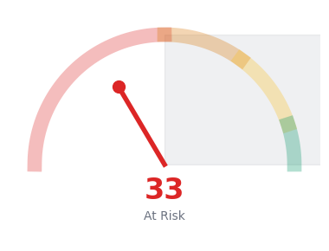
Trend Analysis
💡 AI INSIGHT
7

Slide 8
Risk Radar
CRITICAL
💡 AI INSIGHT
Incident SLA compliance at 64.2%
CRITICAL
9 changes caused incidents (18.0%)
WARNING
Category 'Compliance' MTTR is 67.8h
WARNING
Category 'Customer Complaint' MTTR is 341.8h
8

Slide 9
Recommended Actions
URGENT
💡 AI INSIGHT
Review and optimize incident SLA compliance processes
↗ Improve SLA rate by 10-15%
URGENT
Implement post-change validation and monitoring
↗ Reduce change-induced incidents by 50%
HIGH
Strengthen change assessment and testing procedures
↗ Improve change success rate to 95%+
MEDIUM
Analyze and streamline incident resolution workflow
↗ Reduce average MTTR by 20-30%
9

Slide 10
Thank You
Generated on: 2026-01-29 01:20
Confidential - Internal Use Only
10

