Slide 1





SCIT/SIT Video data analysis
Step 3: Algorithm Analysis
Yanyun Bu
Undergraduate Academic Assistant
H-Behaviours Research Lab
BC Children’s Hospital Research Institute
Supervisor: Dr. Osman Ipsiroglu
Dr. Mike Van der Loos

Slide 2
1. The methods to detect movement
Velocity
Velocity (five-point stencil)
Magnitude

Slide 3
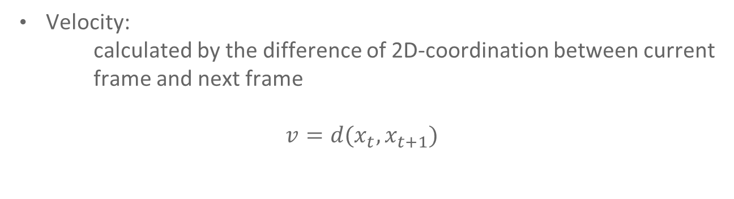
1. The methods to detect movement
Velocity:
calculated by the difference of 2D-coordination between current frame and next frame
$$v=d(x_{t},x_{t+1})$$

Slide 4
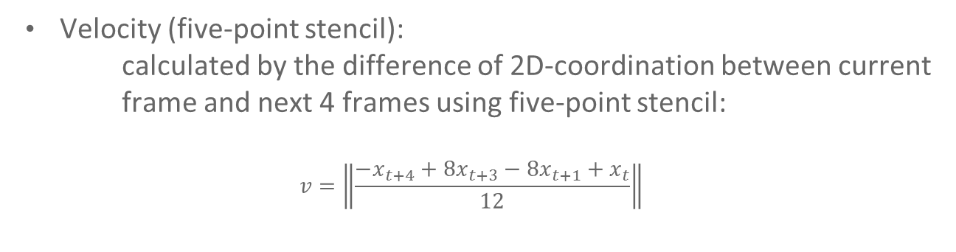
1. The methods to detect movement
Velocity (five-point stencil):
calculated by the difference of 2D-coordination between current frame and next 4 frames using five-point stencil:
$$v=\left\|\frac{−x_{t+4}+8x_{t+3}−8x_{t+1}+x_{t}}{12}\right\|$$

Slide 5
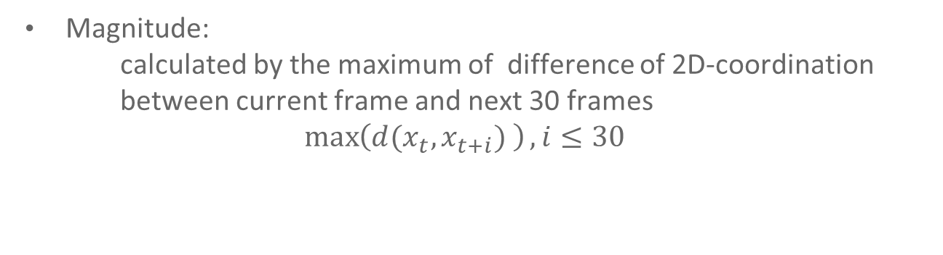
1. The methods to detect movement
Magnitude:
calculated by the maximum of difference of 2D-coordination between current frame and next 30 frames
$$\max\left(d(x_{t},x_{t+i}) \right), i≤30$$

Slide 6
2. Detecting movement
Define a number for the velocity of movement as a threshold to detect movement
ex. Threshold = 10 pixels / sec

Slide 7
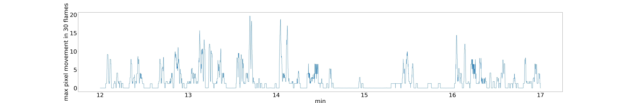
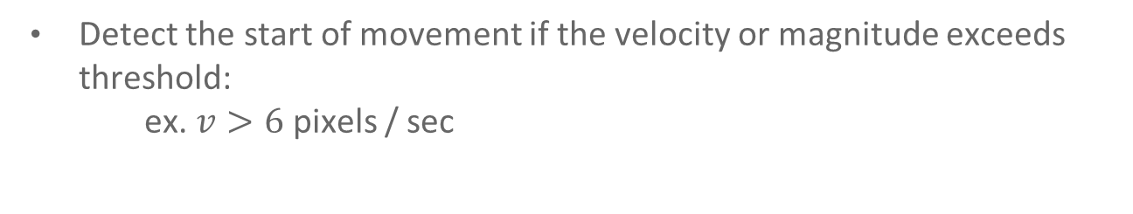
2. Detecting movement
Detect the start of movement if the velocity or magnitude exceeds threshold:
ex. $v>6$ pixels / sec

Slide 8
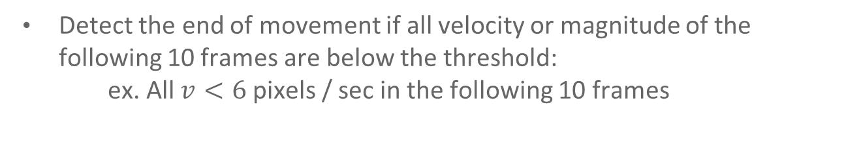
2. Detecting movement
Detect the end of movement if all velocity or magnitude of the following 10 frames are below the threshold:
ex. All $v<6$ pixels / sec in the following 10 frames

Slide 9
3. Algorithm analysis
Focus on nose detection (hardest part)
Use different level of threshold on these 3 method to count the true positives and false negatives
Calculate precision(positive predictive value) and recall(sensitivity) for each methods

Slide 10
4. Data
6 research assistants’ annotation
5 participants
10 min SCIT video

Slide 11
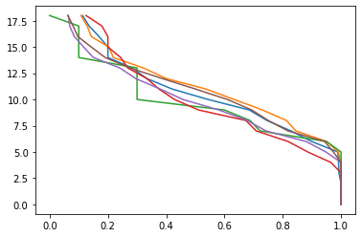
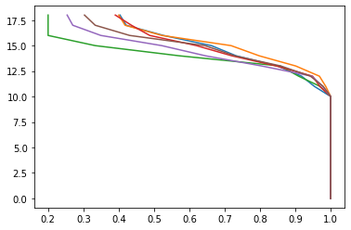
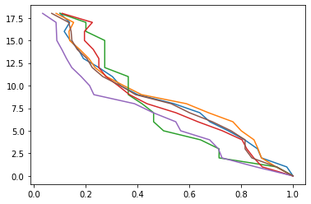
5. Result
Recall rate of each method with different threshold on nose:
X: recall rate
Y: degree of threshold
Left to right: velocity, velocity(five-point stencil), and magnitude

Slide 12
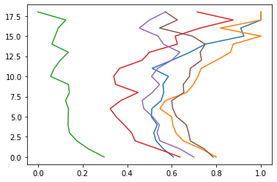
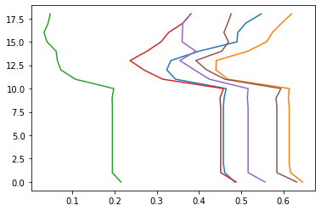
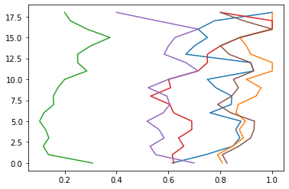
5. Result
Precision rate of each method with different threshold on nose:
X: precision rate
Y: degree of threshold
Left to right: velocity, velocity(five-point stencil), and magnitude

Slide 13
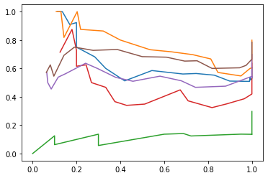
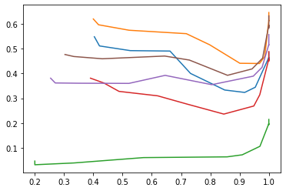
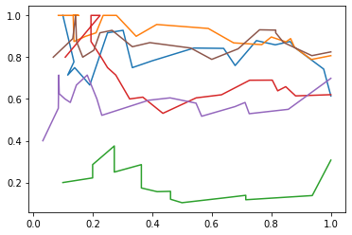
5. Result
ROC curve of each method with different threshold on nose:
X: recall rate
Y: precision rate
Left to right: velocity, velocity(five-point stencil), and magnitude
AUC: 0.469, 0.233, 0.611

Slide 14
4. Problem
Researcher annotation can be improved
The noisy of 2 velocity methods is high. It may causes they are not able to detect small movement.

