Slide 1





SCIT/SIT Video data analysis
Step 2: Extracting feature
Yanyun Bu
Undergraduate Academic Assistant
H-Behaviours Research Lab
BC Children’s Hospital Research Institute
Supervisor: Dr. Osman Ipsiroglu
Dr. Mike Van der Loos

Slide 2
1. Number of Movement
A obvious feature to identify the behavior of participants
The movement of different parts of body:
a. variance on magnitude: Head vs. Arm
b. variance on the time of movement: Shaking leg

Slide 3
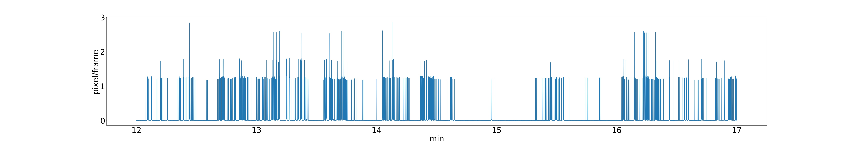
1. Number of Movement
Method of counting movement:
Velocity:

Slide 4
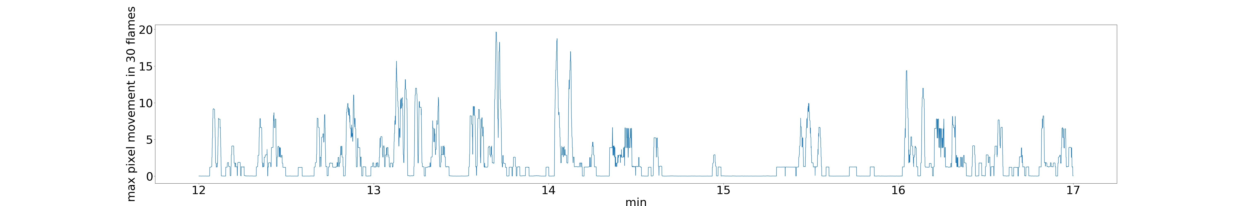
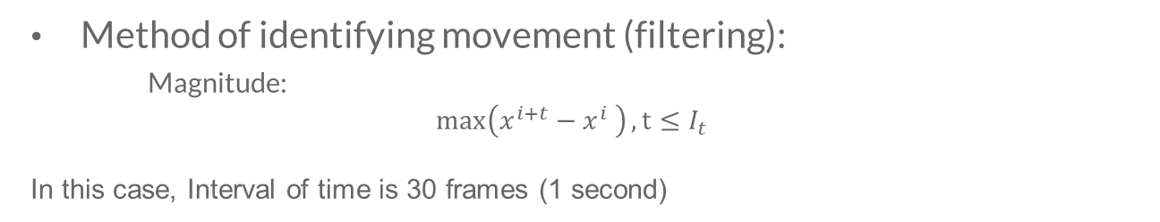
1. Number of Movement
Method of identifying movement (filtering):
Magnitude:
$$\max\left(x^{i+t}−x^{i} \right), t≤I_{t}$$
In this case, Interval of time is 30 frames (1 second)

Slide 5
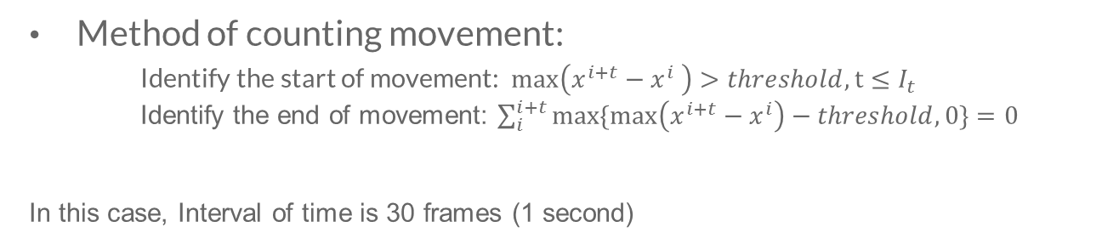
1. Number of Movement
Method of counting movement:
Identify the start of movement: $\max\left(x^{i+t}−x^{i} \right)>threshold, t≤I_{t}$
Identify the end of movement: $\sum_{i}^{i+t}{max\{max\left(x^{i+t}−x^{i}\right)−threshold, 0\}=0}$
In this case, Interval of time is 30 frames (1 second)

Slide 6
1. Number of Movement
How it works:
a. velocity will be affected significantly by the noisy of OpenPose
b. max function:
i. Clean the noisy
ii. Identify some small movements

Slide 7
1. Number of Movement
Parameter:
Interval of time:
depend on the time between two separate movements
Threshold of movement:
depend on how we define a movement based on magnitude

Slide 8
1. Number of Movement
Problem of the number of movement:
can not be used to distinguish the different movements
a. Continuous vs. Instant
b. Quick vs. Slow
c. Big vs. small
Time and Magnitude are useful features to distinguish Continuous movement, Instant movement, Big movement, and Small movement

Slide 9
2. Time of Movement
Extract the time of each movement and the total moving time
Based on the method of counting movement:
Time of each movement = End time – Start time
Sum all time of movements to get the total moving time in SCIT
Count the number of continuous movement or instant movement depend on the time of each movement

Slide 10
3. Big Movement or Small Movement
Set a threshold to distinguish Big movement and Small movement
Extract the number of movement based on the threshold

Slide 11
4. Data
Use OpenPose to construct the body structure of 18 SCIT videos
Extract magnitude graph, number of movement, and time of movement on Head and Upper Body:
Head: Nose, Eye, Ear
Upper Body: Shoulder, Elbow, Wrist

Slide 12
4. Data
Compare these features between 1st SCIT phase and 2nd SCIT phase
Basic Statistic (num of movement):
 | nose: | Left shoulder: | Left elbow: | Left Wrist: | Right shoulder: | Right elbow: | Right Wrist:
mean | 35.0/33.5 | 4.2/3.8 | 10.3/7.1 | 8.9/8.0 | 4.8/4.7 | 9.5/8.3 | 9.6/10.6
median | 35.5/27.0 | 2.5/1.5 | 8.5/4.5 | 7.0/4.0 | 3.0/1.0 | 5.5/5.0 | 6.5/7.0
SD | 27.0/31.0 | 5.3/5.9 | 10.4/9.2 | 7.9/9.5 | 5.8/8.2 | 10.0/12.9 | 9.3/14.0

Slide 13
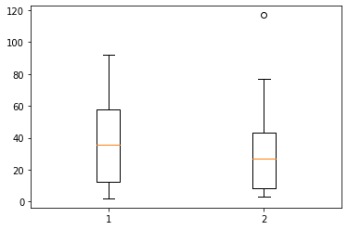
4. Data
Compare these features between 1st SCIT phase and 2nd SCIT phase
Nose Graph (num of movement):

Slide 14
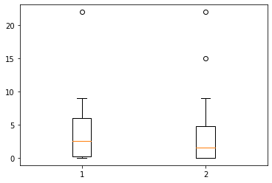
4. Data
Compare these features between 1st SCIT phase and 2nd SCIT phase
Left Shoulder Graph (num of movement):

Slide 15
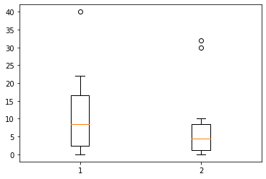
4. Data
Compare these features between 1st SCIT phase and 2nd SCIT phase
Left Elbow Graph (num of movement):

Slide 16
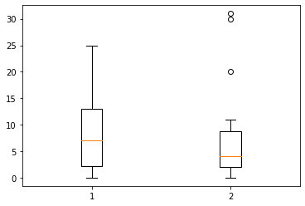
4. Data
Compare these features between 1st SCIT phase and 2nd SCIT phase
Left Wrist Graph (num of movement):

Slide 17
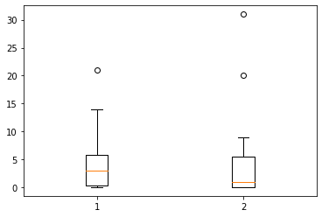
4. Data
Compare these features between 1st SCIT phase and 2nd SCIT phase
Right Shoulder Graph (num of movement):

Slide 18
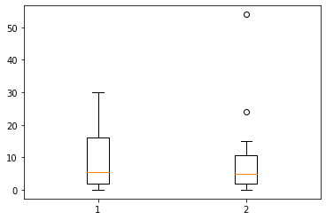
4. Data
Compare these features between 1st SCIT phase and 2nd SCIT phase
Right Elbow Graph (num of movement):

Slide 19
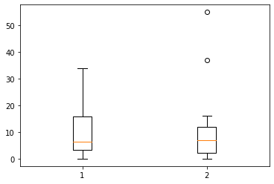
4. Data
Compare these features between 1st SCIT phase and 2nd SCIT phase
Right Wrist Graph (num of movement):

Slide 20
4. Data
T test:
nose: statistic=0.29986017439179785, pvalue=0.7679193340906662
Lshoulder

