Slide 1
认知智能研发进展
师清
2022.1.13

Slide 2
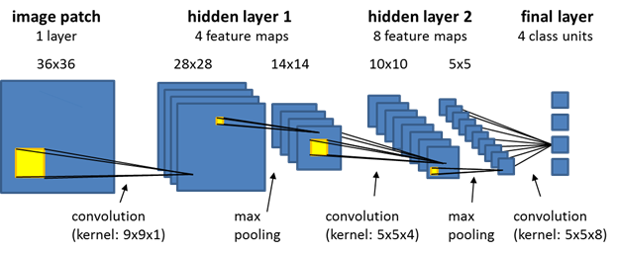
Review
目标:建模单个神经元的分布

Slide 3


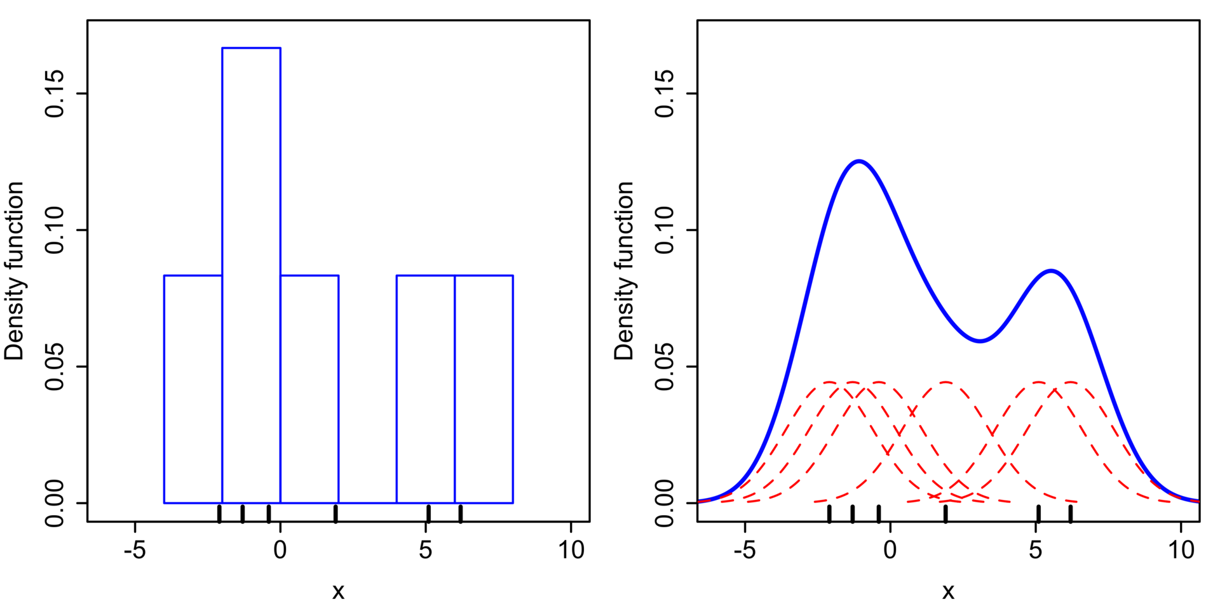

Method
1. KDE 建模
2. 神经元数量太多，存储和计算困难

Slide 4
Method
1. KDE 近似
想法:用一批较少的点构建的分布，去近似原来所有的点所构建的分布
2. Streaming 更新
update
P
Q pool
S
kde近似
N
N
N

Slide 5
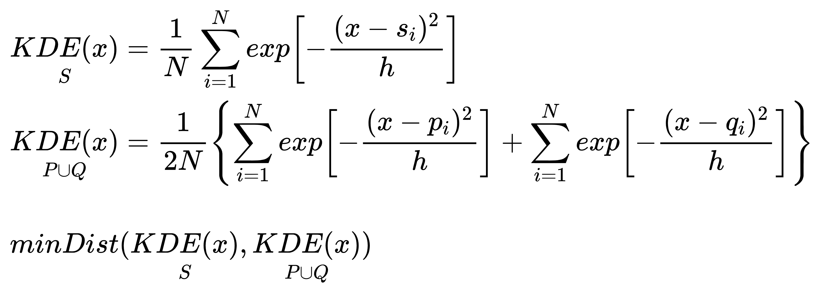
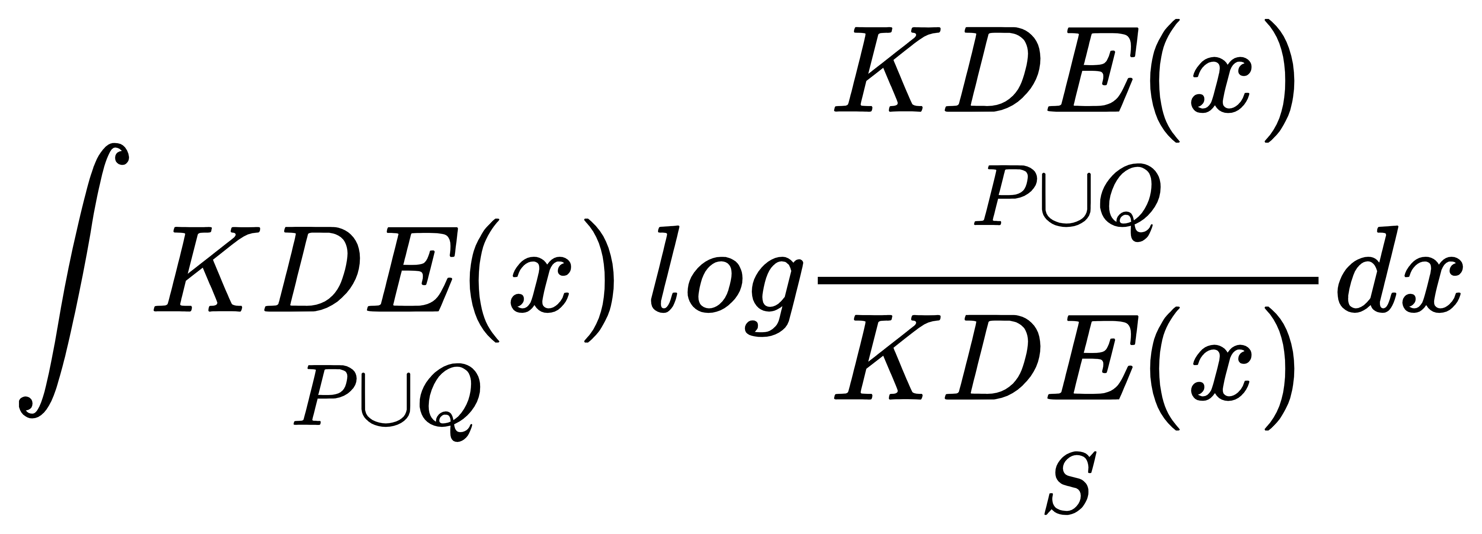
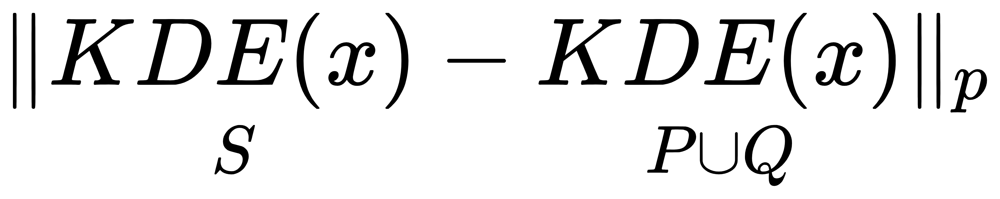
Method
1. 形式化写出问题
2. 度量分布的距离
a. kl散度:
b. Lp范数:

Slide 6
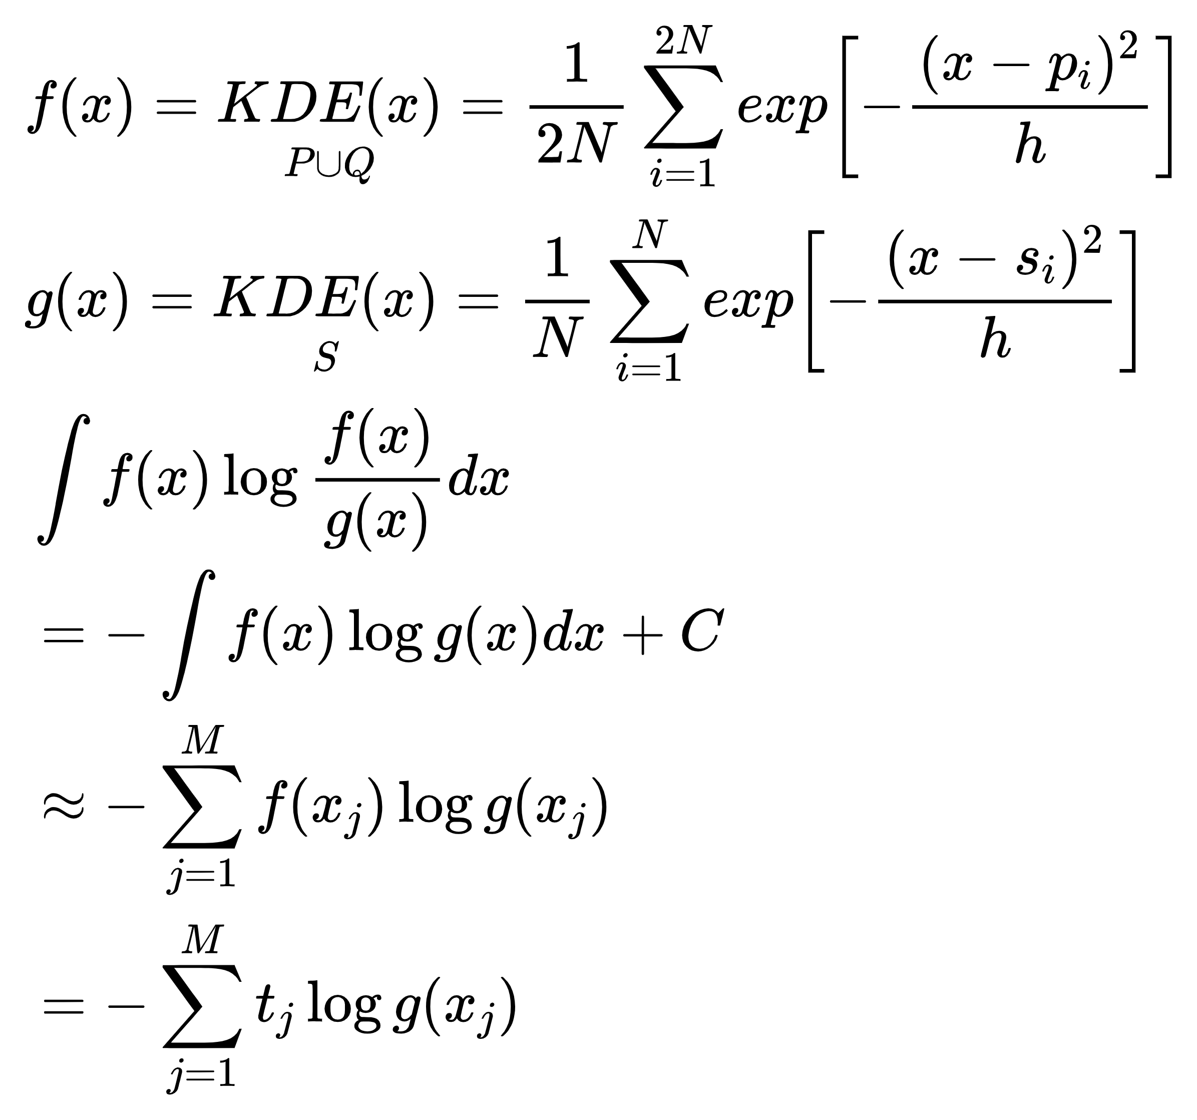
Method
1. KL散度作为分布距离的度量

Slide 7
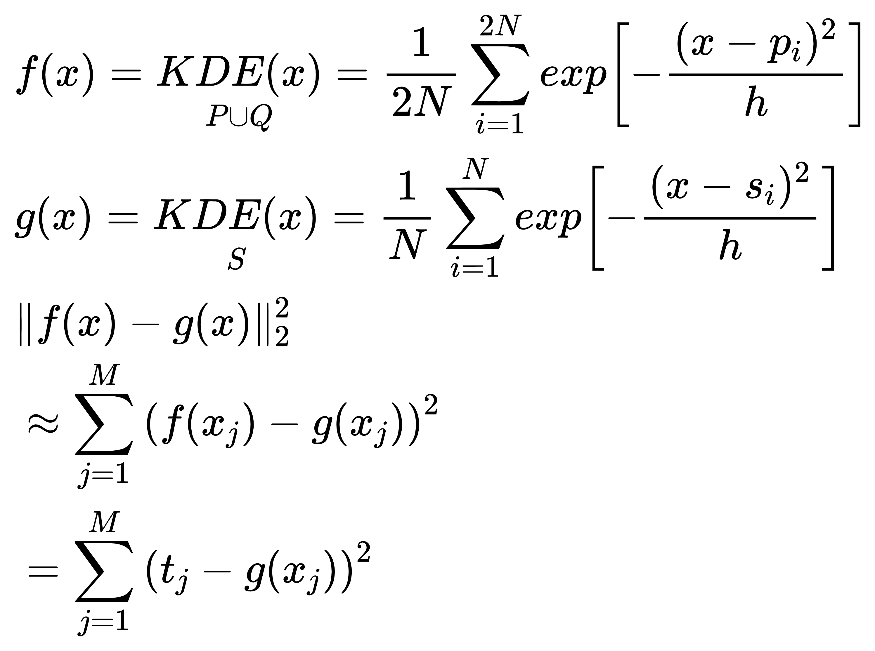
Method
2. L2范数作为分布距离的度量

Slide 8
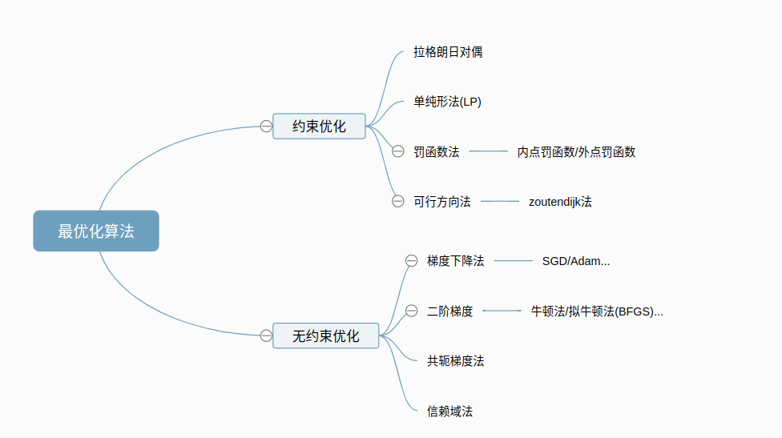
Method
3. 优化算法

Slide 9
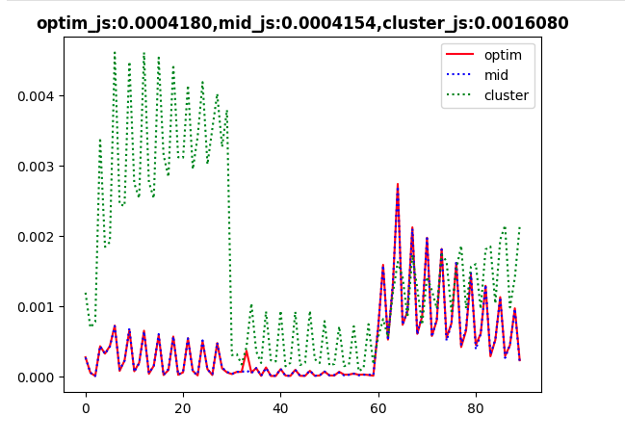
Results
实验结果:
时间
optim: 18s
cluster: 1.1s
mid: 0.003s

Slide 10
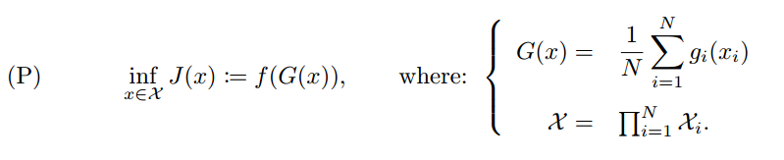

论文分享
paper:《large-scale nonconvex optimization:randomization,gap estimation,and numerical resolution》
1. 问题形式
转化为对偶问题存在的问题
2. 和我们问题的关联

Slide 11




论文分享
paper:《large-scale nonconvex optimization:randomization,gap estimation,and numerical resolution》
1. 对偶问题形式
s.t.
转化为对偶形式存在的问题

Slide 12

论文分享
1. Relaxation by randomization

Slide 13
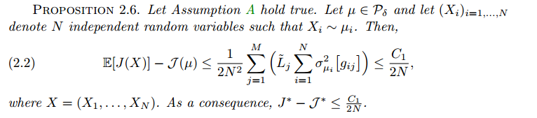
论文分享
1. Relaxation by randomization

Slide 14

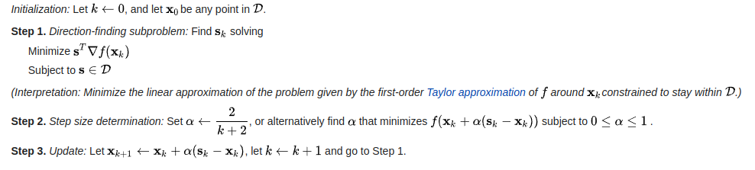
论文分享
2.1 Basic Frank-Wolfe algorithm:

Slide 15
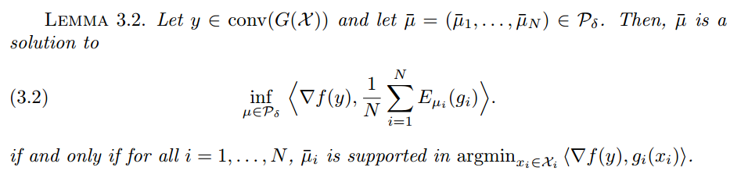
论文分享
2.1 Basic Frank-Wolfe algorithm:

Slide 16
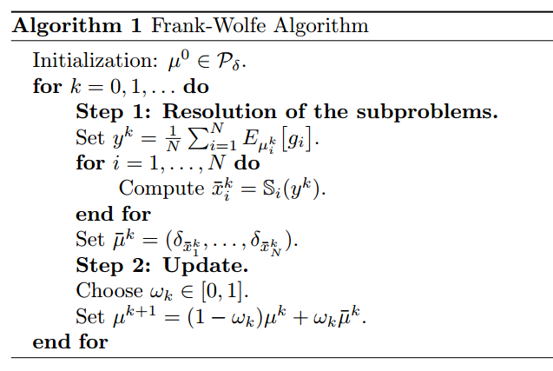

论文分享
2.1 Basic Frank-Wolfe algorithm:

Slide 17

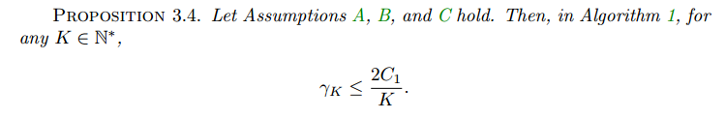
论文分享
2.1 Basic Frank-Wolfe algorithm:

Slide 18
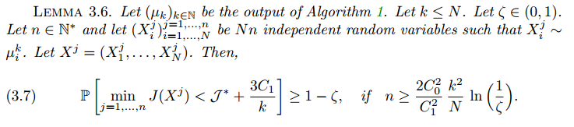
论文分享
2.1 Basic Frank-Wolfe algorithm:

Slide 19
论文分享
2.2 Stochastic Frank-Wolfe algorithm:
算法1存储空间占用比较大，所以作者提出了Stochastic Frank-Wolfe 算法

Slide 20
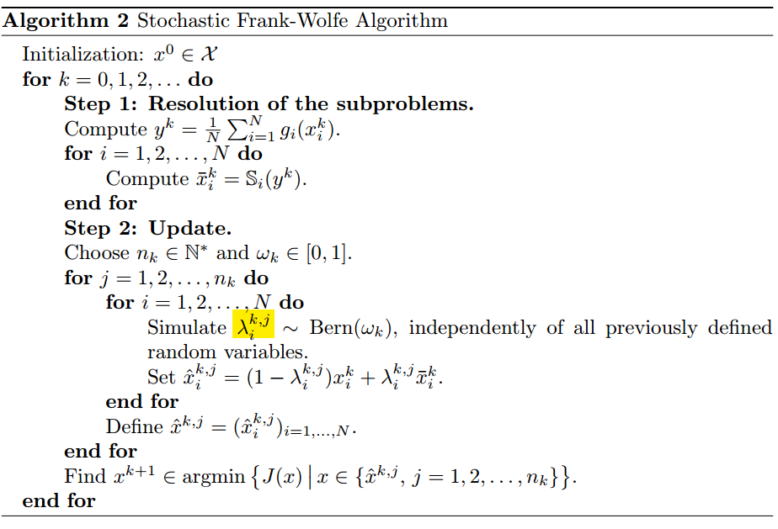
论文分享
2.2 Stochastic Frank-Wolfe algorithm:

Slide 21
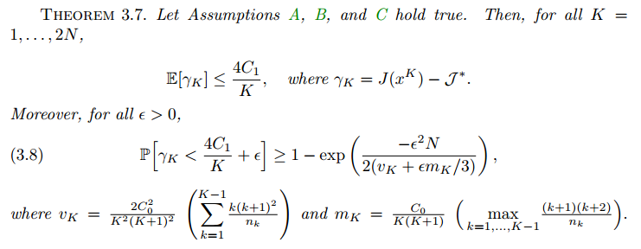
论文分享
2.2 Stochastic Frank-Wolfe algorithm:

Slide 22

论文分享
2.2 Stochastic Frank-Wolfe algorithm:
1.A speed-up of the SFW algorithm
simulating the Bernoulli random variables before Step 1
2.Stopping time strategy.

Slide 23

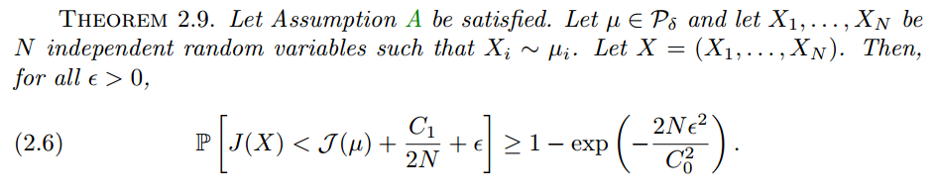
论文分享
3. Selection method:

Slide 24

论文分享
4. Experiments:

Slide 25
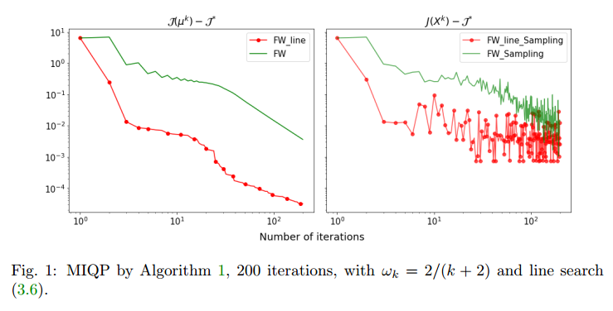
论文分享
4. Experiments:
1. Linear search 方法更快
2. stochastic FW收敛速率比basic FW慢

Slide 26
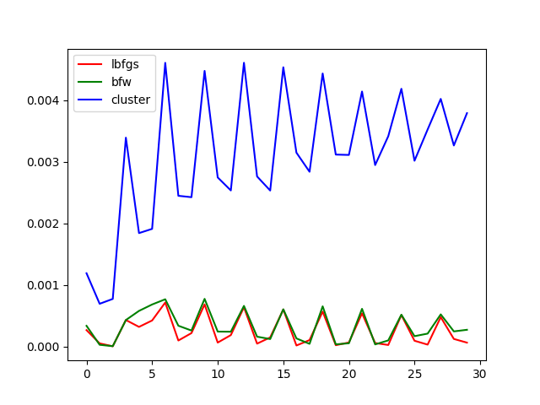
实验进展
算法实现:

Slide 27
实验进展
算法实现:
1. KDE权重更新
2. KDE带宽太大

Slide 28
论文调研
《Non-convex Optimization for Machine Learning》
nonconvex optimization: NP-hard problem
1. The Convex Relaxation Approach : relaxation gap, scalability
2. The Non-Convex Optimization Approach:PGD,alternating minimization, EM, stochasitc optimizaiton
It has been repeatedly revealed that if the problem possesses nice structure, then not only do relaxation approaches succeed, but non-convex optimization algorithms do too.

Slide 29
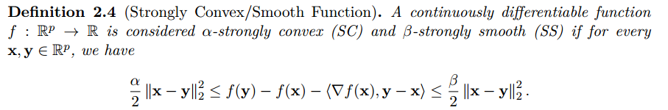
论文调研
Mathematical Tools

Slide 30
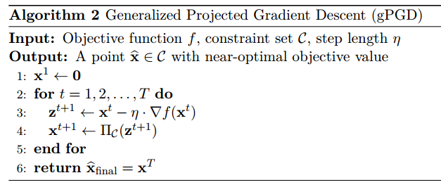
论文调研
PGD: projected gradient descent

Slide 31
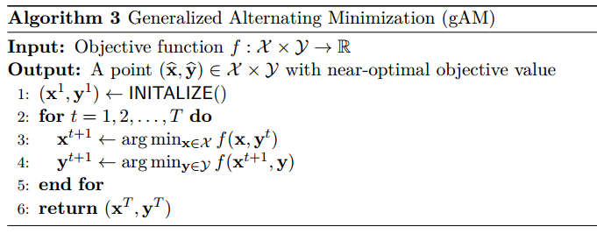

论文调研
gAM: Generalized alternating minimization
descent version of gAM

Slide 32
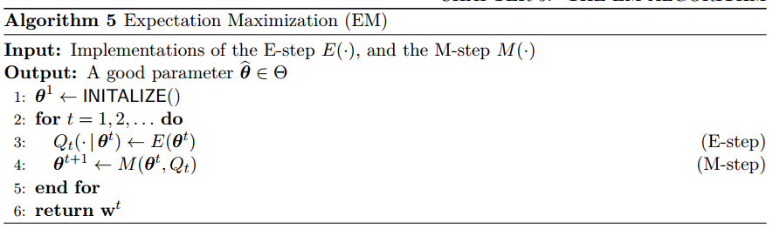
论文调研
EM: Expectation-Maximization

Slide 33
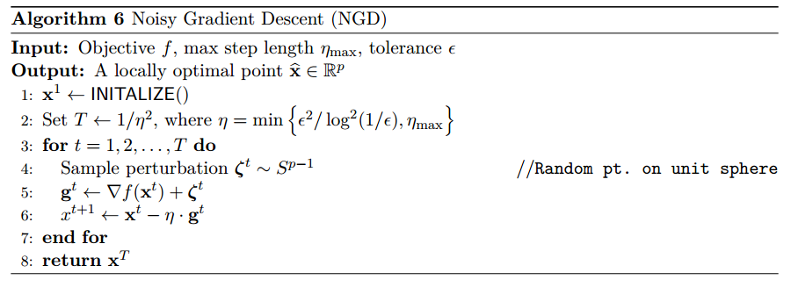
论文调研
Stochastic Optimization

Slide 34
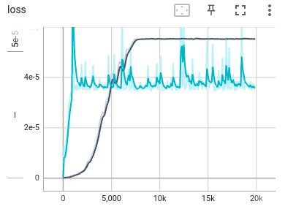
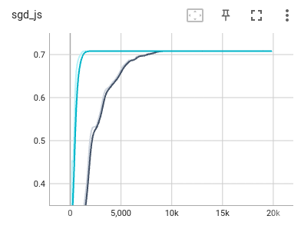
算法实现
Stochastic Optimization
(5000+5000)->100
loss: js散度
optimizer: Adam, lr=10e-3,10e-4
cluster: js=0.00013

Slide 35


