Slide 1
认知智能研发进展
师清
2022.1.13

Slide 2
Introduction
《TRAINING INDEPENDENT SUBNETWORKS FOR ROBUST PREDICTION》
ICLR2021
Gambridge University & Stanford University & Google Research

Slide 3
Introduction
Uncertainty estimation and out-of-distribution robustness
Bayesian Neural network
ensmble learning
batchEnsemble
the benefits of using multiple predictions can be achieved “for free” under a single model’s forward pass.
analyze the diversity of the individual subnetworks

Slide 4
Introduction
《THE LOTTERY TICKET HYPOTHESIS:FINDING SPARSE, TRAINABLE NEURAL NETWORKS》
ICLR2019
MIT CSAIL
The lottery ticket hypothesis: dense, randomly-initialized, feed-forward networks contain subnetworks (winning tickets) that—when trained in isolation—reach test accuracy comparable to the original network in a similar number of iterations.

Slide 5
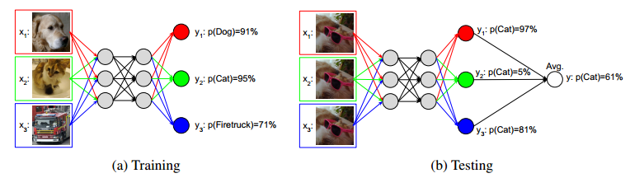
Method
Multi-input multi-output (MIMO) configuration
First, replace the input layer
Second, replace the output layer
0.03% increase in the total number of parameters

Slide 6
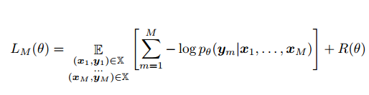

Method
Train loss
Predict

Slide 7
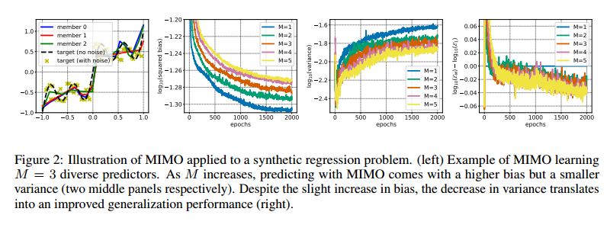
Experiments
1. one-dimensional regression problem

Slide 8
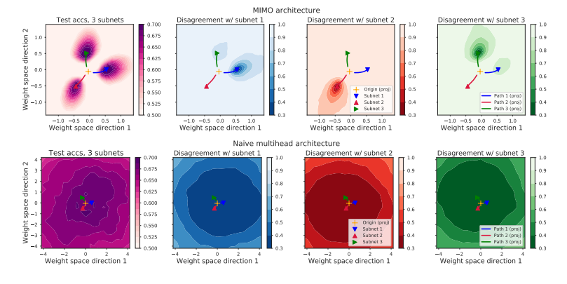
Experiments
2. loss landscape analysis

Slide 9
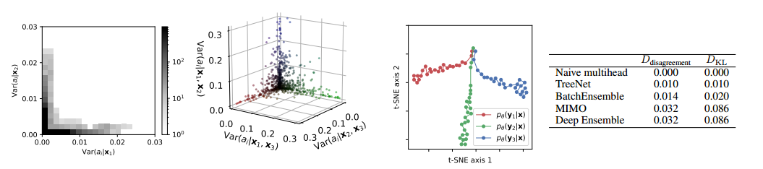
Experiments
3. function space analysis
average pairwose similarity:

Slide 10
Experiments
4. separation of the subnetworks
conditional variance:

Slide 11
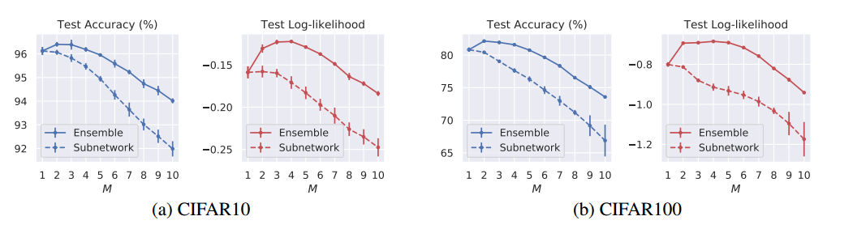
Experiments
5. the optimal number of subnetworks

Slide 12
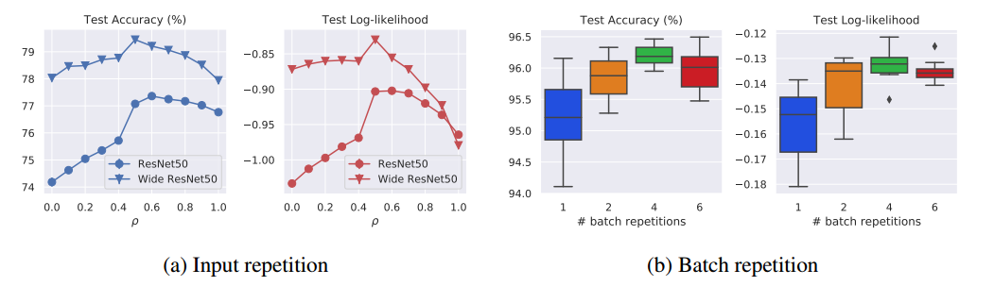
Experiments
6. input and batch repetition

Slide 13
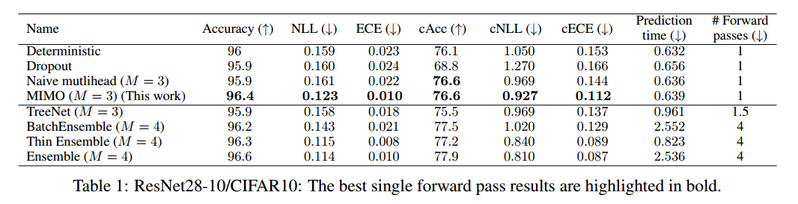
Experiments
Benchmarks
To measure robustness, we look at accuracy, negative log-likelihood (NLL), and expected
calibration error (ECE)

Slide 14


