Slide 1

Taxonomy: Making it Easier
Knowledge Management
&
Health Information Exchange
By bijan Farhoudi & Mark Bannan

Slide 2
Concept
Automating
Taxonomy
Use known text analytics methods to train on a serious of pre-classified documents. (Machine Learning)
Apply the learned categorization strategy to new documents (PDF & Docx) and offer classification (suggested taxonomy feature) to user
Allow upload functionality within SharePoint – upload document within SP and process – offer suggested taxonomy feature.
Store document, taxonomy selection (meta-data) and do so with little user intervention.

Slide 3
Methods
Automating
Taxonomy
Proof of concept – PubMed pre-classified documents (random sample from ftp://ftp.ncbi.nlm.nih.gov/pub/pmc/)
Remove randomly, 25% of documents for testing purposes
Use know text analytics methods to train on a serious of known, “pre-classified” documents - the training data set
Run classification process against 25% testing data set
Use SVM & Naïve Bayes methods of Machine Learning
Review Results

Slide 4
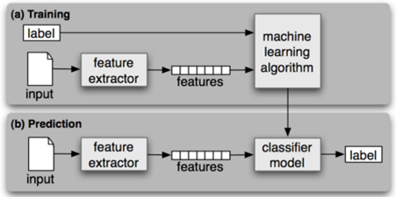
Initial Results
Automating
Taxonomy
Proof of concept provided:
An overall idea of functionality and integration with SP
Testing against a data set of 3955 medically based text documents
Allowed measures against testing data set (~ 990 documents) after training
Overall classification on testing data set = 89%

Slide 5

Initial Results
Automating
Taxonomy
SVM - Facts & Results
 | Total | 75% | 25%
Category | Docs | Train | Test
Addiction | 88 | 66 | 22
AIDS | 117 | 88 | 29
Alcohol | 42 | 32 | 11
Allergy | 53 | 40 | 13
Arthritis | 112 | 84 | 28
Blood | 30 | 23 | 8
Brain | 426 | 320 | 107
Cancer | 62 | 47 | 16
Cardiovasc | 136 | 102 | 34
Diabetes | 2741 | 2056 | 685
Heart | 148 | 111 | 37
Total | 3955 | 2966 | 989
Classification Scores | Precision | Recall | f1-Score
Addiction | 0.81 | 0.95 | 0.88
AIDS | 1.00 | 1.00 | 1.00
Alcohol | 0.83 | 0.50 | 0.62
Allergy | 1.00 | 0.77 | 0.87
Arthritis | 1.00 | 0.96 | 0.98
Blood | 0.00 | 0.00 | 0.00
Brain | 0.99 | 1.00 | 1.00
Cancer | 1.00 | 0.62 | 0.77
Cardiovasc | 0.82 | 0.26 | 0.40
Diabetes | 0.94 | 1.00 | 0.97
Heart | 0.91 | 0.81 | 0.86
Averages | 0.93 | 0.94 | 0.93

Slide 6
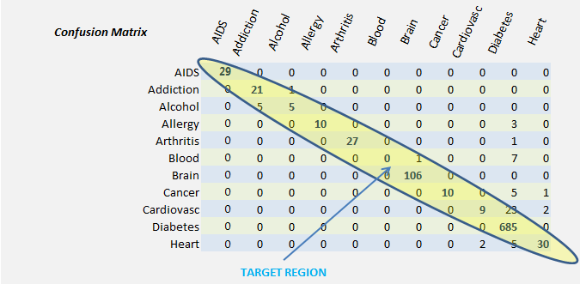
Initial Results
Automating
Taxonomy
Confusion Matrix – highlights accuracy & errors

Slide 7
Conclusion
Automating
Taxonomy
Proof of concept demonstrated:
Bags of Words concept for classification
Reasonable accuracy with fundamental Algorithm
Merit in pursuing more detailed experiments with AHS client and data

Slide 8
Next Steps
Automating
Taxonomy
AHS Client Support:
Solicit AHS client for further experimentation
Create full, proof of concept with AHS data and SP integration
Provide results that may lead to implementation within AHS and SP within KMI.

