Slide 1
Network Hierarchy
SODA 502
20 October 2015
Project Analysis Outline

Slide 2
Data Sets
R Object | # Data Sets | Avg. # Nodes | Avg. # Edges
Network_Data | 29
Influence | 12
Manager | 17
Total | 58
*For now, we treat all data sets as weighted and directed.

Slide 3
Measures of Hierarchy
Measure | Undirected | Weighted | Global | Local
Landau’s h |  |  | X
Kendall’s K |  |  | X
Reach Degree | X |  |  | X
Reach Closeness | X |  |  | X
GRC | X |  | X | X
Rooted Depth |  |  |  | X
Degree | X |  | X | X
Closeness | X |  | X | X
Betweenness | X |  | X | X
Eigenvector | X |  | X | X

Slide 4
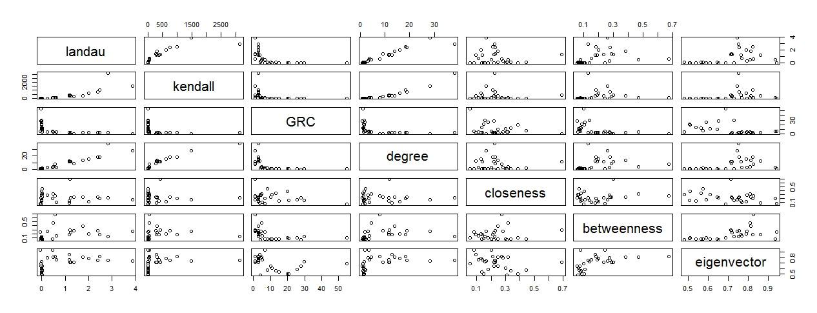
Pairs Plot for Global Measures
*Measures for all 58 Data Sets

Slide 5
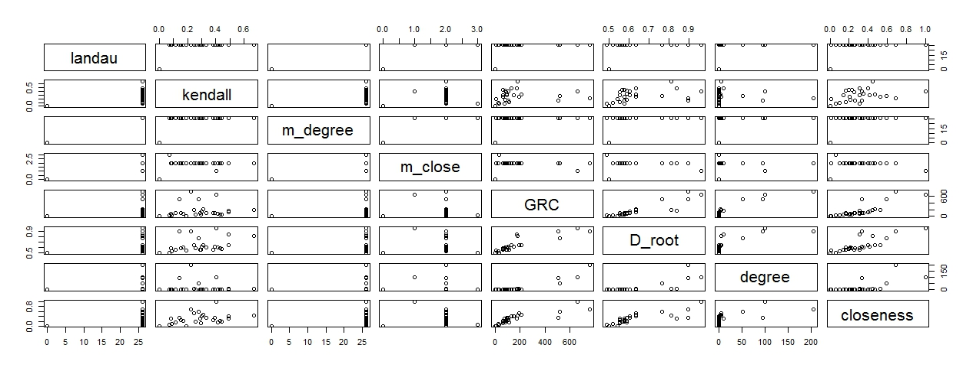
Pairs Plot for Local Measures
*Measures for Data Set 6 in the Network Data; all others follow similar patterns

Slide 6
Plot of how well local measures are doing
Focus on the email datasets

Slide 7
Plot of how well local measures are doing
Focus on the influence data sets

Slide 8
PCA Plots

