Slide 2
Data Sets-29 that are in the git hub
Data Set | # Nodes | # Edges | Directed | Weighted | Topic

Slide 3
Measures of Hierarchy
Measure | Undirected | Weighted | Global | Local | Other…
Landau’s h |  |  | X
Kendall’s K |  |  | X
Reach Degree | X |  |  | X
Reach Closeness | X |  |  | X
GRC | X |  | X | X
Rooted Depth |  |  |  | X
Degree | X |  | X | X
Closeness | X |  | X | X
Betweenness | X |  | X | X
Eigenvector | X |  | X | X

Slide 4
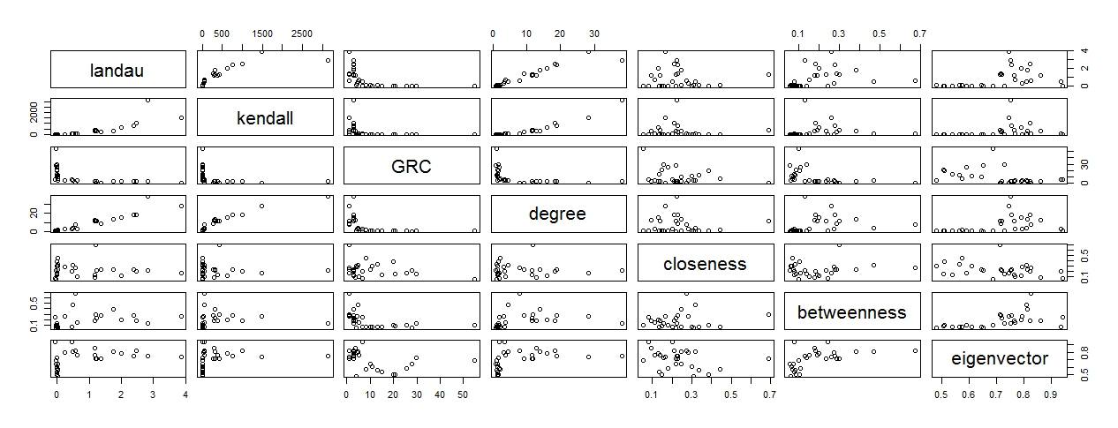
Pairs Plot for Global Measures
*Measures for all 29 Data Sets

Slide 5
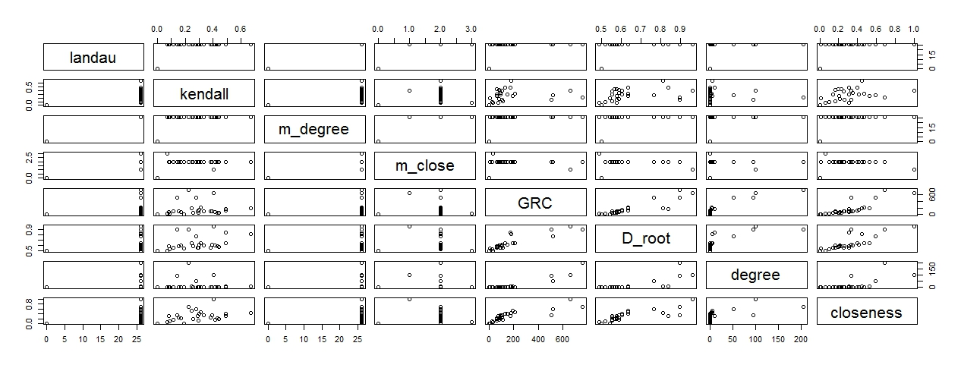
Pairs Plot for Local Measures
*Measures for Data Set 6; all others follow similar patterns

Slide 6
PCA Plots

