Slide 1

Exploratory Data Analysis
CAB DATA ANALYSIS
20.10.2021

Slide 2

Agenda
Executive Summary
Problem Statement
Approach
EDA
EDA Summary
Recommendations

Slide 3
SUMMARY
XYZ is a firm who wants to make investement by entering to the cab endustry.
There are 2 different cab firm called Pink cab and Yellow cab
We have the transactions of these two firms and we have analyzed them to obtain the optimal offer among these firms
We will be presenting our results based on different parameters and we will be ending our presentation with our recommandations

Slide 4
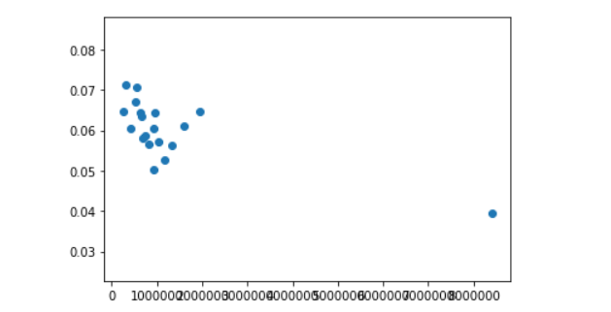
General Hypothesis on Cab Endustry
Price per KM based on Population
Scatter

Slide 5
RESULTS
Hypothesis: There is a relation between population and the price per km because of the traffic:
Hypothesis rejected according to scatter: There is not any linearity between these two parameters.

Slide 6
OTHER Hypothesis
H: Transactions which have smaller distances will have higher profit rate thanks to the constant starting price
Results:
Short distance profit rate: 48%
Long distance profit rate: 47.9%

Slide 7
H: There is a signifiacant difference between two firms’ profit rates
Results:
Pink Cab Average Profit Rate: 25%
Yellow Cab Average Profit Rate: 53%

Slide 8
H: Long distance trips has higher rate on payment with card with respect to shrter trips.
Results:
Short distance card payment ratio: 54173/90525
Long distance card payment ratio: 54127/90169

Slide 9
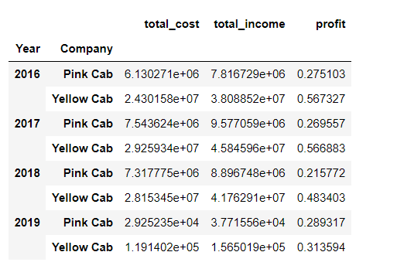
PROFIT RATE BASED ON YEAR AND CAB FIRM

Slide 10
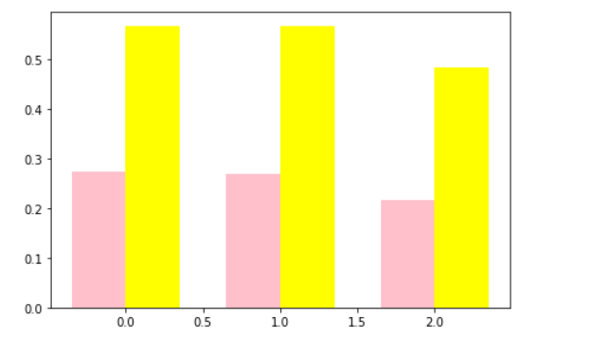
GRAPH

Slide 11
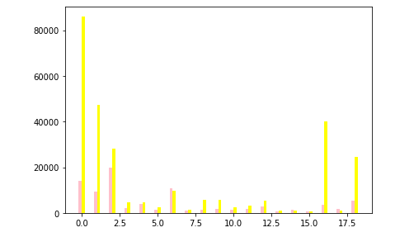
NO OF USERS BASED ON CITY

Slide 12
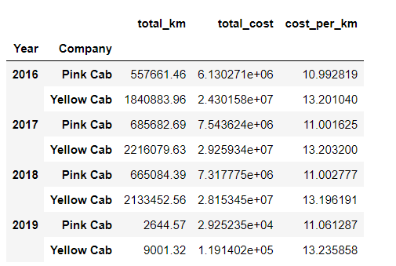
Cost per km based on year&firm

Slide 13
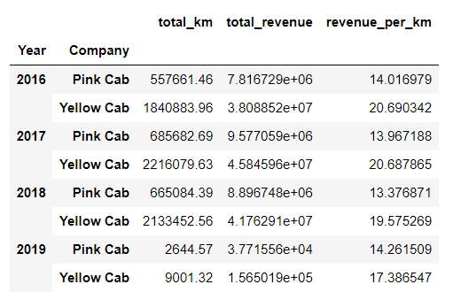
Revenue per km based on year&firm

Slide 14
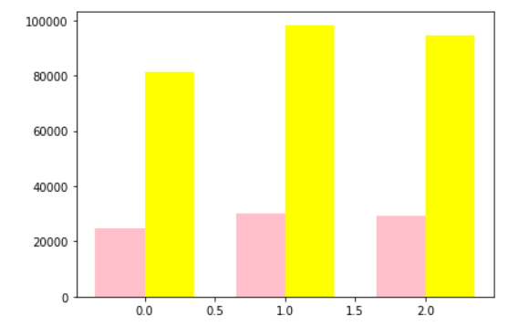
Number of trip based on year&firm

Slide 15
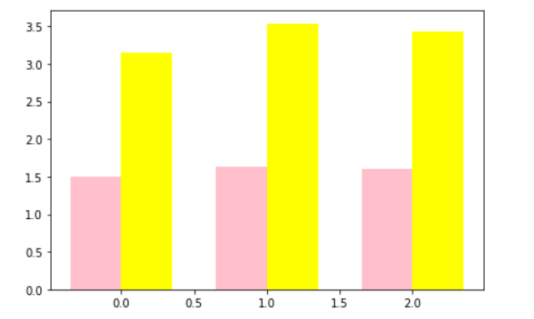
Average trip number by the same user based on year

Slide 16
Reccomandations
General profit rate is higher for Yellow Cab on all three years when the data is limited.
The number of users disribution based on cities show that Yellow Cab have more users in 16 cities out of 20.
Even if the cost per km on Yellow Cab has higher cost with respect to Pink cab, there are more significant difference on revenues in favor of the Yellow Cab Company.
Total number of trip is higher during all of three years for Yellow Cab.
The number of trip made by the same user is higher for Yellow Cab so the customer base of the Yellow Cab likes the service they have taken and continue to use their companies.
By considering the above propositions, it can be yield that the Yellow Cab would be more convenient option for XYZ.

Slide 17
Thank You

