Slide 1
Data Processing Workshop
Presenter: Buz Galbraith

Slide 2
Outline
My Background
Technical Prerequisites
Motivation
Case Study
Questions

Slide 3
My Background
Did my undergrad and masters here at NYU.
Worked this past year as a Data Scientist at the Kaiser Permanente Division of Research.
starting my PhD in the fall at Northeastern in CS, working on computational biology.

Slide 4
Technical Prerequisites: Polars and Bash
A lot of this analysis will be done using Bash as well as Polars.
Bash: Ie the born again shell, is a scripting language and the command line environment for UNIX based systems.
Polars: is a highly optimized data manipulation library, implemented in Rust and with a Python API highly influenced by Pandas
Why these tools:
  They are the fastest for the example we are working on
  To show we should be flexible in the tooling we work with.

Slide 5
Technical Prerequisites: A note about virtual environments
Virtual environments create self contained Python interpreters. This isolation allows the separate installation of python packages without version conflicts between projects.
There are many tools to do this. Some popular ones are Conda, Hatch, Pipenv and Poetry.
For this demonstration I will use plain Venv which is provided directly by the Python Foundation.
I also have the project setup to use poetry as it is the most modern/popular approach.
I would caution against solely relying on anaconda as they recently left the open source so a lot of companies and labs are moving away from it.

Slide 6
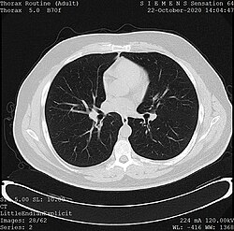
Motivation: Medical Imaging
Hospitals run thousands of imaging exams of various types every day. Meaning some institutions have collected millions of scans.
These scans are used by clinicians for a wide range of tasks including:
  The diagnosis of breast cancer
  Detecting arrhythmia in the heart
  Accessing the bone-density of older patients

Slide 7
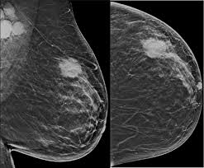
Motivation: Imaging Research
As such there is a very active area of research trying to leverage these images to either extract new information or automate existing radiological sans
However for such projects to take place we need a paradigm for sharing these images that is:
  Standardized: across health systems, tools and exam types
  Space efficient: Images are large, we want to send the minimal amount of information from which both meta data about the scan and the resulting image can be extracted
  Easily de-identifiable: Projects are often collaborations between research teams at multiple health centers as such, we need a way to easily remove PHI (personal health information ) from these scans.

Slide 8
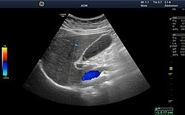
Motivation: The DICOM Standard
The Digital Imaging and Communications in Medicine (DICOM) standard addresses many of these concerns
DICOM files are composed of two primary data structures:
  The header: a plain text store of the files meta data (ex exam type) which can be easily used to filter or find files
  The pixel array: a compressed representation of the pixel data of a given scan from which the original image can be reconstructed

Slide 9
Zooming Out: Why this matters
If you don’t plan to work in imaging or the medical field at all you may wonder how this relates to you.
I feel going through this example with DICOM files offers a few interesting insights:
  Illustrates general data processing workflows
  Shows how domain knowledge can influence how to process data
  Demonstrate the collaborative nature of multi-disciplinary projects
  Show that not all data comes in a nice tabular format, and how we can transfer our existing knowledge to new modalities.
  This is a striped-down version of a real processing workflow I have used at work.

Slide 10
Case Study: Setup
Suppose you are working on a medical research team with a principal investigator from a pure bio background
As the first step in a imaging project, relating body fat to cancer outcomes, she has asked you to construct a dataset from an existing set of DICOM files.

Slide 11
Case Study: Data Extraction
The first step in this process is finding the relevant files and extracting relevant data from them.
Once this is done, this is done you can get some simple summary statistics for the data.

Slide 12
Case Study: Processing Iteration One
Lets say you brought your findings to the PI.
In the discussion you identified the following processioning steps to be taken:
  Adding an absolute path to the file.
  Removing scans relating to the patient Citizen^Jan

Slide 13
Case Study: Processing Iteration Two
Lets say you do those processing steps and have another meeting with the PI.
In this meeting you identify the following further processing steps to take:
  Filter the data the for only MRI and CAT scans.

Slide 14
Case Study: Processing Iteration Three
Lets say you do that and have another meeting with the PI.
In this meeting you identify the following further processing steps to take:
  Filter the data for only axial scans.

Slide 15
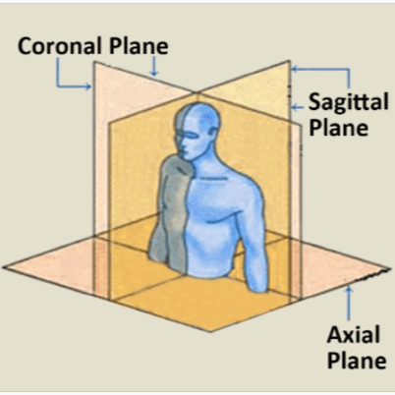
Case Study: Axial Scans
You identify that the image orientation patient field
Reading the DICOM documentation you find:
  Image Orientation (Patient) (0020,0037) specifies the direction cosines of the first row and the first column with respect to the patient. These Attributes shall be provide as a pair. Row value for the x, y, and z axes respectively followed by the Column value for the x, y, and z axes respectively.
Your know an axial scan moves straight up the body.
In other words you know:
  the rows of an axial scan should fully contain information on the lateral (ie left right)
  The columns should only contain information on the depth (ie front or back) axis
Thus you can deduce the proper value for an axial scan is [1.0, 0.0, 0.0, 0.0, 1.0, 0.0]

Slide 16
Case Study: De-identification
Suppose your PI is happy with the processing work we have done with the dataset, but wants to work with a collaborator at another hospital to fit deep learning models to the data.
As such you need to:
  De-identify the data, ie create copies of the data with all identifying information removed.
  Save a key of how to re-identify the data, if you ever need to.
  Extract images (pngs) from the DICOM files to use in the models

Slide 17
Questions?

