Slide 1
Data Processing Workshop
Presenter: Buz Galbraith

Slide 2
Outline
Introduction
  My background
  A note on virtual environments
  The DICOM Standard
  How this relates
Case study
  Setup
  Iteration 1
  Iteration 2
  de-identfication

Slide 3
My Background

Slide 4
A note about virtual enviroments

Slide 5
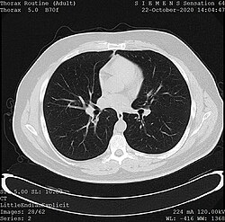
Motivation: Medical Imaging
Hospitals run thousands of imaging exams of various types every day. Meaning some institutions have collected millions of scans.
These scans are used by clinicians for a wide range of tasks including:
  The diagnosis of breast cancer
  Detecting arrhythmias in the heart
  Accessing the bone-density of older patients

Slide 6
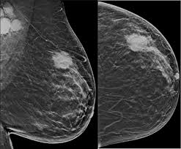
Motivation: Imaging Research
As such there is a very active area of research trying to leverage these images to either extract new information or automate existing radiological sans
However for such projects to take place we need a paradigm for sharing these images that is:
  Standardized: across health systems, tools and exam types
  Space efficient: Images are large, we want to send the minimal amount of information from which both meta data about the scan and the resulting image can be extracted
  Easily de-identifiable: Projects are often collaborations between research teams at multiple health centers as such, we need a way to easily remove PHI (personal health information ) from these scans.

Slide 7
Motivation: The DICOM Standard
Digital Imaging and Communications in Medicine (DICOM) is an international standard for handling, storing, transmitting, and displaying medical images and related information.

