Slide 1
My journey in trexquant
Wensheng Li
Dec 24th, 2024

Slide 2

Content
1.Training month: Submitted 2 Chinese alphas and 2 US alphas to paper trading Human alpha sheet.
2.Training month: Created the Third moment Feature to GAR project feature engineering
3.GAR project 24/06/01 Earnings announcement return Extrapolation Detailed feature engineering. Earned bonus
3.1.Superday test: Created Spillover-effect cross industry extrapolations. Two of them submitted to paper trading.
4.GAR project 24/06/15 Different of opinions
5.GAR project 24/06/28 Shape features Earned bonus
6.GAR project 24/07/12 Spillover-effect features
7.GAR project 24/07/26 intraday-Shape features Earned bonus New 2D data created in pysim
8.GAR project 24/08/16 Adaboost Model
9.GAR project 24/08/30 Adaboost_improvement with random_forest
10.GAR project 24/09/20 Intraday Volatility Decomposition. Earned bonus
11.GAR project 24/10/04 Intraday feature with Two-stage model. Earned bonus
12.GAR project 24/10/18 Classify stocks into N groups. Earned bonus Submitted to paper trading strategies
Useful in many areas.
13. GAR project 24/10/26 New features: markit_LiqCoeff splitover effect.
Classify stocks into N groups

Slide 3
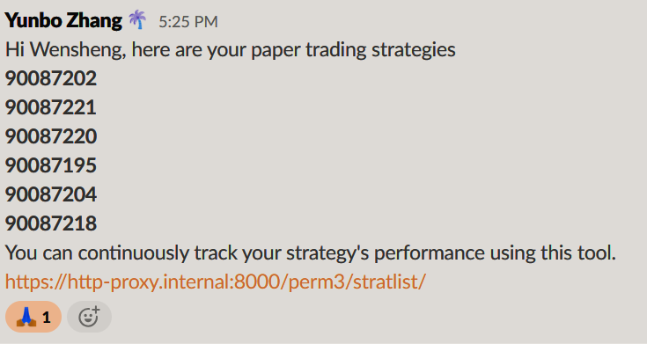
Content
13. GAR project 24/10/26 New features: markit_LiqCoeff splitover effect.
14. GAR project alone 24/11/06 New feature Shape-intravol5nd; Shape-intravolasy
15. Large project alone 24/11/21-24/12/22:
16. GAR project alone 24/11/25 New feature Downvol_skewallday
17. Useful points in Large project alone:
a. eliminates high-missing value features in bot30-mktcap group
b. adding two Quantile regressing Super-features
c. sample_weight parameter in the XGBR.fit(X, y, sample_weight=weight)
18. Creating my own gw1 fit function based on MoE lgbm Model.
Classify stocks into N groups

Slide 4
Key points
Feature Engineering
Created my own alpha research methodology.
Created new real useful features exploration way.
Gain detailed understanding of intraday Shape features and lead-lag effect.
Model Construction.
Created own label about MoE strategies using Machine learning.
Detailed understanding the xgboost/NN methods in real situations.
Classify stocks into N groups

Slide 5
Thanks !
Classify stocks into N groups

