Slide 1
Shape of Price and EA returns
GAR-Team 2
Chenyu Wu, Wensheng Li, 06/28/2024

Slide 2
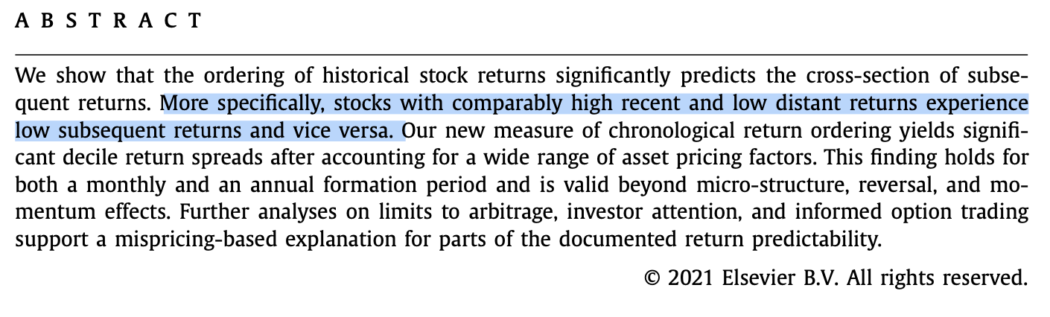
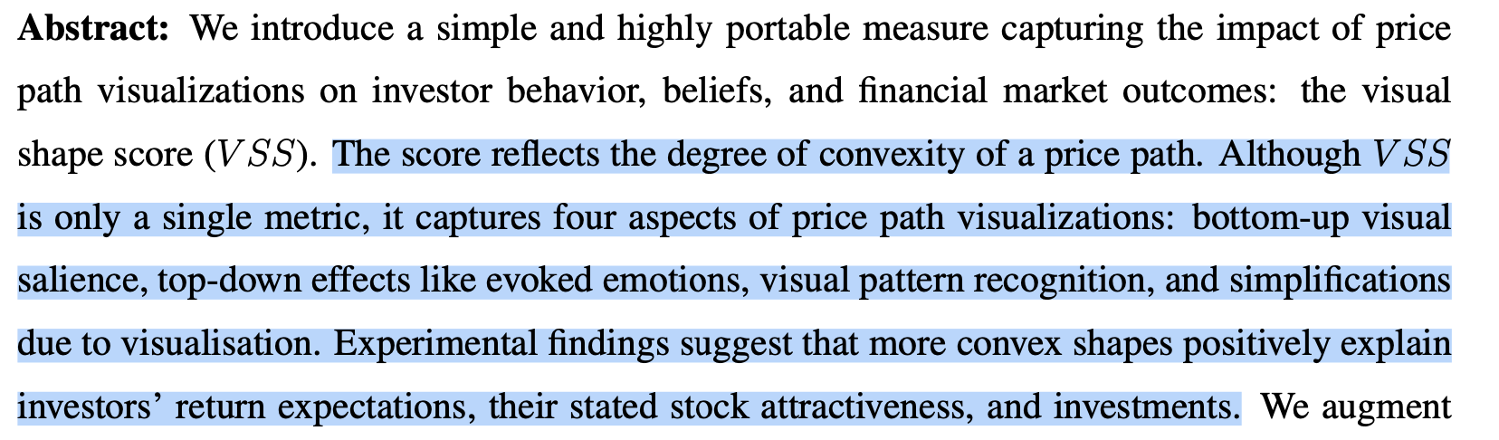
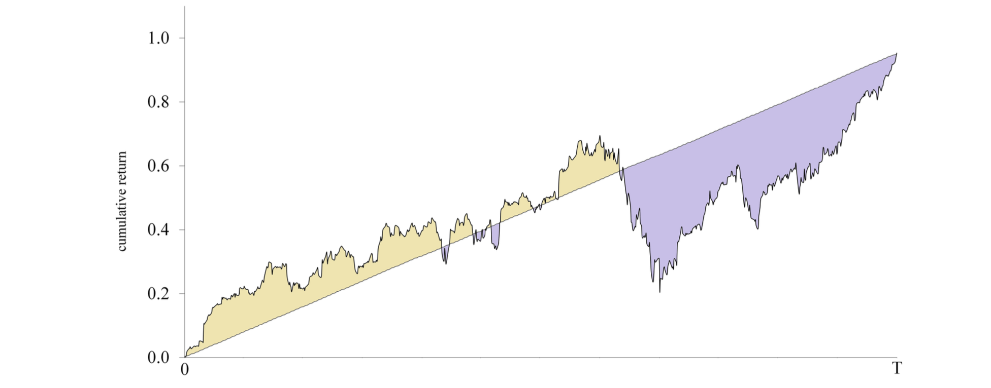
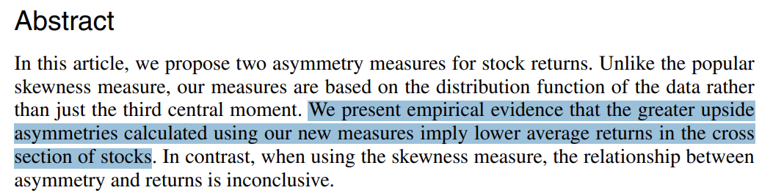



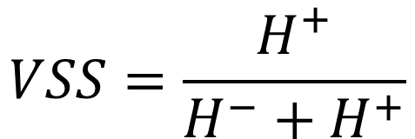

The ordering information of historical returns
Typically, we use basic statistics like mean, std, skew to extract features from historical price or return.
Researchers argue that, finding the high-level characteristics, e.g. regressing stock return on TIME order sequence can extract more information about return order and give a good prediction to EA jump.
Salience
Salience
$$t=[251,250,⋯,0]$$
$$H^{−}$$
$$v=[101,103,⋯,130]$$
$$VSS=\frac{H^{+}}{H^{−}+H^{+}}$$
$$CRO=corr(t,v)$$
Notes:
Many studies have pointed out that the sequential information embedded in price and return series often has strong predictive power for future returns. However, this information is not the most commonly used by people. Quantitative investors typically rely on basic statistical features like mean, standard deviation, and skewness to extract information from past price and return charts.
Research indicates that if we regress the price and volume series over time, we can extract more information, leading to better predictions of future returns, especially around earnings announcement dates. From the first chart, we observe that stocks A, B, and C have similar means and standard deviations but entirely different chart patterns. Stock A shows high recent returns, while Stock C shows high distant returns. Generally, literature suggests that stocks with high short-term returns and low long-term returns are often overvalued and may experience lower future returns.
Similarly, from the second chart, we see differences due to sequential information. Stocks A, B, and C again have similar return means and standard deviations, but Stock A is accelerating upwards, while Stock C is decelerating. Research indicates that accelerating stocks are often overvalued, leading to lower future returns, especially around earnings expectations. The accelerating upwards trend or high recent return, they are both salience, and investors are very sensitive to these salience and overvalued these Small probability event.
This suggests that examining the sequence of stock prices and returns is highly valuable. To distinguish between stocks A and C in the first chart, we calculate their correlation coefficients with a decreasing time series. Stock A shows a large negative correlation, Stock C shows a large positive correlation, and Stock B's correlation is nearly zero. This effectively differentiates these stocks with similar return means but different sequential information characteristics.
And, in the second chart, we calculate the area between the price chart and a increasing time series to characterize the convexity of a stock's price series. This helps to distinguish between accelerating and decelerating stocks.

Slide 3
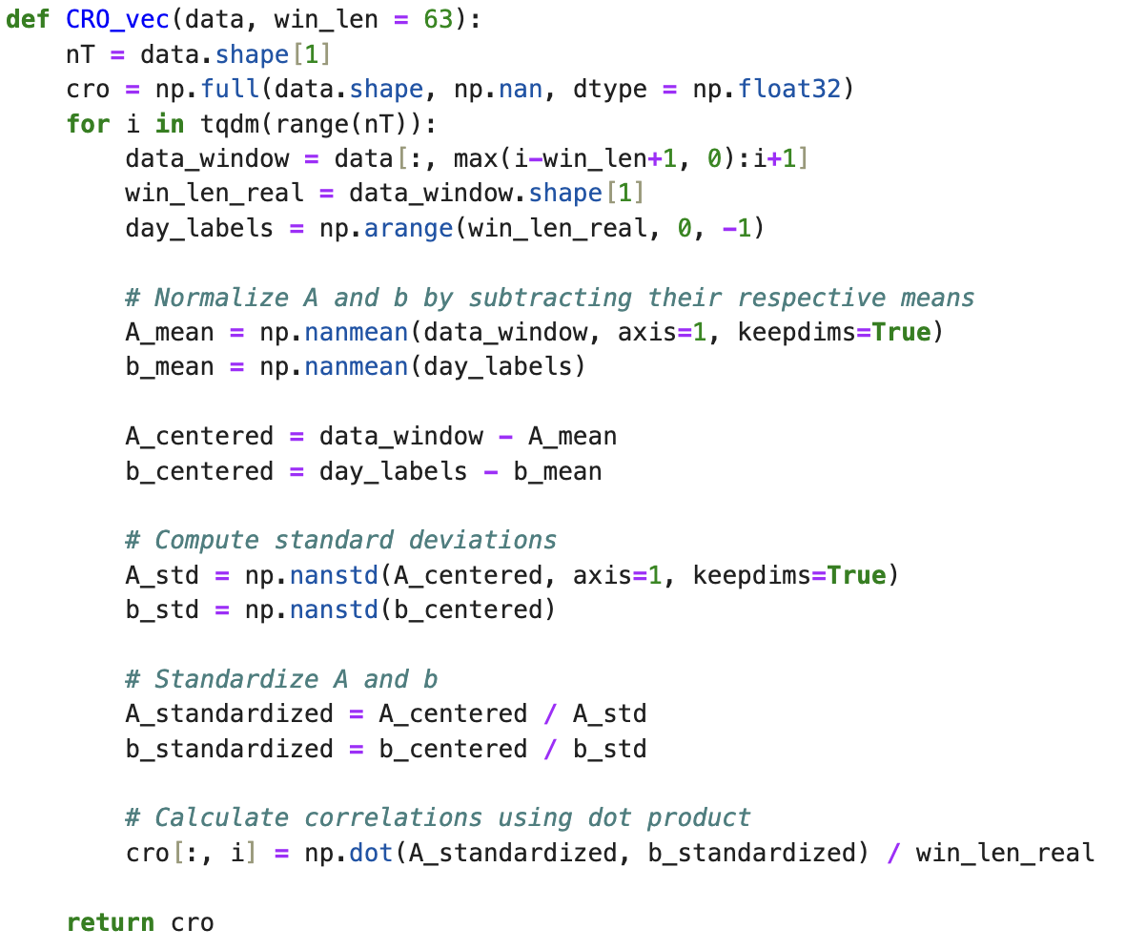
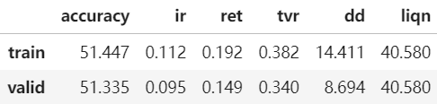
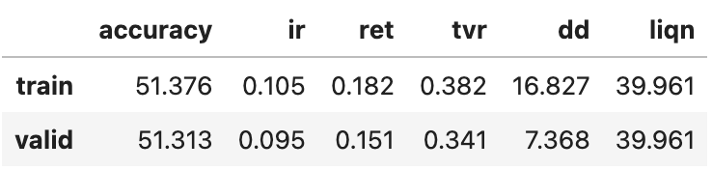
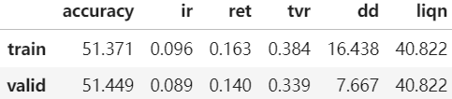
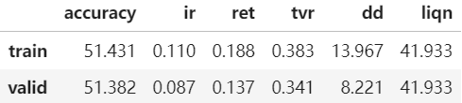
The implementation of the CRO
Compute CRO with user defined operator
We consider the long term correlation between the close price and the date, ignoring short-term noise
Runtime: approximately 240s
Compared with the current baseline: (+0.010, +0.009)
The ordering of the price (CRO)
Operator Definition: the correlation of the var and the time-stamp (date) in a given window
Measures: The stability or the ordering of the stock price
Variable: close, shout
Coverage: 3251, 3237, since 2006
uprice = close * shout
cro = CRO_vec(uprice, 252)
CRO_vec(uhigh)
CRO_vec(mfblock)
CRO_vec(uvwap)
Notes:
Based on these insights, we developed several operators to identify and extract more information from price series. Our first operator, CRO, first uses a rolling window to extract specific price series values, then standardizes and normalizes both the price series and a decreasing time series. By dot these 2 values, we obtain the final CRO value. We incorporated basic features like closing price multiplied by the number of shares and achieved good results, with an training IR of 0.105 and valid ir of 0.095. We also included other price series features, like the highest price and weighted average price, which all improved the baseline model.

Slide 4
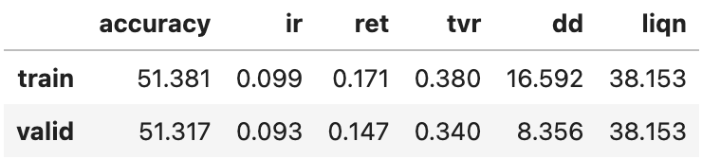
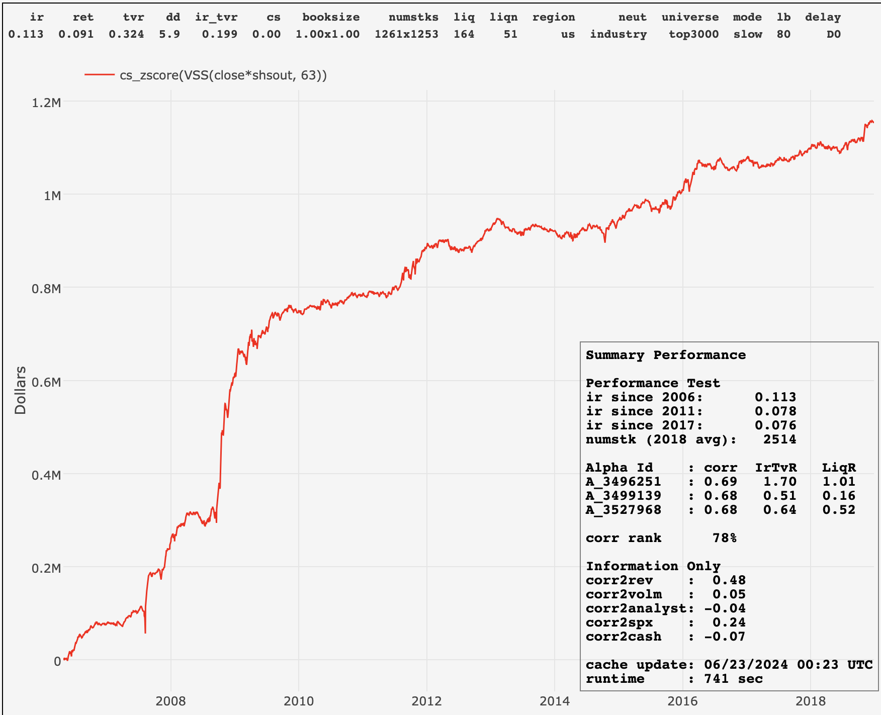
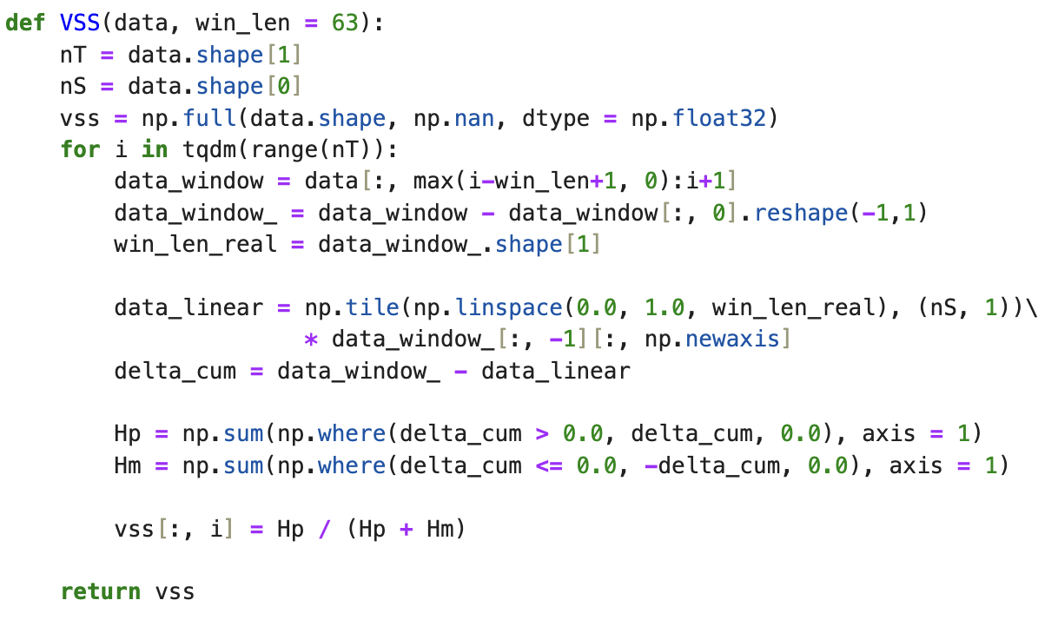
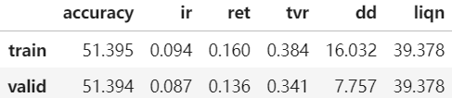
The implementation of the VSS
Compute VSS with user defined operator, and then take the cross-section z-score
Compute the convexity in one quarter, different rolling windows did not show much difference.
Runtime: approximately 30s
Compared with the current baseline: (+0.004, +0.007)
The convexity of the price path (VSS)
Operator Definition: The positive and negative area between the price curve and the linear interpolation
Measures: The convexity of the price curve
uprice = close * shout
vss= cs_zscore(VSS(uprice, 63))
VSS(uhigh * shsout)
Notes:
In addition to the first operator, we developed another to capture the convexity in price series, called VSS. Also first Using a rolling window, we standardize the time and price series, then calculate their difference and the area above and below the time series to get the final VSS value. We also used basic price series information like the closing price multiplied by the number of outstanding shares and achieved good results, with an training ir of 0.099 and valid ir of 0.093. We also tested the robustness of this operator with other price series information, like the highest price multiplied by the number of outstanding shares, and also shows an improvement in the baseline model.
We also developed a factor based on the VSS operato. This factor performed well both in-sample and out-of-sample.
What’s more, here we want to give and explanation of using the close*shsout
We used this to account for significant drops due to stock splits, which could negatively impact our sequence information calculations if we only us uclose. This adjustment improved our results, and it’s also consistent across fast and slow modes.

Slide 5
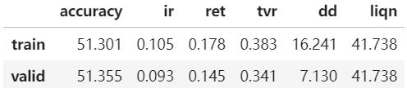
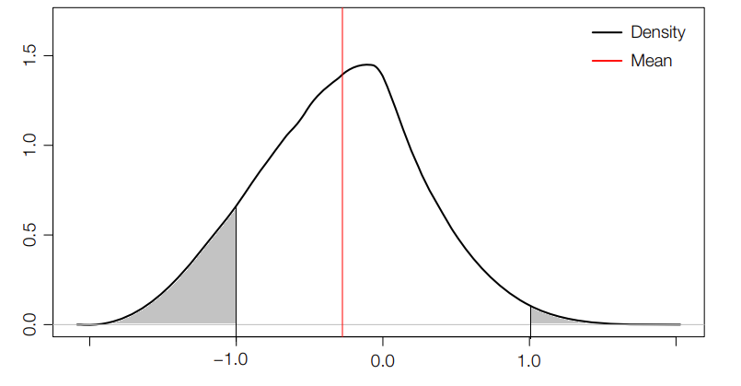
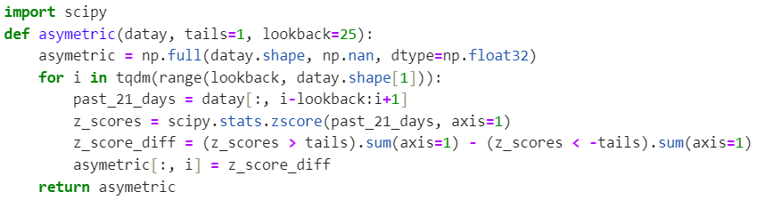
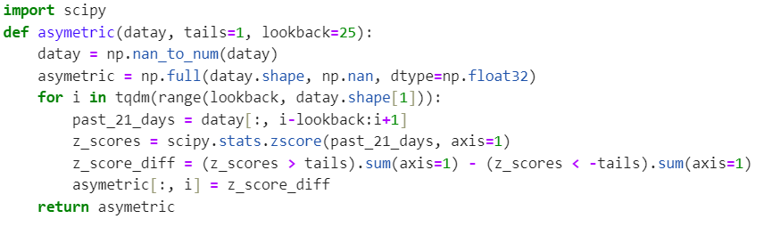
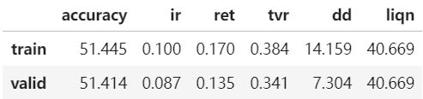
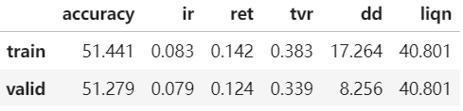
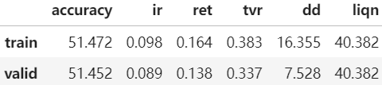
The implementation of the ASY
Compute ASY with defined operator below, then take the cs_zscore
Compute the asymmetries in two month, different rolling windows did not show much difference.
Runtime: approximately 40s
Compared with the current baseline: (+0.010, +0.007)
The asymmetries of the price (ASY)
Operator Definition: The probability of z-score return larger than 1 minus that of return less than 1 minus on time-series axis
Measures: The asymmetries of the price shape
cs_zscore(asymetric(ret1, 1, 42)
cs_indneut(ASY, industry)
asymetric(ret5)
asymetric(min_pv_mean_ssqrt_r)
ts_skew(ret1, 42)
√ beaten
Notes:
Besides these two operators, we added one op to extract distribution features. This operator calculates the probability of standardized return series being greater than one minus the probability of being less than one. Also first using a rolling window, we standardize the return series and count the days which its zscore is above 1 and minus the number of days which zscore is below one, thus obtaining a proxy for asymmetric information. We used the basic daily return series to put into the operator, and it givs out improvements over the baseline model, with an training ir of 0.105 and valid ir of 0.093. Testing with five-day returns and intraday return series also showed robustness.
This operator captures high-order information about the distribution, reflecting the asymmetry of monthly return series. We also compared it to skewness, and the results shows that our operator performed significantly better.

Slide 6
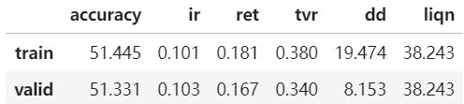
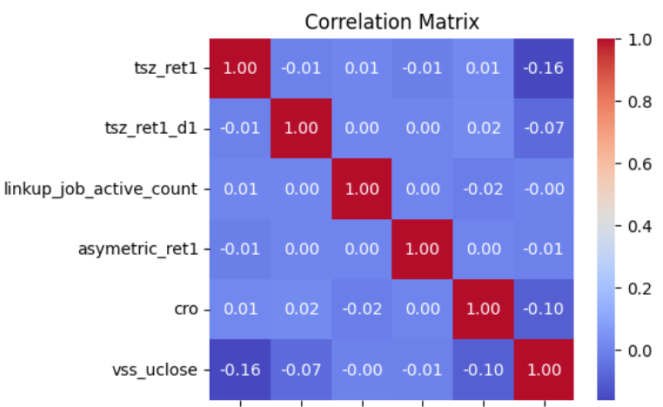
The Final results of the Shape & order prediction
Combination of the 3 features have improvement
The features are un-correlated
Training
Validation

Slide 7
Thank you!

