Slide 1

Designing and Managing a Secure and Efficient Network: Our System Administration Project
Made by: Zachar András and Kádár Kristóf
2023.02.22

Slide 2
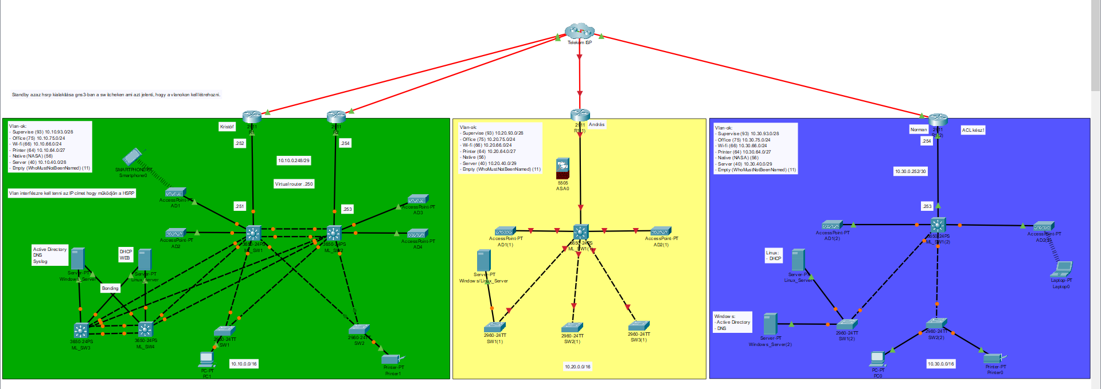

Slide 3
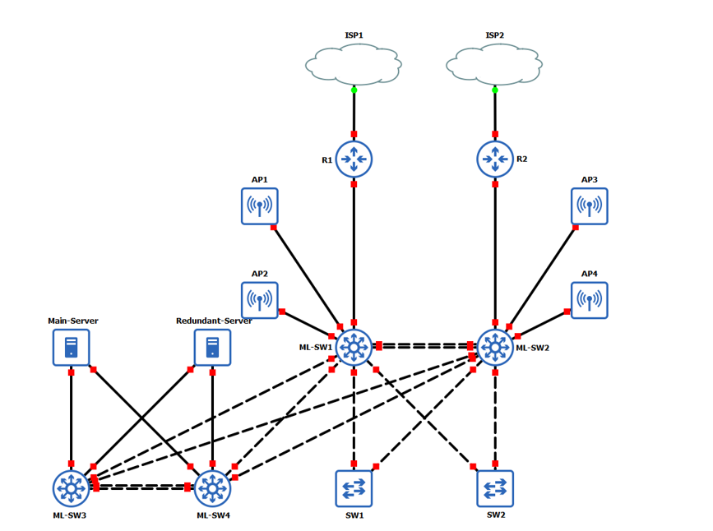

Slide 4
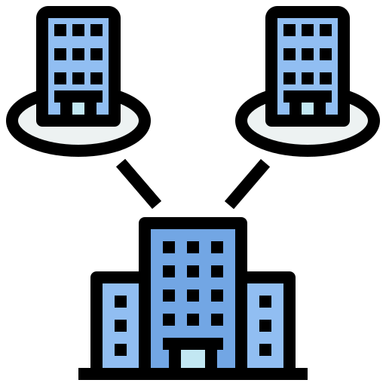
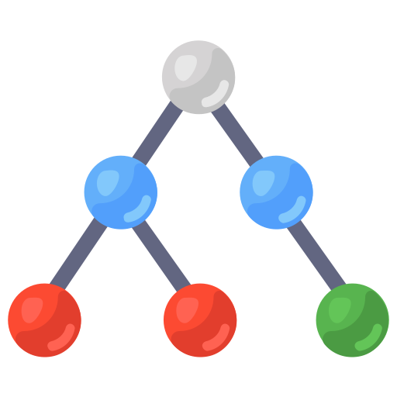

Network topology:
After a long discussion, we chose three office buildings that are different locally, but one nationally, but several hundreds of kilometers apart. These offices perform journalistic duties for a newspaper. Of the three sites, one is larger and two smaller buildings. Internet access is essential for the sites, as the main activity is displayed there for the readers. (BASICS/INTRODUCTION)
Our network infrastructure uses a spanning tree topology with separate routers at each of the three sites, providing increased network performance, resiliency, and stability. The extended tree topology also allows for greater customization to meet the unique needs of each site, resulting in increased network efficiency. (TOPOLOGY)
Determining the number of devices was crucial for designing and implementing the network infrastructure. The number of devices used was based on network requirements and usage habits, with each of the three sites analyzed separately to determine the optimal number of devices needed. All of the premises were equipped with a router, at least three switches, one server, and two access points. (DEVICE NUMBERS)

Slide 5
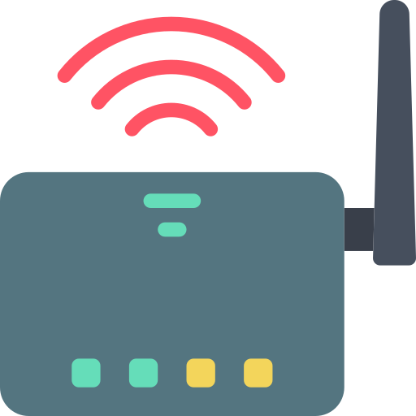
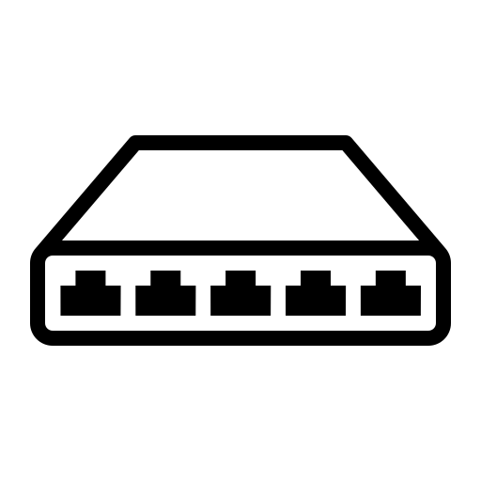

Main Devices
Our network topology heavily relies on routers to direct traffic between devices and the Internet. To ensure their security, we use passwords and various security features such as virtual private networks (VPNs) and Secure Shell (SSH). Additionally, we use domain names and name servers, as well as network address translation (NAT), and assign IP routing capabilities to the routers. Access control lists (ACLs) are also implemented to further enhance the network's security.(ROUTERS)
Switches are essential in creating multiple connections within a network for efficient device communication. There are two types of switches, Layer 2 and Layer 3 switches, which offer various features such as virtual LAN creation and perform routing functions. Using switches provides better network performance, scalability, and flexibility and is typically used to connect devices at each site. ( SWITCHES)
Servers play a critical role in our infrastructure as they provide various services to end-users and other devices on the network. These services include file storage, email, web hosting, and database management, among others. To ensure that servers operate reliably and efficiently, we must regularly perform tasks such as monitoring performance, configuring backups, and implementing security measures.(SERVERS)

Slide 6
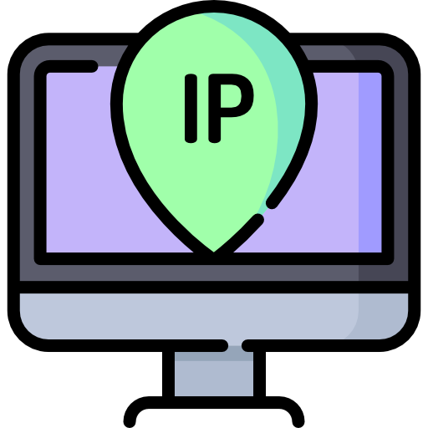


IP addressing scheme
In computer networking, IP addressing is a critical aspect that allows devices to communicate with each other over a network. An IP address is a unique identifier assigned to each device on the network, which enables the devices to exchange data packets with each other.
We implemented 7 VLANs with distinct purposes, such as for servers, for Wifi, and supervision, among others. These VLANs allow us to efficiently manage and organize network traffic, as well as enhance network security and performance. Overall, VLANs are a valuable tool in optimizing network functionality and maintaining security.
In our project, we used the 10.x.x.x IP address class, which is a part of the first class of IP addresses, also known as Class A. This IP address range is reserved for large networks with millions of hosts. By using the 10.x.x.x IP address range, we were able to allocate unique IP addresses to each device on our network, allowing them to communicate with each other effectively.
By using the correct IP addressing scheme, three different sites can connect and exchange data with each other. This allows for collaboration and better efficiency across multiple locations. Ensuring remote site communication is a key element of network administration.

Slide 7

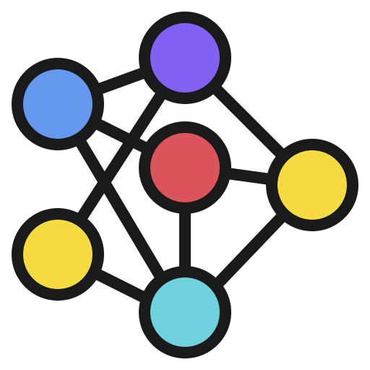
Routing Protocols
Routing protocols are important tools that help in transferring data between computer networks by finding the best route for network traffic to move from one device to another.
Static routing protocol is a type of routing protocol that requires network administrators to manually configure routes. It is a simple and efficient method of routing, but it can become challenging to manage as the network grows. Static routing protocol is often used in small networks or for specific purposes, such as directing traffic to a specific device.
Servers and switches play a critical role in routing protocols by providing the necessary infrastructure to support communication between different network segments or subnets. Servers act as the source or destination for network traffic, while switches route the traffic between different network segments. This makes sure that information is sent to where it needs to go on time and in a reliable way.

Slide 8

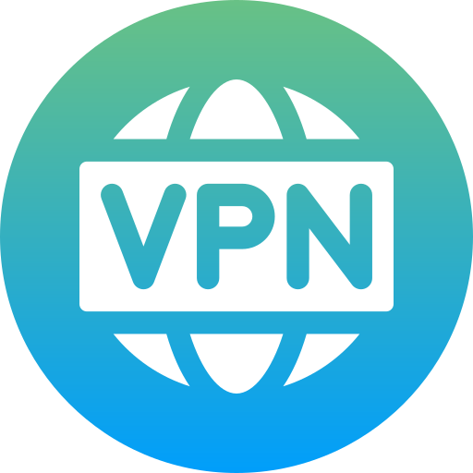

Security measures
In today's rapidly changing threat landscape, security measures play a vital role in system administration. As a system administrator, it is your primary responsibility to safeguard the organization's data and systems against internal and external threats.
ACLs, or Access Control Lists, which are a type of security measure that limit access to network resources based on user identity, group membership, and other factors. They are often used to regulate access to files, folders, and other resources on a network, and can help prevent unauthorized access and data breaches. In simpler terms, ACLs are an important tool for ensuring that only authorized users are able to access important information and resources.
VPNs, or Virtual Private Networks, are secure connections that allow users to access private network resources over a public network, such as the internet. They are frequently used by businesses to securely connect remote workers to corporate resources, enabling employees to work from anywhere while ensuring the safety of sensitive data. Implementing VPNs is critical for any organization that requires remote access for its employees or partners.
Firewalls are also critical in network topology as they provide an additional layer of security against external threats. In our project we used the Cisco Adaptive Security Appliance (ASA) firewall, that is a widely used network security tool that offers stateful packet inspection, access control, and VPN connectivity. It can be configured with security policies and rules to enforce policies and control traffic between networks. (FIREWALLS)

Slide 9
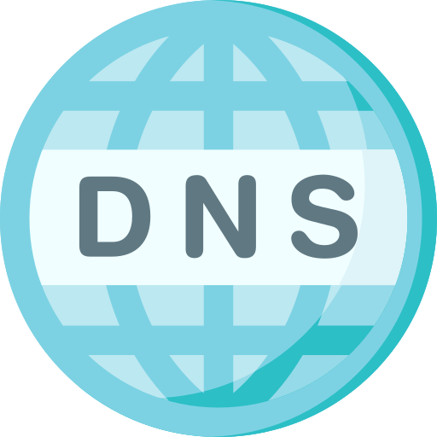


Windows
We chose Windows servers because they are widely used in enterprise environments and provide a range of services such as file and print sharing, directory services, web services, and database management. Furthermore, Windows servers offer a robust set of security features and management tools, making them an ideal choice for us to efficiently maintain and manage the server infrastructure.
DNS or Domain Name System is a crucial component of any network infrastructure as it translates human-readable domain names to IP addresses, which is required for devices to connect to the internet. The DNS servers should be configured properly to avoid any DNS-related issues or security threats.
Syslog is a standard protocol used to send system log or event messages to a logging server. The system administrator can use Syslog to monitor and troubleshoot network issues, security threats, and performance-related issues.
Active Directory is a directory service developed by Microsoft that allows administrators to manage and organize the resources in a network. It provides a centralized location for network users and resources, enabling the administrator to manage permissions and access controls more efficiently. The Active Directory is critical to the security and performance of the network, and it must be configured correctly to ensure optimal functionality.

Slide 10
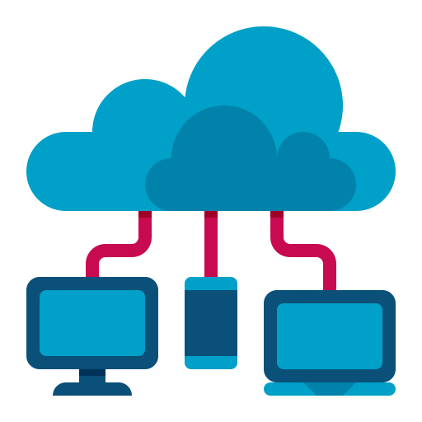

Linux
Linux is a highly flexible operating system that can be customized to meet specific business needs. It is also known for its robust security features, making it less vulnerable to viruses and malware than other operating systems. It is reliable, can handle a lot of work, affordable, and open-source, which means that it can be changed to fit different needs.
DHCP, or Dynamic Host Configuration Protocol, is a way for devices to get assigned an IP address automatically when they connect to a network. It helps reduce the amount of work needed to set up a network by eliminating the need for manually assigning IP addresses to each device. The DHCP server can also assign other important network settings, such as subnet mask, gateway, and DNS server IP addresses, which makes network management more efficient.
A web service is a software system that enables machines to communicate with each other over a network in a standardized way. It helps integrate different applications, databases, and systems across various platforms and technologies. As a system administrator, it's crucial to keep an eye on the performance and security of web services to ensure that end-users can access them without any issues.

