Slide 1
An Introduction To Modular Robots
Introduction
Morphology and Classification
Locomotion
Applications
Challenges
Notes:
This report gives an basic introduction to the ﬁeld of Modular Robots.
It targets interested people how want to go deeper into modular Robotics.
NEXT: WHAT IS A ROBOT?

Slide 2
Introduction
Definition (Robot)
A robot is an artificial, intelligent, autonomous system with a physical electro-mechanical platform. It is a combined device with enough perception, manipulation capability or mobility to implement typical tasks. Its purpose is to release human beings of laborious tasks, and of working in a critical environment, or to provide services to improve our living standard. [Hzhang]
Notes:
NEXT: WHAT IS A MODULAR ROBOT?

Slide 3
Introduction
Definition (Robot)
A robot is an artificial, intelligent, autonomous system with a physical electro-mechanical platform. It is a combined device with enough perception, manipulation capability or mobility to implement typical tasks. Its purpose is to release human beings of laborious tasks, and of working in a critical environment, or to provide services to improve our living standard. [Hzhang]
Definition (Modular Robot)
Modular self-reconfiguring robotic systems are autonomous kinematical machines with variable morphology. Beyond conventional actuation, sensing and control typically found in fixed-morphology robots, self-reconfiguring robots are also able to deliberately change their own shape by rearranging the connectivity of their parts, in order to adapt to new circumstances, perform new tasks, or recover from damage.[Wikipedia]

Slide 4
Introduction
Definition (Robot)
A robot is an artificial, intelligent, autonomous system with a physical electro-mechanical platform. It is a combined device with enough perception, manipulation capability or mobility to implement typical tasks. Its purpose is to release human beings of laborious tasks, and of working in a critical environment, or to provide services to improve our living standard. [Hzhang]
Definition (Modular Robot)
Modular self-reconfiguring robotic systems are autonomous kinematical machines with variable morphology. Beyond conventional actuation, sensing and control typically found in fixed-morphology robots, self-reconfiguring robots are also able to deliberately change their own shape by rearranging the connectivity of their parts, in order to adapt to new circumstances, perform new tasks, or recover from damage.[Wikipedia]

Slide 5
Introduction
Structure
  Few types of building blocks w/ uniform IF:
    Mechanical forces
    Electrical power
    Communication
Notes:
TODO: ADD FIGURE HERE

Slide 6
Introduction
Structure
  Few types of building blocks w/ uniform IF:
    Mechanical forces
    Electrical power
    Communication
  Some primary structured blocks:
    Gripper
    Feet, Wheel
    Sensor, e.g. Camera
    Energy storage, payload

Slide 7
Introduction
Motivation and Inspiration
  Functional Advantage
    Potentially more robust
    Morphological adaptive
    Self-repair (intra + inter robot)
  Economic Advantage
    Lower overall costs by making complex robots out of few mass produced modules
Notes:
TODO: WHY IS IT MORE ROBUST, MAYBE NOT?

Slide 8
An Introduction To Modular Robots
Introduction
Morphology and Classification
Locomotion
Applications
Challenges

Slide 9
Morphology and Classification
General Classification
  Chain topology
  Lattice topology
  Hybrid or Self-Reconfigurable
Notes:
●Main idea: Building robots composed of modules
● The design is focused on the module, not on a particular robot
● The different combinations of modules are called configurations
Some advantages:
Versatility
Fast prototyping
Low-cost

Slide 10
Morphology and Classification
General Classification
  Chain topology
    Connected in a string or tree topology
    Can fold up to become 3D
    Strict serial architecture
    Very versatile but computationally difficult to represent and analyze
  Lattice topology
  Hybrid or Self-Reconfigurable
Notes:
●Main idea: Building robots composed of modules
● The design is focused on the module, not on a particular robot
● The different combinations of modules are called configurations
Some advantages:
Versatility
Fast prototyping
Low-cost

Slide 11
Morphology and Classification
General Classification
  Chain topology
  Lattice topology
    Connected in space filling 3D pattern
    Control + Motion executed in parallel
    Computational simpler
    Scalable to complex systems
  Hybrid or Self-Reconfigurable
Notes:
Arranged and connected in some regular, space-
-filling three-dimensional pattern, such as a cubical or hexagonal grid. Control and motion are executed in parallel. Lattice architectures usually offer simpler a computational representation that can be more easily scaled to complex systems.

Slide 12
Morphology and Classification
General Classification
  Chain topology
  Lattice topology
  Hybrid or Self-Reconfigurable
    Chain + Lattice Topology
    Adaptive to environment
Notes:
Arranged and connected in some regular, space-
-filling three-dimensional pattern, such as a cubical or hexagonal grid. Control and motion are executed in parallel. Lattice architectures usually offer simpler a computational representation that can be more easily scaled to complex systems.

Slide 13
Morphology and Classification
Chain Topology
  Pros
    Easy to generate motion
    Few actuators needed
  Cons
    Few connection possibility
    Hard to self-reconfiguration

Slide 14
Morphology and Classification
Lattice Topology
  Pros
    Easy self-reconfiguration
    Possible to connect in different directions
  Cons
    Difficult to generate motion
    Need of many actuators

Slide 15
Morphology and Classification
Notes:
Each morphology has its own locomotion capabilities
The number of configurations growth exponentially with the number of modules
A classification is needed

Slide 16
Morphology and Classification
1D Topology Sub-classification
Notes:
Each morphology has its own locomotion capabilities
The number of configurations growth exponentially with the number of modules
A classification is needed

Slide 17
Morphology and Classification
Example
  Self reconfigurable furnitures with locomotion capabilities

Slide 18
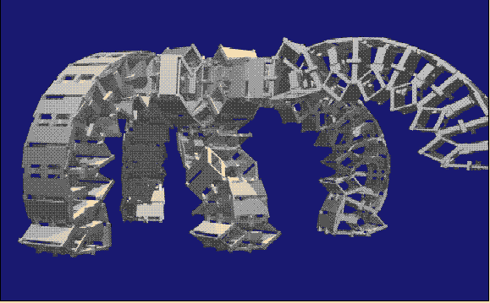
Morphology and Classification
Examples
  Polypod ('94) from Mark Yim
    Chain self-reconfiguration system
    Cubic shaped about 5 cm of edge length
    Many modes of locomotion
    (New version:) w/ force torque sensors, whisker touch sensors and infrared proximity sensors
    DEMO
Notes:
TODO: PICTURES

Slide 19
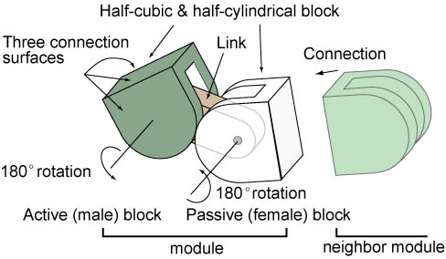
Morphology and Classification
Examples (cont'd)
  M-TRAN from Satoshi Murata et.al.
    Two blocks (active/passive) and a link
    Two parallel axes and six connectable surfaces
    4 CPUs in a Master/Slave-Architecture
      Master CPU: Algorithm computation and communication
      Slave CPUs: Motor/Connection control and sensor data
    DEMO
Notes:
TODO: PICTURES
Both blocks have 90 degrees rotation
Virtual shared memory for inter-module communication

Slide 20
An Introduction To Modular Robots
Introduction
Morphology and Classification
Locomotion
Applications
Challenges

Slide 21
Locomotion
Controller: Classic Approach
  Calculation of the joint's angle to realize a gait φi(t)
  Mathematical modeling
  Con: Equations are only valid for specific morphology

Slide 22
Locomotion
Controller: Bio-inspired Approach
  Central Pattern Generators (CPG)
  Control rhythmic activities
  e.g. lamprey, snake, earthworm

Slide 23
Locomotion
Controller: Bio-inspired Approach (cont'd)
  Sinusoidal oscillators
  Pro: Few resources needed

Slide 24

Locomotion
Controlling Method
  Sinusoidal generators produce smooth movements
  Making the controller much simpler:
  φi: Rotation angle of corresponding joint
  Ai: Amplitude
  T: Control period
  t: time
  Φi: Phase offset
  Oi: Initial offset DEMO1 DEMO2 DEMO3

Slide 25
Locomotion
Controlling Method (cont'd)
  Horizontal +vertical groups (Hi and Vi)
  ΔΦV: Phase difference between two adjacent vertical modules
  ΔΦH: Phase difference between two adjacent horizontal modules
  ΔΦHV: Phase difference between two adjacent horizontal and vertical modules

Slide 26
Locomotion
Locomotion Capabilities
  Linear gait
  Forward and backward movement
  Turning gait
  Turn left and right; or the robot moves along an arc
  Rolling gait
  The robot rolls around its body axis
  Lateral shift
  The robot moves parallel
  Rotation
  The robot rotates around its body axis DEMO

Slide 27
Locomotion
Locomotion Capabilities - Summary
Notes:
TODO: MENTION GRASPING?
TODO: SUMMARY OF OPTIMAL A AND O!

Slide 28
Locomotion
Locomotion and Reconfiguration
  Polypod turn'n'roll DEMO
  Adaptive, M-TRAN II+III DEMO
  Superbot DEMO
Notes:
TODO: MENTION GRASPING?
TODO: SUMMARY OF OPTIMAL A AND O!

Slide 29
An Introduction To Modular Robots
Introduction
Morphology and Classification
Locomotion
Applications
Challenges

Slide 30
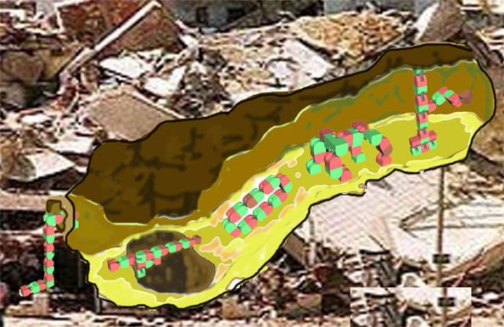
Applications
Search and Rescue
  Access dangerous areas
  Access tight spaces
  Exploration + Detection to support rescue mission
Notes:
●The last decade has seen an increasing interest in developing and
employing modular robots for
– Space exploration;
– Bucket of stuff;
– Inspired research.
Though these very advanced prototypes exist, as yet the possibility of their practical use is being
explored. In the following section some of the references already given will be classiﬁed according
to the three principal applications that are being evaluated.

Slide 31
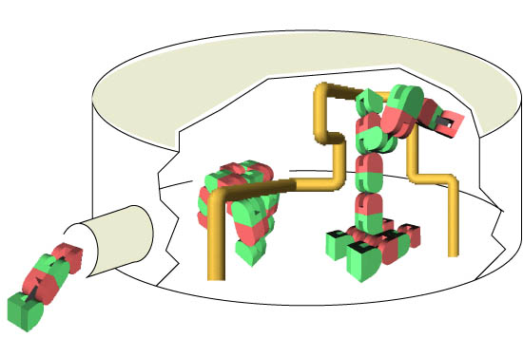
Applications
Inspection of Tubes and Bridges
  Narrow environment
  Dirty environment
  Flexible

Slide 32
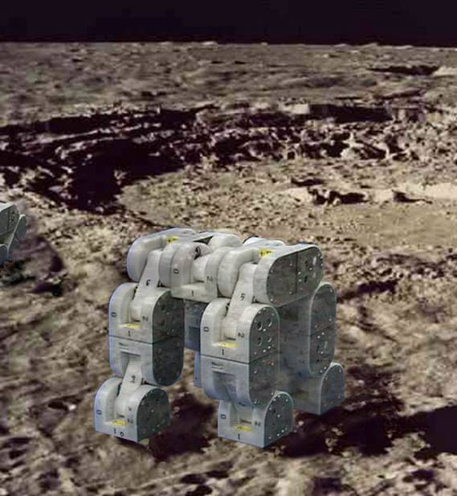
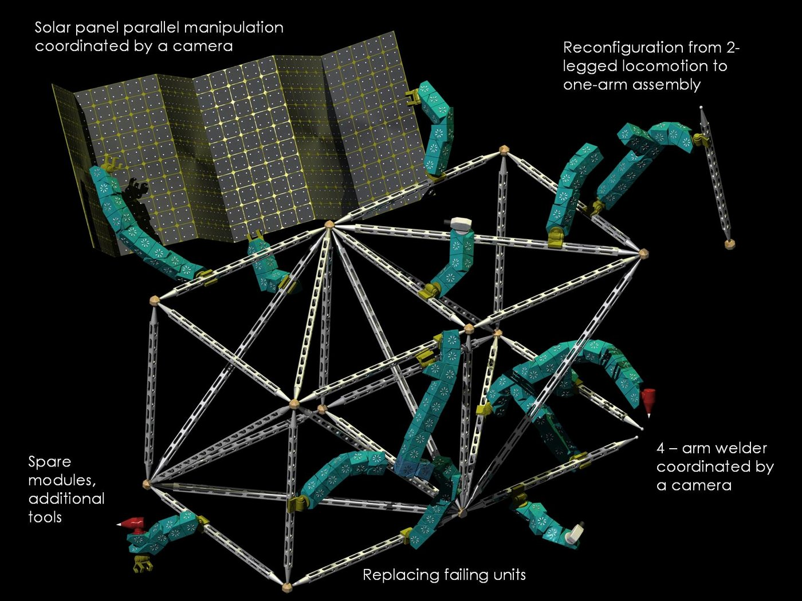
Applications
Space exploration
  Long-term space missions
  Self-sustainable + self-repair
  Handle unknown tasks
  highly volume and mass constrained
    One type of robot for many tasks
Notes:
MENTION?
Telepario
Bucket of stuff

Slide 33
An Introduction To Modular Robots
Introduction
Morphology and Classification
Locomotion
Applications
Challenges

Slide 34
Challenges
Big Systems
  Example: living cell as self-organizing modular system
  Today's systems << 1000 modules
  Demonstration of such a system requires rethinking of key HW issues:
    Binding mechanisms
    Power distribution
    Dynamics and vibrations
  New algorithms:
    Account for noise,
    Errors, failures
    Changing connecting topologies
Notes:
Most systems of modular robots have been small in number, especially compared to, for example, the number of components in a living cell (which many researchers view as the best example of a self-organizing modular system).
The demonstration of a system with at least 1,000 individual units would suggest that modular robots have come of age.
The physical demonstration of such a system will require rethinking key hardware issues, such as binding mechanisms, power distribution, dynamics, and vibrations.
It will also require new distributed algorithms that account fornoise, errors,
failures, and changing connection topologies.

Slide 35
Challenges
Self-Repairing Systems
  Compromised system recovers from (serious) damage
  Requires rethinking of algorithms + HW for:
    Sensing + estimating global state
    Reconfiguration from any initial state
  Demonstrate self-assemble of (randomly) blown-up system or recover under certain percentage of faulty units DEMO
Notes:
Besides reconfiguring itself into a new shape, a system comprised of modular robots would be able to recover from serious damage.
A demonstration of a self-healing structure made up of many distributed,communicating parts would require rethinking algorithms for sensing and estimation of the global state, as well as truly robust hardwareand algorithms for reconfiguration that work from any initial condition.
A concrete example would be having a system blown up (randomly separated into many pieces) and then self-assemble, or recover from failure of a certain percentage of faulty units.

Slide 36
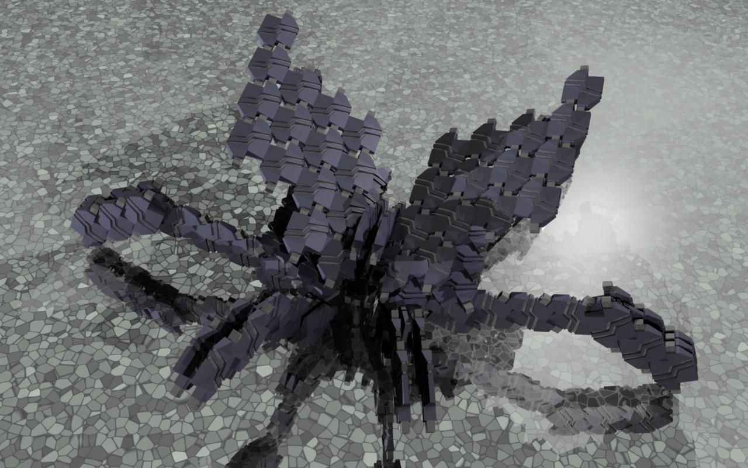
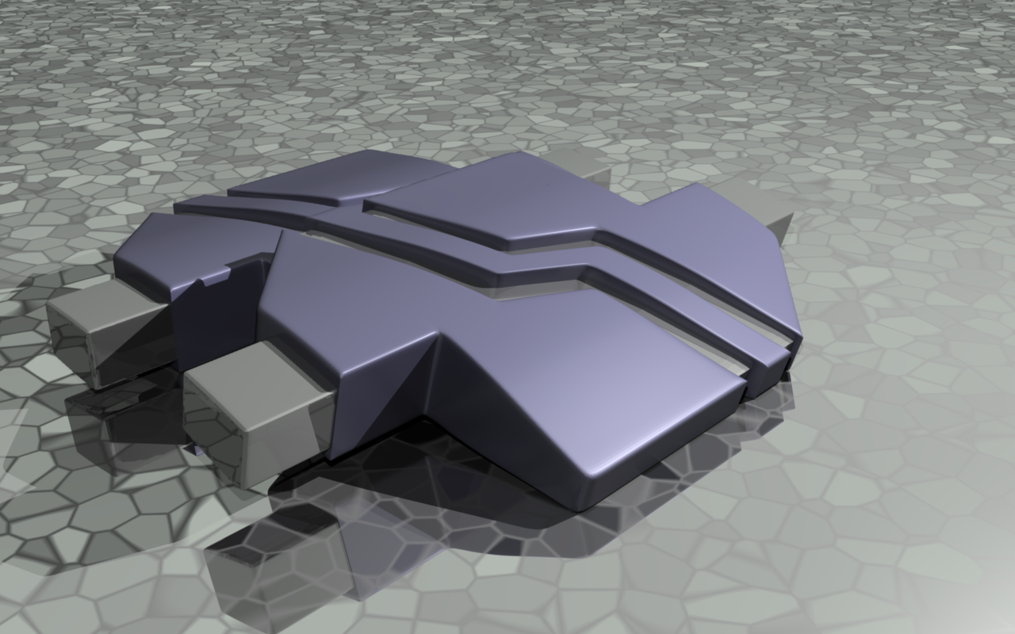
Challenges
Self-replication and self-extension
  Low-level modules or elementary components (raw material?) used to self-replicate
  Improving system from environmental resources
  Overcome complexity of machines building copies of themselves
Notes:
A significant challenge remains to demonstrate self-replication using many low-level modules, and ultimately from elementary components and even raw materials.
Such a system could build active elements as well as passive structures, leading to a self-replicating and even self-improving system from environmental resources.
The demonstration of a “seed”group of modular robots that can build copies of themselves from raw materials would require advancing beyond a level of complexity that Von Neumann identified as essentially the equivalent of the sound barrier for engineered systems.

Slide 37
References
Gómez, Juan G.: Modular Robotics And Locomotion: Application To Limbless Robots, Universidad Autónoma De Madrid, 2008
Wikipedia: Self-Reconﬁguring Modular
Robotics, 2009
http://en.wikipedia.org/wiki/Self-Reconfiguring_Modular_Robotics
Yim, Mark: Locomotion With A Unit-Modular Reconﬁgurable Robot. Stanford University, 1994
Zhang, Ph.D. H.: Introduction to modular robots and our on-going projects. TAMS, Department of Informatics, University of Hamburg, 2009
Zhang, Ph.D. H.: Mobile Robotics, Modular robots achievements. TAMS, Department of Informatics, University of Hamburg, 2009

Slide 38
Thank You!

