Slide 1
01 — INNOVATION
ORIGINALITY · DIFFERENTIATION · RELEVANCE
A transparent eligibility engine, not another scheme search box.
Citizens get a ranked answer to “which schemes fit me, and why” — computed from statutory rules, with the reasoning and the missing paperwork exposed.
STEP 01
Profile capture
Form, free text, voice, or demo persona
STEP 02
Hard gates
Domicile, age, gender, income ceiling, land
STEP 03
Weighted score
Income fit, occupation, category, conditions
STEP 04
Explanation
“Why it fits” in plain language
STEP 05
Gap detection
Flags missing documents before applying
DIFFERENTIATOR
Deterministic, auditable rules
Every match is a reproducible function of 22 statutory rule sets — no hallucinated eligibility, no black-box ranking.
DIFFERENTIATOR
AI assists, it does not decide
Gemini only parses free text into a profile. The score itself is rule-based, and the app works fully with no API key.
DIFFERENTIATOR
Explains the “no” too
Ineligible schemes state which gate failed, so citizens learn the criteria instead of guessing.
SCHEME MATCH · TEAM CODEHACKERS
1 / 6

Slide 2
02 — IMPACT
IMPORTANCE OF THE PROBLEM · CREDIBLE BENEFIT
Eligible people miss benefits because the rules are invisible.
Welfare information is spread across departmental portals, written in bureaucratic language, and gated by criteria that are never surfaced to the person who qualifies.
THE PROBLEM
Discovery is the bottleneck, not intent
A student, a 2-acre farmer, and a woman head of household qualify for different schemes from the same portal — and none can tell which without reading every rule.
CREDIBLE BENEFIT
Fewer rejected applications
Document-gap detection surfaces Aadhaar–NPCI seeding, Nadakacheri RD certificates and land records before submission — the failure points that send citizens back to the counter.
WHO BENEFITS
Six citizen personas modelled end to end
College student, small farmer, homemaker and head of family, unemployed graduate, senior citizen, micro-entrepreneur.
22
11+11
ACCESS
Kannada, Hindi, and voice
Full trilingual UI plus speech input and read-aloud output, so low-literacy and first-time internet users are not excluded by the interface.
SCHEMES ENCODED
STATE & CENTRAL
3
6
LANGUAGES
PERSONAS
SCHEME MATCH · TEAM CODEHACKERS
2 / 6

Slide 3
03 — EXECUTION
IMPLEMENTATION DEPTH · TESTING · BUILD QUALITY
Built, tested, and deployed in one repository.
A typed React client, an Express API, a 22-scheme rule engine and a real deployment pipeline — verified end to end, not mocked.
Rule engine — hard gates, weighted affinity scoring (0–100), gap detection and report generation.
Bilingual extractor — regex/keyword parser handling Kannada and Devanagari numerals.
Hardened AI path — 15 s / 20 s timeouts with graceful fallback, so a stalled model cannot hang the UI.
18 automated tests across matching, extraction and speech.
Deployment-ready — honours injected PORT and serves built assets with SPA fallback.
VERIFICATION
Every claim checked locally
tsc --noEmit clean · 18/18 tests passing · Vite build 415 kB JS / 47 kB CSS · live deployment smoke-tested.
STACK
Modern, boring, maintainable
React 19 · TypeScript 7 · Vite 8 · Express 4 · Tailwind v4 · Gemini 3.8 Flash · Web Speech API · Render
6.2k
18
4
LINES OF CODE
TESTS PASSING
API ROUTES
SCHEME MATCH · TEAM CODEHACKERS
3 / 6

Slide 4
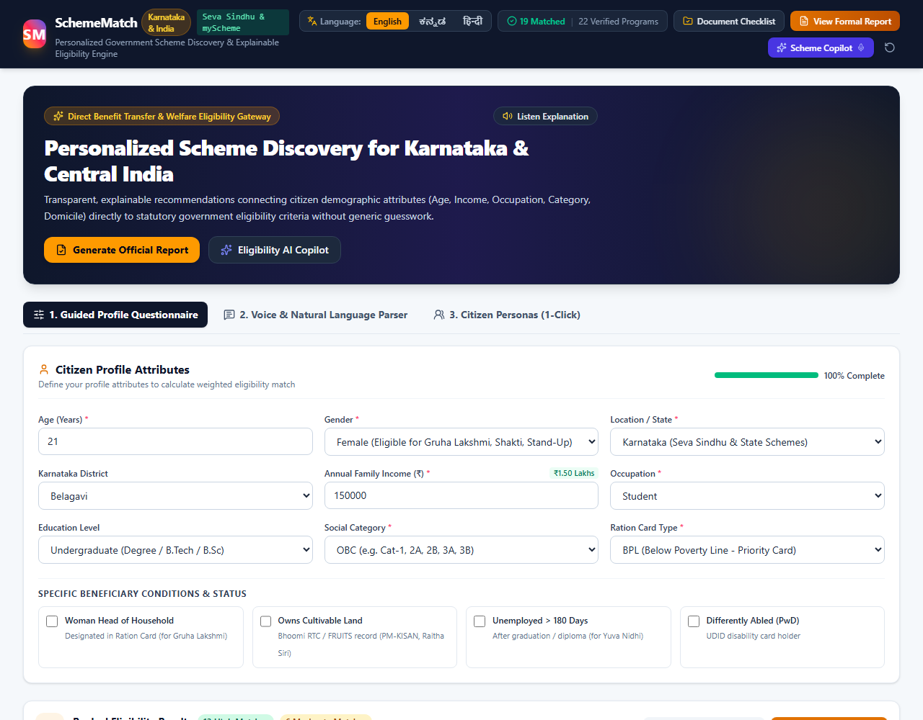
04 — UI/UX
USABILITY · CLARITY · ACCESSIBILITY · COHERENT JOURNEY
One screen from “who am I” to “apply here”.
Profile on the left, ranked matches with visible reasoning on the right — no account, no wizard, no dead ends.
Three input paths — guided form, natural language, or one-click persona.
Reasoning on the card — match percentage, factors, and missing documents.
Language switch that persists — English, Kannada, Hindi.
Voice both ways — speak the profile, listen to the explanation.
Formal report — downloadable four-part Markdown report with disclaimer.
Profile
›
Ranked matches
›
Why it fits
›
Checklist
›
Report
SCHEME MATCH · TEAM CODEHACKERS
4 / 6

Slide 5
05 — DEMO
REAL FUNCTIONALITY · SUPPORTED BY EVIDENCE
Live in production: schemematch-codehackers.onrender.com
A 60-second path a judge can run themselves, with the expected on-screen result at each step.
STEP 1 · 10 S
Pick “Deepthi (College Student)”
A 21-year-old OBC student in Belagavi, family income ₹1.5 L. Profile, category and income populate instantly.
OBSERVED ON THE LIVE SITE
19 matched · 22 verified programs
The deployed build reports 22 schemes and a complete profile score, with zero console errors.
STEP 2 · 20 S
Read the ranked matches
SSP scholarship, Vidyasiri, AICTE Pragati and Shakti surface as high matches; each card states why and what is missing.
ALSO DEMOABLE
Voice + natural language
“I am a 21 year old female B.Sc student from Belagavi with family income 1.5 lakh” builds the same profile deterministically.
STEP 3 · 20 S
Open the checklist and report
Document readiness toggles live, and “View Formal Report” generates the four-part Markdown report with the disclaimer.
HONEST SCOPE
Rule engine runs client-side
On the static deployment the two AI routes are unavailable; the UI falls back to local parsing. A web-service blueprint enables them.
SCHEME MATCH · TEAM CODEHACKERS
5 / 6

Slide 6
06 — FEASIBILITY
PRACTICALITY · DEPLOYMENT · CONSTRAINTS · VIABILITY
Deployable today on a free tier, with a clear path to scale.
Static hosting for the rule engine now; a Node web service when AI endpoints are enabled. No proprietary infrastructure, no vendor lock-in.
DEPLOYMENT
Two supported paths
Static — publish dist, rule engine in the browser. Web service — Express + Vite build, AI routes live, health at /api/health.
CONSTRAINTS, STATED PLAINLY
What it does not do yet
• No accounts or saved profiles — state is per session.
• No application submission; links to Seva Sindhu and myScheme.
• Scheme rules are a curated snapshot and must be maintained.
NEXT 90 DAYS
Roadmap
• Persistence + citizen sign-in
• All 28 states and UTs
• Admin rule updates with citations
• Renewal and deadline reminders
COST
Free tier viable
Render free instance, zero database, Gemini billed only per AI call — degrades to zero-cost deterministic behaviour without a key.
TRUST
Verification is built in
Every recommendation and report carries the statutory disclaimer that approval is not guaranteed.
MAINTENANCE
Data stays out of components
Scheme criteria live in one typed dataset, so correcting a scheme is a data change — not a rewrite.
SCHEME MATCH · TEAM CODEHACKERS
6 / 6

